Slide 1
Bayesian Decision Theory
Nabil Akbarazzima Fatih
Sommersemester 2022

Slide 2
Overview
Introduction
Investigation
Illustration
Conclusion

Slide 3
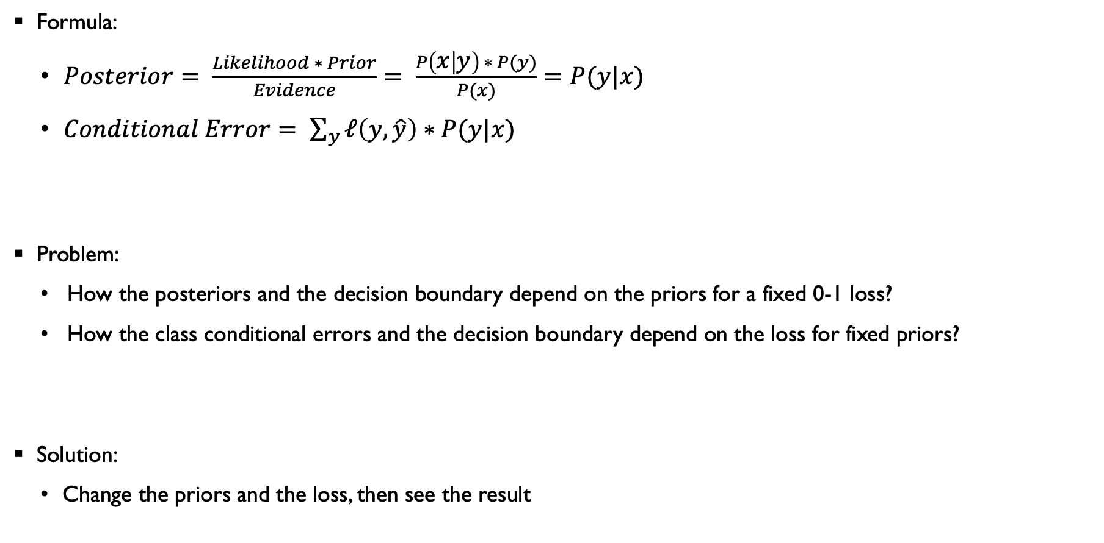
Introduction
Formula:
$Posterior= \frac{Likelihood ∗ Prior}{Evidence}= \frac{P\left(x | y\right) ∗ P(y)}{P(x)}=P(y|x)$
$Conditional Error= \sum_{y}{ℓ\left(y,\hat{y}\right)∗P(y|x)}$
Problem:
How the posteriors and the decision boundary depend on the priors for a fixed 0-1 loss?
How the class conditional errors and the decision boundary depend on the loss for fixed priors?
Solution:
Change the priors and the loss, then see the result

Slide 4
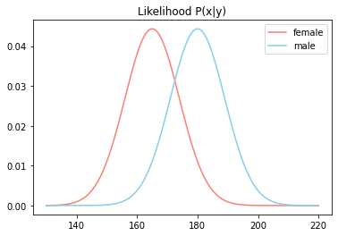

Investigation
Given:
$p\left(x | y=f\right) \sim 𝒩(μ=165, σ=9)$
$p\left(x | y=m\right) \sim 𝒩(μ=180, σ=9)$
Information:
$𝒩$ = Normal distribution
$μ$ = Mean
$σ$ = Standard deviation

Slide 5
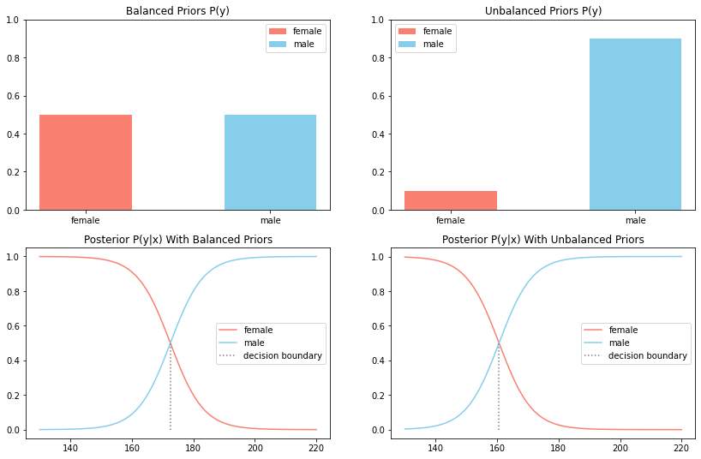

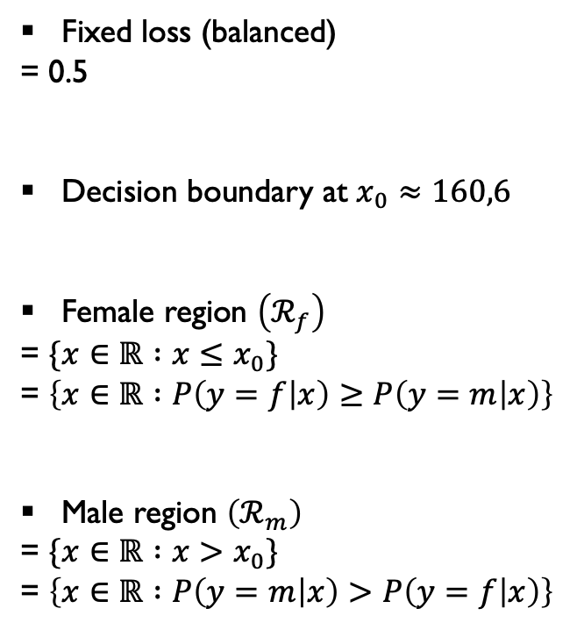

Investigation
How the posteriors and the decision boundary depend on the priors for a fixed 0-1 loss?
Fixed loss (balanced)
= 0.5
Decision boundary at $x_{0}≈160,6$
Female region $\left(ℛ_{f}\right)$
= $\{x∈ℝ :x≤x_{0}\}$
= $\left\{x∈ℝ :P\left(y=f | x\right)≥P\left(y=m | x\right)\right\}$
Male region $\left(ℛ_{m}\right)$
= $\{x∈ℝ :x>x_{0}\}$
= $\left\{x∈ℝ :P\left(y=m | x\right)>P\left(y=f | x\right)\right\}$
$$ℛ_{f}$$
$$ℛ_{m}$$

Slide 6
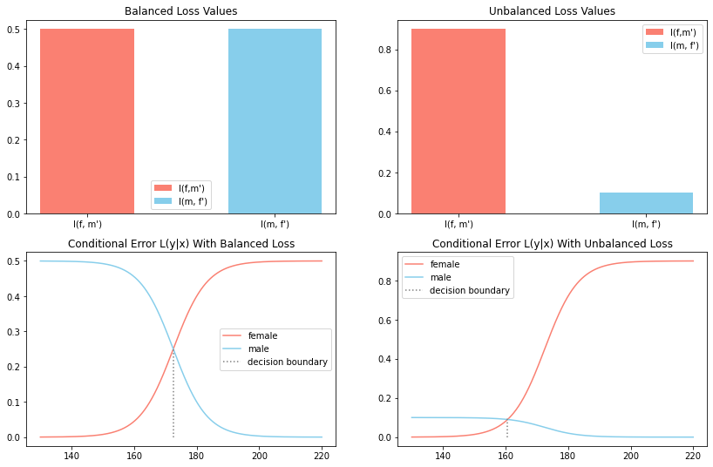
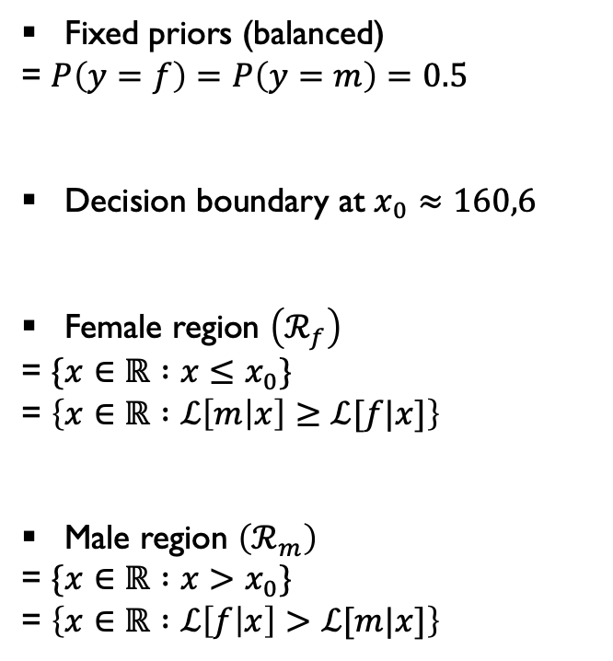
Investigation
How the class conditional errors and the decision boundary depend on the loss for fixed priors?
Fixed priors (balanced)
= $P\left(y=f\right)=P\left(y=m\right)=0.5$
Decision boundary at $x_{0}≈160,6$
Female region $\left(ℛ_{f}\right)$
= $\{x∈ℝ :x≤x_{0}\}$
= $\left\{x∈ℝ :ℒ\left[m | x\right]≥ℒ[f|x]\right\}$
Male region $\left(ℛ_{m}\right)$
= $\{x∈ℝ :x>x_{0}\}$
= $\left\{x∈ℝ :ℒ\left[f | x\right]>ℒ[m|x]\right\}$
$$ℛ_{f}$$
$$ℛ_{m}$$

Slide 7
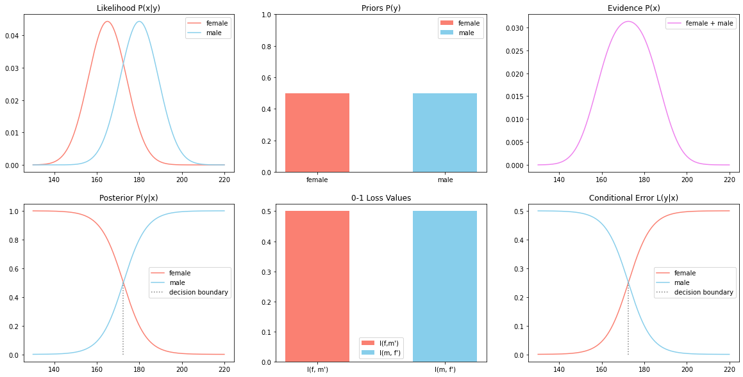
Illustration
1. Balance priors and balanced loss

Slide 8
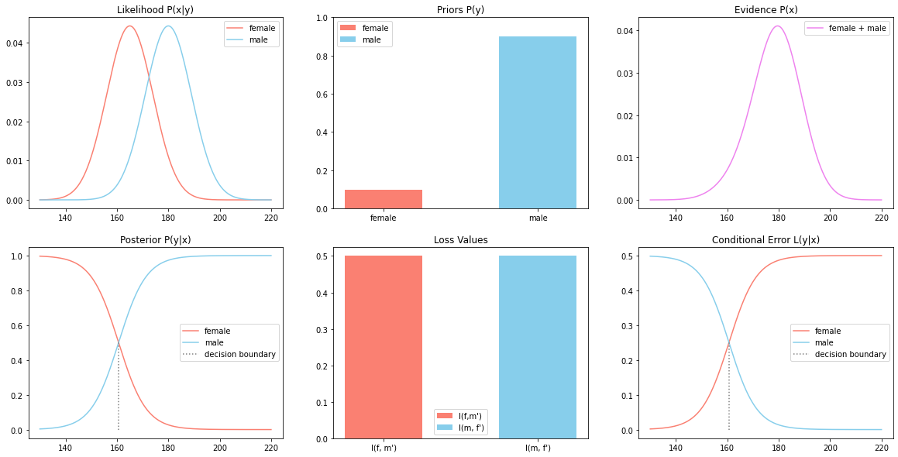
Illustration
2. Unbalance priors and balanced loss

Slide 9
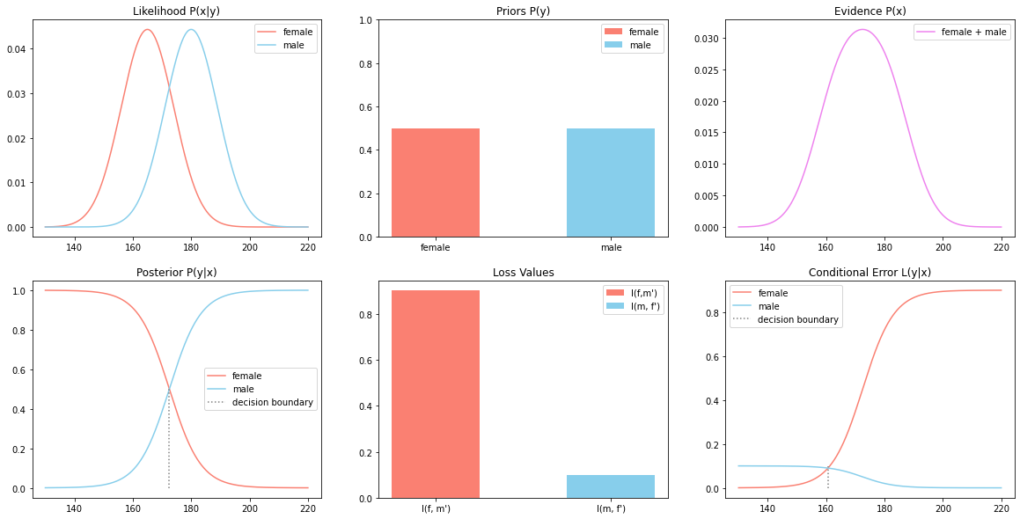
Illustration
3. Balance priors and unbalanced loss

Slide 10
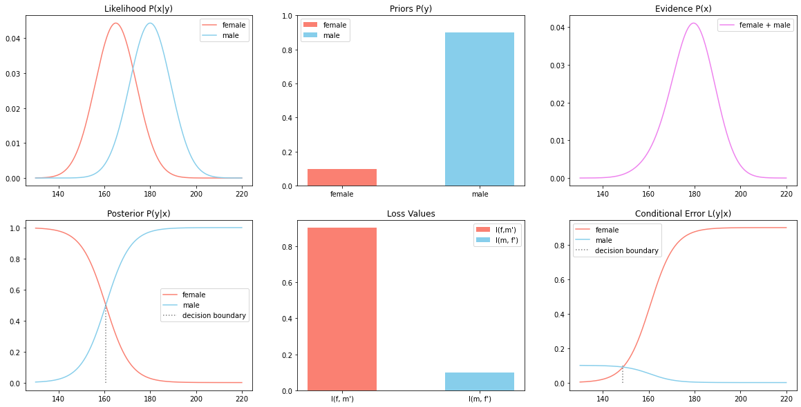
Illustration
4. Unbalance priors and unbalanced loss

Slide 11
Conclusion
The posteriors move depend on the priors
The class conditional errors move depend on the loss values and the priors
The position of the decision boundary depends on the priors and the loss values.

