Slide 1

Fluent Interface Pattern
Sadat khan
Nabil

Slide 2


Introduction
The fluent interface pattern is a design pattern used in object-oriented programming to create a readable, flowing interface. It allows method chaining to make the code more expressive and intuitive.

Slide 3

Intent
1
Clarity
2
Fluency
The intent of the pattern is to improve the readability and understandability of the code.
It aims to provide a smooth and natural way to interact with classes and methods.
3
Expressiveness
It enables concise and self-explanatory code, enhancing developer productivity.

Slide 4
Core Concepts
Method Chaining:
Return Types:
In a fluent interface, each method call returns an instance of the object, enabling the chaining of multiple method calls in a single line.
Methods often return the modified object, allowing consecutive calls without the need for intermediate variables.

Slide 5
Best Practices for implementing Fluent Interface Pattern
1
Clear and Consistent Naming
2
Method Chaining Order
Use descriptive and consistent method names to ensure clarity and improve the overall usability of your Fluent Interface.
Decide on a logical and intuitive order for method chaining to enhance the readability and understanding of your code.
3
Documentation and Examples
4
Version Management
Provide comprehensive documentation and practical examples to help users understand and effectively utilize your Fluent Interface.
When evolving your Fluent Interface, consider versioning to maintain backward compatibility and facilitate smooth upgrades for your users.

Slide 6

Benefits of using Fluent Interface Pattern
1
Improved Readability 📖
2
Enhanced Productivity ⚡️
By using a Fluent Interface, code becomes more self-explanatory and easier to comprehend, making your projects more maintainable in the long run.
Fluent interfaces enable developers to write code faster, as the syntax is concise and intuitive, reducing the need to consult extensive documentation.
3
Reduced Errors ❌
With a Fluent Interface, the risk of syntax errors is minimized, thanks to the structured and self-contained approach of the pattern.

Slide 7

Potential Challenges and Considerations
1
Method Overload
Address the potential challenge of method overload in your Fluent Interface and learn how to manage it effectively.
2
Maintaining Flexibility
Ensure your Fluent Interface remains flexible to accommodate various use cases without sacrificing its intuitive nature.
3
Learning Curve
Discuss strategies to minimize the learning curve associated with using a Fluent Interface and provide tips for easy adoption.

Slide 8
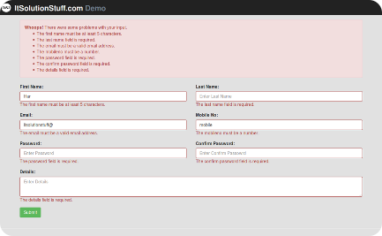
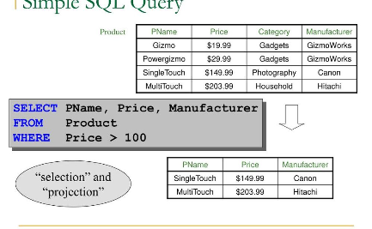
Examples of Fluent Interface Pattern
Form Validation
Database Query
Explore how to use a Fluent Interface to validate form inputs with a seamless and intuitive API that guides users through the validation process.
Discover how a Fluent Interface can simplify database query construction by providing an elegant and readable way to express complex query logic.

Slide 9
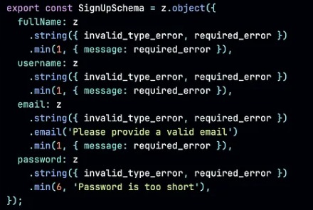
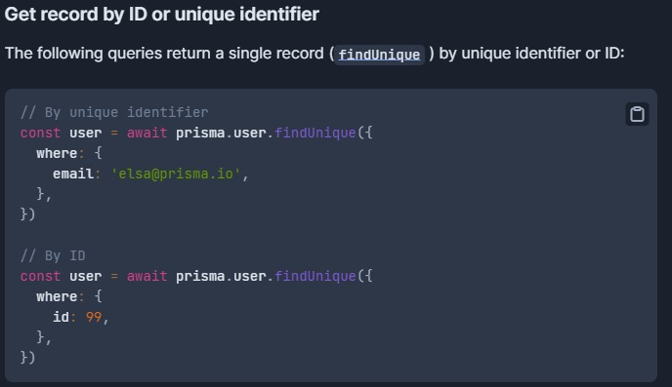
Examples of Fluent Interface Pattern
Form Validation
Database Query

Slide 10
Pros and Cons
Pros:
Cons:
Improved Readability
Learning Curve
Method Chaining
Maintenance Challenges
Discoverability
Not Always Appropriate

Slide 11
Conclusion
As we conclude our exploration of the Fluent Interface Pattern, we hope you now have a solid understanding of its concept, benefits, implementation best practices, and potential challenges. Embrace the power of Fluent Interfaces and elevate your code to new heights!

