Slide 1
Course Teacher:
Adil Ahmed Chowdhury
Lecturer
Department of Computer Science and Engineering
Leading University, Sylhet
Project Title:
LU Bus Reservation
Course Title:
Object Oriented Programming Sessional
Course Code:
CSE-2214
CSE 54th Batch
Presented by:
Abul Hasan Nabil (Leader)- 2022020003
Tufayel Ahmed- 2022020019
Ahnaf Rafid- 2022020002
Kamrul Hasan Bhuyan- 2022020012

Slide 2
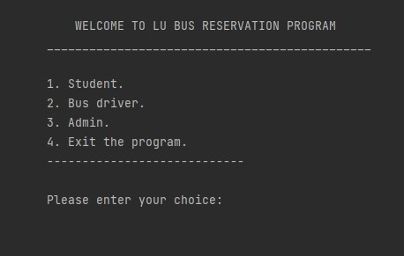
First Page
This is the first page of the program where a user can select whether he wants to log in as a student, a bus driver or an admin.
If someone wants to exit the program he can do it from this page.

Slide 3
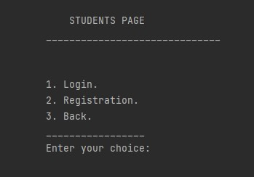
Student Page
By choosing “Student” it leads to the Students Page where the user can log in using the registered user name and password in order to proceed to next page.
If not registered yet, the user requires to do the registration with a username and password.

Slide 4
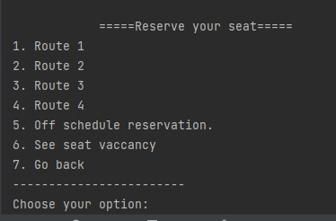
Choosing Route
After logging in a student is forwarded to the seat reservation page where he can select any of the 4 routes.

Slide 5
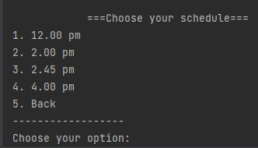
Choosing Time
Then the user has to select on of the scheduled time.

Slide 6
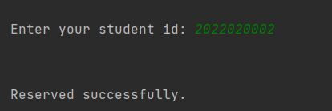
Entering ID
After choosing time it’ll ask for the student’s id to reserve a seat.

Slide 7
Off Schedule Bus
When a student requires to reserve a seat outside the scheduled time then he needs to choose the “Off schedule reservation”.

Slide 8
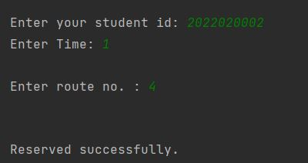
Reserving Seat
For an off schedule reservation the user is required to enter the student id, the time he wants to reserve and the bus route no.

Slide 9
Seat Vacancy
“Seat Vacancy” is the option where a student can check the update on which bus has vacant seats after crossing a particular stoppage.

Slide 10
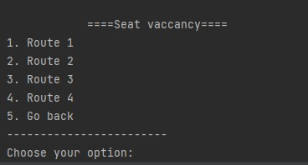
Choosing Route
By choosing the route number we can see how many seats are available on that bus after crossing a particular stoppage.
The update can only be seen if the bus driver updates the vacancy number.

Slide 11
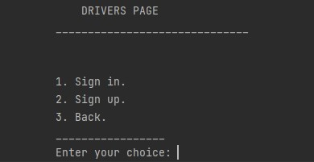
Driver Sign in
If we choose to enter as a bus driver, it’ll again ask for the username and password.

Slide 12
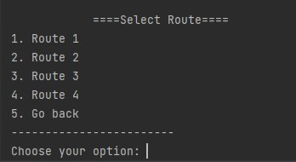
Choosing Route
After signing in he has to choose the route number that he’s traveling.

Slide 13
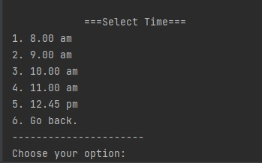
Selecting Time
Now he has to select the scheduled time that he’s traveling by.
After that he’ll enter the number of empty seats after crossing the particular stoppage.

Slide 14
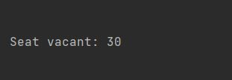
Vacancy Update
When the driver updates the vacancy then a student can see how seats are vacant in his selected route and scheduled time’s bus after crossing the stoppage.

Slide 15
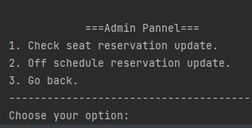
Admin Panel
If the user wants to enter as an admin he’s required to choose admin from the log in page, then provide the username and password to get access.
After getting access he’ll be directed to the “Admin Pannel” where he can see the updates of on schedule and off schedule seat reservations and take the necessary decision or make changes with the help of administration.

Slide 16
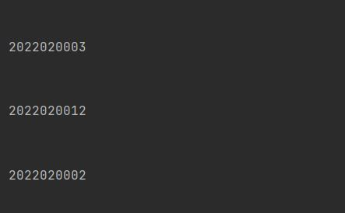
Reservation Request

Slide 17
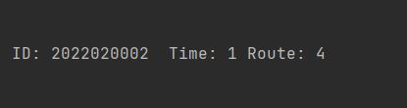
Off Schedule Bus Request

Slide 18
THANK YOU

