Slide 1
Class Diagram
Presented by
Bibek Acharya
Ganesh Poudel
Nabin Magar

Slide 2
UmL(Unified Modeling languages)
UML is a standardized modeling languages consisting of an itegrated set of diagrams
It is developed to help system and software developers for specifying, visualizing, constructing and documenting the artifacts of software systems.
Categories into two types:
Structural Diagram
Behaviour

Slide 3
Class Diagram
It’s an structural diagram of UML(Unified Modeling Language) Diagram.
It is an simple, easy to represent system static view, static aspects of a system.
A class is a description of a set of objects that share the same attributes, operations, relationships, and semantics.
Graphically, a class is rendered as a rectangle, usually including its name, attributes, and operations in separate, designated compartments.
Class Name
attributes
operations

Slide 4
Class Name
The name of the class is the only required tag in the graphical representation of a class. It always appears in the top-most compartment. Example: Student, teacher, suppliers, person etc.
Class Name
attributes
operations

Slide 5
Attributes
Attributes are usually listed in the form:
attribute Name : Type
A derived attribute is one that can be computed from other attributes, but doesn’t actually exist. For example, a Person’s age can be computed from his birth date. A derived attribute is designated by a preceding ‘/’ as in:
/ age : Date
Person
Class Name
name : String
address : Address
birthdate : Date
/ age : Date
attributes
operations

Slide 6
Operations
Person
Operations describe the class behavior and appear in the third compartment.
Class Name
name : String
address : Address
birthdate : Date
attributes
operations
eat
sleep
work
play

Slide 7
Represented of class
Final representation of student class
Class Name
Student
Student
Student
attributes
Name
Roll no
Name: String
Roll no: int
+Name: String
-Roll no: int
operations
Create record()
Create record():int
#Create record():int
Taking example of student as a class
Including data types
Including visibility notation
+ : Public
: Private
# : Protected

Slide 8
Relationship of
class diagram
Association
Dependency
Aggregation
Composition
Generalization

Slide 9
Association relationship
If two classes in a model need to communicate with each other, there must be link between them.
An association denotes that link.
1
1..*
Teacher
Student
Teaches to

Slide 10
Dependency relationship
A dependency indicates a semantic relationship between two or more elements.
Example:
consumer cannot sales the product without the supplies of suppliers.
Consumer
Supliers

Slide 11
AgGreGATion relationship
It represent the two classes having no strong dependency relationship.
1
1..*
Libary
Book
Container class
Or Whole class
Contained class

Slide 12
Composition relationship
It represent the two classes having strong dependency relationship.
1
1..*
Bags
Pocket
Container class
Or Whole class
Contained class

Slide 13
Generalization relationship
A generalization connects a subclass to its superclass.
It denotes an inheritance of attributes and behavior from the superclass to the subclass and indicates a specialization in the subclass of the more general superclass.
Person
Student
teacher

Slide 14
Example of class diagram

Slide 15
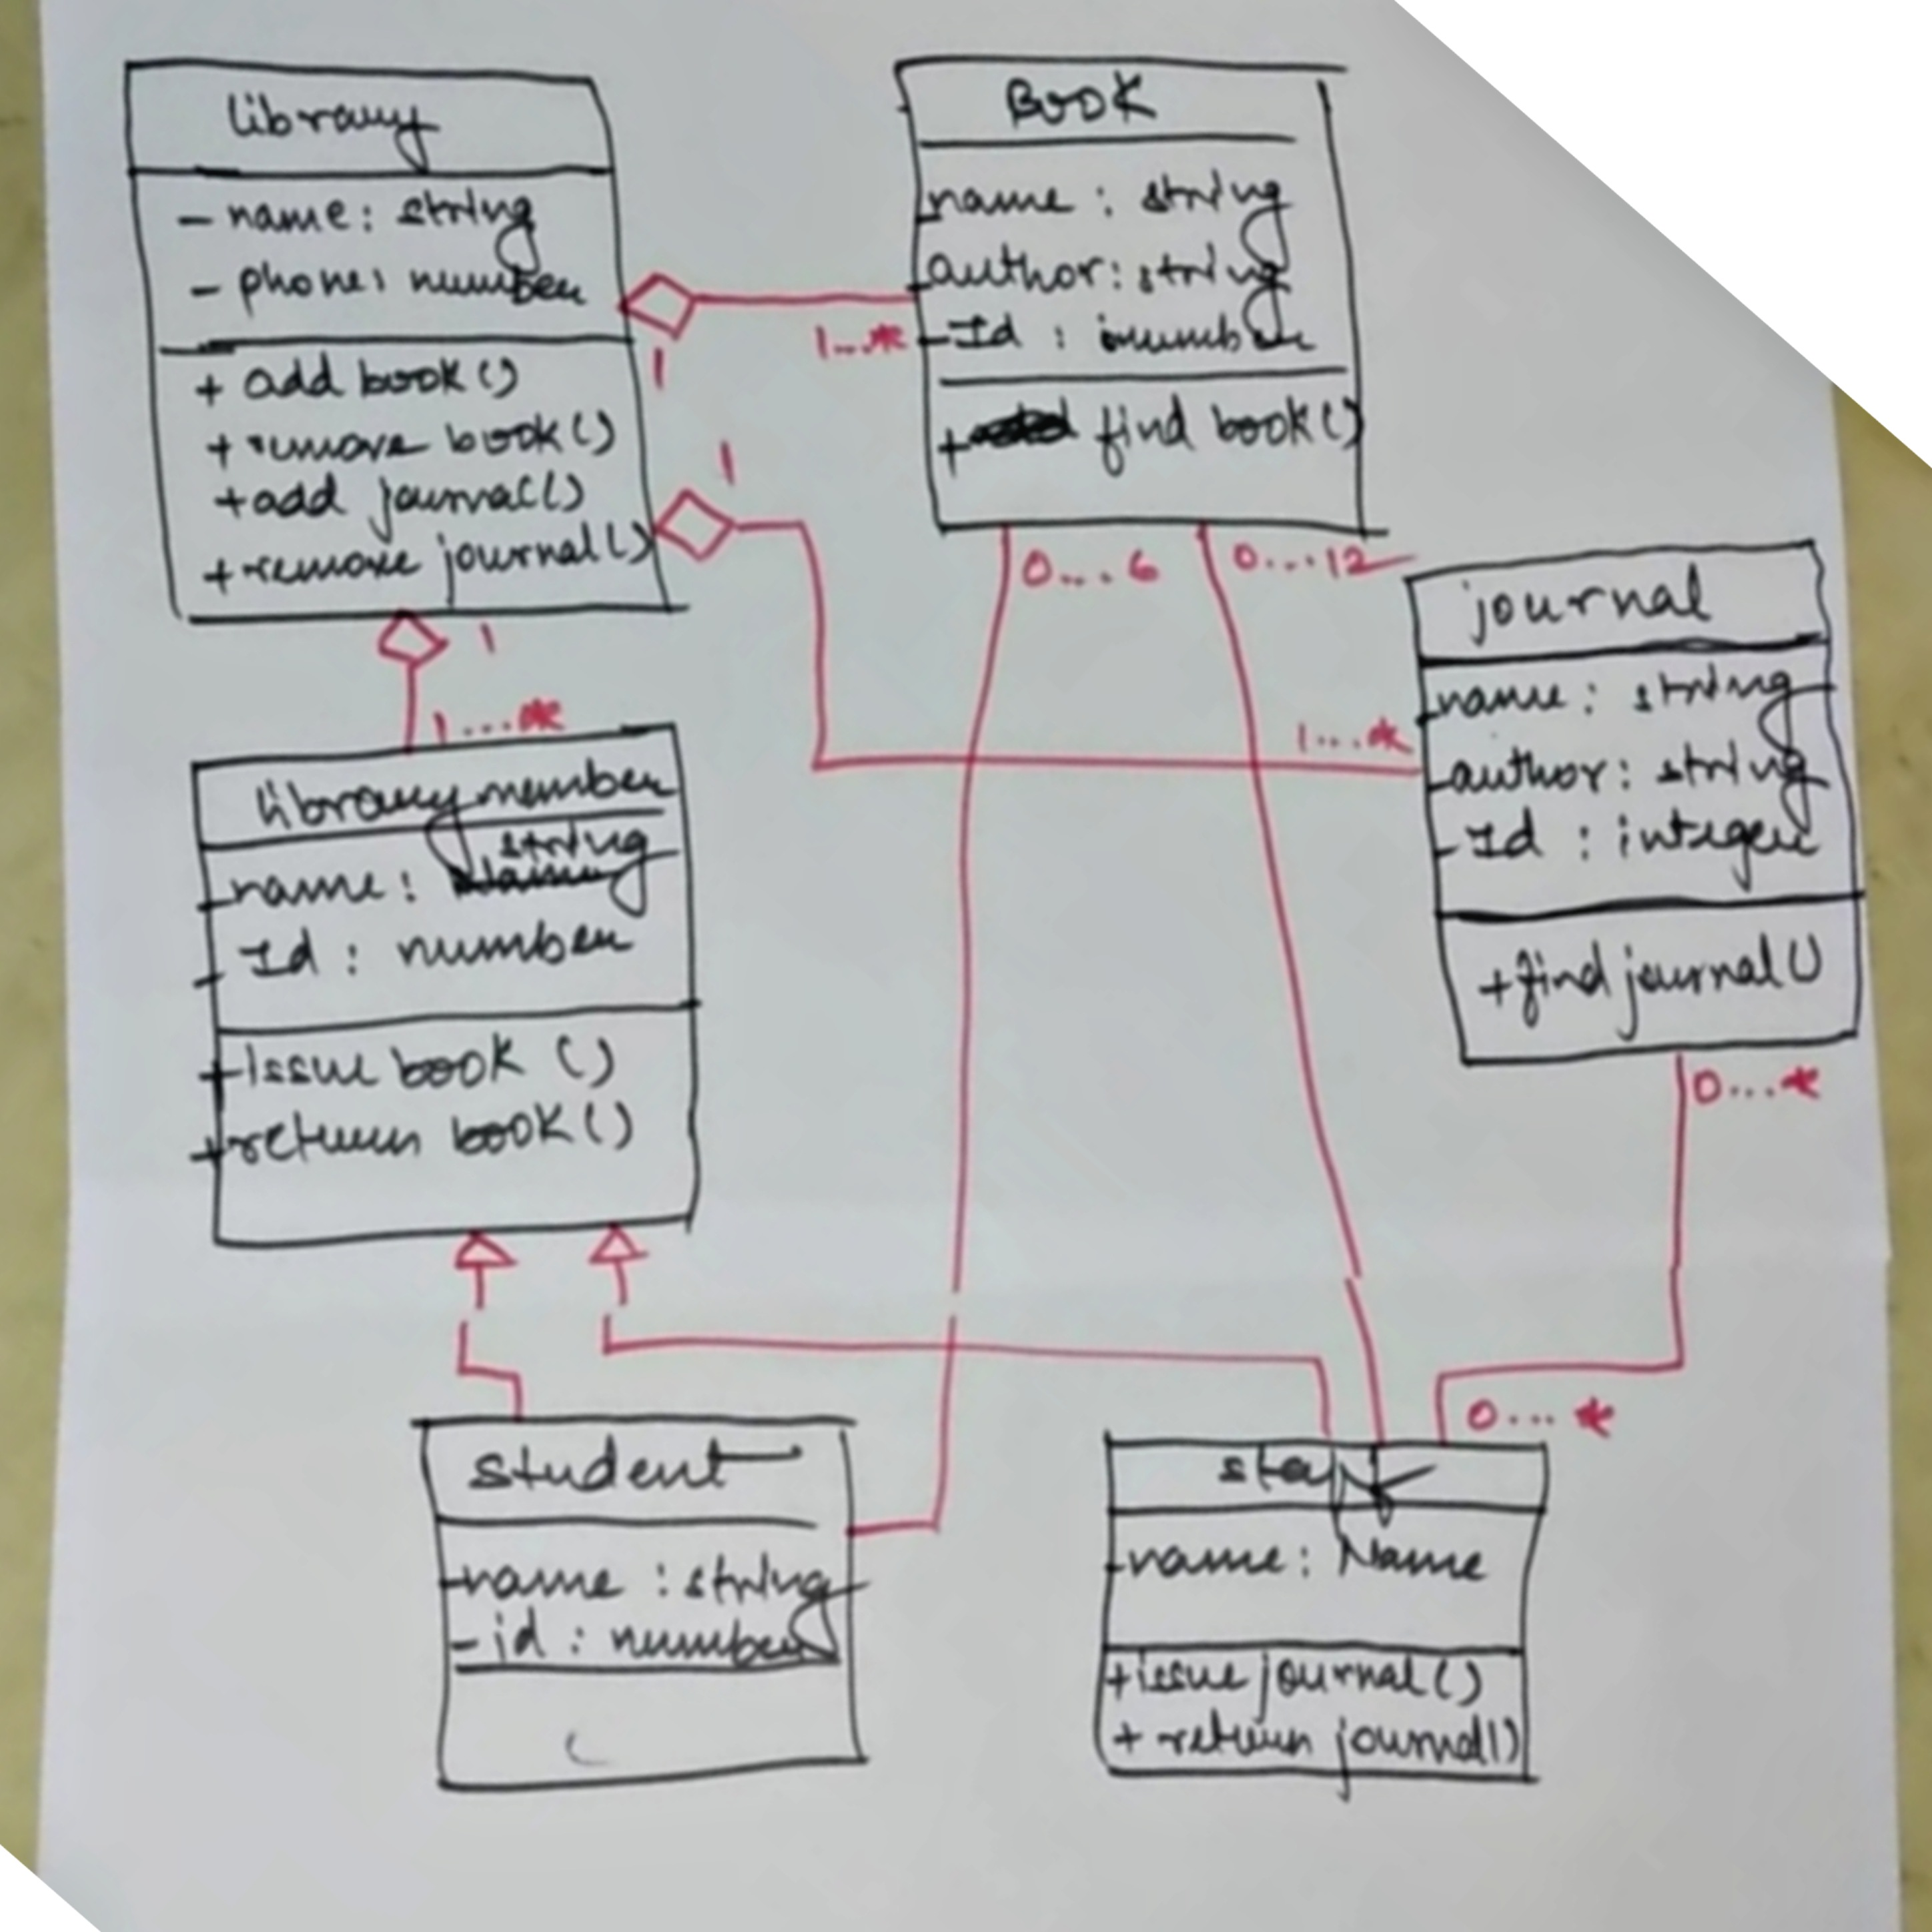

Slide 16
Thank you

Slide 17
Any question
?

