Slide 1
The City Recycler
Name: Nabin Koirala
Roll No: 630
April 11, 2017

Slide 2
Introduction
Online marketplace for selling and buying old stuff
Find partners online and exchange your stuff

Slide 3
Technology
HTML
CSS

Slide 4
Flow of Project
Home
Store
News
About
Contact
Log In or Sign up

Slide 5
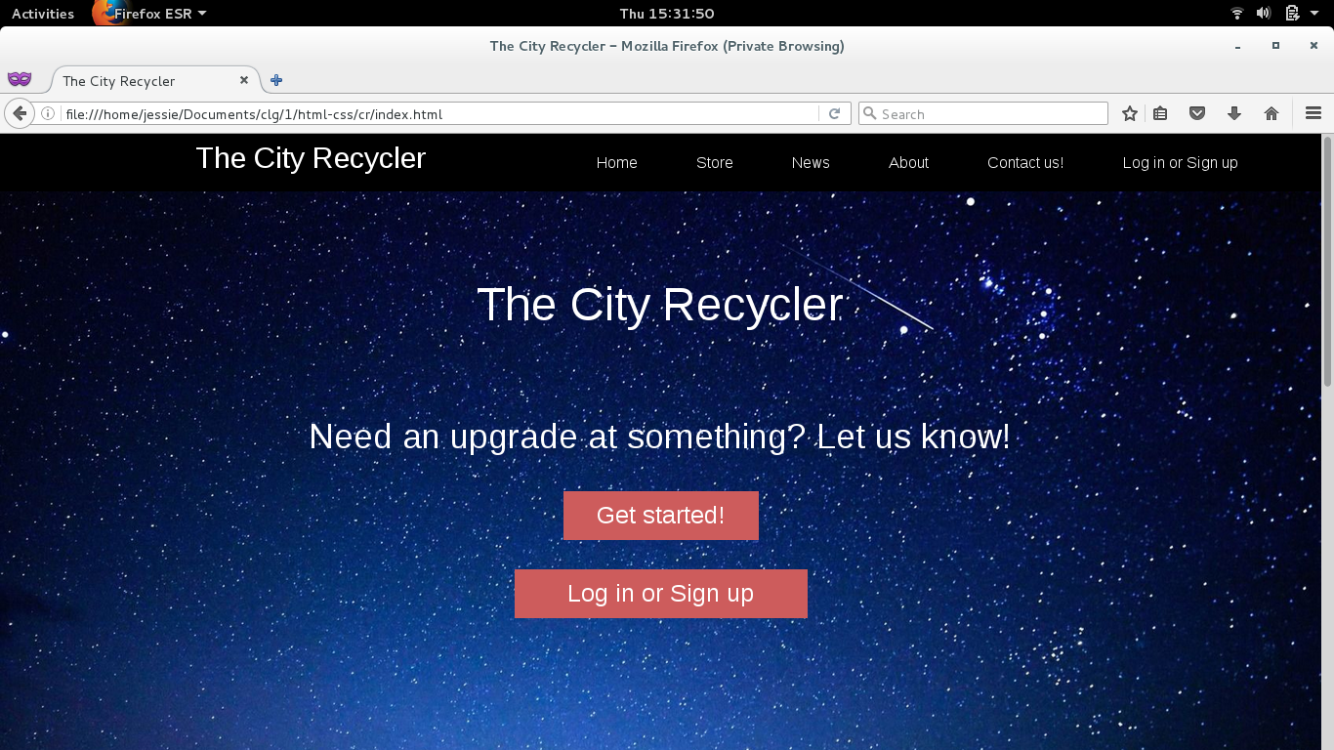
Flow of Project

Slide 6
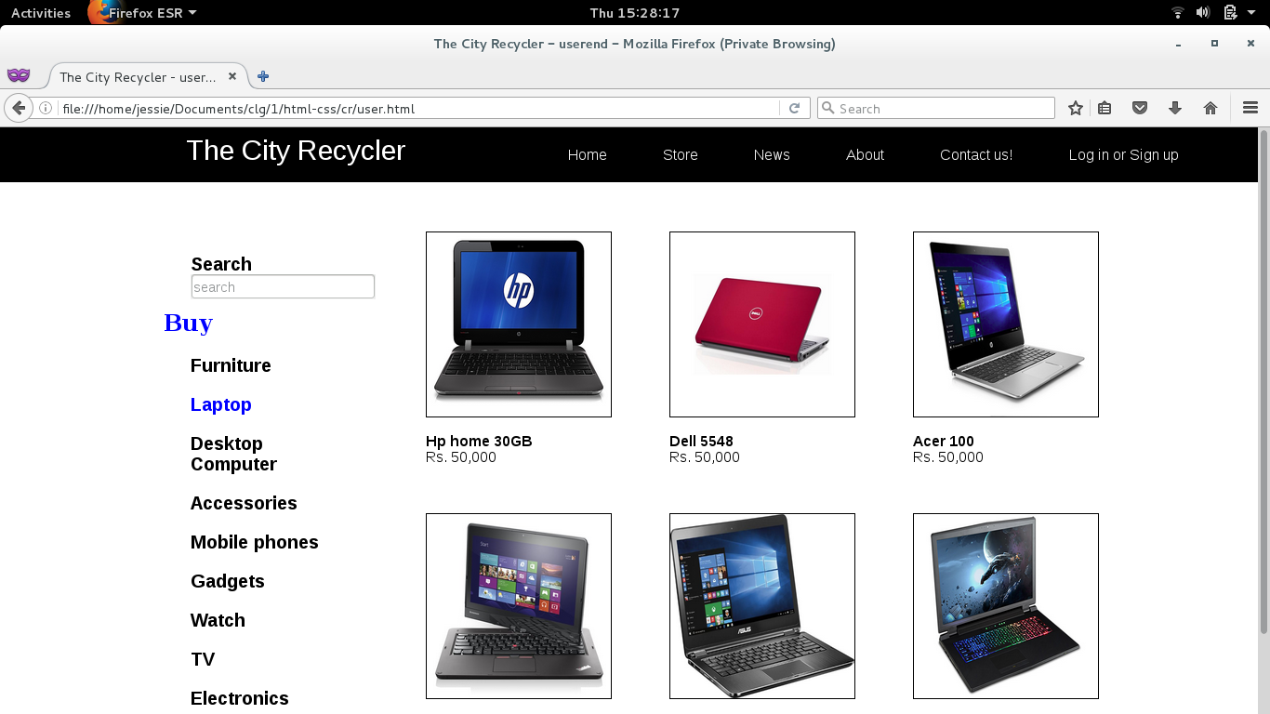
Flow of Project

Slide 7
Project Demo

Slide 8
Thank you

