Slide 1
Music Recommendation using Python
824 | Nabin Katwal
Proposal Defense of Project - II – DWIT-038 – Class of 2022

Slide 2
Introduction
With releases of tens and thousands of new song each year, we find it difficult to discover new music that matches our interest.
It is very useful to develop a music recommender system that can search music library automatically and suggest songs that are suitable for users.

Slide 3
Problem Statement
Many recommendation models only have recommended sections but users still have to go to different platform just to listen to the recommended music.
This system aims to solve that issue by allowing users to listen to the preview of music to decide whether they like it or not.

Slide 4
Objectives
The main objective of this project is to recommend music to the users according to the choices they make.

Slide 5
Scope
This system is concerned with KNN algorithm which is a non parametric supervised learning algorithm.
System can always be modified to get personalized recommendations.

Slide 6
Background Study and Literature Review
KNN is a machine learning algorithm to find clusters of similar users based on common music ratings, and make predictions using the average rating of top-k nearest neighbors [1].
The principle is that known data are arranged in a space defined by the selected features. When a new data is supplied to the algorithm, the algorithm will compare the classes of the k closest data to determine the class of the new data [2].

Slide 7
System Analysis
Functional Requirements
The user shall be able to create their account.
The user shall be able to log in.
The user shall be able to select their favorite genres of music.
The user shall be able to listen to music preview.
The user shall be able to browse different music categories.

Slide 8
System Analysis
Non Functional Requirements
Audio quality must be high.
The system must be scalable.
The model must have high accuracy.
The system must be easy to use.
The system must be fast.

Slide 9
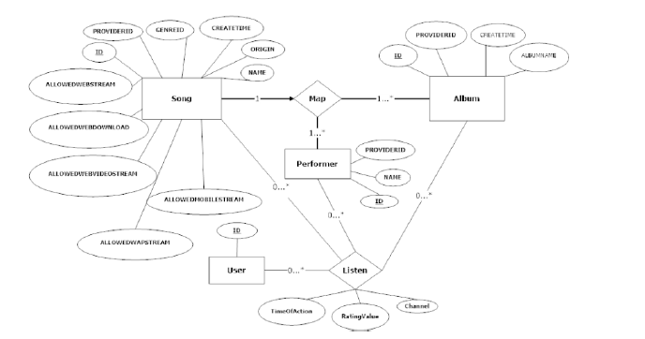
System Design
Fig: ER Diagram

Slide 10
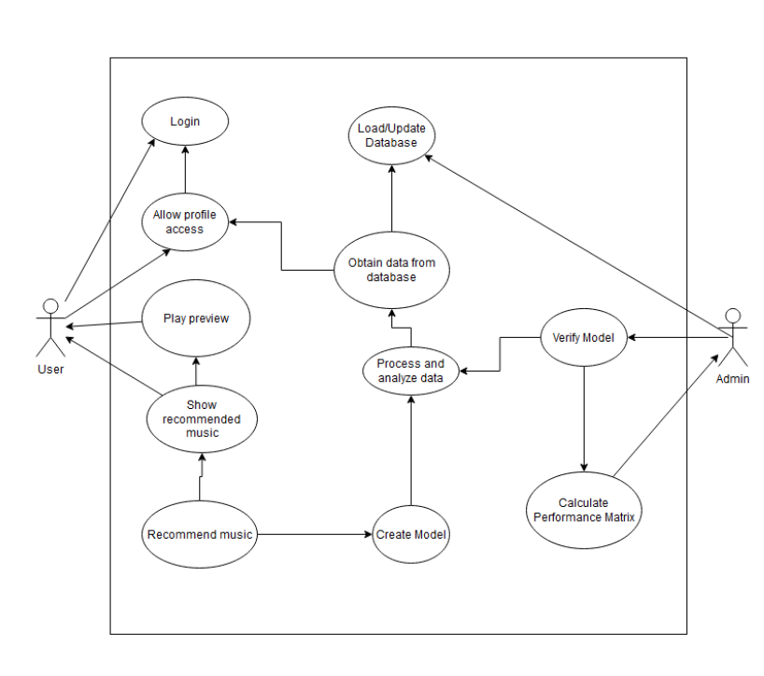
System Design
Fig: Use Case Diagram

Slide 11
Technical Details
HTML/CSS
React
Flask
Python
Tensorflow
Spotify api

Slide 12
References
[1] A. A. S. Gunawan, "Music Recommender System Based on Genre using Convolutional," Science Direct, pp. 5-6, 2019.
[2] M. Ogihara, "NEXTONE PLAYER: A MUSIC RECOMMENDATION SYSTEM BASED ON," 12th International Society for Music Information Retrieval Conference (ISMIR 2011), pp. 1-3, 2011.

Slide 13
Thank You

