Slide 1

Computer Hardware System

Slide 2
Introduction
Computer hardware is the physical components that a computer system requires to function,
Encompasses everything with a circuit board that operates within a PC or laptop,
Supports for major functions such as:
Input
Processing (internal storage, computation and control)
Output
Secondary storage

Slide 3
Central Processing Unit(CPU):
The brain of the computer
Read the instruction from memory
Controls all the function of the computer
Controls the sequence of instruction
Performs the computing tasks specified in program

Slide 4
Memory Unit:
Known as storage unit
Stores data and information,
Data's are entered through input devices
Stores intermediate results of processing
Stores the final result of processing

Slide 5
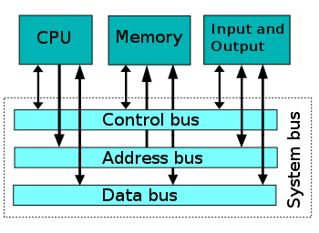
Interconnecting the units of a computer:
CPU sends data and information to the components inside the computer as well as to the peripherals and devices attached to it
Bus is a set of electronic signal pathways that allows information and signals to travel between components inside or outside of a computer
The different components of computer, are connected with each other by a bus
Data, instructions and the signals are carried between the different components via a bus

Slide 6
Computer Cabinet:
The computer cabinet consists of the components that are required for running the computer system effectively with fewer errors
The various elements in the computer cabinet are given below:
Motherboard
Memory chips
Processors
Ports
Cables

Slide 7
Computer Memory:
Electronic holding place of data's
Place for data's where microprocessor can reach quickly
Major component used in computer system
Without memory system cannot run and display data
It can be internal and external

Slide 8
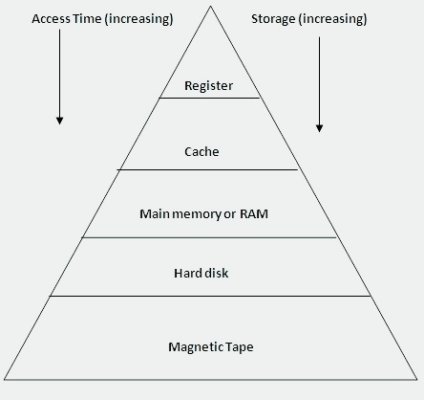
Memory Hierarchy:
It is arranging different kinds of storage present on a computing device based on speed of access.
Its types are:
Registers
Cache memory
Main memory
Magnetic discs
Magnetic tapes

Slide 9
CPU Register:
One of a small set of data holding places that are part of the computer processor.
Hold an instruction, a storage address, or any kind of data
It is not a part of the main memory
Located in the CPU in the form of registers

Slide 10
Cache memory:
A special very high-speed memory
Used to speed up and synchronizing with high-speed CPU
Costlier than main memory or disk memory but economical than CPU registers
An extremely fast memory type that acts as a buffer between RAM and the CPU
Used to reduce the average time to access data from the Main memory

Slide 11
Primary memory:
Primary memory is computer memory that is accessed directly by the CPU
Known as main memory
Small storage capacity
Stores the program under execution
e.g. RAM, ROM

Slide 12
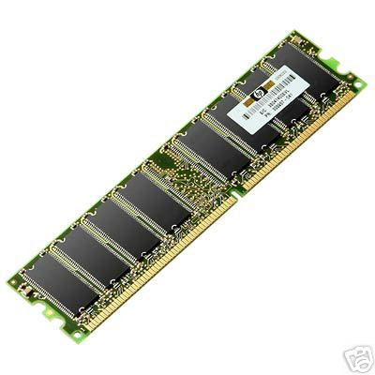
Random Access Memory(RAM):
A volatile memory which could store the data as long as the power is supplied
Has high-speed memory
Large size with higher capacity
costlier

Slide 13
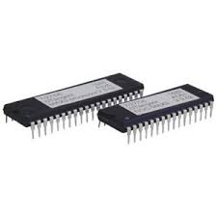
Read Only Memory(ROM):
A non-volatile memory which could retain the data even when power is turned off,
Much slower than the RAM
Small size with less capacity
Cheaper than RAM

Slide 14
Secondary memory
Computer memory that is not accessed directly by the CPU
Known as backup storage memory
Large storage capacity
Stores the program which is non executing stage
e.g. Magnetic Disk, Optical Disk

Slide 15
Storage devices:
It is any type of computing hardware that is used for storing, porting or extracting data files and objects
It can hold and store data's both temporarily and permanently
Its types are given below:
Magnetic tape
Magnetic disk
Optical disk
Magneto optical disk

Slide 16
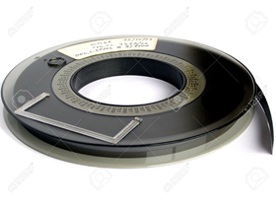
Magnetic Tape:
Most popular storage medium for large data, which are sequentially accessed and processed
This type of device is still used for large data backup
Cheaper than other devices
Easy to carry or transport
Not suitable for random access data

Slide 17
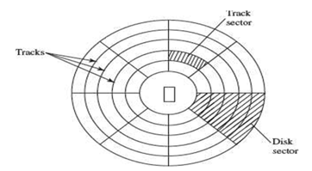
Magnetic Disk:
A circular disk which is coated with magnetic material
Suitable for frequently read/write data
Easy to carry or transport
More reliable storage device
Can store a large amount of data

Slide 18
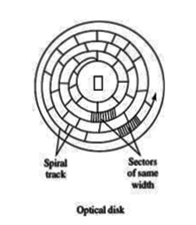
Optical Disk:
A random access storage medium
Relatively new secondary storage medium
Has no mechanical R/W arm movements
Cost-per-bit of storage is very low, because of their low cost.
e.g. CD-ROM, CD-R, DVD-ROM, DVD-RAM

Slide 19
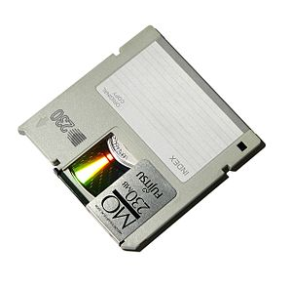
Magneto-Optical Disk:
Used during the mid-1990s
Known as magneto-optical drives and MO drives
Use laser beam to read data and magnetic field to write data to disk.
Dta can be written, erased and re-written.
Expensive and outdated

Slide 20
How the computer uses its memory?
The computer starts using the memory from the moment the computer is switched on, till the time it is switched off. The list of steps that the computer performs from the time it is switched on are:
Turn the computer on
The computer loads data from ROM, It makes sure that the components of the computer are functioning properly
The computer loads the BIOS from ROM
The computer loads the OS from the hard drive into the system’s RAM
Now the system is ready for use
When you load or open an application it is loaded in the RAM
After an application is loaded, any files that are opened for use in that application are loaded into RAM
When you save a file and close the application, the file is written to the specified storage device, and then it and the application are purged from RAM,

Slide 21
Introduction(Input and Output Devices):
A computer interacts with the external environment via the input-output (I/O) devices attached to it
Used for providing data and instructions to the computer
After processing the input data, computer provides output to the user via the output device
The I/O devices that are attached, externally, to the computer machine are also called peripheral devices
Different kinds of input and output devices are used for different kinds of input and output requirements.

Slide 22
Input-Output Unit:
An I/O unit is a component of computer
The I/O unit is composed of two parts: input unit and output unit
The input unit is responsible for providing input to the computer
The output unit is for receiving output from the computer

Slide 23
Input Unit:
The input unit gets the data and programs from various input devices ,
It makes them available for processing to other units of the computer
Input data is provided through input devices, such as keyboard, mouse, trackball and joystick
Input data can also be provided by scanning images, voice recording, video recording,

Slide 24
Output Unit:
The output unit gets the processed data from the computer,
Sends it to output devices to make them available to the user of computer
The output data is provided through output devices like display screen, printer, plotter and speaker

Slide 25
Input Devices:
The devices which allow users and other applications to input the data and,
the programs into the computer , for processing are known as Input Devices
Read data and convert them to a form that a computer can use
Allow for input of data to a computer
It can be classified in two types. They are:
Human data entry devices: keyboard, mouse
Source data entry devices: scanner, digital camera

Slide 26
Human Data Entry Devices:
Input devices that require data to be entered manually to the computer are human data entry devices,
The data may be entered by typing or keying in, or by pointing a device to a particular location
E.g. keyboard, mouse, joystick, touch screen

Slide 27
Source Data Entry Devices: Source Data Entry Devices:
Source data entry devices are used for audio input, video input,
Helps to enter the source document directly to the computer
Do not require data to be typed-in, keyed-in or pointed to a particular location
e.g. speech recognition, scanner, digital camera

Slide 28
Output Devices:
Output devices provide output to the user, which is generated after processing the input data
The processed data, presented to the user via the output devices could be text, graphics, audio or video
The output could be on a paper or on a film in a tangible form, or, in an intangible form as audio, video and electronic form
Using an output device, you can view and get the results of input from a computer
It can be classified in two types. they are:
Hard copy device: printer, plotter
Soft copy device: monitor, ( video/audio)output

Slide 29
I/O Port:
The peripheral devices can be connected to computer in several ways
The I/O ports are the external interfaces that are used to connect input and output devices like printer, modem and joystick to the computer
Devices such as network adapters and sound cards are connected to expansion slots inside the computer
The I/O devices are connected to the computer via the serial and parallel ports, Universal Serial Bus USB port

Slide 30
Working of I/O System
The working of I/O system combines I/O hardware and I/O software
The I/O hardware includes ports, buses and device controllers for different devices, and I/O devices
The I/O software is the device driver software that may be embedded with operating system or comes with each device

Slide 31
Conclusion
Hardware are required to make a computer system to operate effectively. Hardware is the physical components that a computer system requires to function. It encompasses everything with a circuit board that operates within a PC or laptop; including the motherboard, graphics card, CPU (Central Processing Unit), ventilation fans, webcam, power supply, and so on.
The hardware system is the physical element needed to run a computer, without hardware system in computer there would be no way of running the essential software that makes computers so useful.

