Slide 1
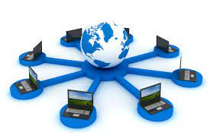
Introduction to networking
Networking, also known as computer networking, is the practice of transporting and exchanging data between nodes over a shared medium in an information system. Networking comprises not only the design, construction and use of a network, but also the management, maintenance and operation of the network infrastructure, software and policies.

Slide 2
Importance of networking
Provides best way of business communication.
Streamline communication.
Cost-effective resource sharing.
Improving storage efficiency and volume.
Cut costs on software.
Cut costs on hardware.
Utilizes Centralized Database.
Increase in efficiency.
Optimize convenience and flexibility.
Allows File sharing.
sharing of peripherals and internet access.
Network gaming.

Slide 3
Data communication media
The medium (or media, if there is more than one) is the physical matter or substance that carries the voice or data transmission. Many different types of transmission media are currently in use, such as copper (wire), glass or plastic (fiber-optic cable), or air (radio, infrared, microwave, or satellite). There are two basic types of media. Guided media are those in which the message flows through a physical media such as a twisted-pair wire, coaxial cable, or fiber-optic cable; the media "guides" the signal. Wireless media are those in which the message is broadcast through the air, such as infrared, microwave, or satellite.

Slide 4
Data transmission across media
1. Guided Media: It is also referred to as Wired or Bounded transmission media. Signals being transmitted are directed and confined in a narrow pathway by using physical links.
Features:
High Speed
Secure
Used for comparatively shorter distances
There are 3 major types of Guided Media:

Slide 5
Twisted Pair Cable – It consists of 2 separately insulated conductor wires wound about each other. Generally, several such pairs are bundled together in a protective sheath. They are the most widely used Transmission Media.
Twisted Pair is of two types:
Unshielded Twisted Pair (UTP): UTP consists of two insulated copper wires twisted around one another. This type of cable has the ability to block interference and does not depend on a physical shield for this purpose. It is used for telephonic applications.
Shielded Twisted Pair (STP): This type of cable consists of a special jacket (a copper braid covering or a foil shield) to block external interference. It is used in fast-data-rate Ethernet and in voice and data channels of telephone lines.

Slide 6
(ii) Coaxial Cable – It has an outer plastic covering containing an insulation layer made of PVC or Teflon and 2 parallel conductors each having a separate insulated protection cover. The coaxial cable transmits information in two modes: Baseband mode(dedicated cable bandwidth) and Broadband mode(cable bandwidth is split into separate ranges). Cable TVs and analog television networks widely use Coaxial cables.
(iii) Optical Fiber Cable – It uses the concept of reflection of light through a core made up of glass or plastic. The core is surrounded by a less dense glass or plastic covering called the cladding. It is used for the transmission of large volumes of data.
The cable can be unidirectional or bidirectional. The WDM (Wavelength Division Multiplexer) supports two modes, namely unidirectional and bidirectional mode.

Slide 7
2. Unguided Media: It is also referred to as Wireless or Unbounded transmission media. No physical medium is required for the transmission of electromagnetic signals.
There are 3 types of Signals transmitted through unguided media:
(I) Radio waves – These are easy to generate and can penetrate through buildings. The sending and receiving antennas need not be aligned. Frequency Range:3KHz – 1GHz. AM and FM radios and cordless phones use Radio waves for transmission.
(ii) Microwaves – It is a line of sight transmission i.e. the sending and receiving antennas need to be properly aligned with each other. The distance covered by the signal is directly proportional to the height of the antenna. Frequency Range:1GHz – 300GHz. These are majorly used for mobile phone communication and television distribution.
(iii) Infrared – Infrared waves are used for very short distance communication. They cannot penetrate through obstacles. This prevents interference between systems. Frequency Range:300GHz – 400THz. It is used in TV remotes, wireless mouse, keyboard, printer, etc.

Slide 8
Network Topologies
The physical or logical layout with geometrical pattern/ arrangement of interconnection of computer in network is called topology. The term topology in the context of a network refers to the way the computers are connected to the network.

Slide 9
Types of network Topologies
Bus topology
Ring topology
Mesh topology
Star topology
Tree topology
Hybrid topology

Slide 10
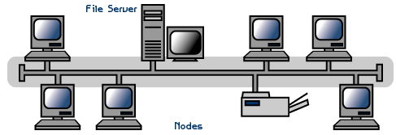
Bus Topology
A topology in which all of the computers in a network are attached to the continuous cable or segments that connects them in a straight line is called bus topology.

Slide 11
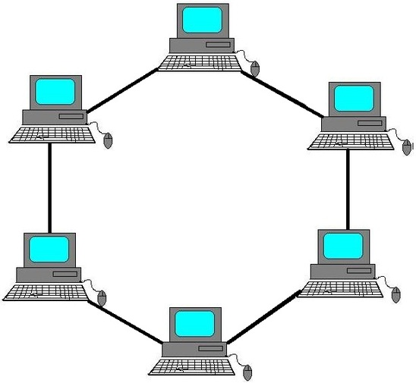
Ring Topology
The topology in which computers are arranged in a circle and data moves around the ring in one direction is called ring topology. Ring topology needs more cabling than a bus topology.

Slide 12
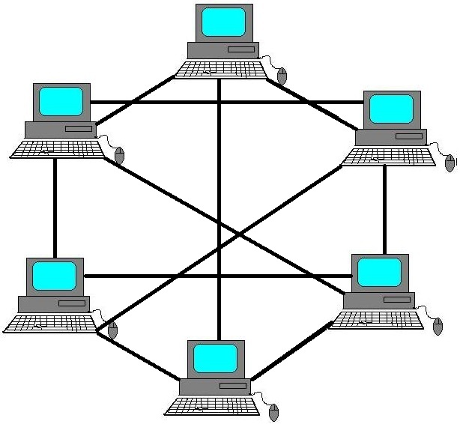
Mesh topology
The topology in which each and every nodes are connected to each other. In a mesh topology there is no central connection point.

Slide 13
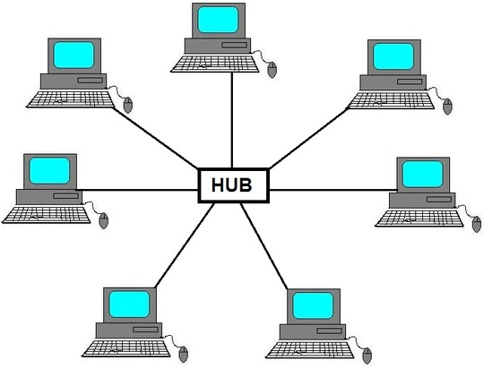
Star Topology
A network topology in which each of the device and computer on a network connect on central hub or switch is called star topology.

Slide 14
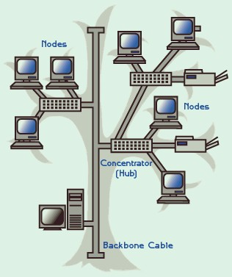
Tree Topology
A tree topology is the combination of a star topology and bus topology in hierarchical manner.

Slide 15
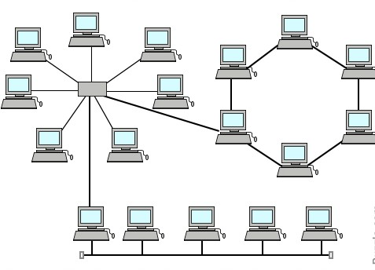
Hybrid Topology
It is the combination of more than two topologies. In computer networking, a network structure that contains more than two topologies is known as topology.

Slide 16
Networking Hardware
NIC card
MODEM
HUB
Switch
Bridge
Router

Slide 17
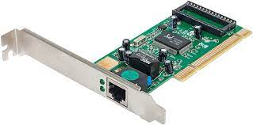
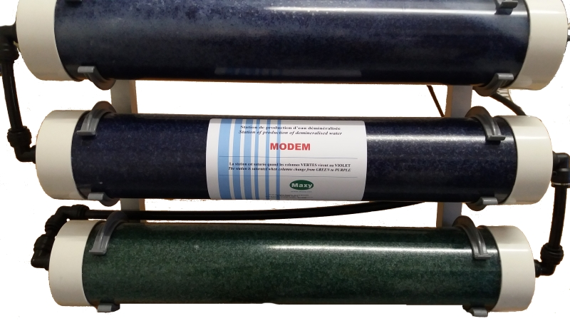
NIC card: Network interface card is a device connects computer and network cable. It prepare data from the computer for the network cable.
MODEM: The word MODEM stand for modulator and demodulator. It is a device, which translates data from binary codes to analog data that can be transmitted over the telephone network and translate analog data into binary codes.

Slide 18
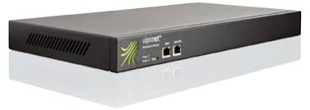
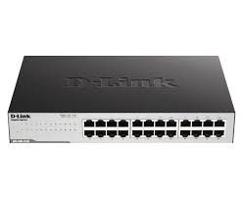
HUB: HUB is a connectivity device with multiple parts for connecting computers in a star topology. It transfer data to the nodes connected in it.
Switch: It is known as intelligent hub. The switch receives a data packet, it creates a direct connection between sender and receiver and forward the data packet to the destination computer only.

Slide 19
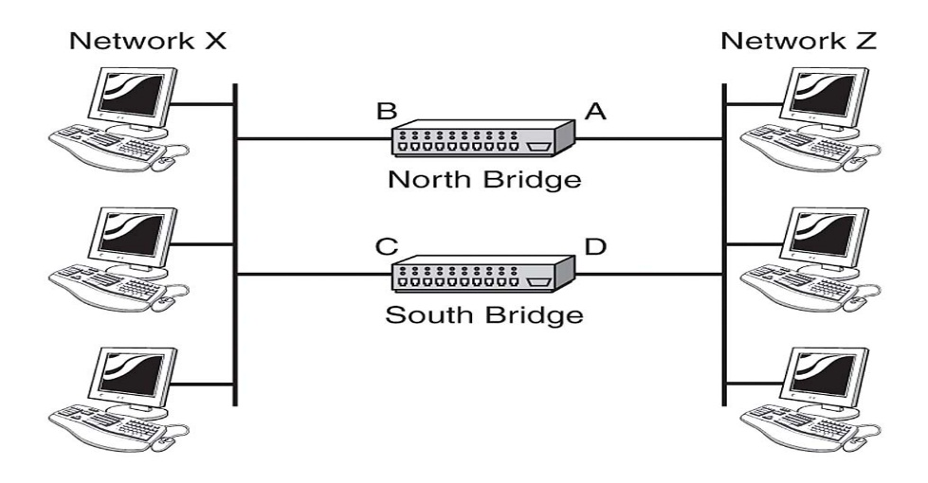
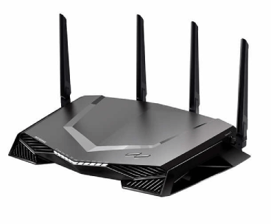
Bridge: It is a computer networking device that creates a single, aggregate network from multiple communication network or network segments.
Router: the router is used to connect two or more different network together. It’s main job is to find the best route (path) that can be used for transmission.

Slide 20
Communication Protocol
A communication or network protocol is set of rules for communicating between computing devices. A protocol defines hoe computers identify one another in a network. Communication protocols allow different network devices to communicate with each other. They are used in both analog and digital communications and can be used for important processes, ranging from transferring files between devices to accessing the internet.

Slide 21
The most commonly used network protocols are:
TCP/IP:
TCP stands for Transmission Control Protocol a communications standard that enables application programs and computing devices to exchange messages over a network. TCP is a layered set of protocol. It is designed to send packets across the internet and ensure the successful delivery of data and messages over networks.
UDP:
User Datagram Protocol (UDP) is a communications protocol that is primarily used to establish connections between applications on the Internet. UDP is a simple connectionless unreliable transport protocol performs very limited error checking. It is mainly used for transmitting multimedia data which requires faster transmission and error checking is not used..

Slide 22
SMPT:
SMPT is a standard protocol for transmitting electronic mail (email) by the Internet. It is an Internet mail protocol.
POP:
POP is also a protocol for transmitting email. It is simple but has limited functionality. It is an application layer Internet standard protocol used by local e-mail clients to retrieve e-mail from remote server over a TCP/IP connection.
IMAP:
IMAP stands for Internet Message Access Protocol. It is an application layer protocol which is used to receive the emails from the mail server. It is the most commonly used protocols like POP3 for retrieving the emails.

Slide 23
FTP:
FTP stands for File transfer protocol. It is mainly used for transferring the web page files from their creator to the computer. It is also used for downloading the files to computer f rom other servers.
HTTP:
HTTP stands for Hyper Text Transfer Protocol. It is a protocol used to access the data on the World Wide Web (www). It is used to load web pages using hypertext links.
HTTPS:
HTTPS stands for Hyper Text Transfer Protocol Secure. It is a protocol for securing the communication between two systems e.g. the browser and the web server.
Telnet:
Telnet is a network protocol used to virtually access a computer and to provide a two-way, collaborative and text-based communication channel between two machines.

Slide 24
Wireless Networking
A wireless network refers to a computer network that makes use of Radio Frequency (RF) connections between nodes in the network. A wireless network is a computer network that uses wireless data connections between network nodes. Wireless network is a computer network connected wirelessly. The communication is done through a wireless media like radio waves, infrared or Bluetooth.

Slide 25
Uses of Wireless Networking
Used for broadcasting in radio and television communication.
Used for communication using mobile phones and pagers.
Used for connecting components of computers using Bluetooth technology, for Internet connection using Wi-Fi, Wireless LAN, PDA, and in remote controls for television, doors etc.

Slide 26
Types of Wireless Communication
Satellite:
A satellite is an object that revolves around another object. For example, earth is a satellite of The Sun, and moon is a satellite of earth. A communication satellite is a microwave repeater station in a space that is used for telecommunication, radio and television signals. A communication satellite processes the data coming from one earth station and it converts the data into another form and send it to the second earth station.
Microwave:
Microwave is a line-of-sight wireless communication technology that uses high frequency beams of radio waves to provide high speed wireless connections that can send and receive voice, video, and data information. Microwave radio transmission is commonly used in point-to-point communication systems on the surface of the Earth, in satellite communications, and in deep space radio communications.

