Slide 1


welcome

Slide 2
Digital marketing
STUDENT NAME : NABITHA K
REGISTER NO AND NMID : 3F3173777020760A83647C808C744B11
DEPARTMENT : BACHELOR OF COMPUTER APPLICATION
COLLEGE : SIR BHARATHI WOMENS ARTS & SCIENCE COLLEGE /
THIRUVALLUVAR UNIVERSITY

Slide 3
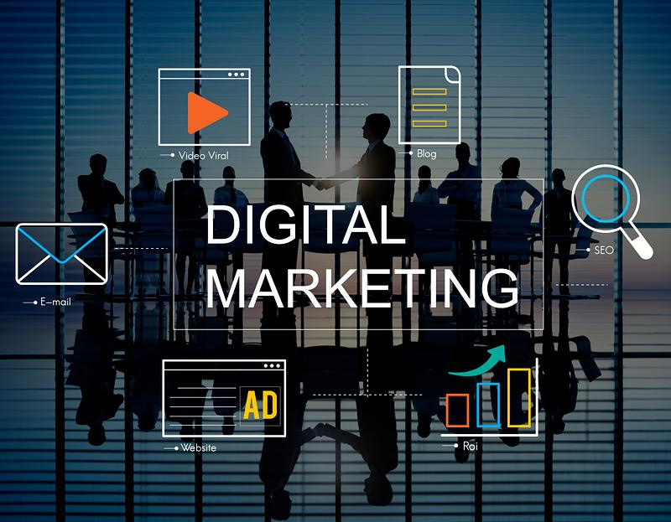

Slide 4
AGENDA
1.PROBLEM STATEMENT
2.PROJECT OVERVIEW
3.END USERS
4.TOOLS AND TECHNOLOGIES
5.PORTFOLIO DESGIN AND LAYOUT
6.FEATURES AND FUNCTIONALITY
7.RESULTS AND SCREENSHOTS
8.CONCLUSION
9.GITHUB LINK

Slide 5
PROBLEM STATEMENT
A digital marketing problem statement serves as a foundational element that identifies specific challenges hindering a business's marketing success. It is essential for aligning marketing strategies with organizational goals and ensuring that all stakeholders understand the core issues at hand.

Slide 6
PROJECT OVERVIEW
In a project overview, digital marketing involves defining goals, identifying a target audience, selecting relevant digital channels (like social media, SEO, email, content marketing), creating engaging content, and then executing, monitoring, and optimizing the campaign using data analytics to achieve measurable business objectives, ensuring a consistent brand message across platforms to attract and retain customers.

Slide 7
END USER
Digital marketing targets end users – the actual people who use or buy a product or service – by reaching them through digital channels like websites, social media, mobile apps, and search engines. This strategic approach uses data to create personalized, engaging experiences and drive brand awareness, lead generation, and customer loyalty by understanding the end user's needs, behaviors, and preferences at every stage of their interaction with a brand.

Slide 8
TOOLS AND TECHNOLOGIES
Digital marketing relies on technology and software tools for promotion and analysis across channels like websites, social media, email, and search engines. Key tools include SEO platforms (e.g., SEMrush), social media managers (e.g., Sprout Social), email marketing software (e.g., Mailchimp), content creation tools (e.g., Canva), analytics platforms (e.g., Google Analytics), and AI-driven solutions for automation and content optimization. These technologies enhance strategy execution, performance tracking, and customer engagement in the digital landscape.

Slide 9
PORTFOLIO DESIGN AND LAYOUT
Digital marketing portfolios use online platforms to showcase a marketer's skills and results through a user-friendly design and layout, featuring compelling visuals, detailed case studies, and clear contact information. A strong portfolio includes an engaging "About" page, a consistent visual aesthetic, easy navigation, and a link in your resume and social media to attract potential clients and employers

Slide 10
Features and functionality
Digital marketing utilizes online channels to promote brands, services, and products, and its core features include global reach, cost-effectiveness, targeted audience reach, measurability, flexibility and adaptability, and interactivity. Functionality is provided through technologies like SEO, content marketing, social media management, and email marketing, allowing businesses to reach specific customers, analyze campaign performance in real-time, and create personalized experiences.

Slide 11
Marketing strategy
Digital marketing is the practice of promoting products or services through online channels and digital devices, while a digital marketing strategy is a comprehensive plan for how a business will use these channels and tools to achieve specific, measurable business goals like brand awareness, lead generation, or sales. A strong strategy integrates various tactics such as SEO, social media marketing, and email campaigns to connect with a target audience across platforms, ultimately driving conversions and revenue.

Slide 12
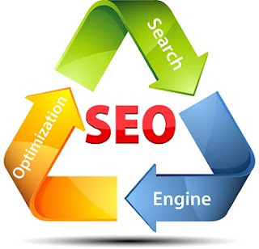
Seo strategy for small businesses
A digital marketing SEO strategy for small businesses focuses on making a business's website more visible in search engine results to attract customers actively seeking their products or services

Slide 13

Building relationships with customers
Digital marketing builds customer relationships by fostering consistent communication, delivering personalized experiences, providing valuable content, and prioritizing excellent customer service through channels like email, social media, and websites. Using customer data helps create targeted and relevant interactions, while leveraging Customer Relationship Management (CRM) systems manages and nurtures these connections for long-term loyalty and trust

Slide 14
solution
Digital marketing solutions are online strategies and tools, such as SEO, content marketing, social media, and email marketing, used to promote brands, increase online presence, and connect with target audiences across digital devices. These solutions help businesses generate leads, drive sales, and build customer relationships by reaching potential customers where they spend their time online, often more affordably and with greater precision than traditional methods.

Slide 15
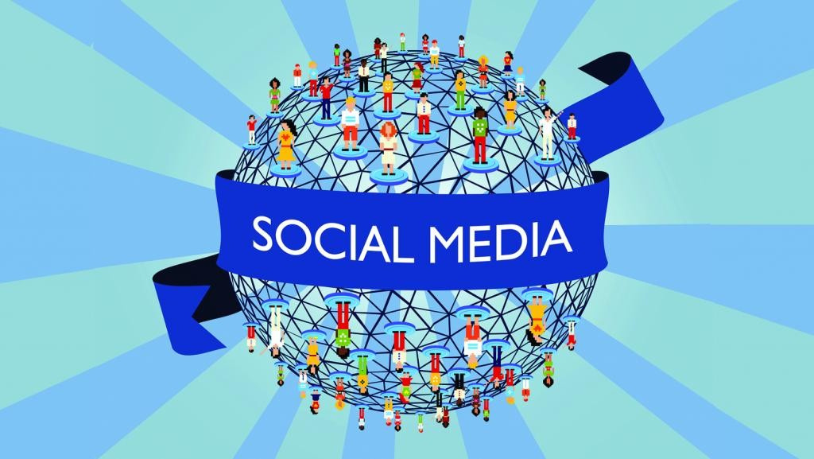
Social media marketing
Social media marketing is a component of digital marketing, utilizing social media platforms like Facebook, Instagram, and LinkedIn to promote brands, engage audiences, and achieve business objectives such as increased sales, website traffic, and brand loyalty. It involves publishing valuable content, fostering two-way conversations, running targeted ads, and analyzing performance data to build connections and reach new customers.

Slide 16
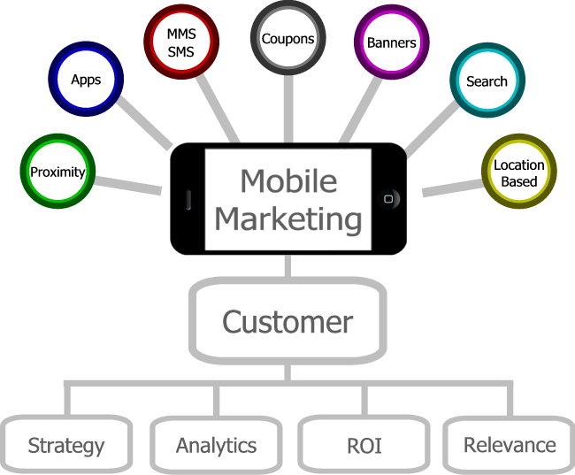
Mobile marketing
Mobile marketing is a specialized form of digital marketing that focuses on reaching consumers through their mobile devices, such as smartphones and tablets. It encompasses a broad range of tactics, including SMS/MMS messaging, mobile apps, mobile websites, social media, and push notifications, all designed to deliver personalized and targeted messages, promotions, and advertisements directly to the user's device.

Slide 17
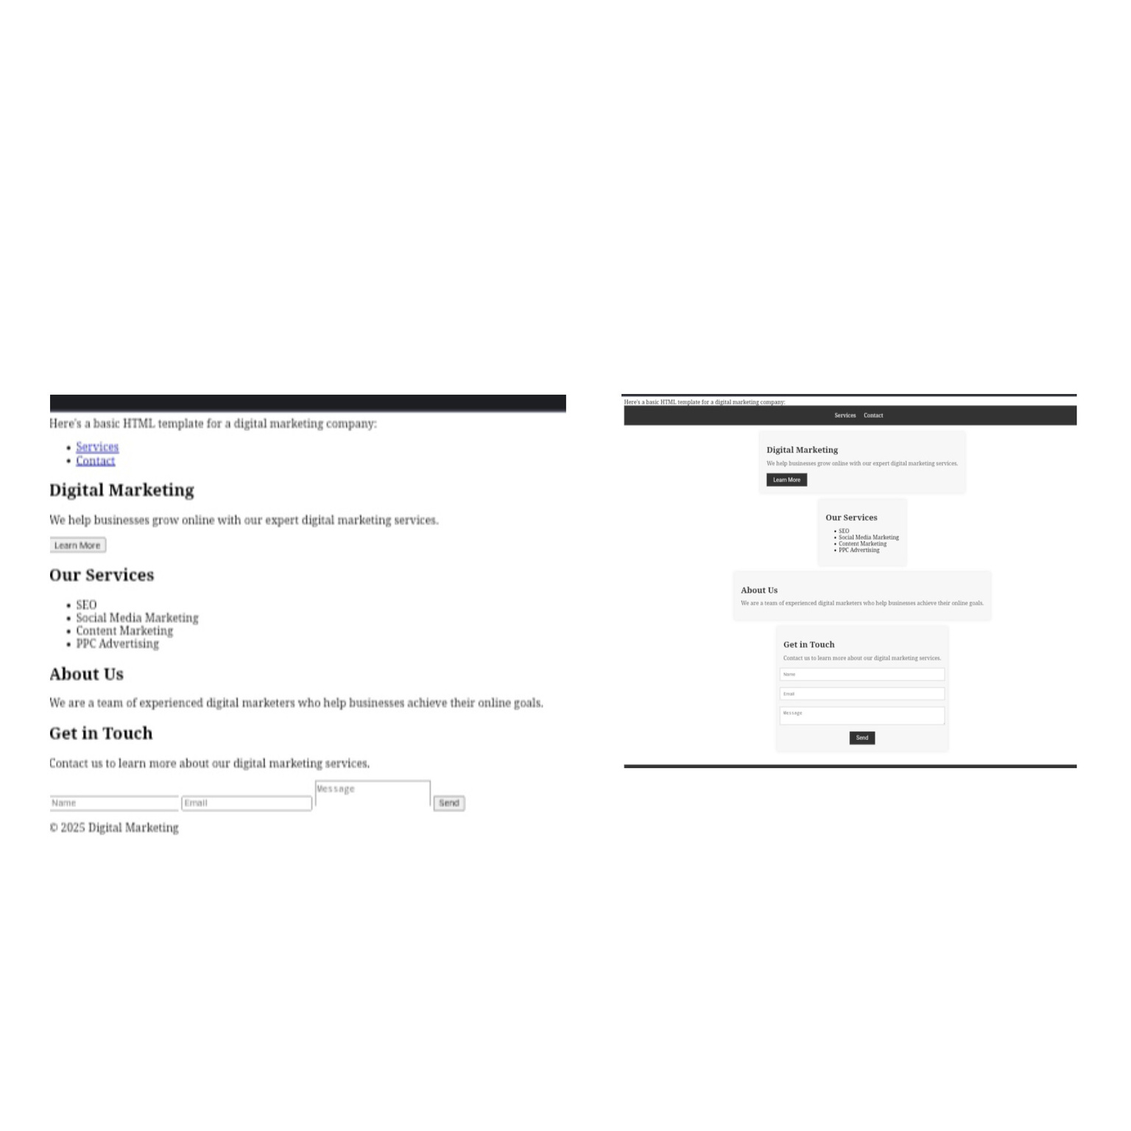
Result and screenshots
Notes:
17

Slide 18
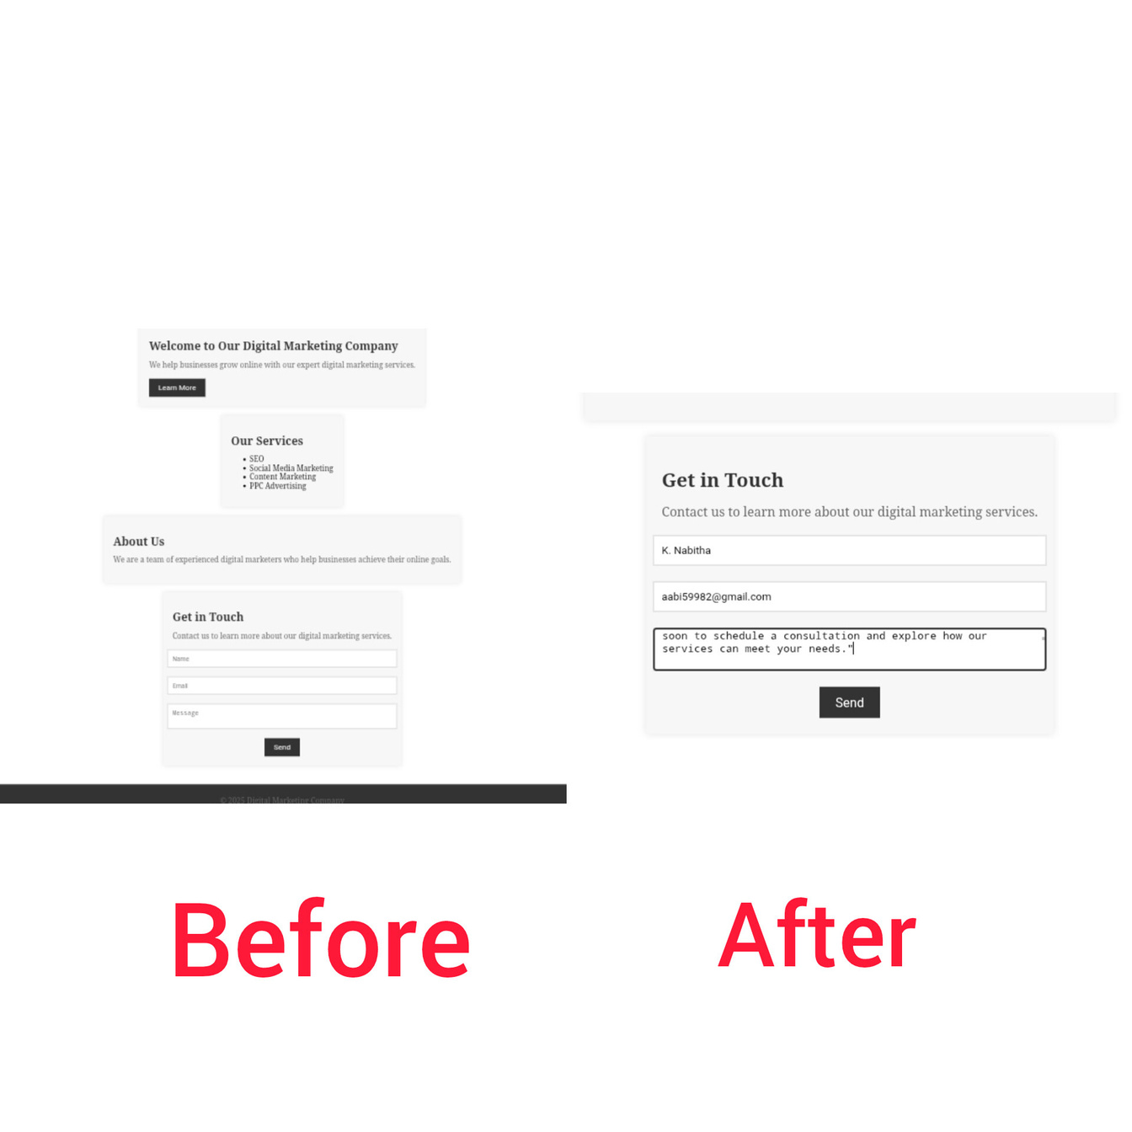

Slide 19
conclusion
The conclusion of digital marketing is that it's an essential, integrated strategy for modern businesses to drive growth and success by offering global reach, cost-effective campaigns, and precise audience targeting. Key benefits include improved brand awareness, enhanced customer engagement, and measurable results through data analytics, making it vital for staying competitive in the digital age.

Slide 20
Thank you
Submitted by
NABITHA.K

