Slide 1

Humanities Research with Sound: Introduction to Audio Machine Learning
Stephen McLaughlin
PhD Student

Slide 2
What do you need to classify sound?
A little theory
Stephen McLaughlin / @SteveMcLaugh

Slide 3
What do you need to classify sound?
A little theory
Intuition w/r/t what is tractable
Stephen McLaughlin / @SteveMcLaugh

Slide 4
What do you need to classify sound?
A little theory
Intuition w/r/t what is tractable
Patience and skills to manage lots of audio files
Stephen McLaughlin / @SteveMcLaugh

Slide 5
What do you need to classify sound?
A little theory
Intuition w/r/t what is tractable
Patience and skills to manage lots of audio files
Features
Stephen McLaughlin / @SteveMcLaugh

Slide 6
What do you need to classify sound?
A little theory
Intuition w/r/t what is tractable
Patience and skills to manage lots of audio files
Features
A passable algorithm
Stephen McLaughlin / @SteveMcLaugh

Slide 7
Stephen McLaughlin / @SteveMcLaugh
Notes:
This is not an option.

Slide 8
Understanding Sound
Stephen McLaughlin
PhD Student

Slide 9
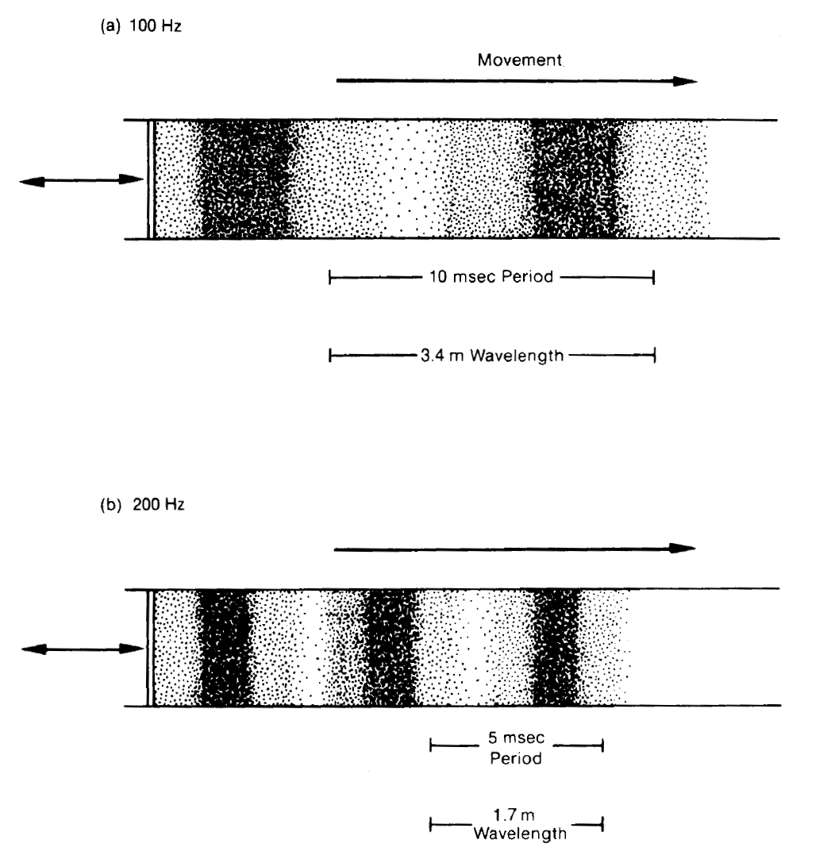
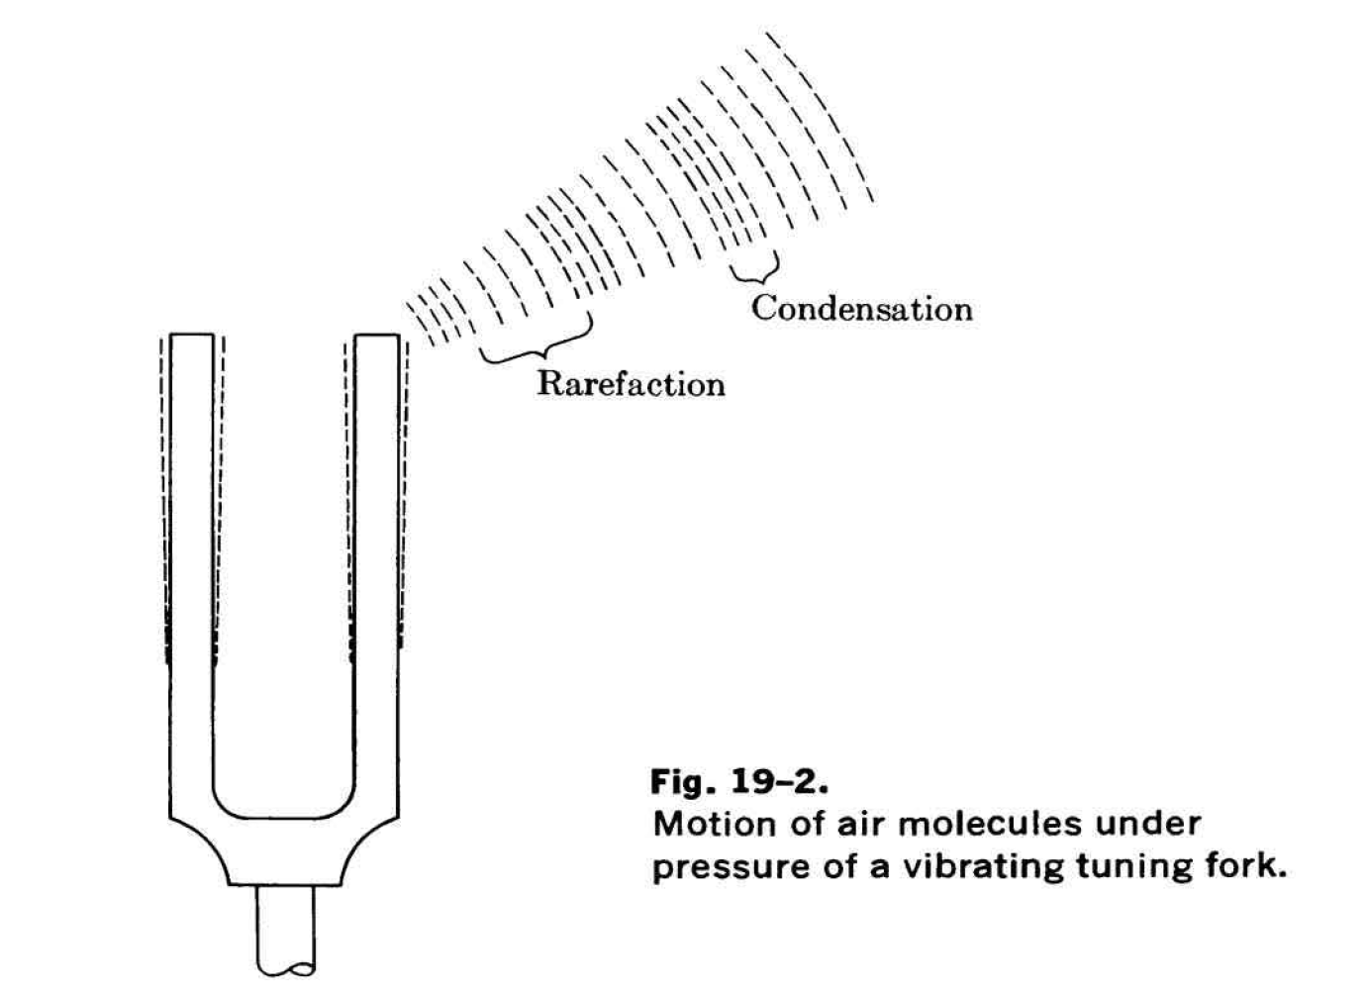
Stephen McLaughlin / @SteveMcLaugh
Notes:
This is not an option.

Slide 10
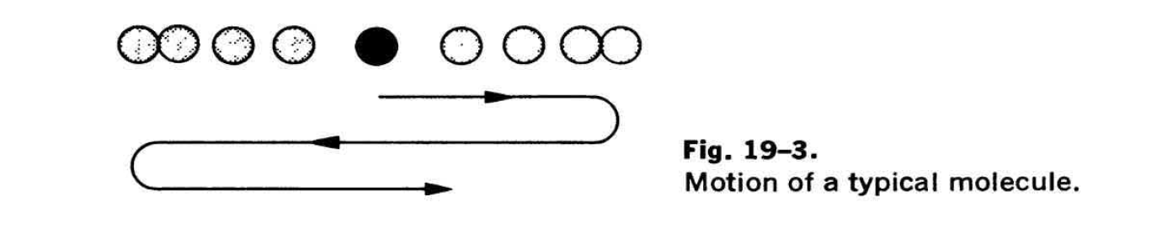
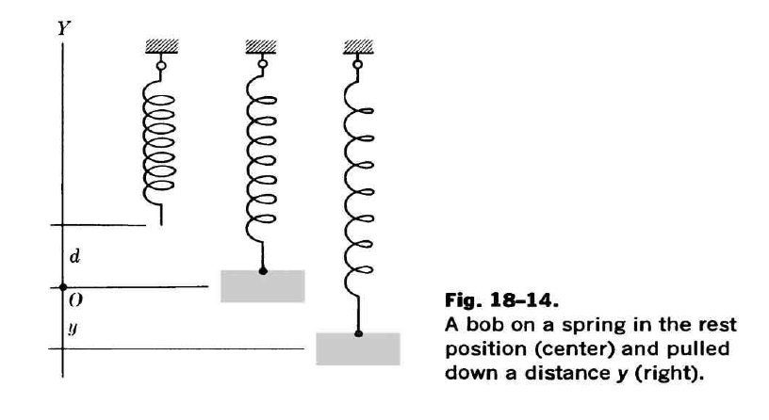
Credit: Kline 1985
Stephen McLaughlin / @SteveMcLaugh
Notes:
This is not an option.

Slide 11
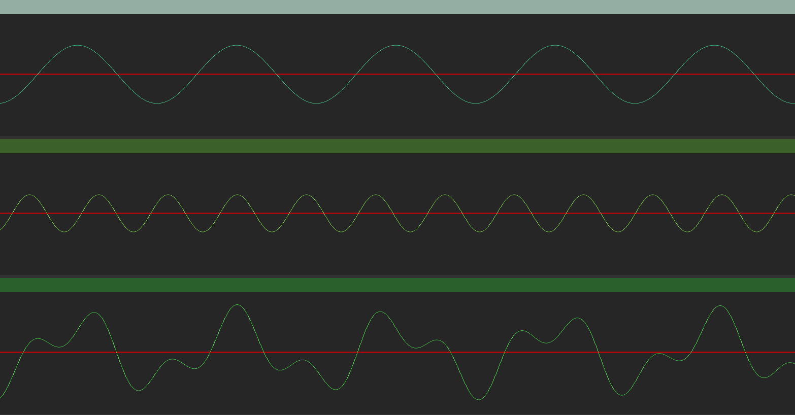
Stephen McLaughlin / @SteveMcLaugh
Notes:
This is not an option.

Slide 12
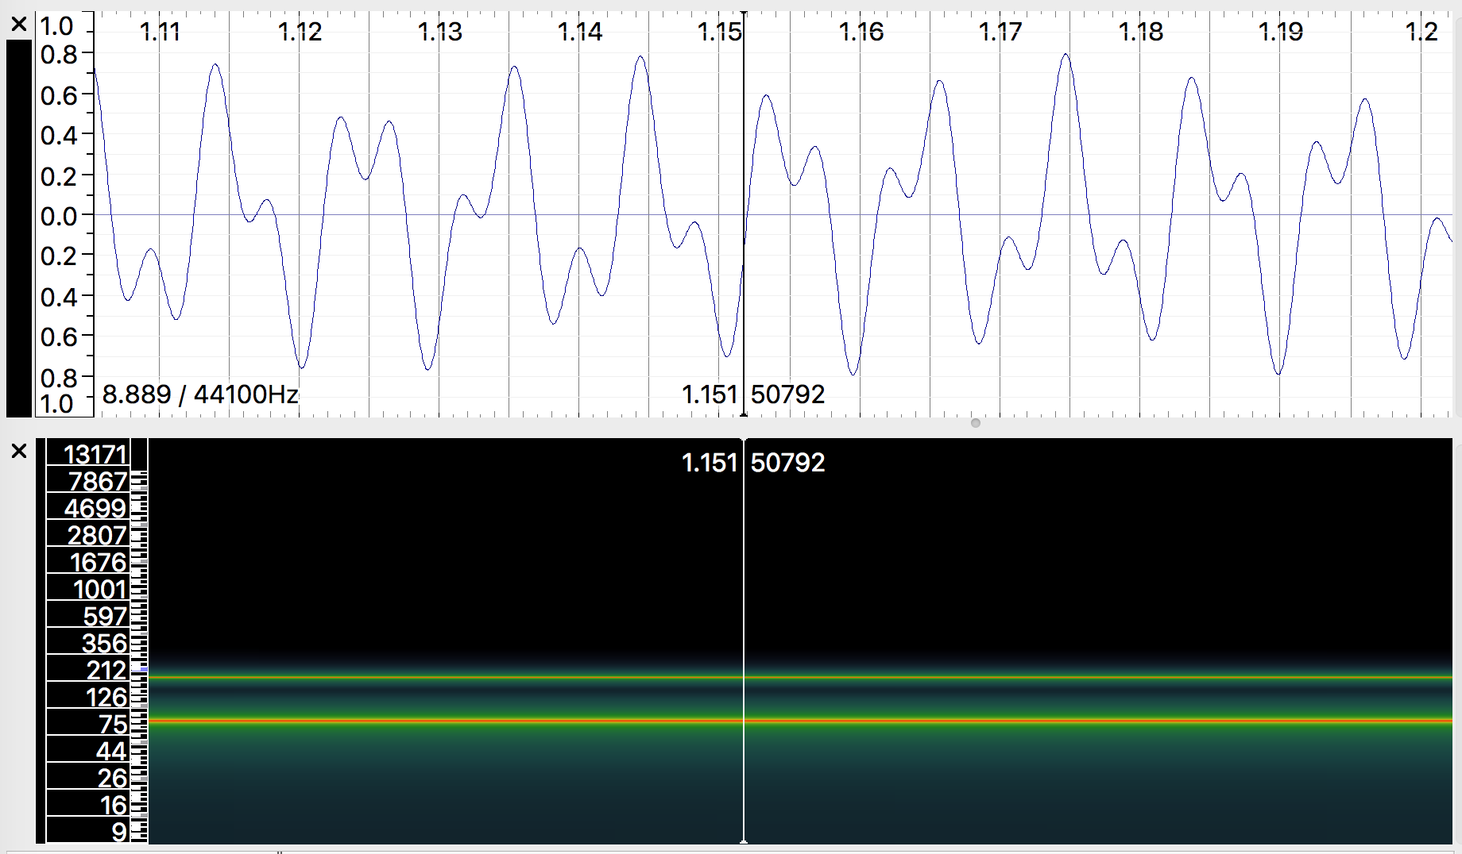
Stephen McLaughlin / @SteveMcLaugh
Notes:
This is not an option.

Slide 13
Stephen McLaughlin / @SteveMcLaugh
Notes:
This is not an option.

Slide 14
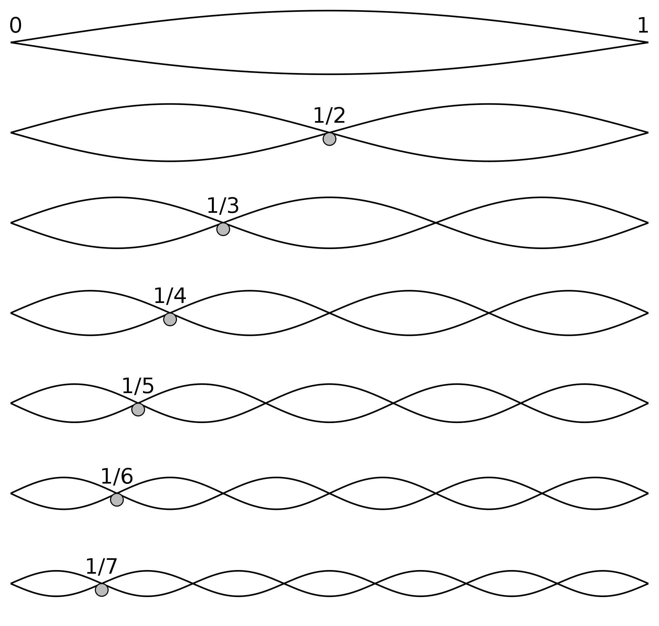
Stephen McLaughlin / @SteveMcLaugh
Notes:
This is not an option.

Slide 15
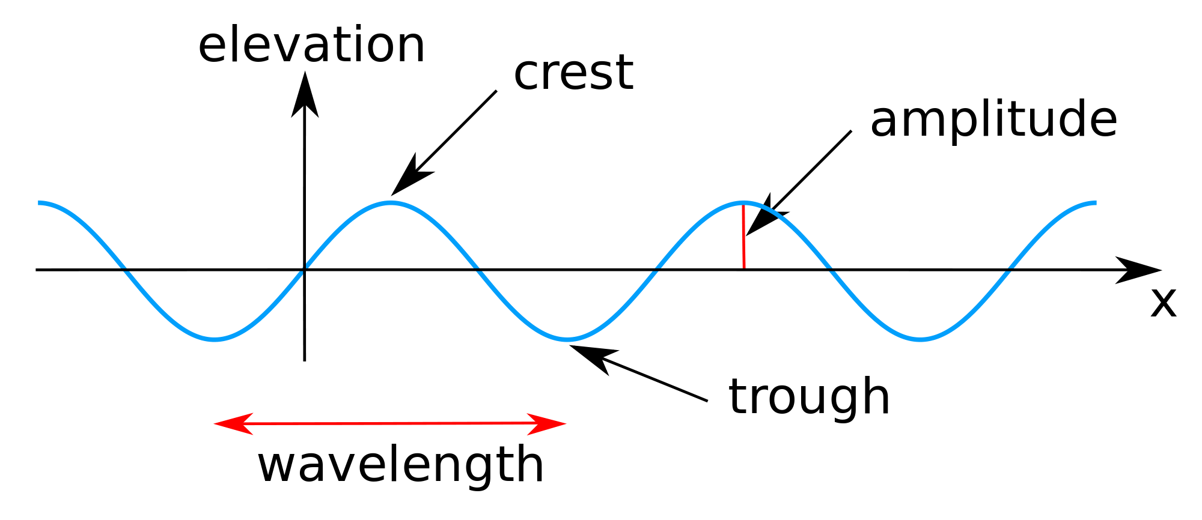
Stephen McLaughlin / @SteveMcLaugh
Notes:
This is not an option.

Slide 16
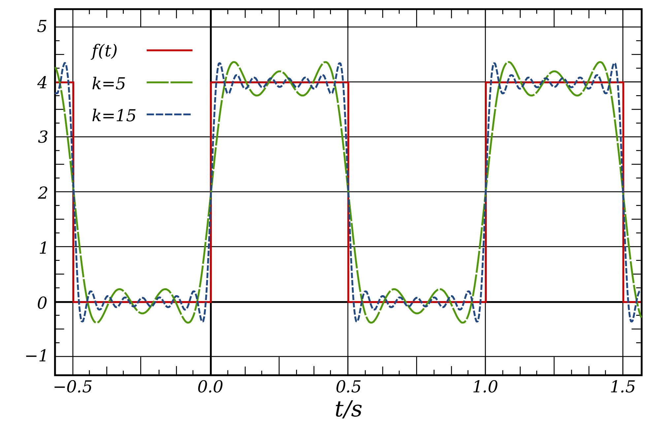
Stephen McLaughlin / @SteveMcLaugh
Notes:
This is not an option.

Slide 17
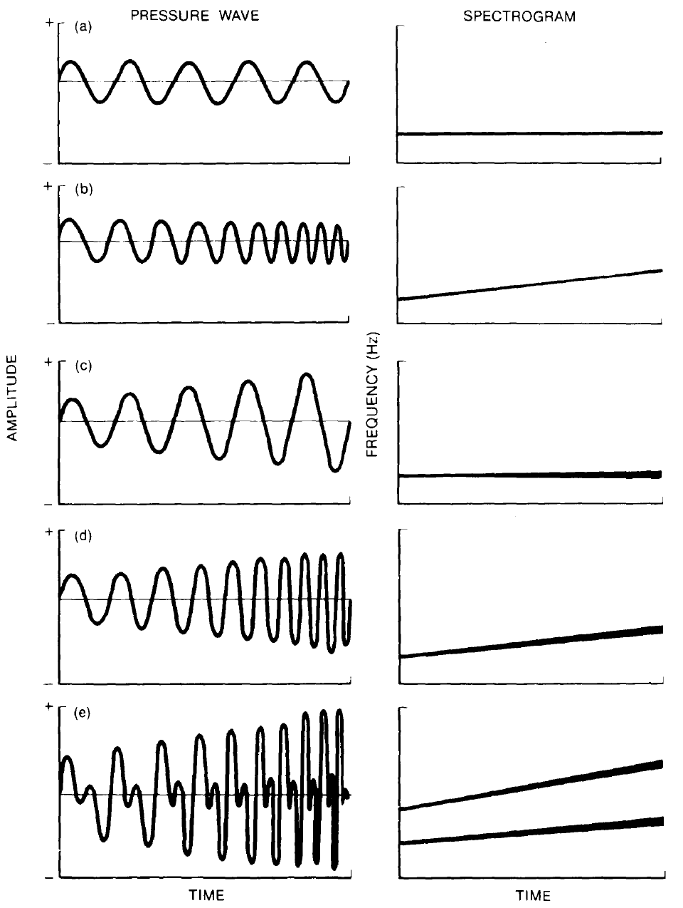
Credit: Handel 1989
Stephen McLaughlin / @SteveMcLaugh
Notes:
This is not an option.

Slide 18
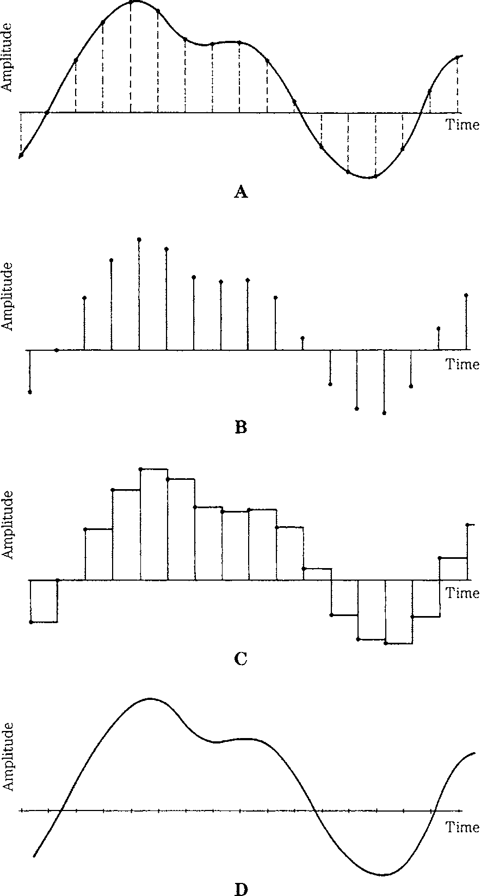
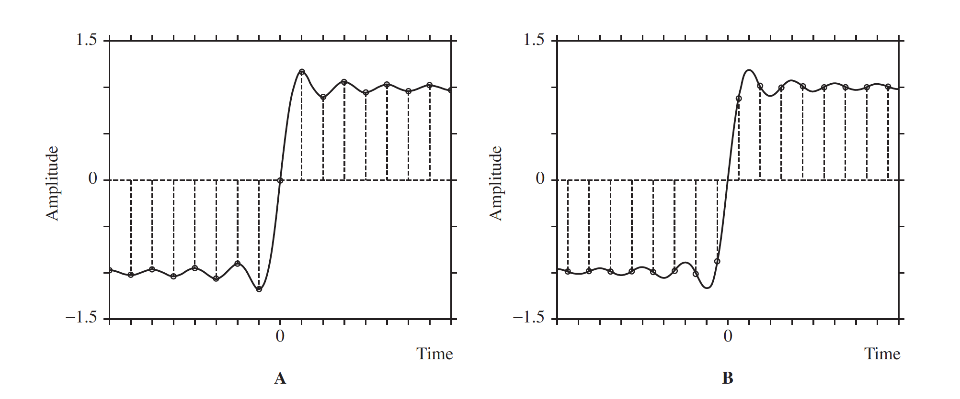
Credit: Pohlmann 2011
Stephen McLaughlin / @SteveMcLaugh
Notes:
This is not an option.

Slide 19
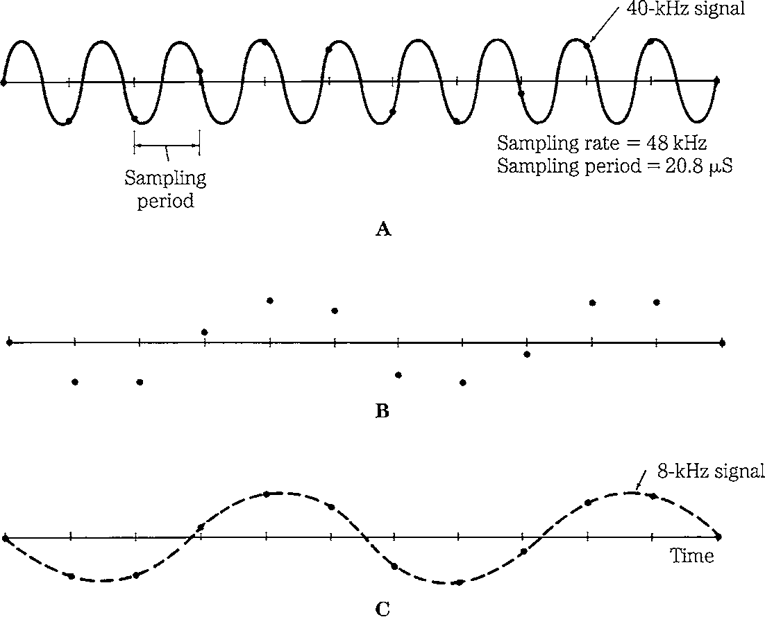
Credit: Pohlmann 2011
Stephen McLaughlin / @SteveMcLaugh
Notes:
This is not an option.

Slide 20
Stephen McLaughlin / @SteveMcLaugh
Notes:
This is not an option.

Slide 21
Digital audio terms
sample rate: The number of audio samples per second in a digital audio file.
bit depth: The number of bits used to represent each sample, which corresponds to dynamic range of a given file
bit rate: The number of bits used to encode a unit of time in a digital audio file.
Stephen McLaughlin / @SteveMcLaugh
Notes:
(i.e., the range of possible "loudness" levels). Each sample in a 16-bit audio file has 2^16 or 65,536 possible values.
CD-quality audio has a bit rate of 1,411.2 kbit/second.

Slide 22
Stephen McLaughlin / @SteveMcLaugh
Notes:
This is not an option.

Slide 23
Credit: Handel David Forsyth
Stephen McLaughlin / @SteveMcLaugh
Notes:
This is not an option.

Slide 24
Stephen McLaughlin / @SteveMcLaugh
Notes:
This is not an option.

Slide 25
Title
1
2
3
4
Stephen McLaughlin / @SteveMcLaugh

Slide 26
Title
1
2
3
4
Stephen McLaughlin / @SteveMcLaugh

Slide 27
Title
1
2
3
4
Stephen McLaughlin / @SteveMcLaugh

Slide 28
Stephen McLaughlin / @SteveMcLaugh
Notes:
This is not an option.

Slide 29
Title
1
2
3
4
Stephen McLaughlin / @SteveMcLaugh

Slide 30
Stephen McLaughlin / @SteveMcLaugh
Notes:
This is not an option.

Slide 31
Title
1
2
3
4
Stephen McLaughlin / @SteveMcLaugh

Slide 32
Stephen McLaughlin / @SteveMcLaugh
Notes:
This is not an option.

Slide 33
Title
1
2
3
4
Stephen McLaughlin / @SteveMcLaugh

Slide 34
Stephen McLaughlin / @SteveMcLaugh
Notes:
This is not an option.

Slide 35
Title
1
2
3
4
Stephen McLaughlin / @SteveMcLaugh

Slide 36
Stephen McLaughlin / @SteveMcLaugh
Notes:
This is not an option.

Slide 37
Title
1
2
3
4
Stephen McLaughlin / @SteveMcLaugh

Slide 38
Stephen McLaughlin / @SteveMcLaugh
Notes:
This is not an option.

Slide 39
Title
1
2
3
4
Stephen McLaughlin / @SteveMcLaugh

Slide 40
Stephen McLaughlin / @SteveMcLaugh
Notes:
This is not an option.

Slide 41
Title
1
2
3
4
Stephen McLaughlin / @SteveMcLaugh

Slide 42
Stephen McLaughlin / @SteveMcLaugh
Notes:
This is not an option.

Slide 43
Title
1
2
3
4
Stephen McLaughlin / @SteveMcLaugh

Slide 44
Stephen McLaughlin / @SteveMcLaugh
Notes:
This is not an option.

Slide 45
Title
1
2
3
4
Stephen McLaughlin / @SteveMcLaugh

Slide 46
Stephen McLaughlin / @SteveMcLaugh
Notes:
This is not an option.

Slide 47
Title
1
2
3
4
Stephen McLaughlin / @SteveMcLaugh

Slide 48
Stephen McLaughlin / @SteveMcLaugh
Notes:
This is not an option.

Slide 49
Title
1
2
3
4
Stephen McLaughlin / @SteveMcLaugh

Slide 50
Stephen McLaughlin / @SteveMcLaugh
Notes:
This is not an option.

Slide 51
Title
1
2
3
4
Stephen McLaughlin / @SteveMcLaugh

Slide 52
Stephen McLaughlin / @SteveMcLaugh
Notes:
This is not an option.

Slide 53
Title
1
2
3
4
Stephen McLaughlin / @SteveMcLaugh

Slide 54
Stephen McLaughlin / @SteveMcLaugh
Notes:
This is not an option.

Slide 55
Title
1
2
3
4
Stephen McLaughlin / @SteveMcLaugh

