Slide 1

Humanities Research with Sound: Introduction to Audio Machine Learning
Stephen McLaughlin
PhD Student

Slide 2
https://stevemclaugh.github.io/HILT-Audio-ML/
Stephen McLaughlin / @SteveMcLaugh

Slide 3
What do you need to classify sound?
A little theory
Stephen McLaughlin / @SteveMcLaugh

Slide 4
What do you need to classify sound?
A little theory
Intuition w/r/t what is tractable
Stephen McLaughlin / @SteveMcLaugh

Slide 5
What do you need to classify sound?
A little theory
Intuition w/r/t what is tractable
Patience and skills to manage lots of audio files
Stephen McLaughlin / @SteveMcLaugh

Slide 6
What do you need to classify sound?
A little theory
Intuition w/r/t what is tractable
Patience and skills to manage lots of audio files
Features
Stephen McLaughlin / @SteveMcLaugh

Slide 7
What do you need to classify sound?
A little theory
Intuition w/r/t what is tractable
Patience and skills to manage lots of audio files
Features
A passable algorithm
Stephen McLaughlin / @SteveMcLaugh

Slide 8
What we won’t learn
statistics
signal processing
programming in general
state-of-the-art ML techniques
Stephen McLaughlin / @SteveMcLaugh

Slide 9
What we will learn
how to think about sound as data
how to process & manage audio from the command line
how to combine & modify existing tools
the limits and possibilities of machine learning for sound collections
Stephen McLaughlin / @SteveMcLaugh

Slide 10
Stephen McLaughlin / @SteveMcLaugh
Notes:
This is not an option.

Slide 11
Stephen McLaughlin / @SteveMcLaugh
Notes:
This is not an option.

Slide 12
Understanding Sound
Stephen McLaughlin
PhD Student

Slide 13
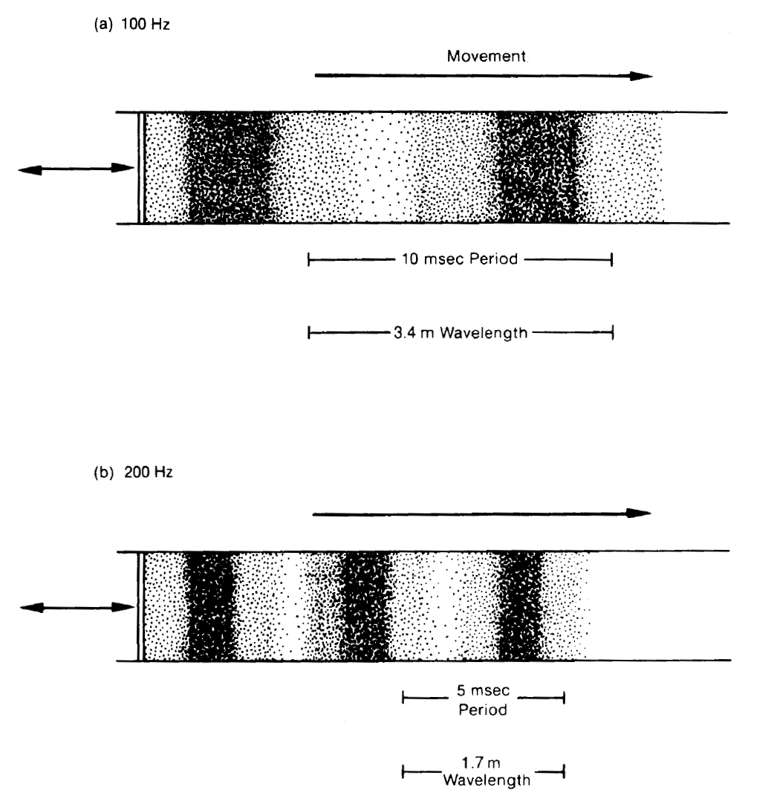
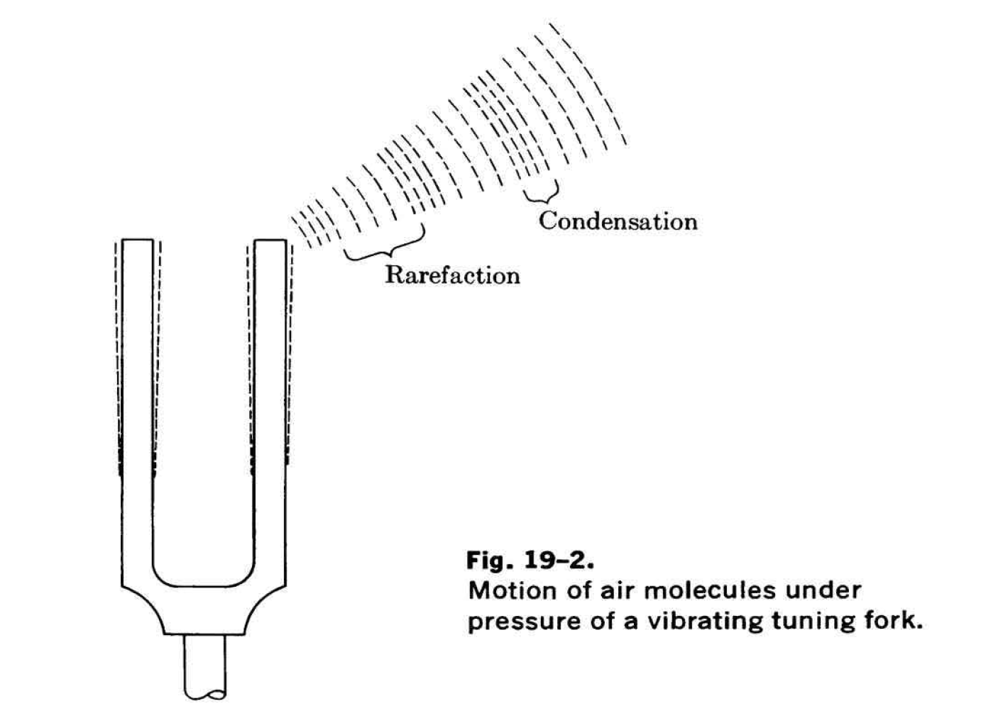
Stephen McLaughlin / @SteveMcLaugh
Notes:
This is not an option.

Slide 14
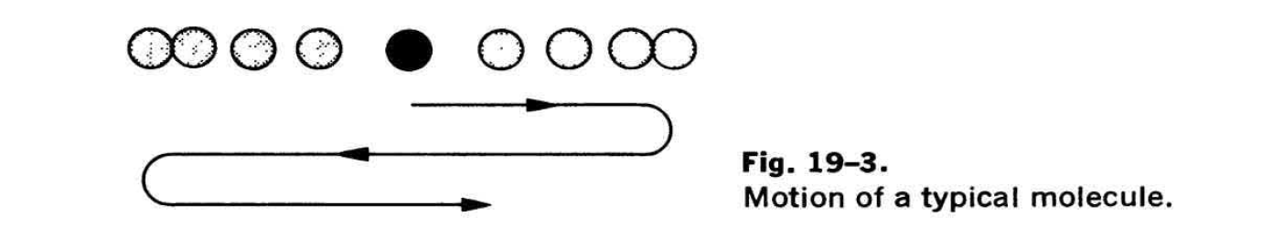
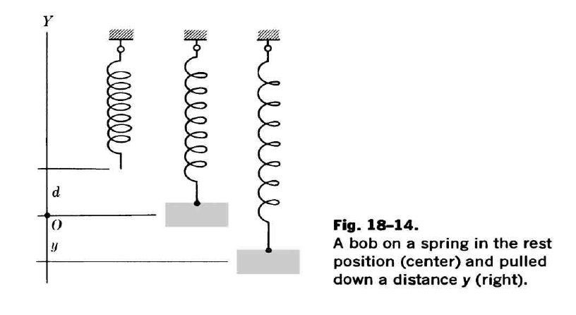
Credit: Kline 1985
Stephen McLaughlin / @SteveMcLaugh
Notes:
This is not an option.

Slide 15
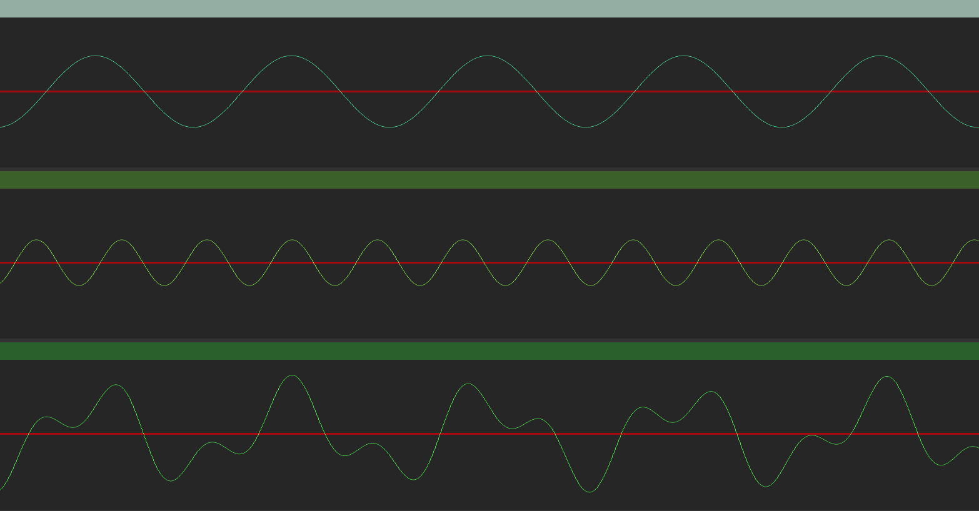
Stephen McLaughlin / @SteveMcLaugh
Notes:
This is not an option.

Slide 16
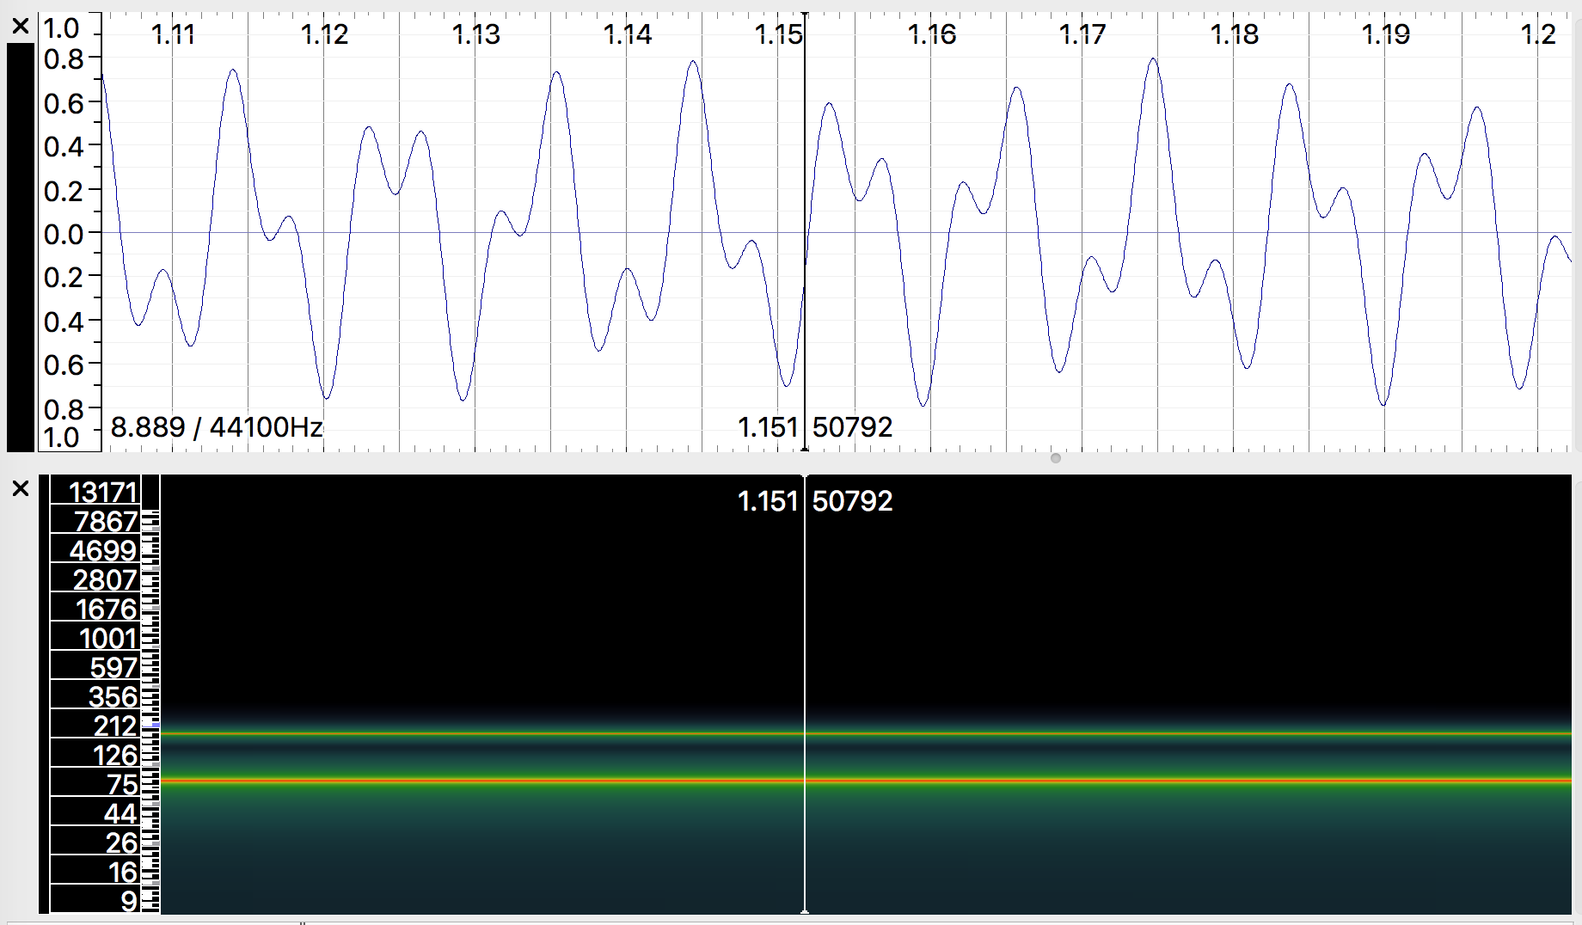
Stephen McLaughlin / @SteveMcLaugh
Notes:
This is not an option.

Slide 17
Credit: Wikimedia Commons
Stephen McLaughlin / @SteveMcLaugh
Notes:
This is not an option.

Slide 18
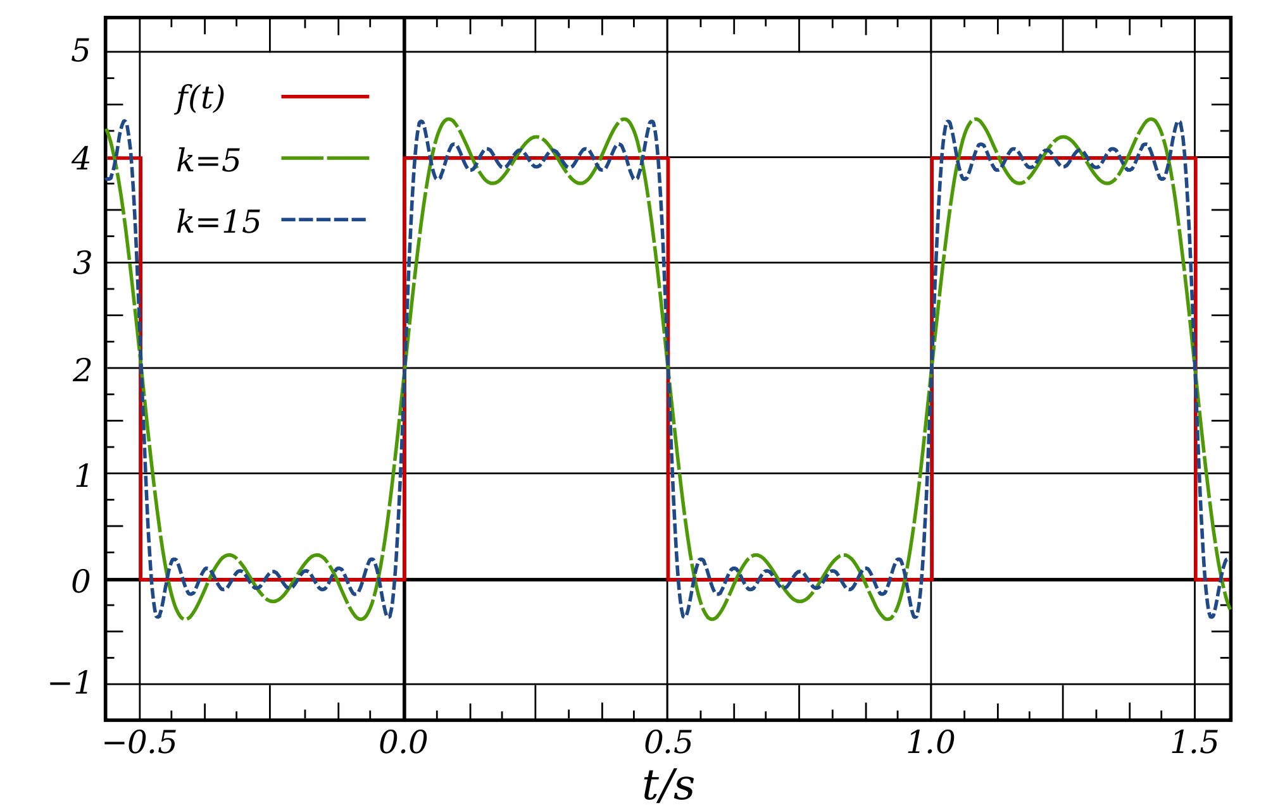
Credit: Wikimedia Commons
Stephen McLaughlin / @SteveMcLaugh
Notes:
This is not an option.

Slide 19
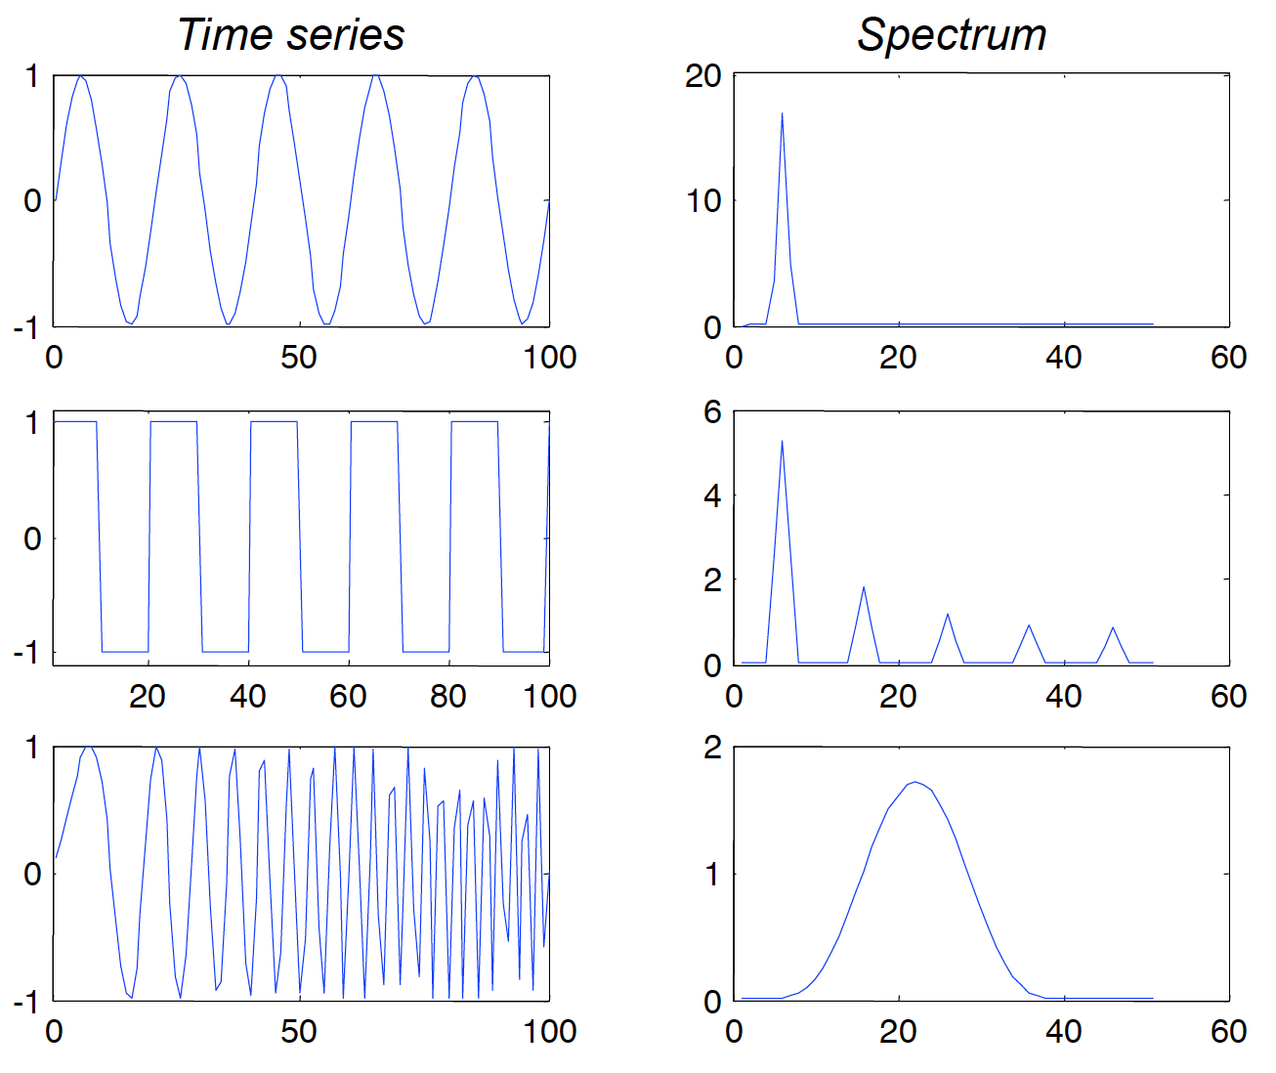
Stephen McLaughlin / @SteveMcLaugh
Notes:
This is not an option.

Slide 20
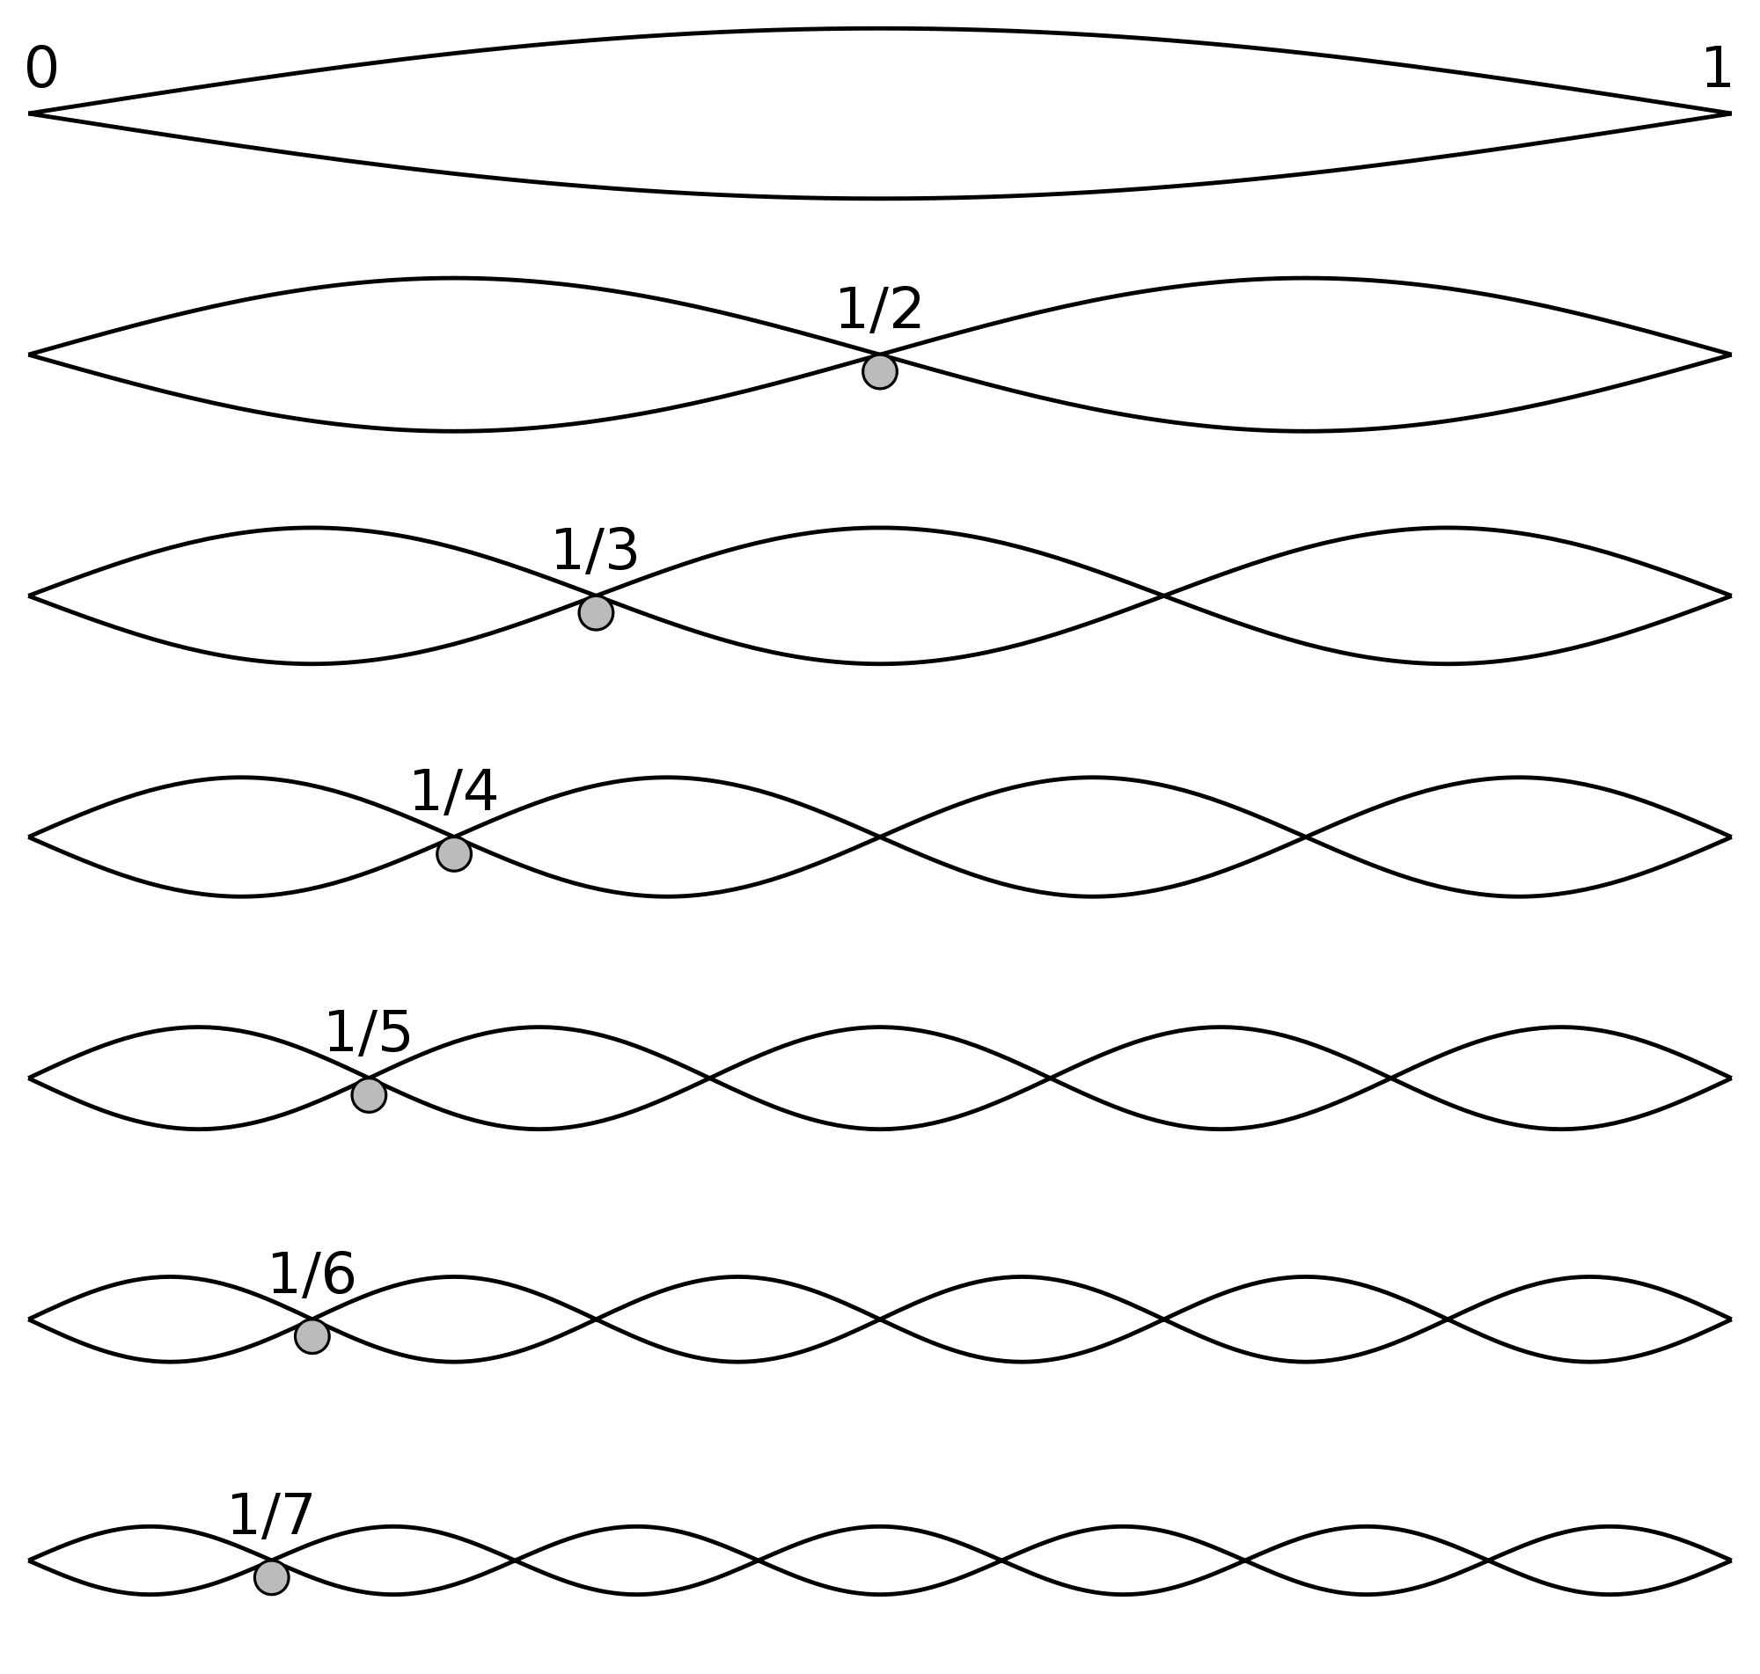
Credit: Wikimedia Commons
Stephen McLaughlin / @SteveMcLaugh
Notes:
This is not an option.

Slide 21
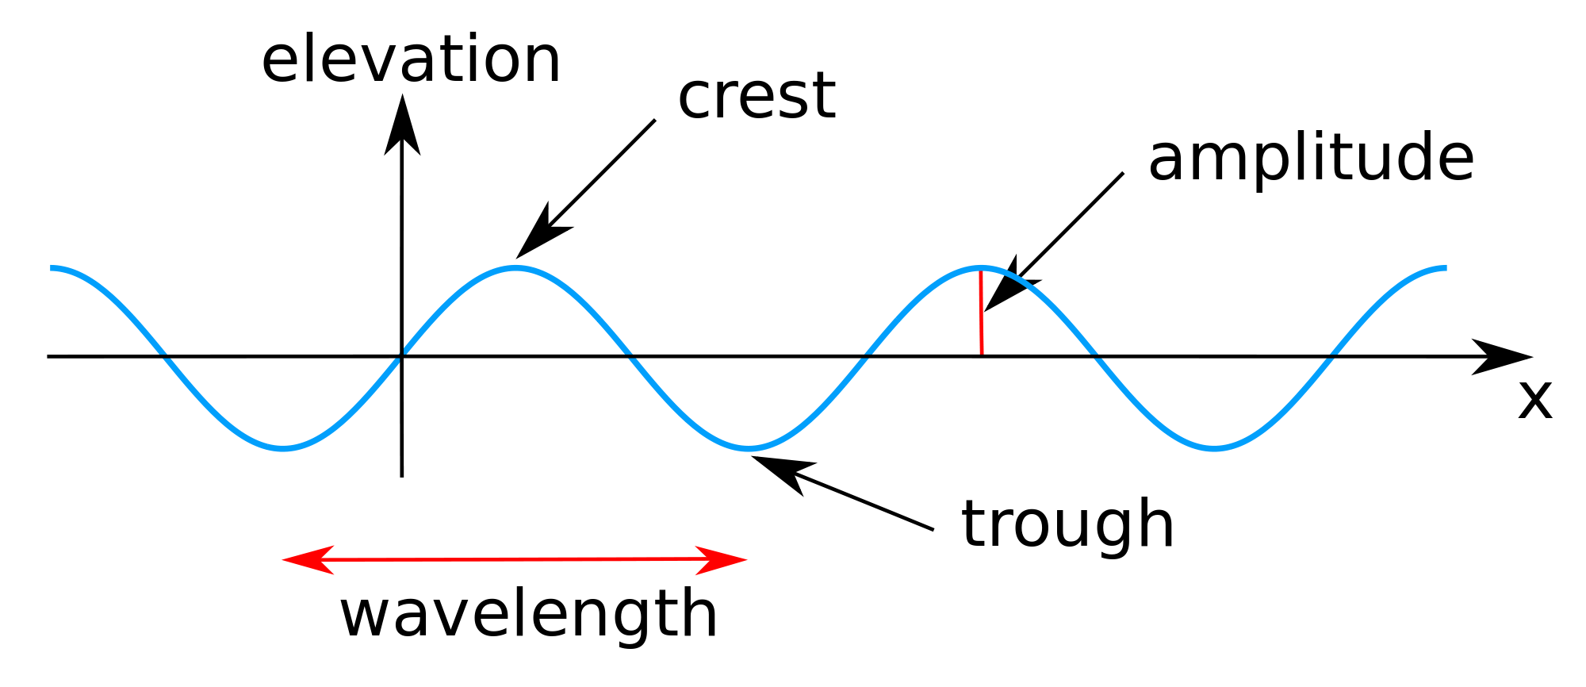
Credit: Wikimedia Commons
Stephen McLaughlin / @SteveMcLaugh
Notes:
This is not an option.

Slide 22
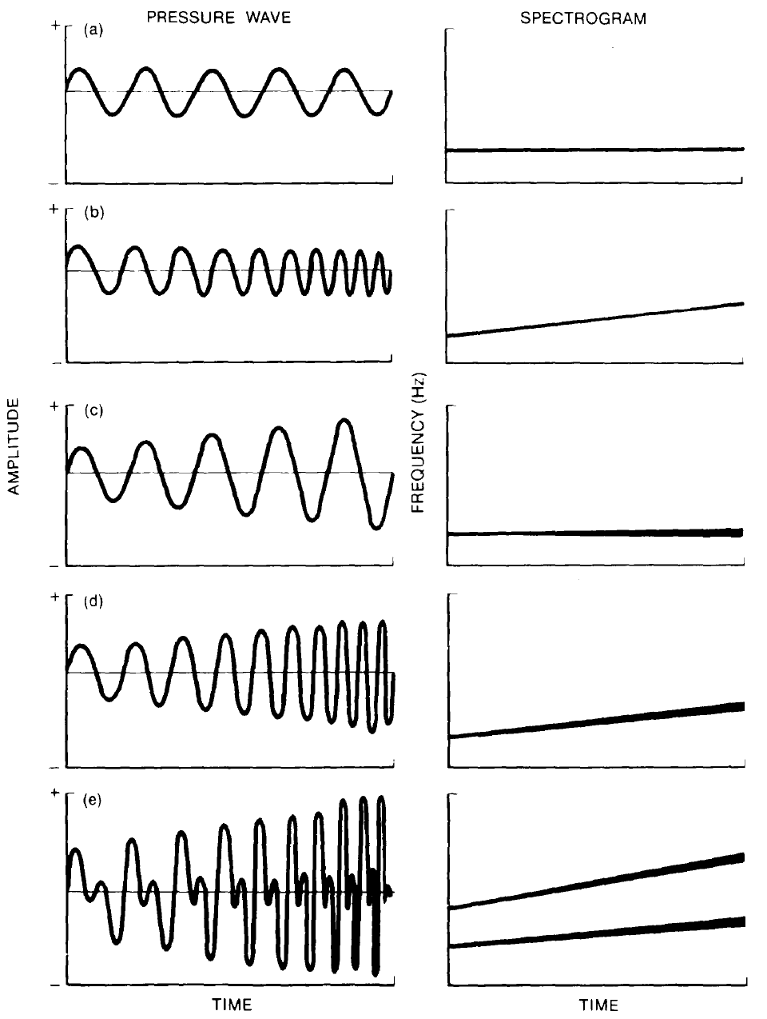
Credit: Handel 1989
Stephen McLaughlin / @SteveMcLaugh
Notes:
This is not an option.

Slide 23
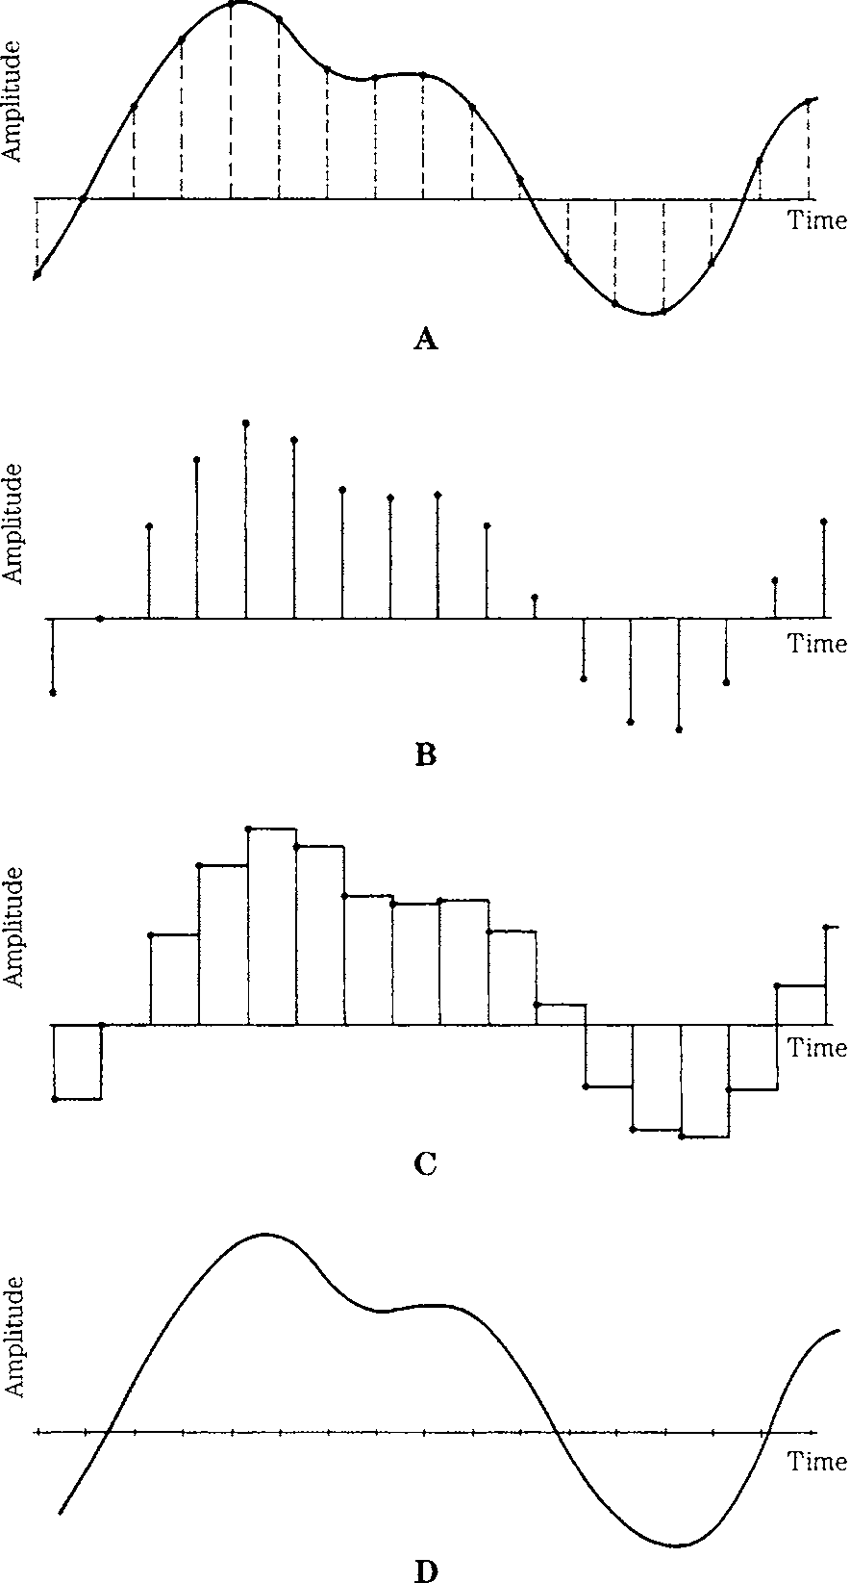
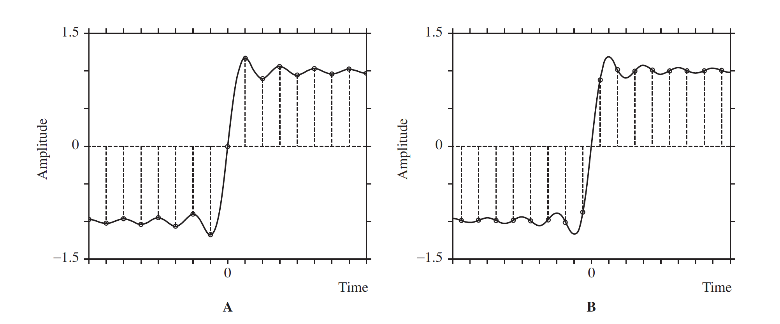
Credit: Pohlmann 2011
Stephen McLaughlin / @SteveMcLaugh
Notes:
This is not an option.

Slide 24
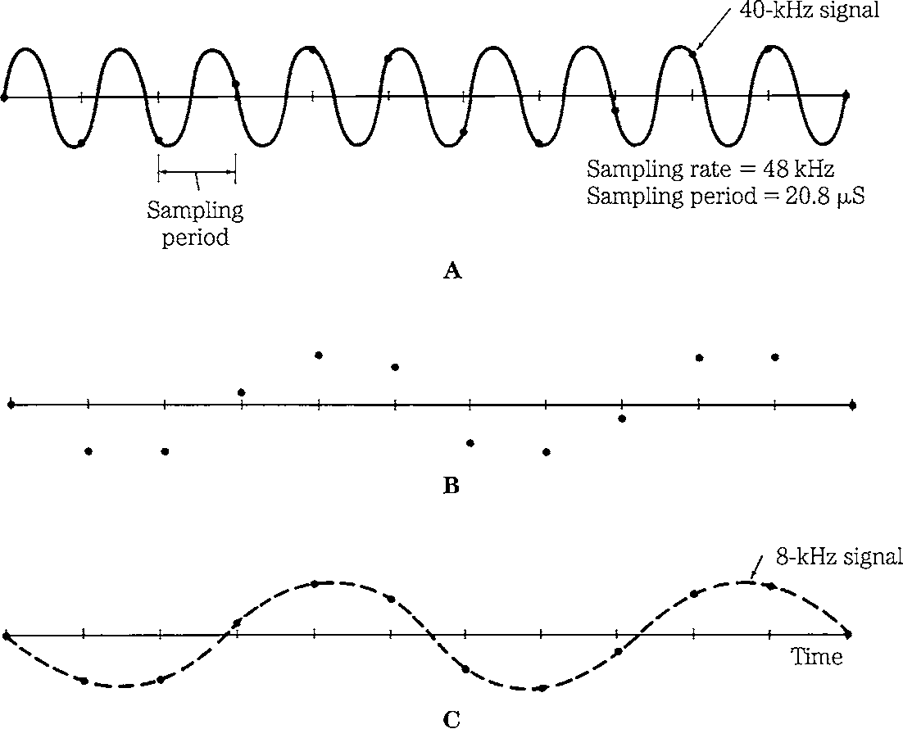
Credit: Pohlmann 2011
Stephen McLaughlin / @SteveMcLaugh
Notes:
This is not an option.

Slide 25
Stephen McLaughlin / @SteveMcLaugh
Notes:
This is not an option.

Slide 26
Digital audio terms
sample rate: The number of audio samples per second in a digital audio file.
bit depth: The number of bits used to represent each sample, which corresponds to dynamic range of a given file
bit rate: The number of bits used to encode a unit of time in a digital audio file.
Stephen McLaughlin / @SteveMcLaugh
Notes:
(i.e., the range of possible "loudness" levels). Each sample in a 16-bit audio file has 2^16 or 65,536 possible values.
CD-quality audio has a bit rate of 1,411.2 kbit/second.

Slide 27
Stephen McLaughlin / @SteveMcLaugh
Notes:
This is not an option.

Slide 28
Credit: Handel David Forsyth
Stephen McLaughlin / @SteveMcLaugh
Notes:
This is not an option.

Slide 29
Stephen McLaughlin / @SteveMcLaugh
Notes:
This is not an option.

Slide 30
Title
1
2
3
4
Stephen McLaughlin / @SteveMcLaugh

Slide 31
Title
1
2
3
4
Stephen McLaughlin / @SteveMcLaugh

Slide 32
Title
1
2
3
4
Stephen McLaughlin / @SteveMcLaugh

Slide 33
Stephen McLaughlin / @SteveMcLaugh
Notes:
This is not an option.

Slide 34
Title
1
2
3
4
Stephen McLaughlin / @SteveMcLaugh

Slide 35
Stephen McLaughlin / @SteveMcLaugh
Notes:
This is not an option.

Slide 36
Title
1
2
3
4
Stephen McLaughlin / @SteveMcLaugh

Slide 37
Stephen McLaughlin / @SteveMcLaugh
Notes:
This is not an option.

Slide 38
Title
1
2
3
4
Stephen McLaughlin / @SteveMcLaugh

Slide 39
Stephen McLaughlin / @SteveMcLaugh
Notes:
This is not an option.

Slide 40
Title
1
2
3
4
Stephen McLaughlin / @SteveMcLaugh

Slide 41
Stephen McLaughlin / @SteveMcLaugh
Notes:
This is not an option.

Slide 42
Title
1
2
3
4
Stephen McLaughlin / @SteveMcLaugh

Slide 43
Stephen McLaughlin / @SteveMcLaugh
Notes:
This is not an option.

Slide 44
Title
1
2
3
4
Stephen McLaughlin / @SteveMcLaugh

Slide 45
Stephen McLaughlin / @SteveMcLaugh
Notes:
This is not an option.

Slide 46
Title
1
2
3
4
Stephen McLaughlin / @SteveMcLaugh

Slide 47
Stephen McLaughlin / @SteveMcLaugh
Notes:
This is not an option.

Slide 48
Title
1
2
3
4
Stephen McLaughlin / @SteveMcLaugh

Slide 49
Stephen McLaughlin / @SteveMcLaugh
Notes:
This is not an option.

Slide 50
Title
1
2
3
4
Stephen McLaughlin / @SteveMcLaugh

Slide 51
Stephen McLaughlin / @SteveMcLaugh
Notes:
This is not an option.

Slide 52
Title
1
2
3
4
Stephen McLaughlin / @SteveMcLaugh

Slide 53
Stephen McLaughlin / @SteveMcLaugh
Notes:
This is not an option.

Slide 54
Title
1
2
3
4
Stephen McLaughlin / @SteveMcLaugh

Slide 55
Stephen McLaughlin / @SteveMcLaugh
Notes:
This is not an option.

Slide 56
Title
1
2
3
4
Stephen McLaughlin / @SteveMcLaugh

Slide 57
Stephen McLaughlin / @SteveMcLaugh
Notes:
This is not an option.

Slide 58
Title
1
2
3
4
Stephen McLaughlin / @SteveMcLaugh

Slide 59
Stephen McLaughlin / @SteveMcLaugh
Notes:
This is not an option.

Slide 60
Title
1
2
3
4
Stephen McLaughlin / @SteveMcLaugh

