Slide 1

Title
Stephen McLaughlin
PhD Student

Slide 2
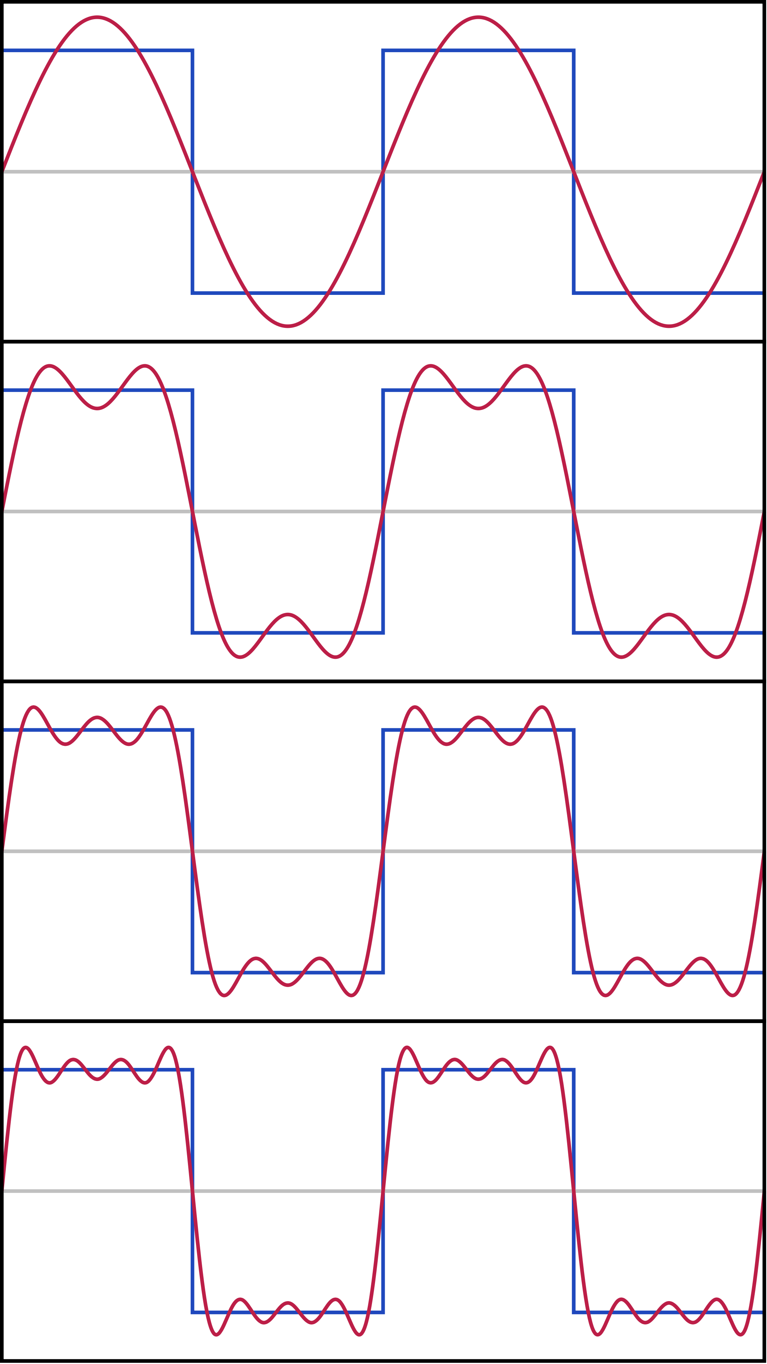
Stephen McLaughlin / @SteveMcLaugh
Notes:
This is not an option.

Slide 3
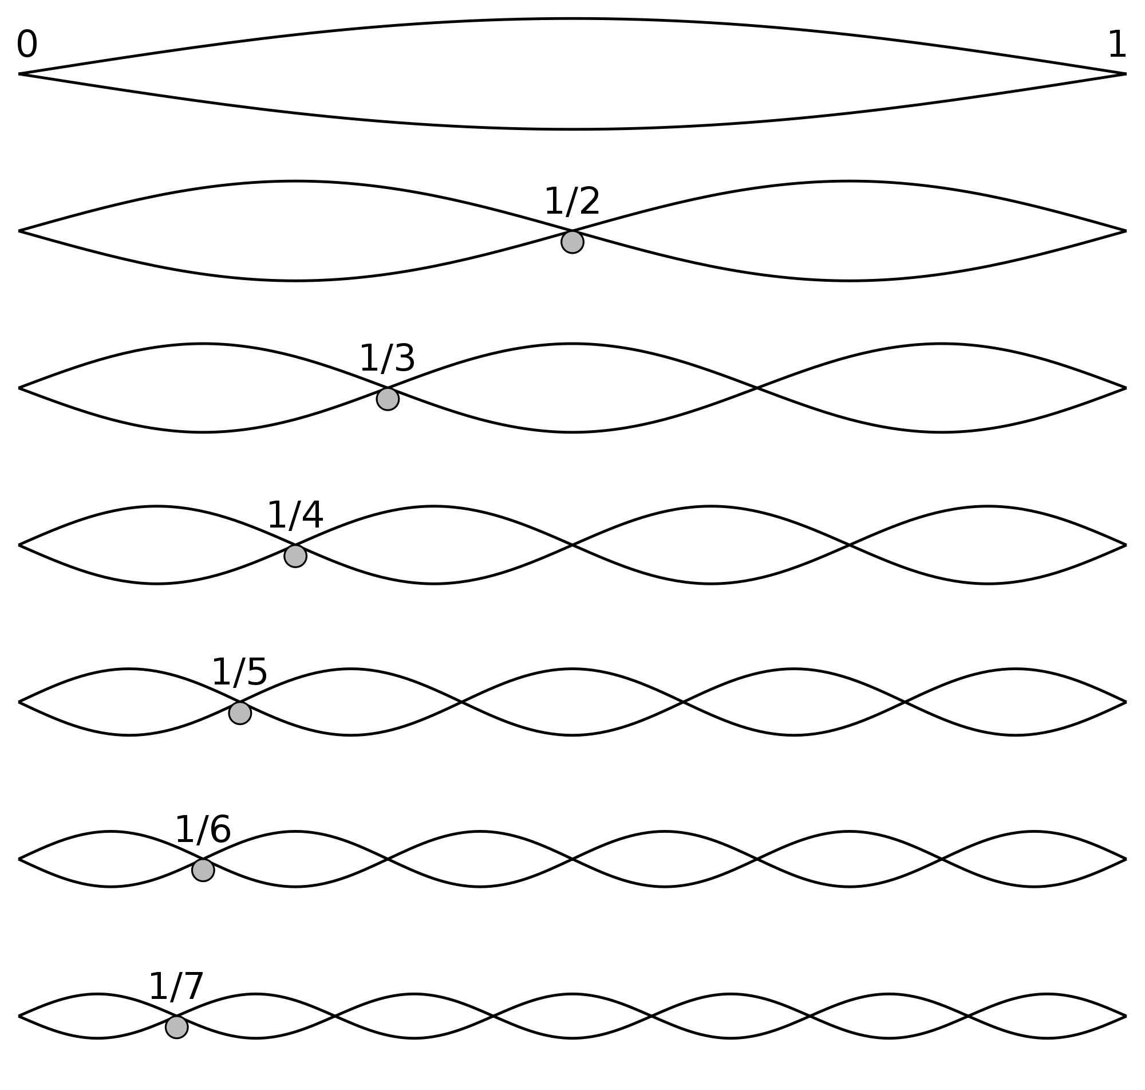
Stephen McLaughlin / @SteveMcLaugh
Notes:
This is not an option.

Slide 4
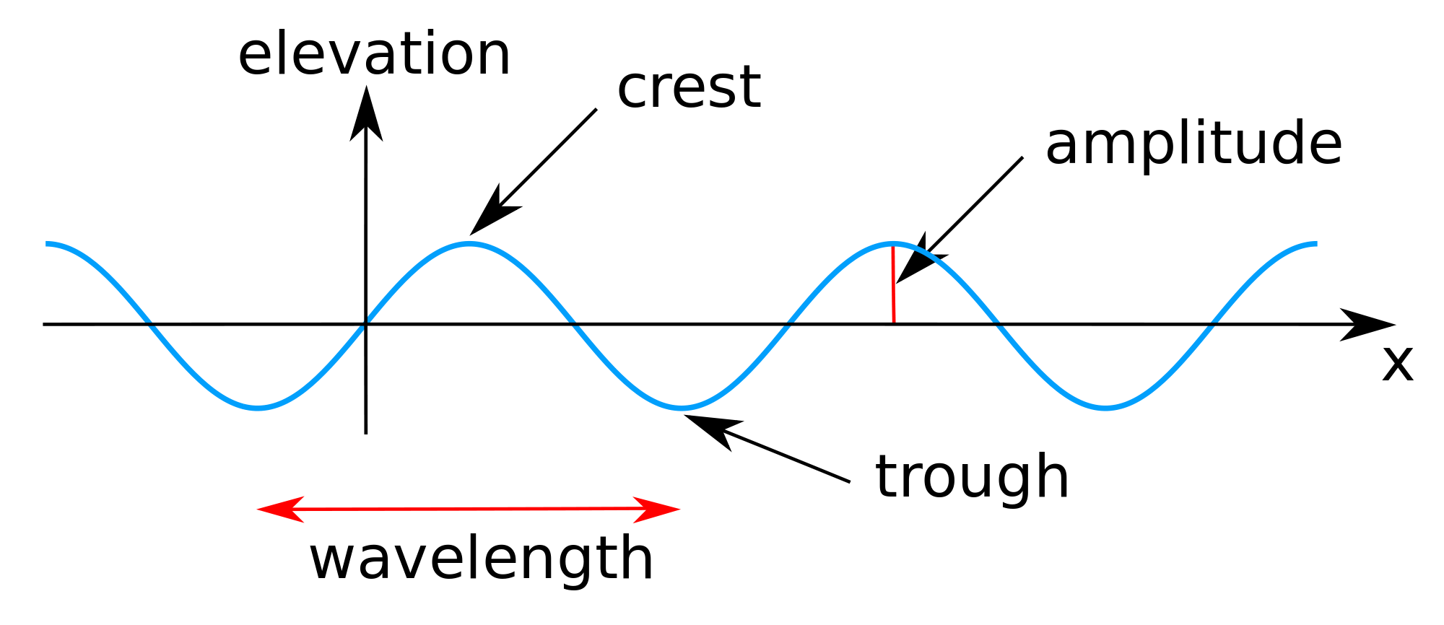
Stephen McLaughlin / @SteveMcLaugh
Notes:
This is not an option.

Slide 5
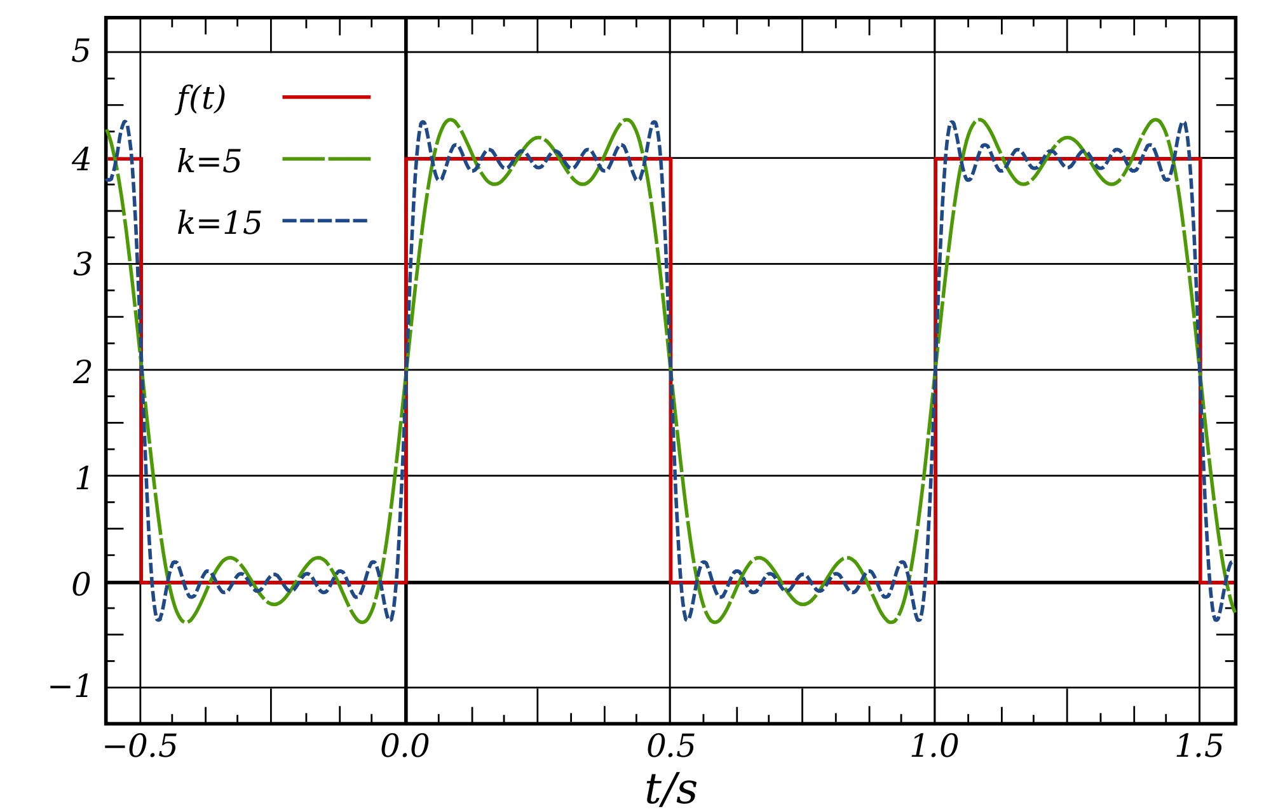
Stephen McLaughlin / @SteveMcLaugh
Notes:
This is not an option.

Slide 6
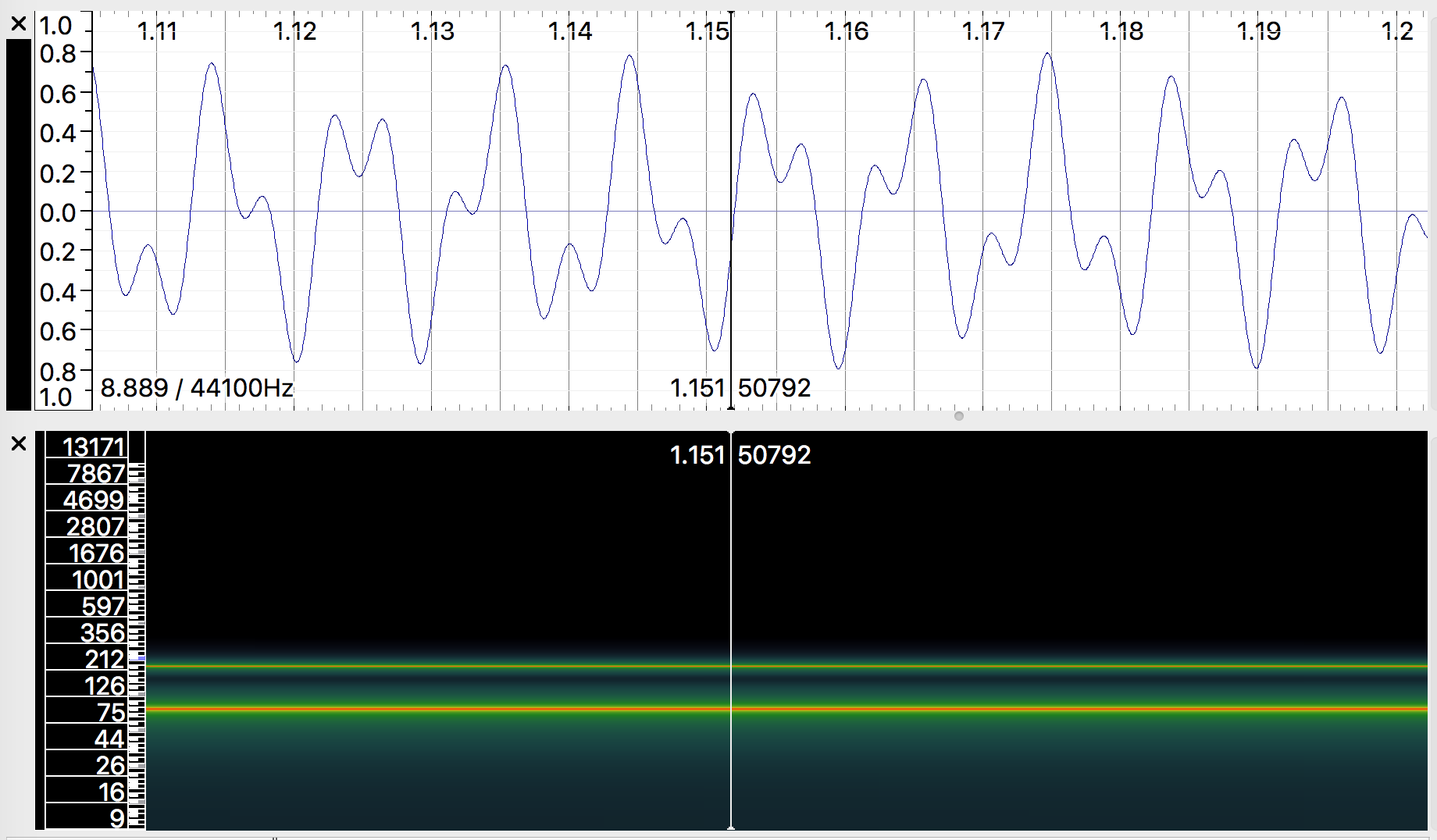
Stephen McLaughlin / @SteveMcLaugh
Notes:
This is not an option.

Slide 7
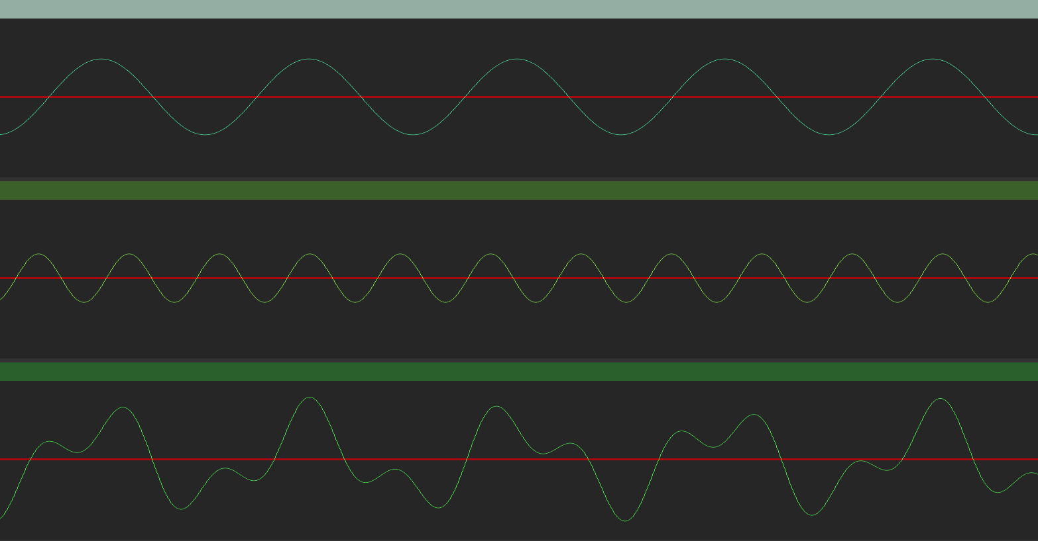
Stephen McLaughlin / @SteveMcLaugh
Notes:
This is not an option.

Slide 8
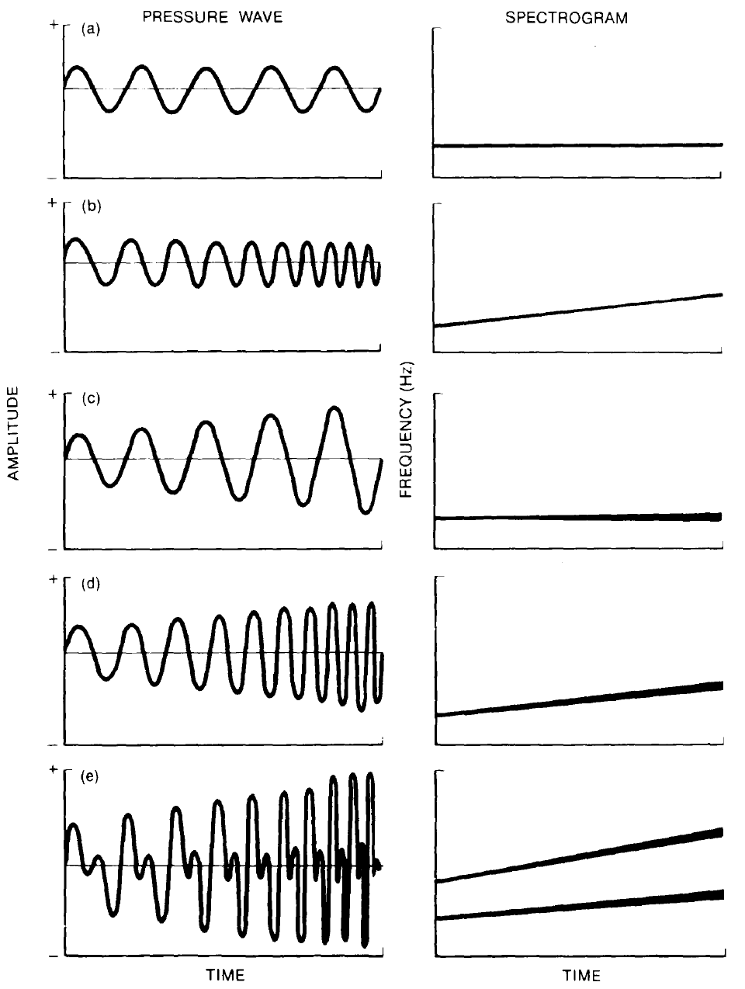
Stephen McLaughlin / @SteveMcLaugh
Notes:
This is not an option.

Slide 9
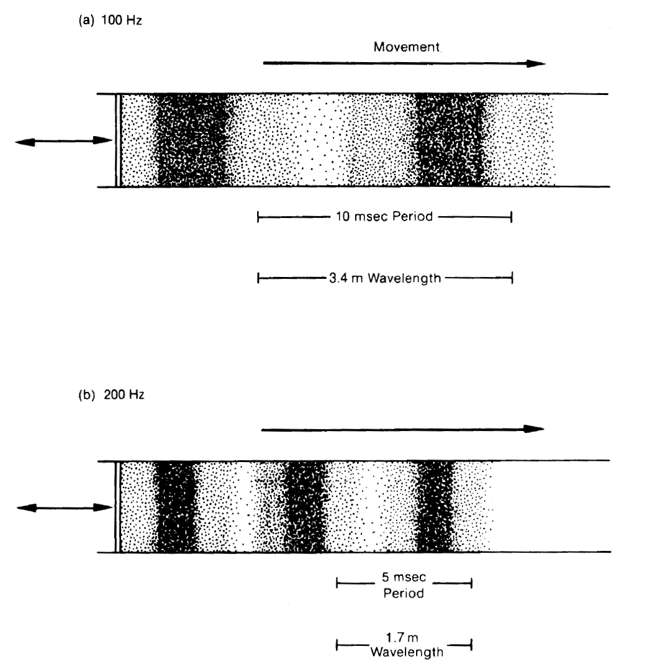
Stephen McLaughlin / @SteveMcLaugh
Notes:
This is not an option.

Slide 10
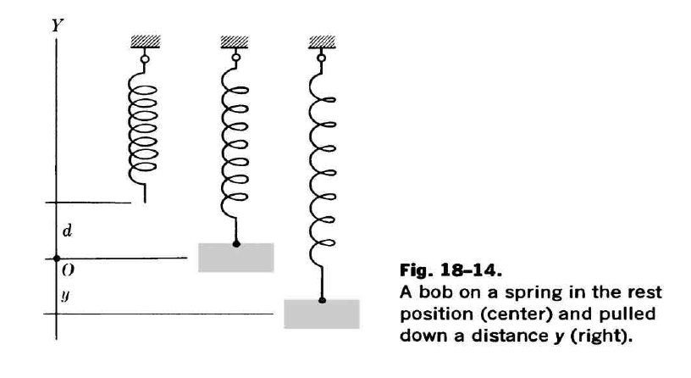
Stephen McLaughlin / @SteveMcLaugh
Notes:
This is not an option.

Slide 11
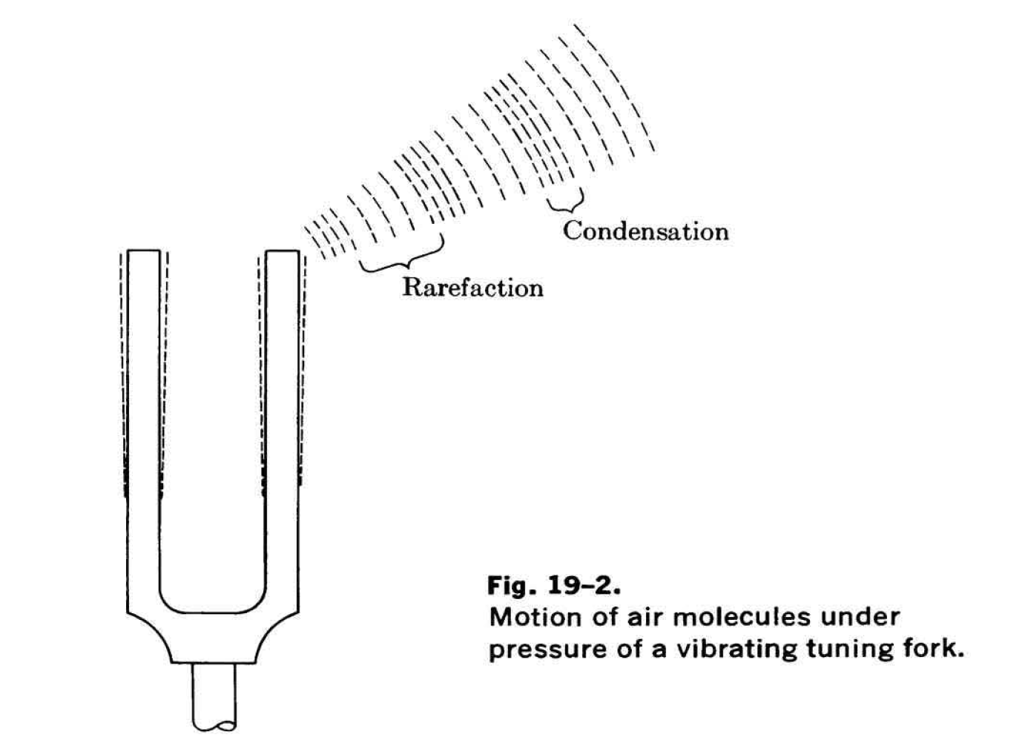
Stephen McLaughlin / @SteveMcLaugh
Notes:
This is not an option.

Slide 12
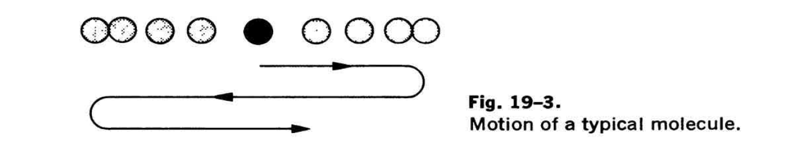
Stephen McLaughlin / @SteveMcLaugh
Notes:
This is not an option.

Slide 13
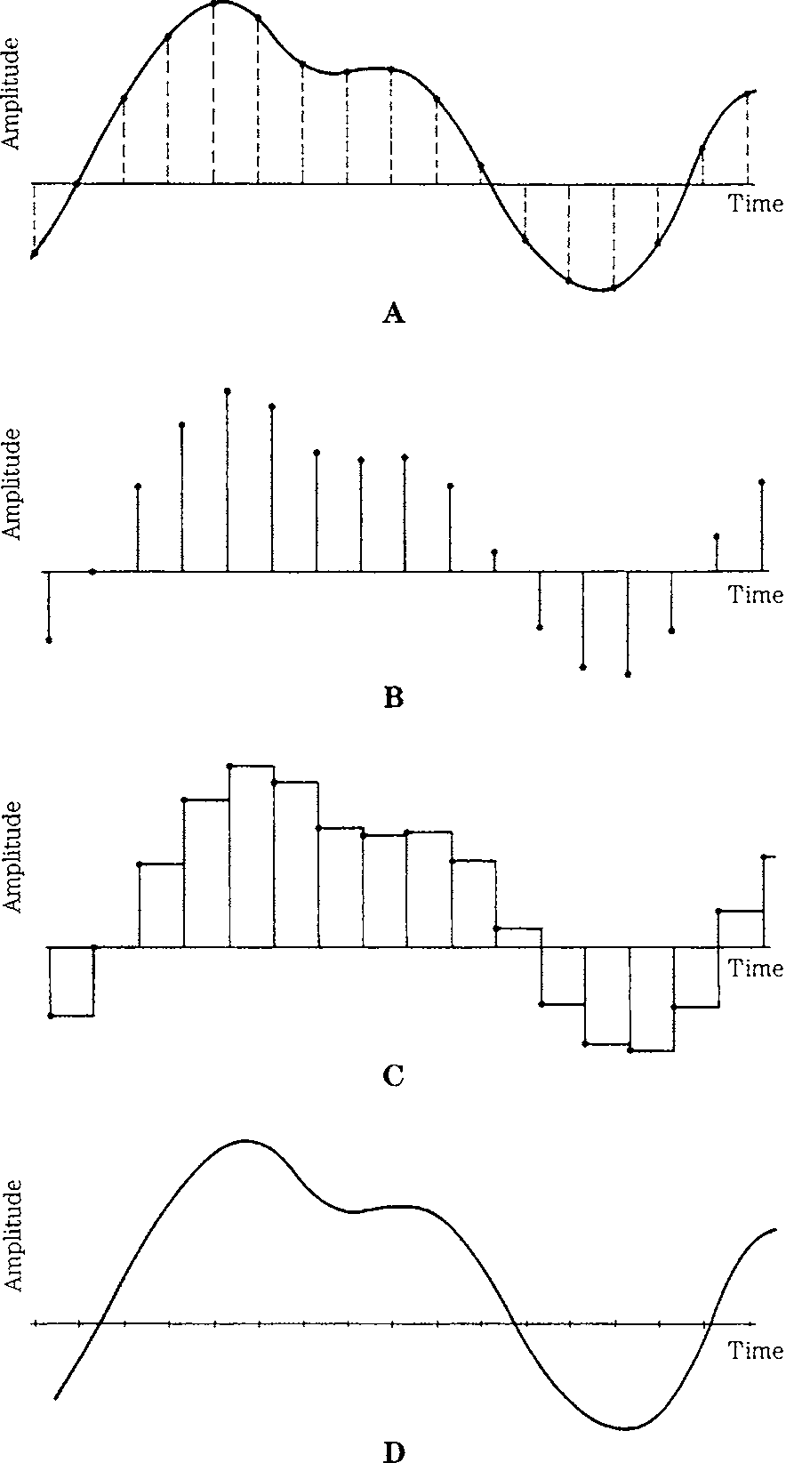
Stephen McLaughlin / @SteveMcLaugh
Notes:
This is not an option.

Slide 14
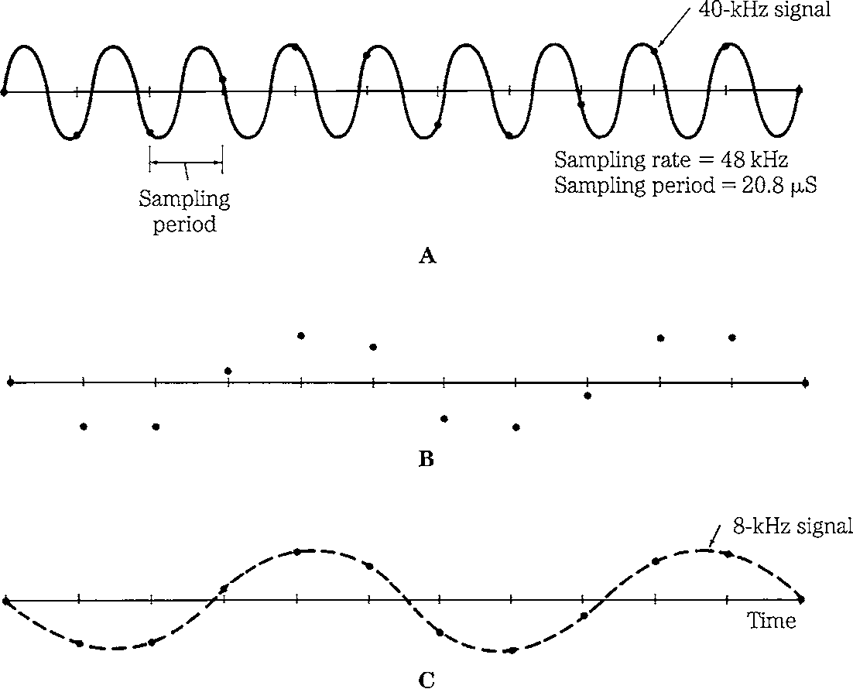
Stephen McLaughlin / @SteveMcLaugh
Notes:
This is not an option.

Slide 15
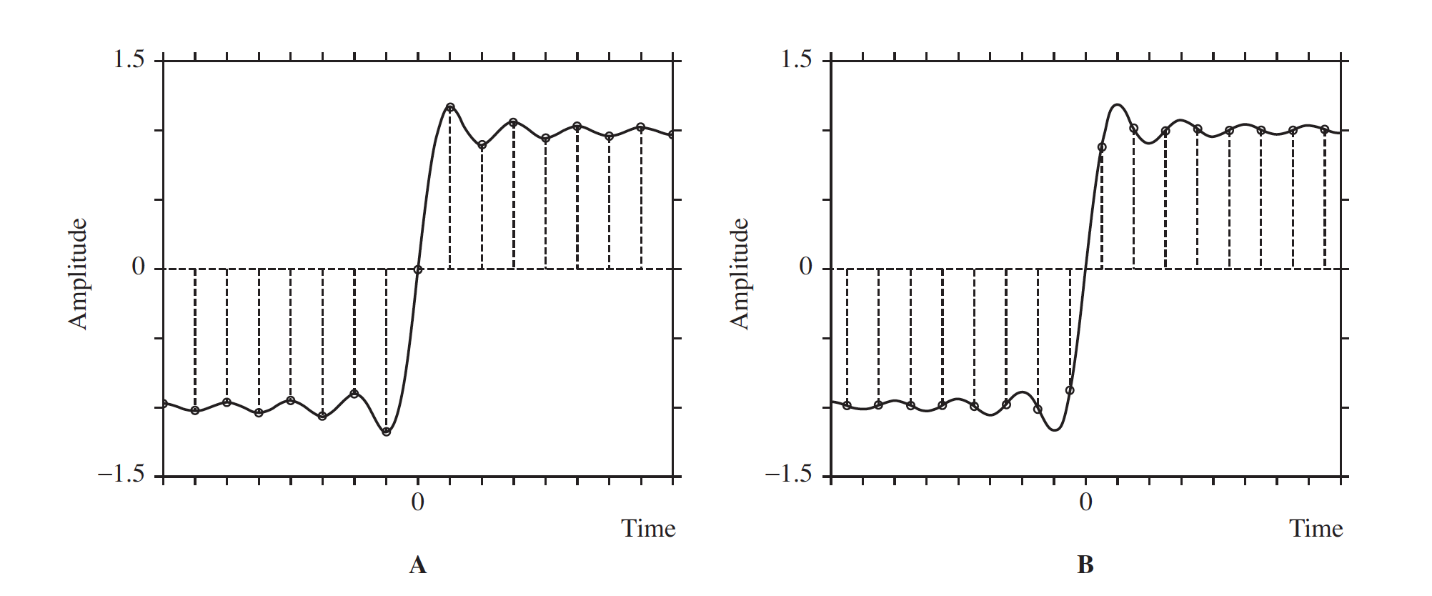
Stephen McLaughlin / @SteveMcLaugh
Notes:
This is not an option.

Slide 16
Stephen McLaughlin / @SteveMcLaugh
Notes:
This is not an option.

Slide 17
Title
sample rate: The number of audio samples per second in a digital audio file. A file with a sample rate of 44.1kHz contains 44,100 samples per second.
bit depth: The number of bits used to represent each sample, which corresponds to dynamic range of a given file (i.e., the range of possible "loudness" levels). Each sample in a 16-bit audio file has 2^16 or 65,536 possible values.
bit rate: The number of bits used to encode a unit of time in a digital audio file. CD-quality audio has a bit rate of 1,411.2 kbit/second.
Stephen McLaughlin / @SteveMcLaugh

Slide 18
Title
1
2
3
4
Stephen McLaughlin / @SteveMcLaugh

Slide 19
Title
1
2
3
4
Stephen McLaughlin / @SteveMcLaugh

Slide 20
Stephen McLaughlin / @SteveMcLaugh
Notes:
This is not an option.

Slide 21
Title
1
2
3
4
Stephen McLaughlin / @SteveMcLaugh

Slide 22
Stephen McLaughlin / @SteveMcLaugh
Notes:
This is not an option.

Slide 23
Title
1
2
3
4
Stephen McLaughlin / @SteveMcLaugh

Slide 24
Stephen McLaughlin / @SteveMcLaugh
Notes:
This is not an option.

Slide 25
Title
1
2
3
4
Stephen McLaughlin / @SteveMcLaugh

Slide 26
Stephen McLaughlin / @SteveMcLaugh
Notes:
This is not an option.

Slide 27
Title
1
2
3
4
Stephen McLaughlin / @SteveMcLaugh

Slide 28
Stephen McLaughlin / @SteveMcLaugh
Notes:
This is not an option.

Slide 29
Title
1
2
3
4
Stephen McLaughlin / @SteveMcLaugh

Slide 30
Stephen McLaughlin / @SteveMcLaugh
Notes:
This is not an option.

Slide 31
Title
1
2
3
4
Stephen McLaughlin / @SteveMcLaugh

Slide 32
Stephen McLaughlin / @SteveMcLaugh
Notes:
This is not an option.

Slide 33
Title
1
2
3
4
Stephen McLaughlin / @SteveMcLaugh

Slide 34
Stephen McLaughlin / @SteveMcLaugh
Notes:
This is not an option.

Slide 35
Title
1
2
3
4
Stephen McLaughlin / @SteveMcLaugh

Slide 36
Stephen McLaughlin / @SteveMcLaugh
Notes:
This is not an option.

Slide 37
Title
1
2
3
4
Stephen McLaughlin / @SteveMcLaugh

Slide 38
Stephen McLaughlin / @SteveMcLaugh
Notes:
This is not an option.

Slide 39
Title
1
2
3
4
Stephen McLaughlin / @SteveMcLaugh

Slide 40
Stephen McLaughlin / @SteveMcLaugh
Notes:
This is not an option.

Slide 41
Title
1
2
3
4
Stephen McLaughlin / @SteveMcLaugh

Slide 42
Stephen McLaughlin / @SteveMcLaugh
Notes:
This is not an option.

Slide 43
Title
1
2
3
4
Stephen McLaughlin / @SteveMcLaugh

Slide 44
Stephen McLaughlin / @SteveMcLaugh
Notes:
This is not an option.

Slide 45
Title
1
2
3
4
Stephen McLaughlin / @SteveMcLaugh

Slide 46
Stephen McLaughlin / @SteveMcLaugh
Notes:
This is not an option.

Slide 47
Title
1
2
3
4
Stephen McLaughlin / @SteveMcLaugh

Slide 48
Stephen McLaughlin / @SteveMcLaugh
Notes:
This is not an option.

Slide 49
Title
1
2
3
4
Stephen McLaughlin / @SteveMcLaugh

