Slide 1
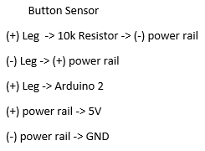
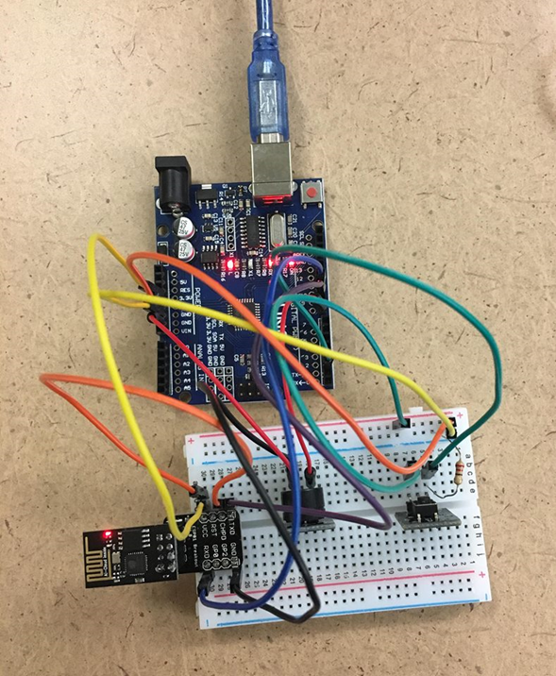

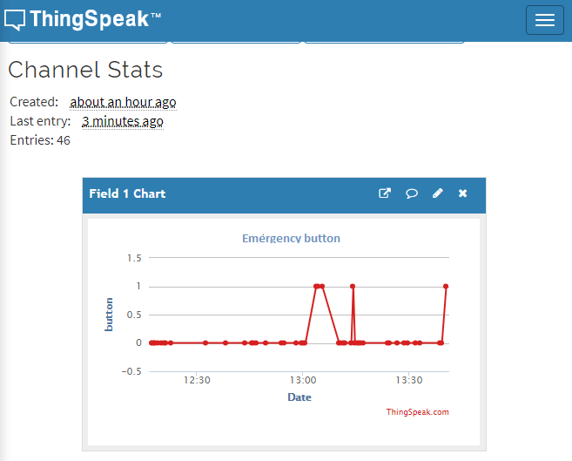
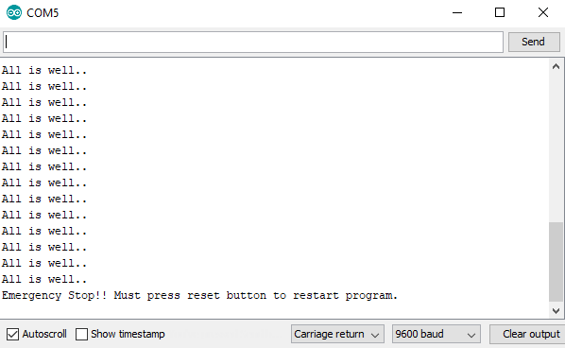
Software-Based Emergency Button
Nicole Abuzo
Dr. Suk Lee
TSYS School of Computer Science, Columbus State University
Abstract
Design and Implementation
Evaluation and Discussion
Emergencies can occur anytime we don’t expect. This project demonstrates emergency stop routine using one of the hardware based interrupt pins, some code, and few external components. The project is achieved by using Arduino Uno which acts as the brain of the system where all instructions are carried out. In addition, by using “ThingSpeak”, it is possible to process data and perform online analysis.
The circuitry and code will enable one to “halt” or “stop” the loop until the reset button is pressed. By using the ESP8266 as the WiFi source connected to Arduino, the code from previous Lab helped me to receive data in my ThingSpeak channel. Within the code that was provided, I implemented additional information for my button and buzzer sensor to work. The wirings to connect the Wifi is the same although there are few adjustments in order to add the connection for both sensors. The wiring combinations as followed below:
While working on this project, the main problem I came across is the connection between my sensor and Wifi. Everyone is trying to connect into one connection and it causes the weakness in the network. Although, this device is beneficial in number of things and more useful if its implemented by appropriate hardware requirements. If I’m able to add more into it, it can be more helpful in such as:
Stopping a treadmill from running when needed.
Immediately stops an uncontrollable operating machine
Being able to send an SMS or call an emergency hotline for someone who’s in danger.
These ideas can be possible with enough equipment that can be provided. The device will be cheap, reliable, simple, and doesn’t have a monthly plan to pay.
Introduction
The main objective of this project is to show that one button can do so much for the safety of individuals. This Software-based Emergency button is used to immediately stop a machine to operate. Because this is a software-based “emergency stop” it should never be used as a fail safe for potentially dangerous project such as involving automobiles, medical devices, etc. This application loop a message that says “All is well..” until the button gets pushed. It shows an Emergency message along with the sound coming from the buzzer sensor.
Conclusions
The idea of making this device is to make people feel safer whatever they do and wherever they are. A simple button to stay aware in the surroundings and help someone as soon as possible. It’s simplicity makes the device affordable and easy to use for everybody.
Results
The data shown in my ThingSpeak channel proves that the data is getting send to the cloud. The dots represents that data is uploaded and the line that reaches 1 is to determine that somebody had pressed the button. However, the connection in class is a little weak which caused the difficulty to sense that the button is being pressed. When running the code, an emergency message appear when button is pressed and hitting the Reset button in Arduino to restart the program.
Acknowledgements
This project is completed in the course of CPSC3555 and the help of Dr. Suk Lee
Buzzer melody: http://www.mertarduino.com/buzzer-melody-with-pushbutton-and-arduino/2018/11/20/
Button sensor: https://www.instructables.com/id/Emergency-Button/

