Slide 1
Digital Transformation in Nigerian Private Universities:
Adoption of E-Learning Technologies
Victor O. Sobanke (PhD)
NACETEM Researchers’ Seminar Series
Thursday, 17th July 2025

Slide 2
Outline
Background of the study
Statement of problem
Research methods
Results and discussion
Conclusions
Recommendations

Slide 3
Background to the Study
Traditional learning is constrained by time and space (That means students and lecturers must be in the same location, at the same time, for learning to happen. While this method offers structure and face-to-face interaction, it also comes with limitations — for example, when there's bad weather, traffic, or even physical disabilities, learning stops).
E-learning evolved from correspondence courses to MOOCs (Over time, it evolved into radio and TV broadcasts, then into full-fledged digital platforms. And eventually, Massive Open Online Courses, or MOOCs, made it possible for anyone, anywhere, to access education from top institutions).
COVID-19 accelerated online learning adoption. (Even students and lecturers who had never used e-learning before had to adjust quickly).
Private universities in Lagos use platforms like Zoom and Moodle (this shift was more successful because these institutions already had access to digital tools. Platforms like Zoom, Moodle, and Coursera became part of everyday learning. For example, Covenant University used Moodle extensively for assignments and lectures).
E-learning enhances access, flexibility, and student engagement. (Students can learn from anywhere, at their own pace. They can rewatch lectures, engage in forums, and access materials 24/7 — something that’s impossible with traditional classrooms.)

Slide 4
Statement of the Problem
Rapid shift to online learning introduced digital literacy challenges (Students were not prepared for the demands of online learning, which created a learning curve. not all students were ready to effectively use the tools available to them).
Limited access to devices and internet; 77% reported connectivity issues. (The internet and device limitations created barriers that affected the overall learning experience for many students.)
Low engagement and interaction in virtual classrooms (Traditional classrooms provide an opportunity for face-to-face interaction, where teachers can engage students and keep them motivated. Online platforms, however, often lack that level of engagement).
Gap in literature on impact in Lagos private universities (There's very little research on how Lagos private university students are experiencing and adopting online learning platforms, which this study aims to address).

Slide 5
Research Objectives
To examine the relationship between perceived ease of use of adopted e-learning technologies and perceived usefulness of these technologies;
To examine the influence of perceived ease of use of adopted e-learning technologies and students’ attitude towards using e-learning technologies;
To evaluate the contribution of students’ perceived usefulness of adopted e-learning technologies and students’ attitude towards using e-learning technologies;
To evaluate the influence of perceived usefulness of adopted e-learning technologies on students’ intention to use the e-learning technologies; and
To assess the relationship between students’ attitude towards using e-learning technologies and their intention to use e-learning technologies.

Slide 6
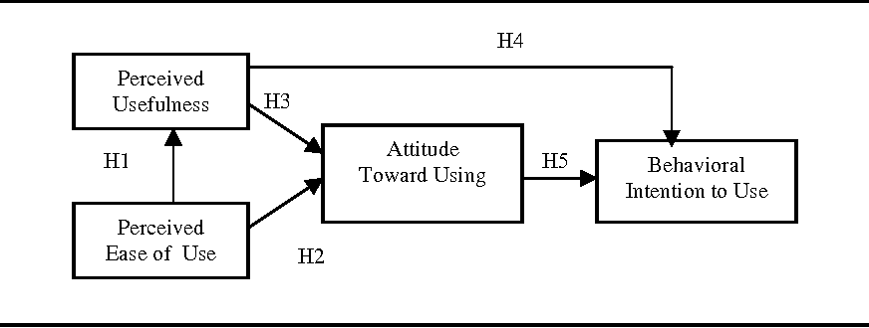
Methodology
Figure 1: TAM introduced by Fred Davis (Davis 1986)

Slide 7
Methodology
Design: Quantitative based research design.
Study area: 4 private Universities was selected due to convenience of data gathering (Trinity University, Augustine University, Caleb University, and Anchor University)
Population and sample: 400 students at 100 respondents per university across different departments and levels.
Research instrument: Primary data were collected through structured questionnaire deployed using online survey system designed for the purpose.
Analysis: SPSS & SmartPLS.

Slide 8
Descriptive results
University | Frequency | Percentage
Anchor University | 37 | 19.5
Augustine University | 52 | 27.4
Caleb University | 67 | 35.3
Trinity University | 34 | 17.9
Total | 190 | 100
Gender | Frequency |  | %
Female |  | 78 | 41
Male |  | 112 | 59
Total |  | 190 | 100

Slide 9
Results
Age range | Frequency | Percentage
Below 16 | 1 | 0.5
16 - 18 | 54 | 28.4
19 - 21 | 107 | 56.3
22 - 25 | 27 | 14.2
Above 25 | 1 | 0.5
Total | 190 | 100
Academic level | Frequency |  | Percentage
100 level |  | 30 | 15.8
200 level |  | 47 | 24.7
300 level |  | 50 | 26.3
400 level |  | 57 | 30.0
500 level |  | 6 | 3.2
Total |  | 190 | 100

Slide 10
Results

Slide 11
Results
Perceived Usefulness | Disagree | Slightly Agree | Moderately Agree | Agree | Strongly Agree | Total
I find the e-learning platform in my school useful in my daily school life (PU1). | 10(5.3) | 5(2.6) | 27(14.2) | 66(34.7) | 82(43.2) | 190(100)
Using the e-learning platform in my school improves my productivity in completing coursework (PU2). | 9(4.7) | 12(6.3) | 27(14.2) | 62(32.6) | 80(42.1) | 190(100)
Using the e-learning platform in my school makes it easier to access school materials (PU3). | 6(3.2) | 9(4.7) | 26(13.7) | 50(26.3) | 99(52.1) | 190(100)
Using the e-learning platform in my school enhances my learning experience (PU4). | 9(4.7) | 12(6.3) | 24(12.6) | 56(29.5) | 89(46.8) | 190(100)
The e-learning platform enables me to accomplish learning tasks more quickly (PU5). | 7(3.7) | 13(6.8) | 24(12.6) | 60(31.6) | 86(45.3) | 190(100)

Slide 12
Results
Perceived Ease of Use | Disagree | Slightly Agree | Moderately Agree | Agree | Strongly Agree | Total
Learning to operate the e-learning platform is easy for me (PEOU1). | 3(1.6) | 8(4.2) | 22(11.6) | 73(38.4) | 84(44.2) | 190(100)
I find the e-learning platform to be flexible and user-friendly (PEOU2). | 5(2.6) | 5(2.6) | 21(11.1) | 84(44.2) | 75(39.5) | 190(100)
Interacting with the platform does not require a lot of mental effort (PEOU3). | 5(2.6) | 9(4.7) | 29(15.3) | 72(37.9) | 75(39.5) | 190(100)
I find it easy to navigate the e-learning platform to do what I want it to do (PEOU4). | 3(1.6) | 10(5.3) | 30(15.8) | 67(35.3) | 80(42.1) | 190(100)
The e-learning platform's interface is clear and understandable (PEOU5). | 4(2.1) | 6(3.2) | 22(11.6) | 71(37.4) | 87(45.8) | 190(100)

Slide 13
Results
Attitude Towards Using | Disagree | Slightly Agree | Moderately Agree | Agree | Strongly Agree |  | Total
I have a positive attitude toward using the e-learning platform (ATU1). | 3(1.6) | 7(3.7) | 28(14.7) | 78(41.1) | 74(38.9) | 190(100)
Using the platform is a good practice for aiding my learning experience (ATU2). | 5(2.6) | 9(4.7) | 22(11.6) | 79(41.6) | 75(39.5) | 190(100)
I enjoy using the e-learning platform for my studies (ATU3). | 6(3.2) | 10(5.3) | 29(15.3) | 67(35.3) | 78(41.1) | 190(100)
The thought of using the e-learning platform is appealing to me (ATU4). | 7(3.7) | 6(3.2) | 38(20.0) | 65(34.2) | 74(38.9) | 190(100)
I believe it is worthwhile to use the e-learning platform (ATU5). | 4(2.1) | 10(5.3) | 20(10.5) | 71(37.4) | 85(44.7) | 190(100)

Slide 14
Results
Behavioural Intent To Use | Disagree | Slightly Agree | Moderately Agree | Agree | Strongly Agree | Total
I intend to use the e-learning platform regularly (BITU1). | 3(1.6) | 13(6.8) | 26(13.7) | 74(38.9) | 74(38.9) | 190(100)
I plan to use the e-learning platform for my future coursework (BITU2). | 2(1.1) | 9(4.7) | 21(11.1) | 82(43.2) | 76(40.0) | 190(100)
I intend to log into the e-learning platform more than twice daily (BITU3). | 14(7.4) | 24(12.6) | 28(14.7) | 60(31.6) | 64(33.7) | 190(100)
I expect my use of the e-learning platform to continue in the future (BITU4). | 6(3.2) | 16(8.4) | 28(14.7) | 57(30.0) | 83(43.7) | 190(100)
I am committed to integrating the e-learning platform into my studies (BITU5). | 5(2.6) | 13(6.8) | 26(13.7) | 66(34.7) | 80(42.1) | 190(100)

Slide 15
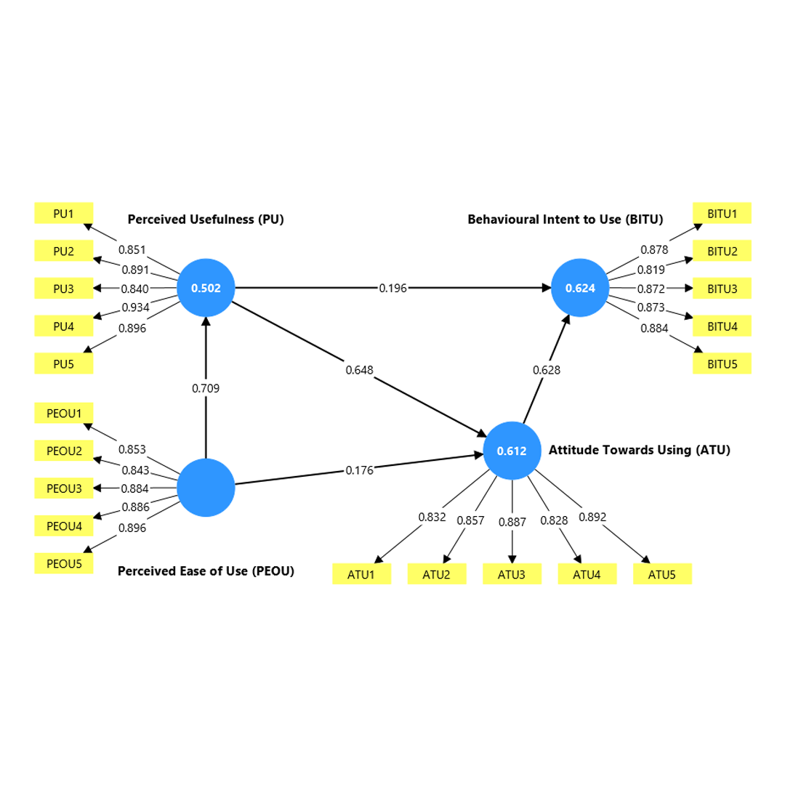
Inferential results
Measurement Model

Slide 16
Inferential results
Structural model
Variables | Cronbach’s alpha | Composite reliability (rho_a) | Composite reliability (rho_c) |  |  | Average variance extracted (AVE)
Attitude Towards Using (ATU) | 0.911 | 0.913 |  | 0.934 | 0.739
Behavioural Intent to Use (BITU) | 0.916 | 0.916 |  | 0.937 | 0.749
Perceived Ease of Use (PEOU) | 0.922 | 0.925 |  | 0.941 | 0.762
Perceived Usefulness (PU) | 0.929 | 0.933 |  | 0.946 | 0.780

Slide 17
Key Findings
Path | Original sample (O) | Sample mean (M) |  | Standard deviation (STDEV) | T statistics (|O/STDEV|) |  | P values
PEOU -> PU | 0.709 | 0.711 | 0.051 |  |  | 13.875 | 0.000 | H1
PEOU -> ATU | 0.176 | 0.182 | 0.081 |  |  | 2.183 | 0.029 | H2
PU -> ATU | 0.648 | 0.644 | 0.079 |  |  | 8.230 | 0.000 | H3
PU -> BITU | 0.196 | 0.193 | 0.107 |  |  | 1.839 | 0.066 | H4
ATU -> BITU | 0.628 | 0.633 | 0.092 |  |  | 6.802 | 0.000 | H5
Notes:
PEOU > PU & ATU: If students find the e-learning platform easy to use, they’re more likely to think it’s useful for their education, and they’re more likely to have a positive attitude towards it.
ATU > BITU: Students with a positive attitude toward the e-learning platform are much more likely to intend to keep using it in the future.
PU > BITU: Even if a student thinks a platform is useful, it doesn’t mean they’ll automatically intend to use it regularly. Something else — like their attitude toward it — comes in between. This finding is surprising but important. It tells us that usefulness alone isn't enough. Students might acknowledge that the platform helps them — but if they don’t like using it, they won’t stick with it.
This points to the need for e-learning platforms to be not just functional but also enjoyable and engaging.
There’s a chain reaction:
→ If a platform is easy to use,
→ Students start to see it as useful,
→ And that develops a positive attitude toward using it.

Slide 18
Conclusion
E-learning is transformative but needs refinement.
Ease of use and positive attitude drive adoption.
Institutional and design improvements are crucial for better educational outcomes.

Slide 19
Recommendations
Customize platforms to suit user preferences.
Invest in infrastructure and institutional support.
User friendly experience and navigation (If we want students to adopt these platforms long-term, universities and developers must focus on making platforms simple, intuitive, and well-integrated into students’ academic lives.)
Train educators and students on digital tools.
Promote inclusive policies and access.

Slide 20
Thank you

