Slide 1
ASSESSMENT OF ATMOSPHERIC PARTICULATE MATTER AND AIR POLLUTANTS IN FIVE MOTOR PARKS IN UGHELLI, DELTA STATE, NIGERIA.
Dr .Tari, Joel Honda
National Centre for Technology Management (NACETEM), Federal Ministry of Innovation, Science and Technology, Nigeria
A RESEARCHER’S SEMINAR SEREIS
JUNE, 2025

Slide 2
Outline
Introduction
Statament of the problems
Aim & Objectives
Methodology
Results and Discussions
Contributions to knowledge
Recommendations
Conclusions

Slide 3
INTRODUCTION
Ughelli is an operational industrial and agricultural city serving as the administrative center of Ughelli North Local Government Area in Delta State, Nigeria. With its vibrant road transportation network, which includes several motor parks, the city plays a critical role in facilitating trade and mobility. However, this infrastructure also presents significant environmental challenges, particularly air pollution.
The high volume of vehicular traffic contributes to the emission of harmful pollutants into the atmosphere. These pollutants primarily result from vehicular emissions, fossil fuel combustion, and various industrial processes. Notably, atmospheric particulate matter (APM), including particulate matter (PM10 and PM2.5), as well as gases such as sulfur dioxide (SO2), nitrogen oxides (NOx), and carbon monoxide (CO) pose serious health risks.

Slide 4
CONT’S
According to research by Pope et al. (2002) and the World Health Organization (2015), these pollutants are linked to various adverse health outcomes, including respiratory and cardiovascular diseases, lung dysfunction, and elevated mortality rates. Vulnerable populations such as the elderly, children, and individuals with preexisting health conditions are disproportionately affected by the consequences of air pollution (Cadelis et al., 2014; WHO, 2015)
Globally, air pollution is a leading cause of mortality, responsible for millions of premature deaths each year. Its impact extends beyond health, leading to significant economic burdens associated with healthcare costs and lost productivity (Yang et al., 2013; OECD, 2015, 2016).

Slide 5
Statement of the problem
Atmospheric particulate matter has been linked to numerous health issues, including respiratory diseases (e.g., asthma, chronic bronchitis), cardiovascular diseases, lung dysfunction, and even increased infant mortality rates. These conditions place a significant burden on healthcare systems and reduce the overall quality of life for affected populations.
In developing countries like Nigeria, the adverse health effects of APM may be grossly underestimated due to a lack of comprehensive data and research. Rapid urbanization, increasing vehicle ownership, and poor regulatory frameworks exacerbate the situation, leading to higher exposure levels for the population.
The combustion of fossil fuels in vehicles leads to the release of atmospheric particulate matter (APM) such as PM2.5 and PM10, along with other harmful pollutants like hydrogen sulfide (H₂S), nitrogen dioxide (NO₂), and carbon monoxide (CO). This pollution seriously threatens air quality and public health in urban areas.
There is a notable gap in research focusing on the concentrations and effects of APM and associated pollutants in specific locales like the motor parks of Ughelli. Without detailed studies, policymakers remain inadequately informed about the full extent of health hazards faced by individuals utilizing these transport hubs.

Slide 6
CON’T
To effectively mitigate the health risks associated with air pollution in motor parks, targeted research is essential and as such Gathering data is crucial for developing effective policies and interventions to improve air quality and public health in the region.
The findings from this research will provide vital information for health authorities and stakeholders, enabling them to implement evidence-based interventions to reduce APM exposure. It will also raise awareness regarding air quality issues in motor parks, driving advocacy for stricter vehicle emission regulations, and public health initiatives.

Slide 7
Aim and Objectives of the Study
The study aims to assess the mean concentration of atmospheric particulate matter (APM) (PM_{2.5} and PM₁₀) and H₂S, NO_{2,} and CO in five selected motor parks in Ughelli town in Delta State, Nigeria. Specifically, the study intends:
1. To determine the average values for the meteorological parameters (wind speed, relative humidity, and air temperature) in the five selected motor parks.
2. To compare the average concentration of PM_{2.5} and PM₁₀ in the five selected motor parks.
3. To determine the mean concentrations of H₂S, NO_{2,} and CO in the five selected motor parks.
4. To ascertain the air quality index (AQI) in each of the five selected motor parks in terms of PM_{2.5}, PM_{10,} H₂S, NO_{2,} and CO.

Slide 8
Materials and methods
Research Design
Causal-Comparative Design: Investigated air quality dynamics across five motor parks in Ughelli, Delta State, Nigeria, comparing atmospheric particulate matters (APMs) (PM2.5, PM10) and other air pollutants with meteorological parameters (wind speed, humidity, temperature) (Davis & Cornwell, 2008).
Study Area
Locations: Agofure Motor Park, Otu Motor Park, Ekingbo Motor Park, Ughelli Central Motor Park, and Otovwodo Central Motor Park, all within Ughelli City (Amin, 2018).
Sampling Equipment
Air Quality Monitor: BLATN BR-Smart 126 for PM2.5 and PM10 concentrations.
Anemometer: TL-300 for measuring meteorological parameters,
Multi-Gas Monitor: AS8900 for levels of H2S, NO2, and CO.
GPS Device: Garmin Dakota 20 for location coordinates and digital mapping using ArcGIS 10.5 software.

Slide 9
                Sampling Frequency
Locations: Five motor parks with air quality assessed at three sampling points per park.
Schedule: Measurements taken on weekdays (Monday, Wednesday, Friday) from 6:00 am to 6:00 pm, three times daily (morning, afternoon, evening) for four weeks Measurement of Parameters:
PM2.5 and PM10: Portable air quality monitor used to detect concentrations at 1.5m height.
H₂S, NO₂, CO: Measured using a Smart sensor multi-gas monitor.
Meteorological Parameters: Wind speed, direction, temperature, and relative humidity measured hourly using a digital anemometer.
Air Quality Index (AQI):Calculation of Mean values of PM2.5 and PM10 compared with WHO guidelines; indices for each pollutant was derived using the EPA's AQI formula.
Guidelines: WHO annual mean for PM2.5 is 10 µg/m³, 24-h mean is 25 µg/m³; for PM10, annual mean is 20 µg/m³, 24-h mean is 50 µg/m³ (WHO, 2015).

Slide 10
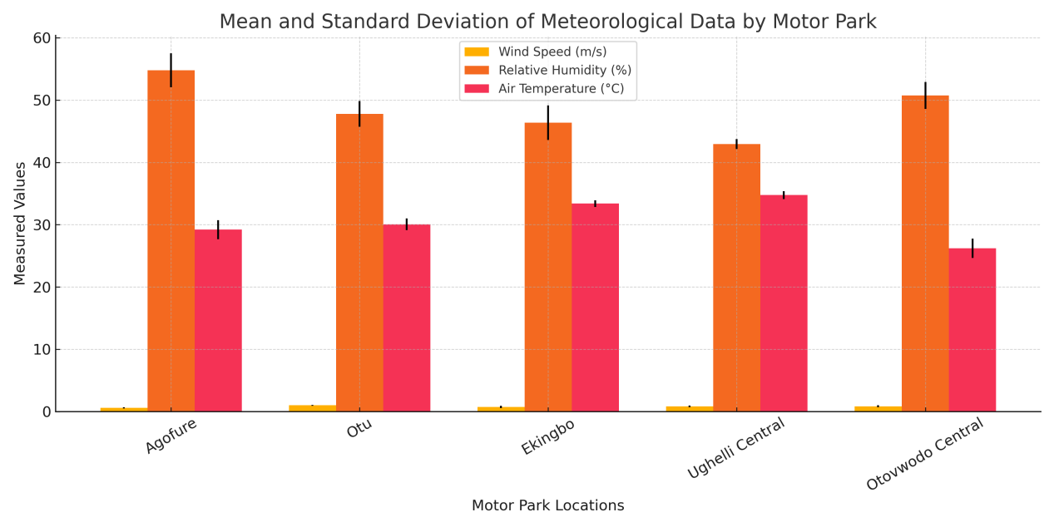
RESULT AND DISCUSSION

Slide 11
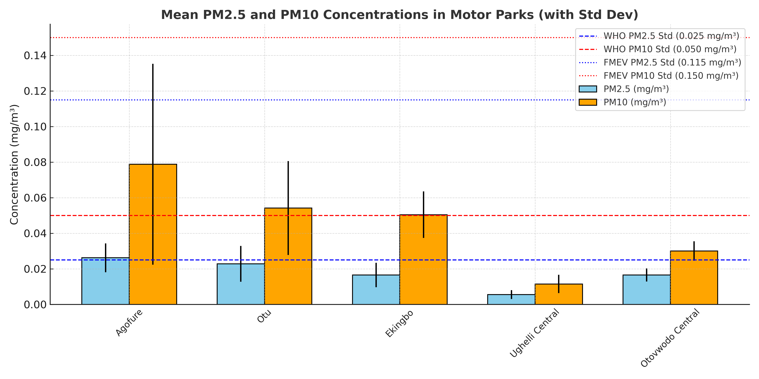

Slide 12
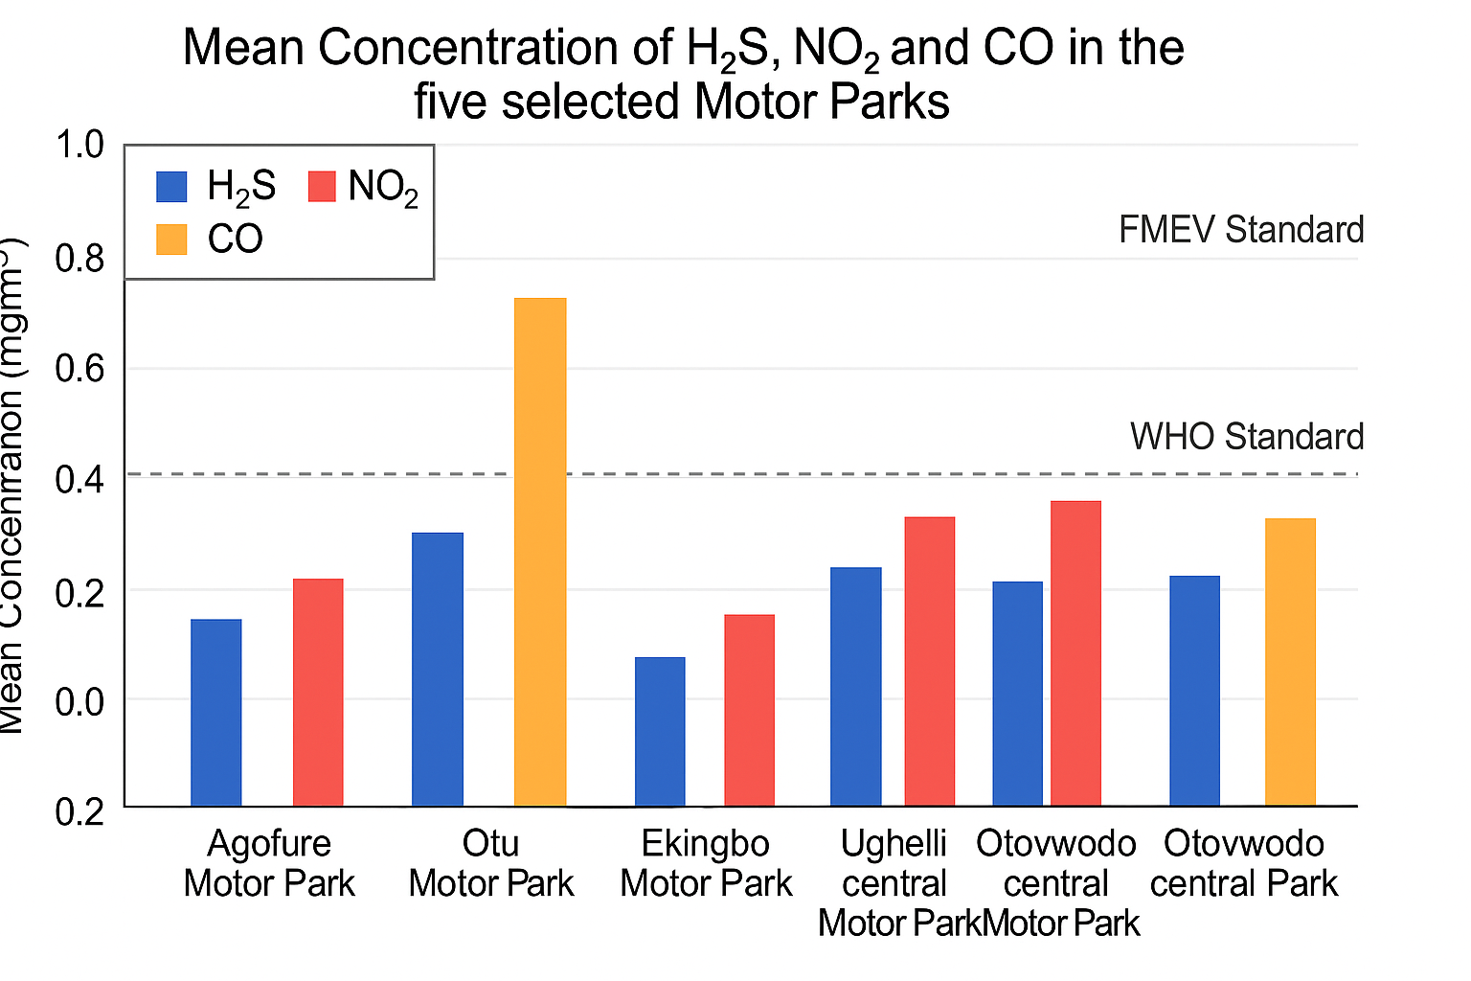

Slide 13
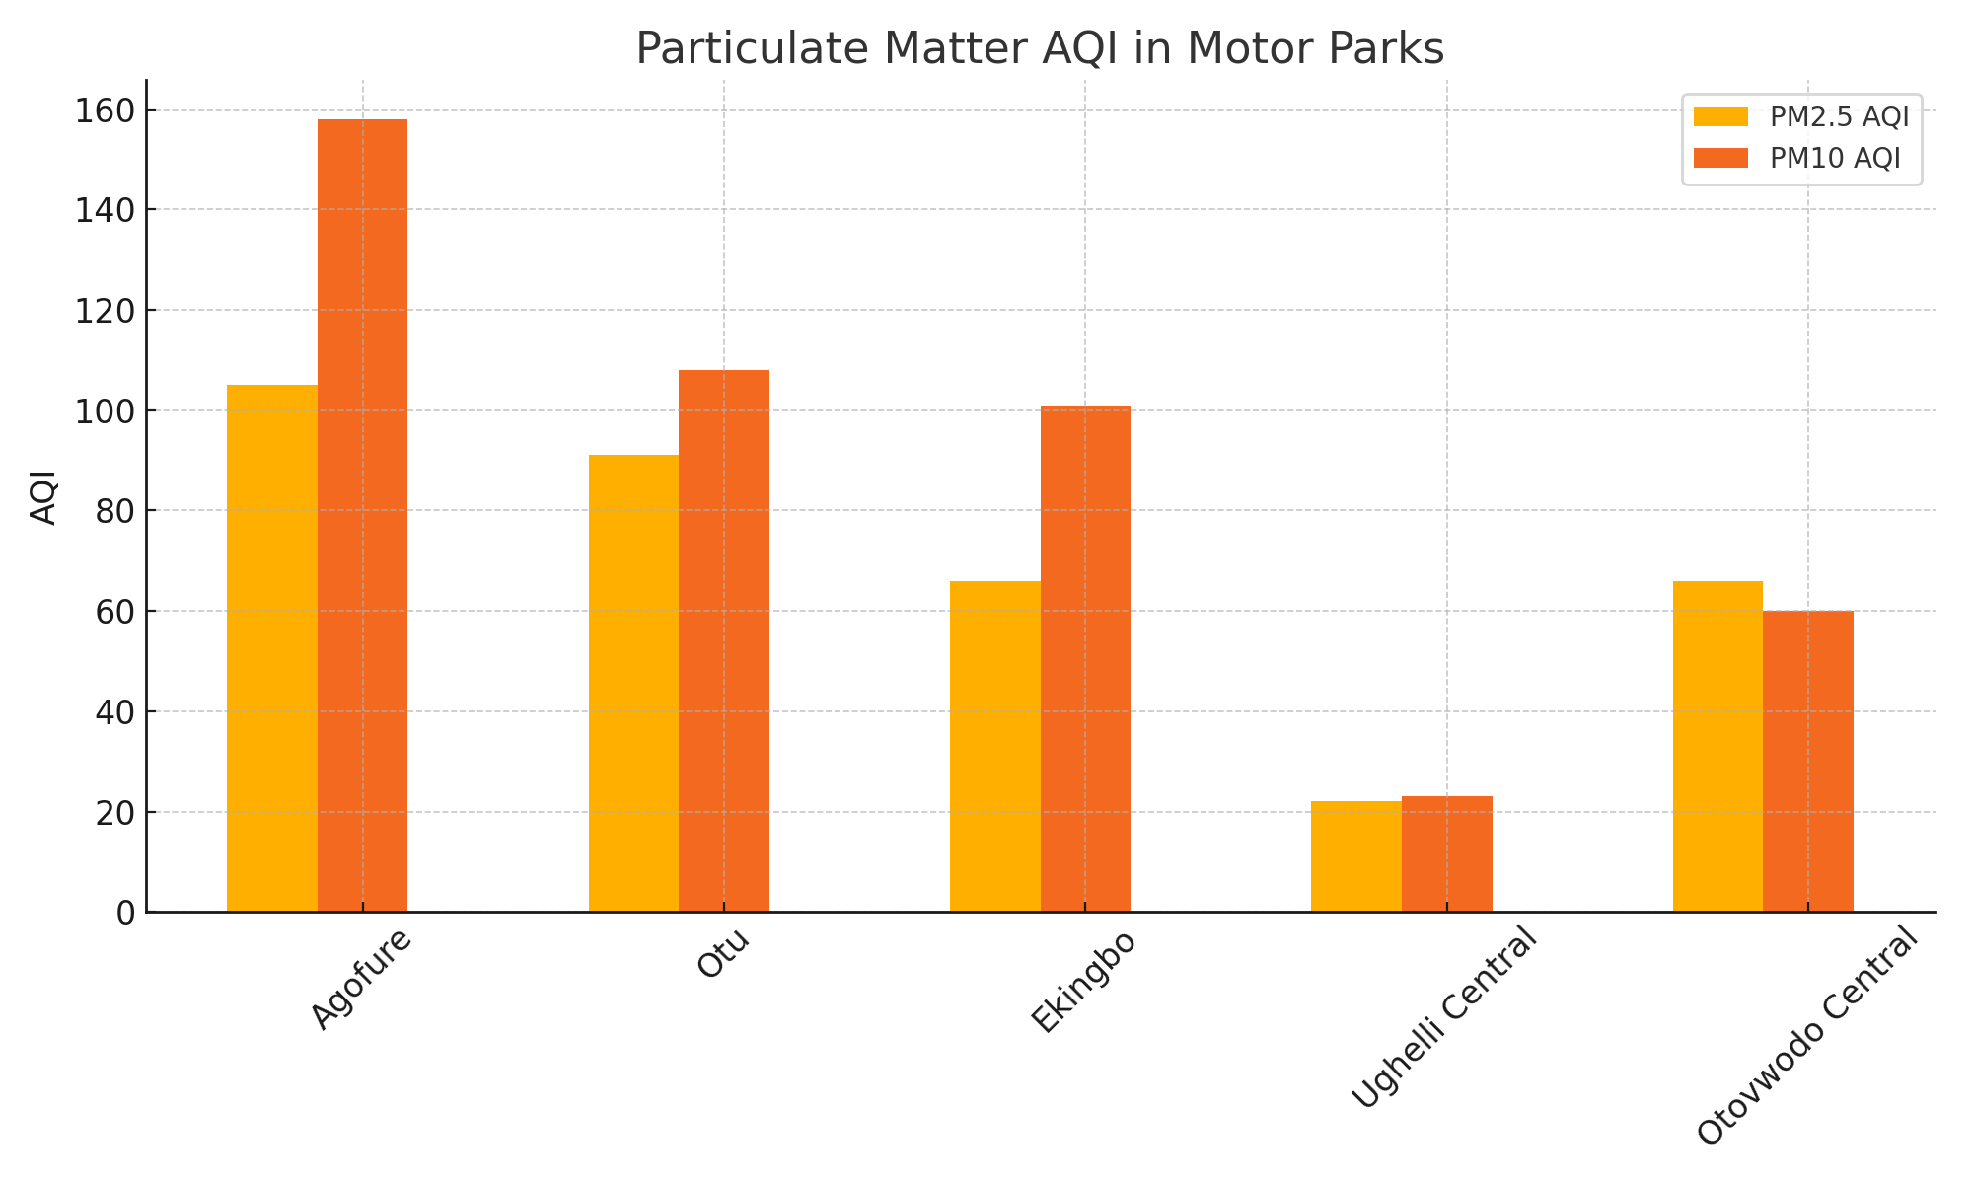
PM2.5and PM10 AQI Levels by Motor Parks

Slide 14
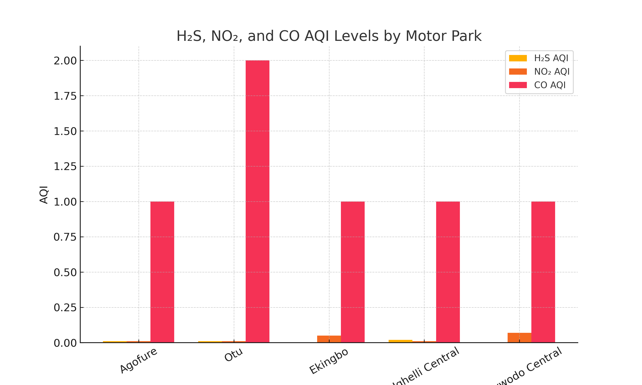
Gaseous Pollutants AQI in Selected Motor Parks

Slide 15
Recommendations
Awareness for Park Management
Educate motor park managements (especially Agofure, Otu, and Ekingbo Parks) on PM-related air pollution risks.
Policy Development for Urban Planning
Ministry of Environment & NURTW should enforce policies for motor park planning, data tracking, and monitoring.
Update Air Pollution Regulations
NESREA, Ministry of Environment, and policymakers should review/strengthen air quality laws in Nigeria.
Continuous Air Quality Monitoring
Regular assessments to track environmental changes and protect public health.
Use of Protective Equipment (PPEs)
Promote PPEs for vulnerable groups to reduce health risks from pollutants.
Public Sensitization
Raise awareness among high-risk groups on air pollution dangers.

Slide 16
Contributions to Knowledge
This work has contributed to knowledge in the following ways:
The information from this research work will help relevant authorities in planning adequate pollution control measures.
The study has contributed data to ambient air conditions and health risks of pollutants in air in the study area.
The study has exposed motor parks in Ughelli town/city with PM concerns for human health and well-being.
The study has also revealed that human activities such as automobile (vehicular) movement within and around motor parks could also pollute ambient air.
The study has also contributed to knowledge by indicating that, there may be risk due to continuous inhalation of polluted air from the study areas in Delta State in particular and Nigeria in general.

Slide 17
Conclusion
PM₂.₅ Levels:
- Unhealthy: Agofure Motor Park
- Moderate: Otu, Ekingbo, Otovwodo Motor Parks
- Good: Ughelli Central Motor Park
PM₁₀ Levels:
- Unhealthy: Agofure, Otu, Ekingbo Motor Parks
- Moderate: Otovwodo Central Motor Park
- Good: Ughelli Central Motor Park
H₂S, NO₂, CO Levels:
- All five parks meet WHO standards
- No current health concerns from these pollutants

Slide 18
THANK YOU
FOR LISTENING

