Slide 1
Development and Optimization of Super-hydrophobic Biochar-infused Coating for Corrosion Protection of Carbon Steel Pipelines in Oil and Gas Facilities
Engr. AYUBA, David Mshelia
NACETEM NORTHEAST ZONAL OFFICE, MODIBBO ADAMA UNIVERSITY, YOLA, NIGERIA
NACETEM Researchers’ Seminar Series
Thursday, 18th September, 2025

Slide 2
Outline
Introduction
Statement of the problem
Aim and Objectives of the study
Significance of the study
Materials and methods
Expected results
Conclusions

Slide 3
    INTRODUCTION
Carbon steel pipelines play a crucial role in oil and gas transportation but are highly susceptible to corrosion due to exposure to harsh environments. Corrosion leads to material degradation, safety hazards, and economic losses, accounting for about 25% of failures in the industry (Solovyeva et al., 2023).
Super-hydrophobic coatings have emerged as a promising alternative, reducing the contact between water and steel surfaces, thereby minimizing corrosion (Ferrari et al., 2019).
Biochar, a carbon-rich material derived from biomass, has gained attention as an environmentally friendly and cost-effective material for these coatings(Zhang et al., 2020).

Slide 4
STATEMENT OF THE PROBLEM
In Nigeria, oil and gas companies lose an estimated $765 million annually to corrosion-related damage, with 81% of this cost attributed to chemical treatments and 19% to protective coatings (Ijuo et al., 2023).
Superhydrophobic coatings have emerged as an alternative solution, aiming to repel water and reduce corrosion. However, real-world applications have revealed critical failures:
1. Mechanical durability issues: Many superhydrophobic coatings lack sufficient abrasion resistance, leading to rapid degradation in high-flow environments such as pipelines.

Slide 5
2. Loss of hydrophobicity over time: Prolonged exposure to oil, saltwater, and extreme temperatures causes degradation of surface roughness and chemical coatings, diminishing their water-repellent properties.
3. Poor adhesion to metal substrates: The coatings often delaminate from carbon steel surfaces under thermal and mechanical stresses.
4. Chemical instability: Fluorine-based hydrophobic agents, commonly used in these coatings, pose environmental concerns and degrade under harsh conditions.

Slide 6
AIM AND OBJECTIVES
This study aims to develop and optimize a super-hydrophobic biochar-based coating for corrosion mitigating in carbon steel pipelines.
The objectives of the study are to:-
  Synthesize biochar from cocoyam (Xanthosoma sagittifolium) leaves through pyrolysis at different temperatures.
  Develop super-hydrophobic biochar based coatings using biochar synthesized from cocoyam leaves.
  Characterise the coatings' surface morphology, chemical composition, and hydrophobic properties.
  Determine the mechanical properties and corrosion resistance on carbon steel pipes.
  Optimize the composition and application of the coating for maximum performance.

Slide 7
SIGNIFICANCE OF THE STUDY
The development of a superhydrophobic biochar-based coating represents a transformative solution for mitigating corrosion in carbon steel pipelines within the oil and gas industry. This innovation integrates biochar, a cost-effective and sustainable material, to create a robust, water-repellent coating that addresses the limitations of conventional coatings

Slide 8
MATERIALS AND METHODS
Materials
A carbon steel substrate (ASTM A106) with the following measurements: 2.0 cm x 1.0 cm x 0.1 cm will be used. Cocoyam leaves (Xanthosoma sagattifolium) will be collected in accordance with institutional, national, and international guidelines. Ultrasonicator (Hielscher UP100H), Bisphenol A diglycidyl ether (BADGE) epoxy resin and Jeffamine D230, anhydrous ethanol, zirconium IV oxide, sodium chloride, and sodium hydroxide of analytical grade will be used.

Slide 9
Methods
Biochar is synthesized from cocoyam leaves by first washing the leaves to remove impurities, then air-drying it before placing it in an oven at 60°C for 24 hours. The clean, dried cocoyam leaves is then processed into a fine powder using size reduction machinery (hammer mill; Pellet master, Ecostan). The biochar is produced by pyrolyzing of the fine powder for three hours at different temperatures in a muffle furnace. ZrO₂ is added to 100mL of deionized water containing 10g of cocoyam leaves fine powder at a wt% ratio of 1:10 for ZrO₂: cocoyam leaves powder. The mixture is sonicated for 30 minutes and then stirred for 1 hour. Subsequently, the mixture is oven-dried at 60°C overnight and then pyrolyzed in a muffle furnace at 600°C for three hours to obtain the zirconia-modified biochar material, Zr-BC.

Slide 10
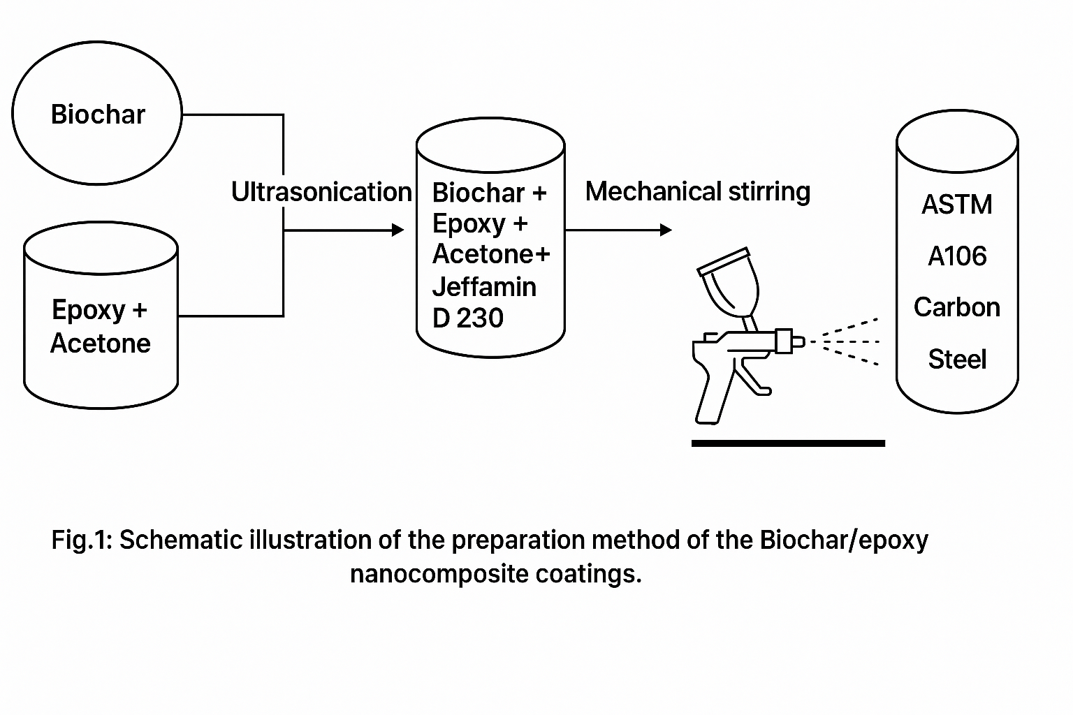

Slide 11
DESIGN OF EXPERIMENT
The sythesis of the biochar will be done at different temperatures to obtain low-temperature biochar (600ºC), moderate-temperature biochar (800ºC) and high-temperature biochar (1000ºC). Each of the biochar produced at different temperature will be used at different percentages 10 %, 15%, 20%, 25% and 30% to develop the SHP coatings.

Slide 12
DATA ANALYSIS
The study will apply various analytical and statistical techniques to achieve its objectives:
Development of Super-Hydrophobic Biochar-Based Coatings
Objective: Develop coatings using biochar derived from cocoyam leaves.
Analysis Methods:
  Fourier Transform Infrared Spectroscopy (FTIR): Identify functional groups in biochar.
  X-Ray Diffraction (XRD): Confirm crystallinity and phase composition.
  Scanning Electron Microscopy (SEM): Examine surface morphology and roughness.
Statistical Tests (Design Expert): One-way ANOVA to evaluate effects of pyrolysis temperature on biochar properties.

Slide 13
DATA ANALYSIS
Characterization of Surface Morphology, Composition, and Hydrophobic Properties
Objective: Characterize coatings’ morphology, chemical composition, and hydrophobicity.
Analysis Methods:
  Contact Angle Measurement (Goniometer, ASTM D7334-08): Determine water contact angle.
  SEM Analysis: Assess surface roughness and coating distribution.
Statistical Tests (Design Expert): Regression analysis and ANOVA to compare contact angles across different biochar compositions.

Slide 14
DATA ANALYSIS
Durability and Mechanical Performance Testing
Objective: Assess coatings’ resistance to environmental degradation and mechanical wear.
Analysis Methods:
  Impact Resistance Test (ASTM D2794): Measure coating toughness.
  Abrasion Resistance Test (ASTM D4060): Evaluate wear resistance.
Statistical Tests (Design Expert): Two-way ANOVA for environmental exposure effects and paired T-test for performance before and after durability testing.

Slide 15
DATA ANALYSIS
Evaluation of Corrosion Resistance
Objective: Evaluate coatings’ ability to resist corrosion on carbon steel.
Analysis Methods:
  Electrochemical Impedance Spectroscopy (EIS, ASTM G106-89): Measure corrosion resistance.
  Weight Loss Method: Determine corrosion rate after exposure.
Statistical Tests (Design Expert): T-test for coated vs. uncoated samples, Kaplan-Meier survival analysis for coating durability over time.

Slide 16
DATA ANALYSIS
Optimization of Biochar Composition and Application Parameters
Objective: Optimize composition and processing conditions for best performance.
Analysis Methods:
  Factorial Design in Design Expert: Evaluate biochar ratio, curing temperature, and curing time.
  Response Surface Methodology (RSM): Identify optimal settings for maximum hydrophobicity.
Statistical Tests (Design Expert): Full factorial ANOVA to assess combined factor effects and regression analysis to model variable influences.

Slide 17
EXPECTED RESULTS

Slide 18
CONCLUSIONS
- Corrosion in carbon steel pipelines remains a critical challenge in the oil and gas industry, causing high economic losses.
- Superhydrophobic biochar-based coatings present a sustainable and effective solution by enhancing hydrophobicity, adhesion, and corrosion resistance.
- Biochar derived from cocoyam leaves, modified with zirconium and epoxy resin, shows strong potential for durable, eco-friendly protective coatings.
- The study’s optimization approach will ensure coatings achieve maximum performance under harsh operational conditions.
- This research contributes to advancing green materials for pipeline integrity management in Nigeria’s oil and gas sector.

Slide 19

Thank you for listening.

