Slide 1
Modeling the Nigerian Education System: A system dynamics approach
Victor O. Sobanke (PhD)

Slide 2
Contents
Introduction
Statements of the Problem
Objectives
Dynamic Hypothesis
Research Methodology
Historical Behaviour (Model Boundary)
Study Variables
Results and Discussion
Conclusion

Slide 3
Introduction
Science and technology is a major factor responsible for sustainable economic development, and shifting the foundation of the global economy from resource-based to knowledge-based.
Endogenous growth theory argued that investment in education is helpful in building human capital which is key determinant in growth process and innovation (Arrow, 1962; Nelson and Phelps, 1966; Romer, 1986; Lucas, 1988)
Nigeria education system has continued to witness an increase in the rate of enrolments and completion resulting production of manpower (Halsey, 1961; Okoh, 2002).

Slide 4
Statement of the Problem
Despite the importance of human capital as a central element in the current knowledge-based economy.
Recent report from the labour market showed generally that there is a rising incidence of unemployment among graduates (Yesufu, 2000, NBS, 2016).
Although, there are many studies on education system and unemployment in Nigeria, they all employed variable-oriented approach.
Hence, the need for this study to apply process-oriented approach using SD modelling.

Slide 5
Objective
examined the dynamics influencing the Nigerian education sector.

Slide 6
Dynamic Hypothesis
The increase in primary and secondary school-leavers increases the unemployment of graduates.
The unemployment of graduates results in low absorptive capacity and poor innovation.
The low absorptive capacity and poor innovation capability further increases the number of primary and secondary school-leavers.

Slide 7
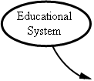
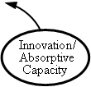
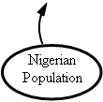

Research Methodology
R
Figure 3.1: Conceptual framework

Slide 8
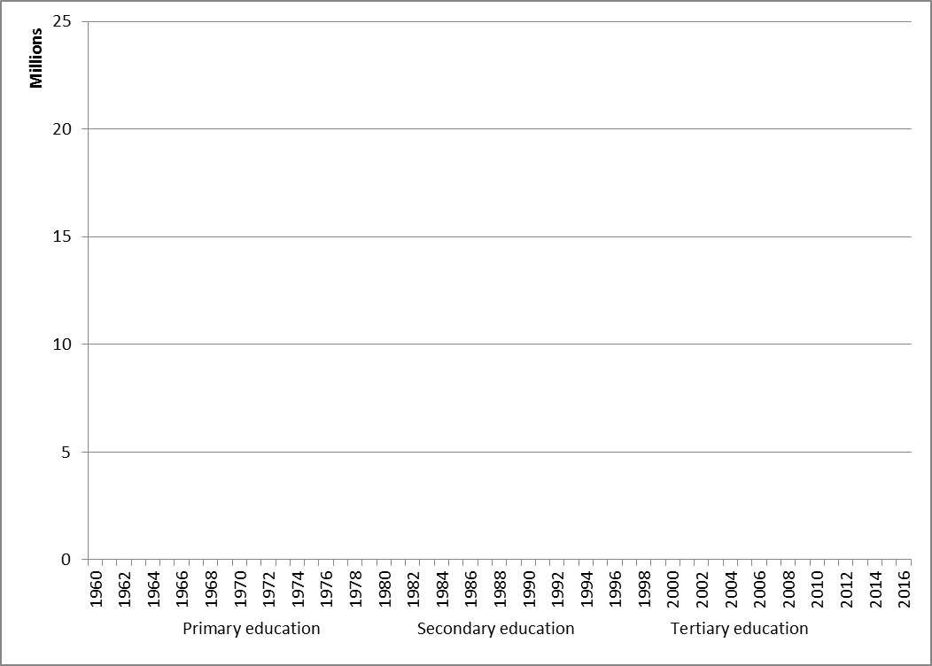
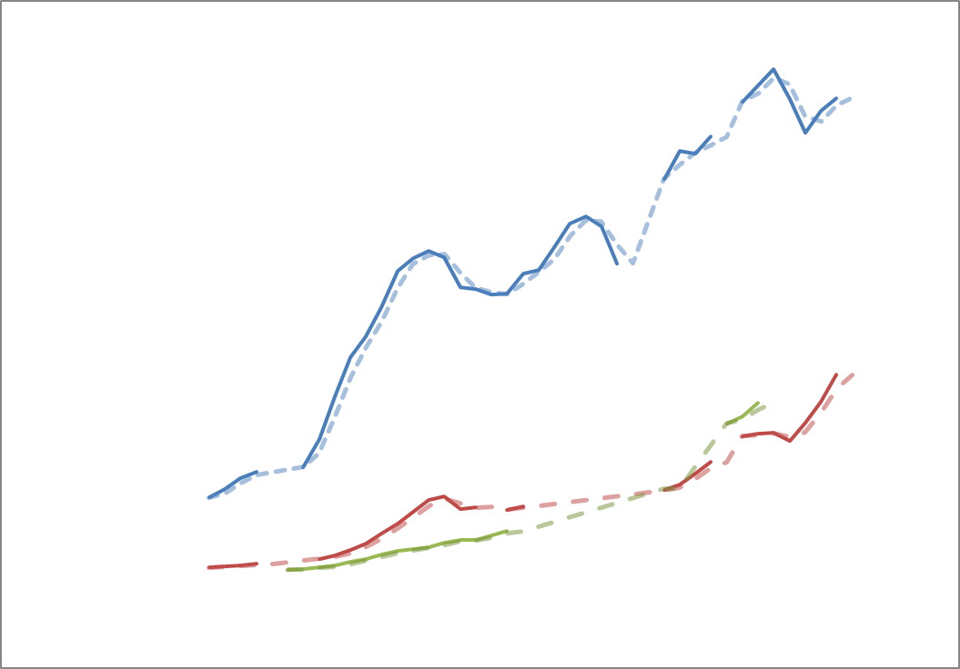
System Historical Behaviour

Slide 9
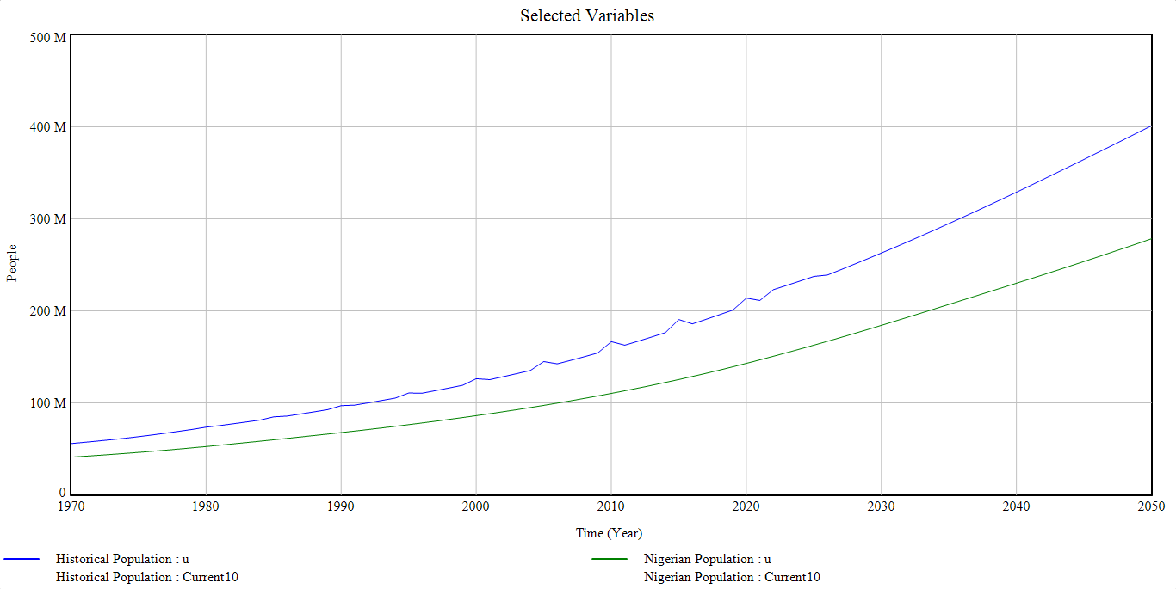
Results and Discussion

Slide 10
Results and Discussion

Slide 11
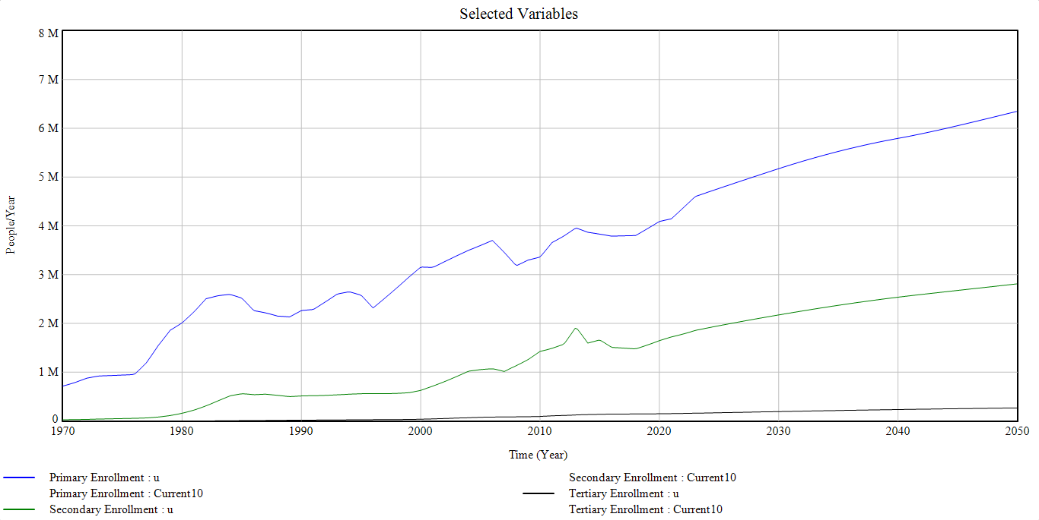
Results and Discussion

Slide 12
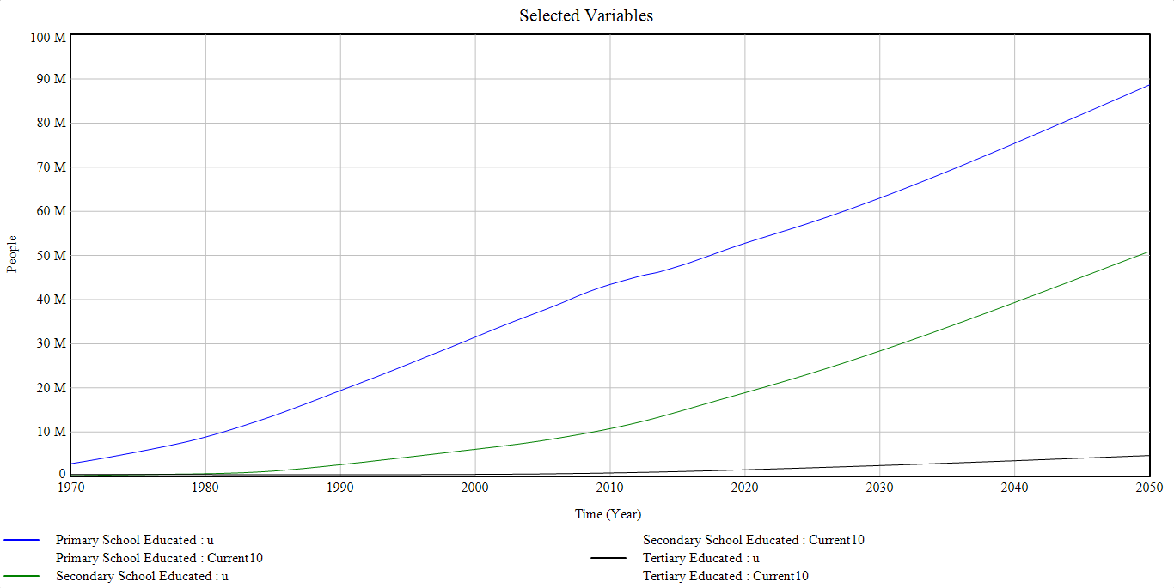
Results and Discussion

Slide 13
Conclusion
The insight of the activities of variables as important to the overall configuration of the whole system was discussed along the line of developing a model for engaging more graduates in employment.
The interaction of these subsystems is in such a way that alters the state of the system and its components which further results in a complex problem of low productivity, and poor innovation.

Slide 14

Thank you for listening.

