Slide 1
Unlocking Nigeria's Natural Resources through Strategies for Sustainable Development in Clean Energy
Thompson-Adewole Valentina
NACETEM NORTH-CENTRAL OFFICE, ABUJA
NACETEM Researchers’ Seminar Series
Thursday, 15th May 2025

Slide 2
Outline
Introduction
LR
Methodology
Analysis and Discussions
Conclusions
Recommendations

Slide 3
    INTRODUCTION
Resource-rich economies, such as Nigeria, often face challenges in transitioning from fossil fuels to renewable energy sources, despite the long-term economic and environmental benefits.
The Environmental Kuznets Curve (EKC) theory suggests that as economies grow, environmental degradation initially increases but eventually declines as cleaner technologies are adopted-”a pattern particularly relevant to Nigeria’s oil-dependent growth” (Kaika & Zervas, 2013).
This framework is adopted because is central to understanding Nigeria’s resource-rich, fossil-fuel-dependent growth and the transition towards clean energy.

Slide 4
INTRODUCTION CONT’D
Despite extensive research on the environmental and socioeconomic impacts of resource exploitation in Nigeria, few studies holistically integrate clean energy strategies (Obada et. al, 2024)
This study addresses this gap by applying EKC-derived parameters to benchmark Nigeria’s clean energy transition against BRICS countries, leveraging their potential for technology transfer and Nigeria’s interest in joining BRICS

Slide 5
Clean Energy
Natural Resource Management
Qualitative Policy Analysis
Quantitative Metrics
Mechanism Test
Target polices
EKC Curve Theory

Slide 6
RESEARCH OBJECTIVES
To examine the difference between Nigeria and BRICS countries in rural access to clean fuels and technologies for cooking as sustainable development enablers.
To analyze and compare fossil fuel energy consumption in Nigeria with the average consumption levels in BRICS countries for driving clean energy.

Slide 7
SIGNIFICANCE OF STUDY
To propose strategies for harnessing Nigeria’s natural resources for clean energy, comparing indicators with BRICS
To develop actionable strategies for leveraging Nigeria’s abundant natural resources for clean energy, this study compares key indicators such as rural access to clean fuels and fossil fuel consumption between Nigeria and BRICS countries
Note:
The justification for juxtaposing Nigeria with the BRICS countries was based on the interest on Nigeria in joining the BRICS countries and the proposition that technology transfer and adaptation may occur with relevant impact on sustainable development.

Slide 8
RESEARCH HYPOTHESES
1. H₀: There is no significant difference between Nigeria and BRICS countries in rural access to clean fuels and technologies for cooking.
H₁: Nigeria has significantly lower access to clean fuels and technologies for cooking in rural areas compared to BRICS countries.
2. H₀: Fossil fuel energy consumption in Nigeria is not significantly higher than the average consumption in BRICS countries.
H₁: Nigeria’s fossil fuel energy consumption is significantly higher than the average consumption in BRICS countries.

Slide 9
METHODOLOGY
This study employs a comparative analytical approach, utilizing secondary data from the World Bank for Nigeria and BRICS countries. The analysis covers fossil fuel consumption (1971–2022) and rural access to clean fuels (2000–2022)

Slide 10
Methodology - Analytical Techniques
Statistical Methods:
Descriptive statistics: Means, standard deviations, trends
Correlation analysis: Examining relationships between variables
Analytical Software:
  SPSS for statistical analysis
  Excel for data visualization
  System Dynamics Loop Generator (SDLG)

Slide 11
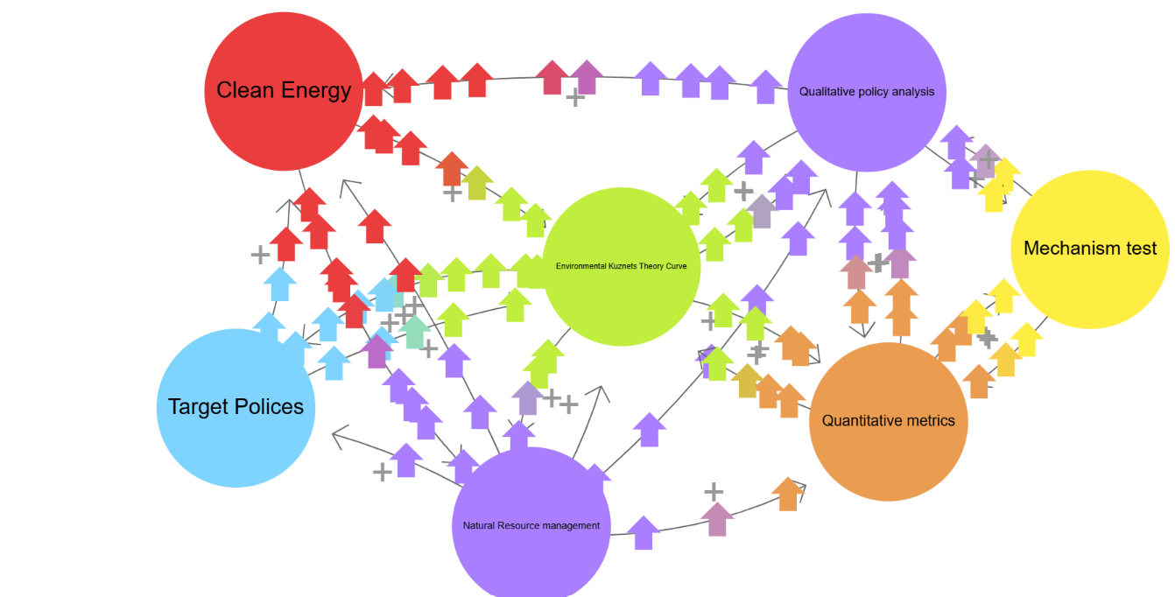
Loop Diagram identifying the parameters patterns and relationships (Authors’ Idea, 2025)

Slide 12
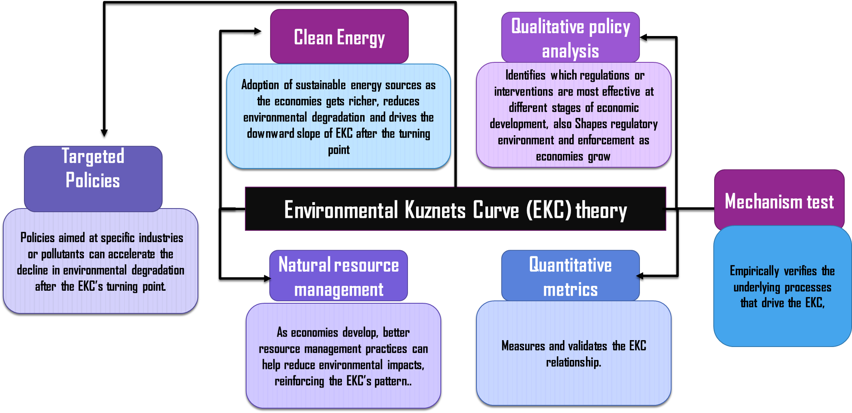
ANALYTICAL FRAMEWORK
(Adapted from Femi, et al, 2022)

Slide 13
ANALYSIS & DISCUSSIONS

Slide 14
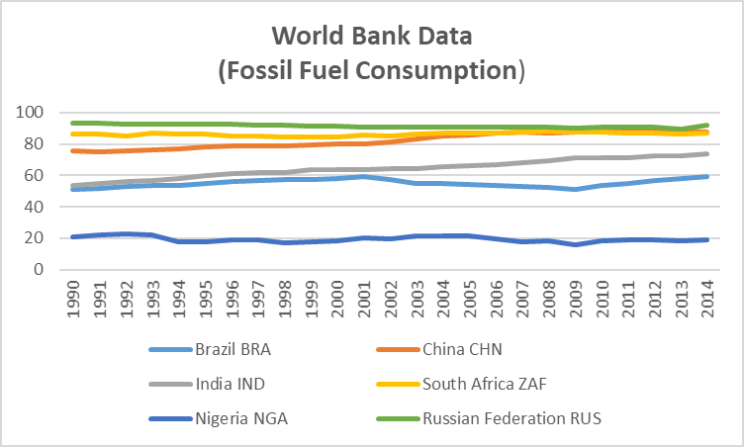

Slide 15
ANALYSIS & DISCUSSIONS
Rural access to clean gas
 | N | Minimum | Maximum | Mean Statistics | Standard Deviation
Brazil | 23 | 55.8 | 83.1 | 70.200 | 9.1732
India | 23 | 6.8 | 62.5 | 23.489 | 17.3269
South Africa | 23 | 29.6 | 71.4 | 54.411 | 13.3044
China | 23 | 22.0 | 75.8 | 41.448 | 18.5406
Russia | 23 | 98.9 | 99.9 | 99.291 | .3260
Nigeria | 23 | 3 | 10.8 | 2.448 | 3.1444

Slide 17
Correlation & Regression Analysis Overview
Rural access to clean gas
 | Nigeria | BRICS Avg
Nigeria | 1 | 0.896
BRICS Avg | 0.896 | 1
N | 23 | 23
Strong positive correlation (r = 0.896, p < 0.001), indicating Nigeria’s progress mirrors BRICS trends, suggesting benchmarking opportunities.
Nigeria’s positive trend aligns with BRICS, implying that policy improvements could accelerate progress.
Recent policies (e.g., National Clean Cooking Policy, LPG initiatives) are steps in the

Slide 18
Strong positive correlation (R = 0.896, R² = 0.803, p < 0.001) between Nigeria and BRICS trends, but Nigeria’s absolute access remains much lower.

Slide 19
Fossil Fuel Consumption
Nigeria’s fossil fuel consumption is much lower and more stable than that of BRICS countries.

Slide 20
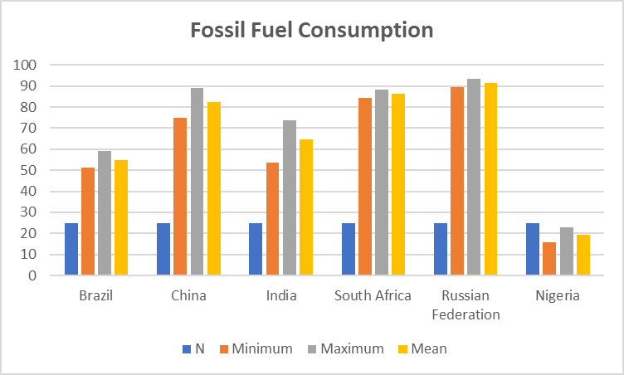
Nigeria’s mean fossil fuel consumption (19.35%) is much lower than all BRICS countries, reflecting limited access to modern energy rather than a clean energy transition.
BRICS countries on the other hand have higher and more variable fossil fuel consumption, consistent with their industrialization and energy infrastructure

Slide 21
Nigeria vs. BRICS Fossil Fuel Consumption Analysis
Statistically significant negative relationship between Nigeria's fossil fuel consumption and BRICS average (1990-2014), challenging the hypothesis that Nigeria's consumption is higher than BRICS.

Slide 22
Contextual Analysis
Qualitative Policy Analysis | Reveals that, despite policy frameworks implementation gaps persist due to weak governance and limited coordination. According to EKC, effective policy interventions are crucial at the “turning point”
Quantitative Metrics | Quantitative findings show Nigeria’s rural access to clean fuels is significantly lower than BRICS, and fossil fuel consumption patterns diverge which validated the hypothesis and EKC. Nigeria is at a stage where economic growth has not yet translated into environmental improvement, unlike more advanced BRICS economies
Natural Resource Management | Nigeria’s vast natural resources (oil, gas, solar, hydropower, marine) are underutilized leading to environmental degradation and lost economic opportunities. EKC suggests that improved resource management-through investment in renewables and blue economy initiatives-can help Nigeria move past the degradation peak

Slide 23
Contextual Analysis
Clean Energy | Clean energy adoption (solar, LPG, hydropower) is central to reducing Nigeria’s reliance on traditional biomass and fossil fuels. EKC theory underscores the role of clean energy in the post-peak phase, where environmental quality improves with economic advancement and innovation”
Mechanism Test | The correlation and regression tests confirm that Nigeria’s clean energy progress is positively correlated with the BRICS trends but lags in absolute terms. This supports the EKC view that structural transformation and policy alignment with global best practices are needed for sustainable progress.
Natural Resource Management | The Study calls for targeted subsidies, public-private partnerships, and technology transfer from BRICS as levers to accelerate clean energy adoption. According to EKC such policies are essential to reach and surpass the “turning point,” that will enable Nigeria to decouple growth from environmental harm.

Slide 24
CONCLUSION
EKC theory effectively frames Nigeria’s energy-environment dilemma: economic growth has not yet led to environmental improvement due to overreliance on fossil fuels and weak policy execution.
The results reveals that Nigeria’s rural access to clean fuels is significantly lower than that of BRICS countries, supporting the alternative hypothesis.
The findings align with the EKC theory, highlighting the need for targeted policies to accelerate Nigeria’s progress toward sustainable development.

Slide 25
RECOMMENDATION
Accelerate Clean Energy Adoption: Invest in solar, LPG, and hydropower infrastructure, prioritizing rural and peri-urban areas.
Adopt Targeted Policies: Implement subsidies, public-private partnerships, and technology transfer initiatives modeled after successful BRICS strategies.
Strengthen Resource Management: Improve governance, reduce corruption, and enhance regulatory frameworks to optimize natural resource use.
Leverage Quantitative Monitoring: Use robust data analytics to track progress, identify gaps, and adjust policies dynamically.

