Slide 1
The Adoption of Internet-based Technological Innovations in Latecomer Industrial Settings
OLOMU, MICHAEL O. PhD
NACETEM HQ, OBAFEMI AWOLOWO UNIVERSITY, ILE-IFE, NIGERIA
NACETEM Researchers’ Seminar Series
Thursday, 17th April 2025

Slide 2
Outline
Introduction
Methodology
Results and Discussions
Conclusions
Recommendations

Slide 3
    INTRODUCTION
The adoption of technological innovation is crucial towards the realisation of economic growth and development, notably driven by numerous factors and conditions (Venkatesh et al., 2012).
The impact of technological innovations in sustainable development presents important considerations for industrial policy and growth.
In the present globalised economy, the industrial firms are threatened with stiff competition and growing demands for high quality products and services in the market.

Slide 4
Many industrial firms are seeking new ways to stand out and sustain their competitive advantage.
The industrial sector has been one of the early adopters of new or disruptive technologies influenced and driven by Internet technology (Khan et al., 2021).
High-performance computing, connectivity and data services, the demand for cutting-edge technological solutions by the industrial settings.
The digital economy and the new industrial revolutions are fundamentally transforming the way firms operate.

Slide 5
Internet has spread exponentially across the nations of the world and it has become one of the most important technologies of the 21st century.
The full effects of new technologies such as Internet of Things (IoT), the artificial intelligence (AI), smart automation, 3-D printing, energy storage and dynamic computing are evolving.
Industrial Internet of Things (IIoT) are with robust influence which triggers the performance of all sectors of the economies.
Internet technology forms the basis of what has become known as the “4IR” (Lee et al., 2014).

Slide 6
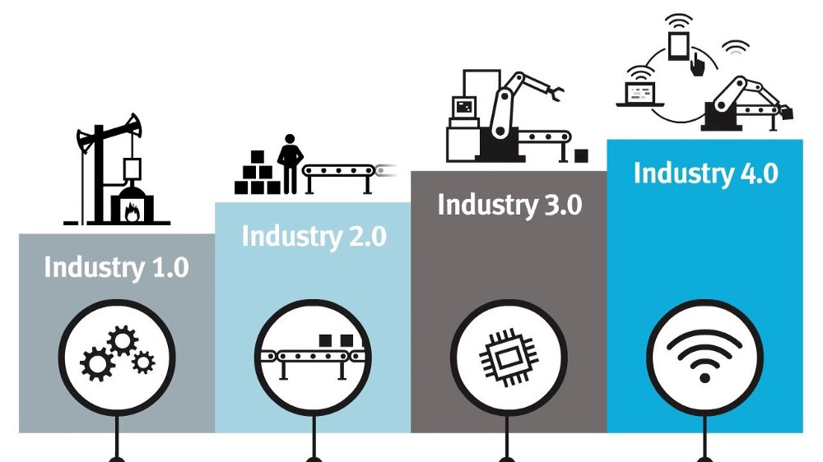

Slide 7
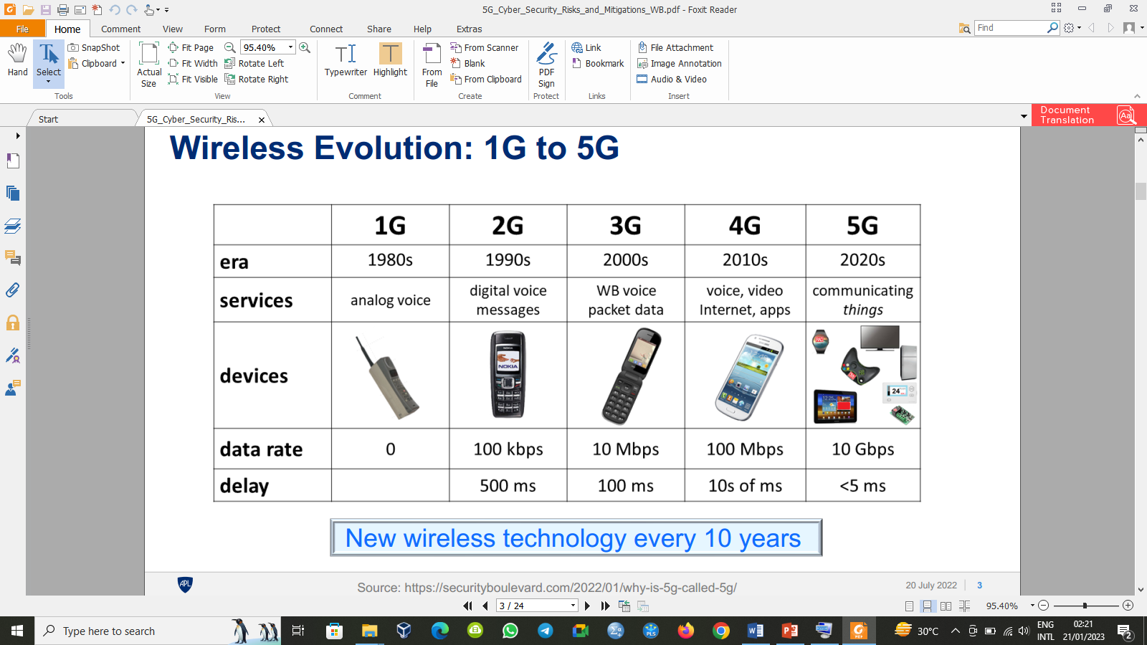

Slide 8
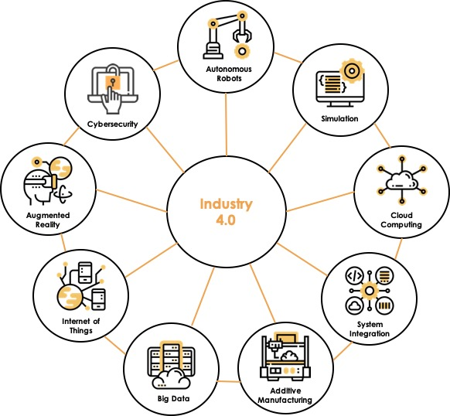

Slide 9
The Nigerian Government has initiated efforts especially as it affects clusters through industrial policy and initiatives (Ugoani & Ibeenwo, 2015).
Initiating efforts in collaborations with the financial sectors to strengthen and regulate the industrial clusters (Bank of Industry, 2018).
The Nigeria Industrial Revolution Plan (NIRP) in 2017 which was an integral part of the Economic Recovery and Growth Plan (ERGP) policy document.
The Nigeria’s ICT Innovation and Entrepreneurship Vision (NIIEV) in April, 2019.

Slide 10
INDUSTRIAL CLUSTERS
An industrial cluster is an agglomeration of interconnected industrial firms and associated institutions (UNIDO, 2022).
Firms produce related or similar products or services, and are supported by a range of committed institutions located in spatial proximity.
Industrial clusters are formed from diverse competitive assets or resources such as natural resources; grown organically; gradual agglomeration of technological know-how or via policy mandates.

Slide 11
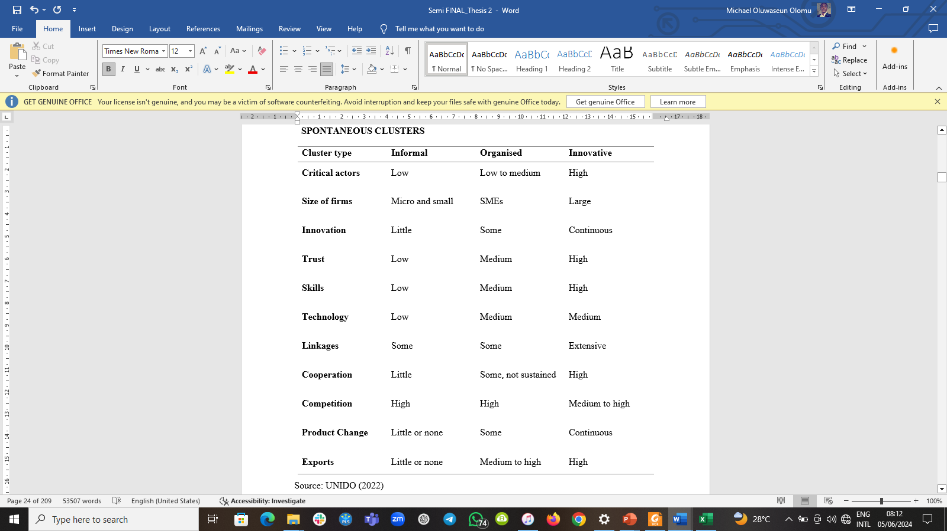
SPONTANEOUS CLASSIFICATIONS OF INDUSTRIAL CLUSTERS

Slide 12
PROBLEM STATEMENTS
There are concerns that industrial policy and technological innovations are failing to create adequate improvement to close technological gaps in the industrial sector.
The cost-effective best use of Internet-based technological innovations in production, marketing and networking (Osarenkhoe & Fjellström, 2017).
The adoption phenomena of Internet technological innovations in industrial firms which co-locate and share common facilities are unknown.

Slide 13
OBJECTIVES OF THE STUDY
To examine the extent and level of the adoption of Internet-based technological innovations.
To assess the impact of the adoption of Internet-based technological innovations on the performance of the industrial clusters.

Slide 14
JUSTIFICATION OF THE STUDY
The economic development of a country is largely dependent on industrial sector and firms in the present market-based global competitive environment (Azam, 2015).
The Nigerian industrial sector is very dynamic, and makes up 25.7% of the GDP and employs 12% of the workforce (MAN, 2020).
The Nigeria Industrial Revolution Plan (NIRP) in 2017.
The Nigeria’s ICT Innovation and Entrepreneurship Vision (NIIEV) in April, 2019.

Slide 15
METHODOLOGY
The study was conducted in the Southwestern, Nigeria.
The survey was targeted at fast-moving consumer goods (FMCG) industrial clusters’ firms in Southwestern Nigeria.
Both descriptive and inferential statistics.
Mean, standard deviation, frequencies, percentages, skewness and kurtosis (SPSS).
Regression, correlation, confirmatory and exploratory factor analyses – Partial Least Square (SmartPLS).
A survey of 384 fast-moving consumer goods (FMCG) firms with 89% response rate were used (343).

Slide 16
RESULTS & DISCUSSIONS

Slide 17
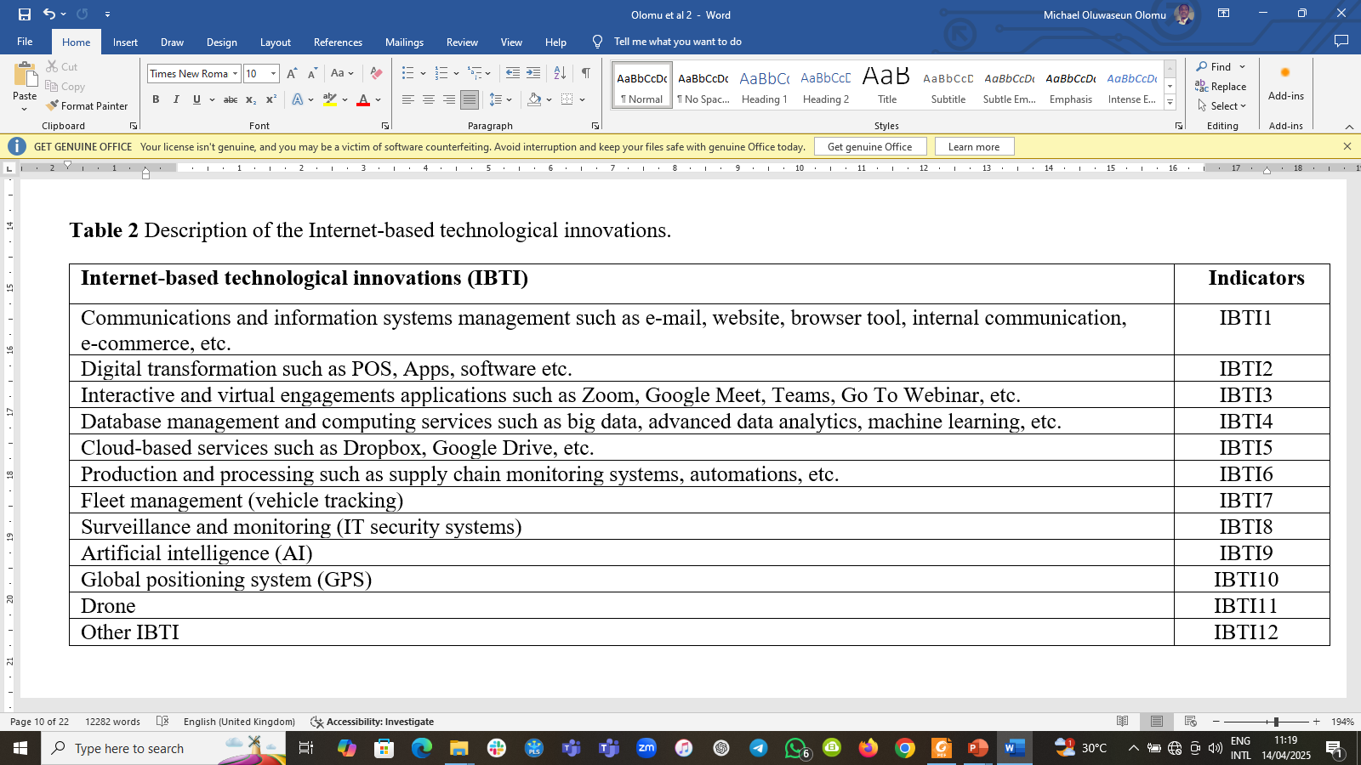
DESCRIPTION OF THE INTERNET-BASED TECHNOLOGICAL INNOVATIONS

Slide 18
THE LEVEL OF THE ADOPTION OF INTERNET-BASED TECHNOLOGICAL INNOVATIONS

Slide 19
THE STATUS OF THE ADOPTION OF INTERNET-BASED TECHNOLOGICAL INNOVATIONS

Slide 20
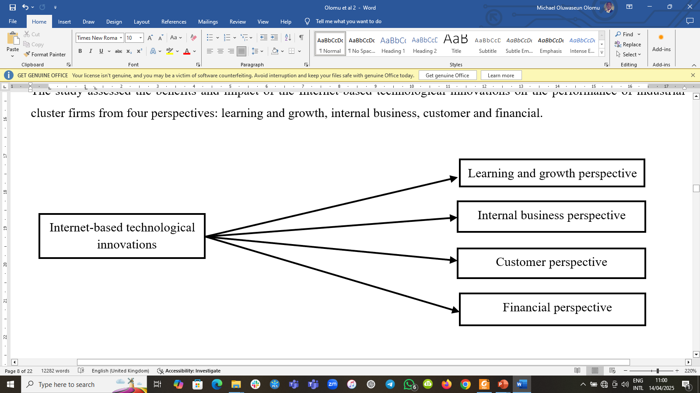
THE ANALYTICAL FRAMEWORK

Slide 21
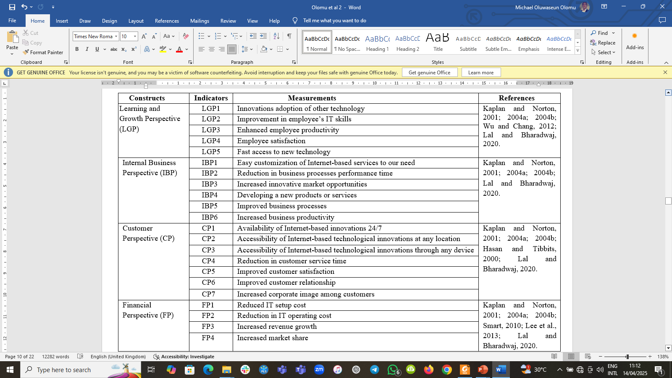
DESCRIPTION OF THE MODEL CONSTRUCTS

Slide 22
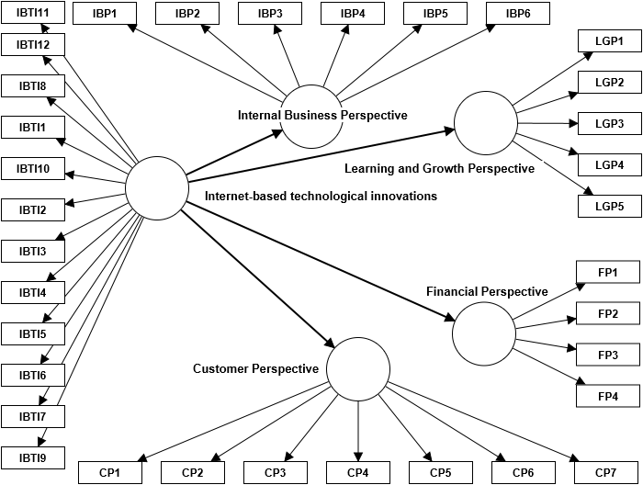
PROPOSED MODEL FOR THE IMPACT OF THE ADOPTION OF INTERNET-BASED TECHNOLOGICAL INNOVATIONS

Slide 23
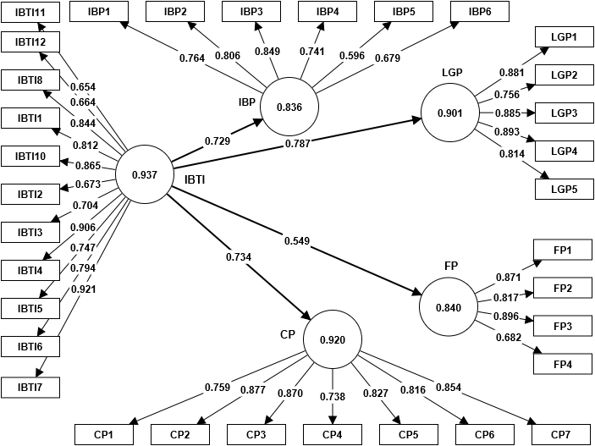
STRUCTURAL MODEL FOR THE IMPACT OF THE ADOPTION OF IBTI

Slide 24
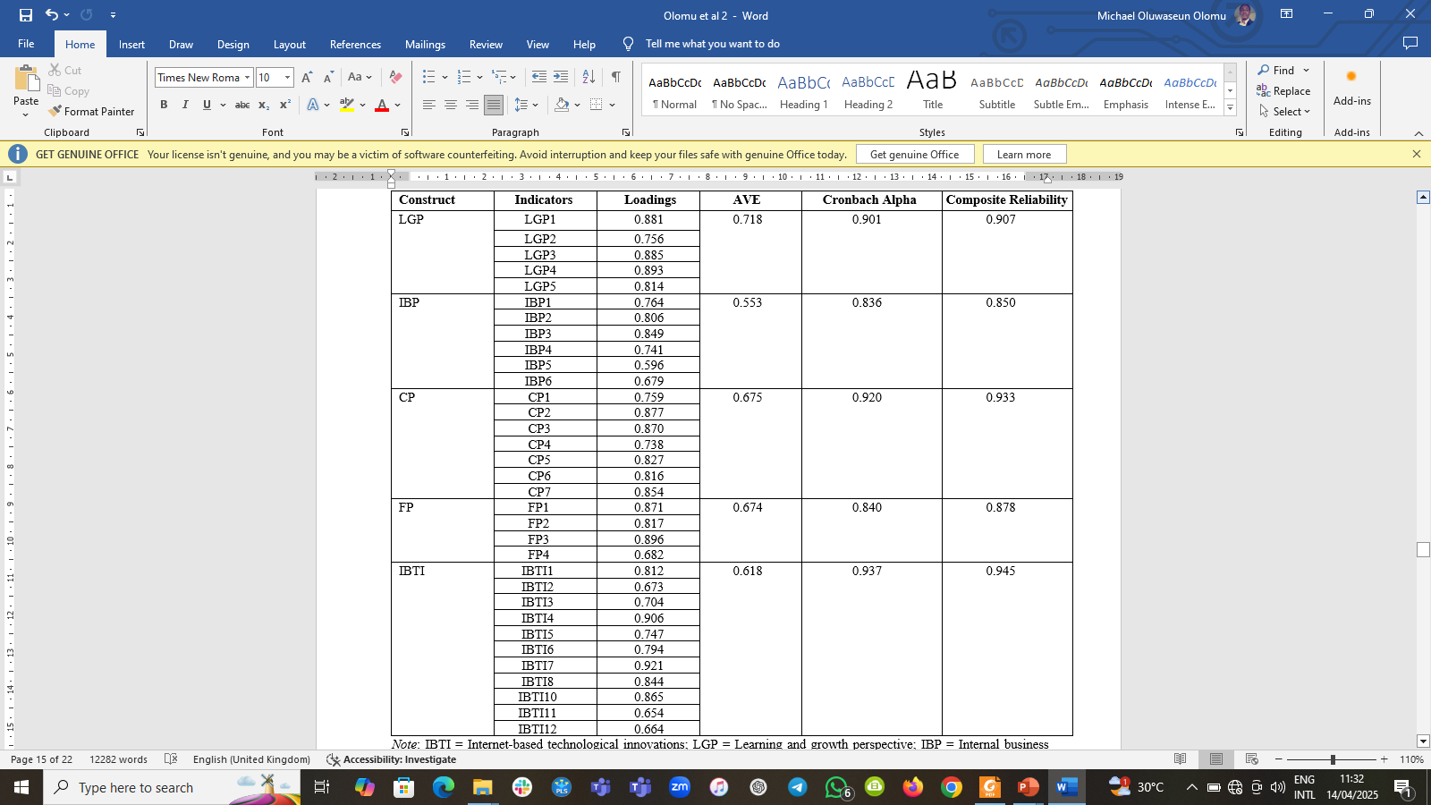
RELIABILITY OF ITEMS AND CONSTRUCTS

Slide 25
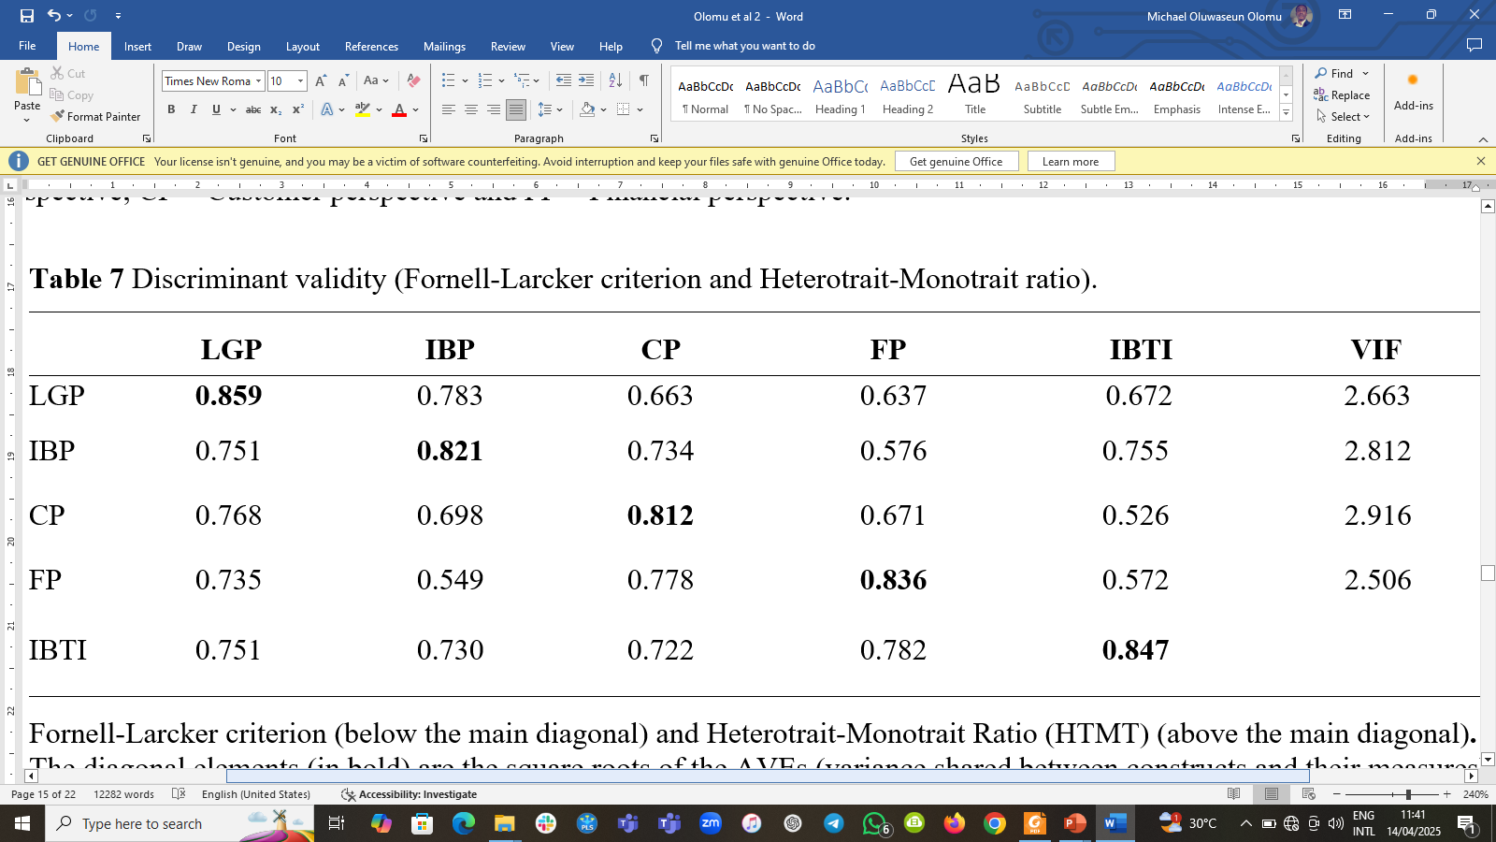
DISCRIMINANT VALIDITY (FORNELL-LARCKER CRITERION AND HETEROTRAIT-MONOTRAIT RATIO)

Slide 26
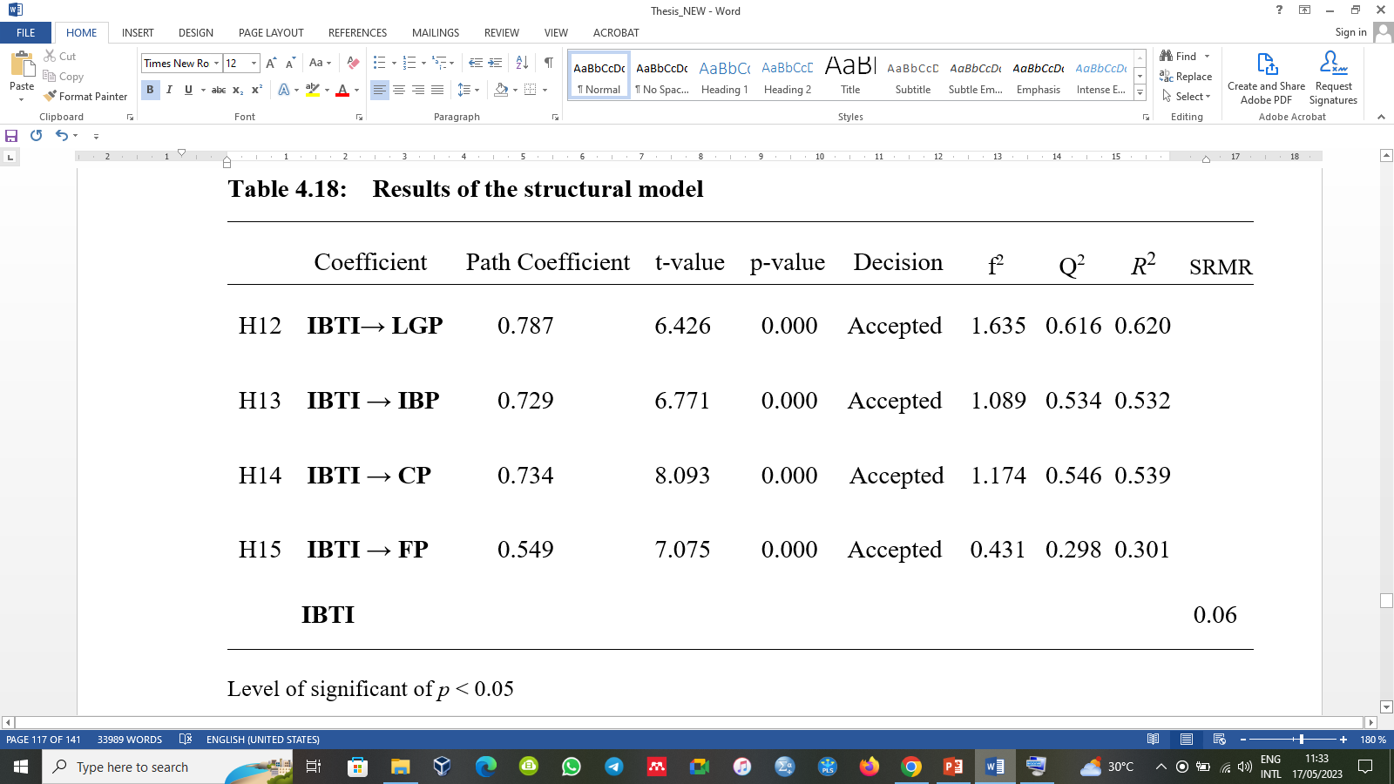
RESULTS OF THE STRUCTURAL MODEL

Slide 27
CONCLUSIONS
The study examined the extent of the adoption of IBTI and the impact on the performance of the industrial clusters’ firms.
The IBTI have been adopted and deployed more in the areas of digital transformation functions, communications and information systems management activities, surveillance and monitoring.
Majority of the firms currently utilise a combination of Internet-based technological innovations with internally owned IT systems in operations.
Low level of investment and expenditure on Internet-based systems.
The adoption level of IBTI is significantly low.

Slide 28
RECOMMENDATIONS
The industry is still late majority adopters of disruptive technologies.
This poses a threat to the industry, especially in this era of 4IR.
Need for institutional supports for the survival of industrial clusters in this era of globalisation so as to keep up with the Fourth Industrial Revolution (4IR).
Concerted efforts should be channeled toward intense exchange of business information, technical know-how and technological expertise in the clusters.
The provision of technological infrastructure is crucial to support industrial firms’ performance.

Slide 29
FURTHER READING:
Olomu, M. O., Binuyo, G. O., and Oyebisi, T. O. (2023). The Adoption and Impact of Internet-based Technological Innovations on the Performance of the Industrial Cluster Firms. Journal of Economy and Technology. Volume 1, 164–178, ISSN 2949-9488. https://doi.org/10.1016/j.ject.2023.11.004

Slide 30

Thank you for listening.

