Slide 1
PRESIDENTIAL PRIORITIES AND MINISTERIAL DELIVERABLES (PP&MD):
-THE ROLE OF NACETEM.
Presentation by: EMEKA JOSEPH

Slide 2
EXPECTED OUTCOME AT THE END OF THE PRESENTATION:
An overview of the PP&MD
Objectives
Methodology for evaluating PP&MD
Areas that NACETEM is involved
Reporting Format for NACETEM

Slide 3

INTRODUCTION
The Nigerian government, under the current administration, has outlined a clear framework of priorities aimed at addressing the nation's most pressing challenges and fostering sustainable development.
These priorities form the foundation for ministerial deliverables. The deliverables are strategic targets assigned to various ministries to drive impactful results across critical sectors

Slide 4

MINISTERIAL DELIVERABLES
In order the priorities of Mr. President, each ministry is tasked with specific deliverables aligned with the administration's priorities. These include:
Development of policies, projects, and programs to address sectoral challenges.
Collaboration with stakeholders to ensure efficient and impactful implementation.
Regular monitoring and reporting of progress to maintain accountability.

Slide 5
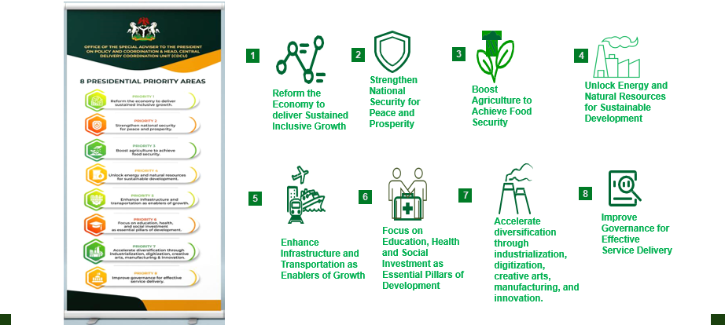
THE 8 PRIORITY AREAS OF MR PRESIDENT

Slide 6
OBJECTIVES OF THE PP&MD
The Objectives of PP&MD are to
Achieve a diversified and resilient economy.
Enhanced security and improved quality of life for citizens.
Modernized infrastructure and better public services.
Ensure a transparent and accountable government

Slide 7
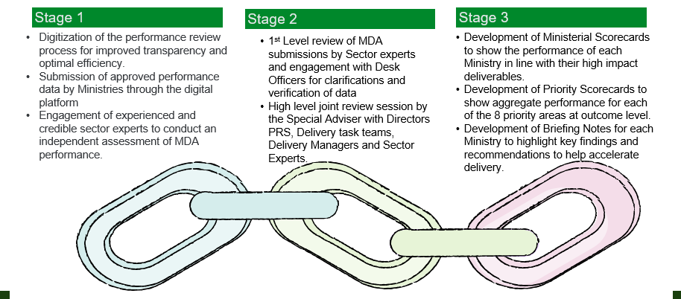
METHODOLOGY ADOPTED FOR THE MINISTERIAL PERFORMANCE REVIEW

Slide 8

PRIORITY AREAS AND DELIVERABLES FOR NACETEM.
FOR high impact deliverables - Enhancing research and collaboration within agencies.
Implementation of 2022 STI Policy
Bridging MSMEs gap
Developing STI programs

Slide 9
ROLES OF NACETEM
Evaluation of the current reporting template of the ministry
Improving on the agency's current performance
Others, collective discussion, WE take a look at the current reporting format for the ministry.

Slide 10

REPORTING FORMAT FOR NACETEM
Name of program
Comprehensive report or resolution from the program
Attached picture evidence

Slide 11
CONCLUSION
In conclusion, this presentation has provided a comprehensive overview of the Presidential Priorities and Ministerial Deliverables (PP&MD), emphasizing NACETEM's critical role in driving impactful outcomes.
Through strategic implementation of STI policies, bridging MSME gaps, and fostering research collaboration, NACETEM contributes significantly to achieving national development goals.
By maintaining accountability and aligning efforts with the administration's priorities, NACETEM stands as a vital player in realizing sustainable development in Nigeria.

Slide 12
Thank you for Listening

