Slide 1
Metering as a Tool for Minimizing Non-Technical Losses in Yola Electricity Distribution Company
Engr. AMOS, Chinda
National Centre for Technology Management, Nigeria
SCIENCE, POLICY AND DEVELOPMENT STUDIES
NORTH EAST ZONAL OFFICE
March, 2025
NACETEM Researchers’ Lecture Series 2024
Notes:
NACETEM Researchers’ Lecture Series 2024

Slide 2
OUTLINE
INTRODUCTION
STATEMENT OF PROBLEM
AIM AND OBJECTIVES
LITERATURE REVIEW
METHODOLOGY
RESULTS ANALYSIS AND DISCUSSIONS
CONCLUSION
NACETEM Researchers’ Lecture Series 2024

Slide 3
INTRODUCTION
Electrical Power System and its Application
Functional zones: Generation, Transmission and Distribution
Devices for electricity billing
Energy theft
Losses in Electrical power System
NACETEM Researchers’ Lecture Series 2024

Slide 4
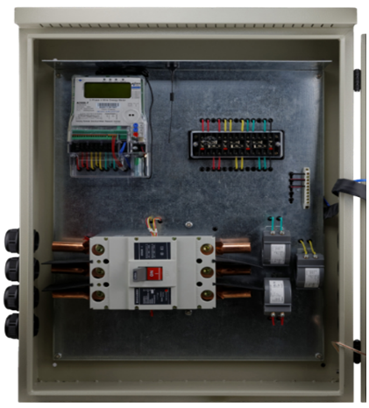
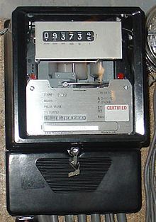
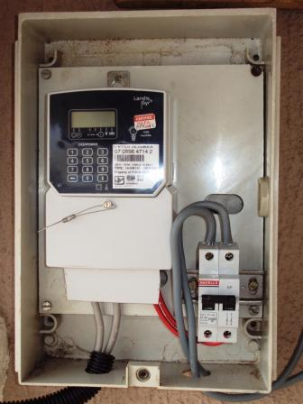
Devices for Electricity Billing
Analogue Meter
Pre-payment Meter
MD Prepayment Meter

Slide 5
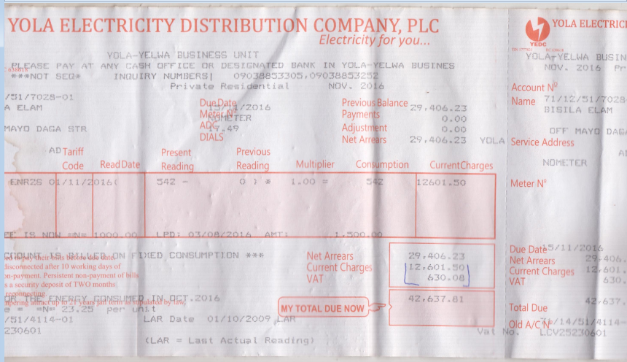
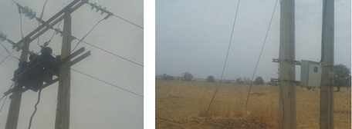
Devices for Electricity Billing
Un-Metered customer bill
Boundry Substation Metering

Slide 6
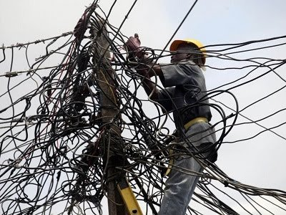
Electricity Theft
Type of violation
Direct connection to supply
Using alternative neutral
Phase to phase connections
Meter tampering/breaking of meter seals
Meter by-pass

Slide 7
STATEMENT OF PROBLEM
Given the attitude of Nigerians towards Public Property, whatever the quantity of electrical energy is generated, if proper control is not pursued and maintained, there can hardly be a time when She would get out of Her Electrical Energy crisis, hence a deliberate metering policy is required to be put in place both on the grid and at the distribution level where the actual power is dispensed and utilized.
NACETEM Researchers’ Lecture Series 2024

Slide 8
AIM AND OBJECTIVES
The aim of this research is to analyze electrical energy consumption pattern of electricity consumers within YEDC network with a view to ascertaining the benefit of metering as a tool for minimizing non-technical losses in electrical energy distribution of Yola Electricity Distribution Zone (YEDC).
Thus the Objectives are:
To analyze the benefits of metering to the electricity supply chain for the sole purpose of enhancing service delivery.
To ascertain any net improvement in revenue collection when compared with delivered energy and actual revenue collected for such within a sampled billing period.
Suggest ways on how to minimize non-technical losses to enhance reliable/sufficient electrical power supply.

Slide 9
LITERATURE REVIEW
Author | title | source | findings
Nizar et al, 2006 | Load profiling Non-Technical Loss Activities in a power utility | proceedings of the 1st International power and Energy Conference (PECON) | Describes an intelligent system for detection of non-technical losses in Tenaga Nasional Berhad (TNB) Malaysia on low voltage Distribution network
Julio, 2012 | Improving the Efficiency of Power Distribution Systems through Technical and Non-Technical Losses Reduction | Transmission and Distribution Conference and Exposition | Ascertain all expected losses in the power system using load-flow analysis also by reducing both technical and non-technical losses and thereby improving the efficiency
EEA Technical Report. 2013 | Achieving Energy Efficiency Through Behaviour Change | https://www.eea.europa.eu | Explains how the pricing schemes work and the relative lack of ability for consumers to negotiate with energy suppliers
NACETEM Researchers’ Lecture Series 2024

Slide 10
LITERATURE REVIEW Contd.
Author | Title | Source | Findings
Ortech Management Engineering Training 2014 | Statistical Metering; (An Invaluable Tool for Energy Accountability and Improved Service Delivery) | Paper presented at MYTO 2014 Meter roll out programme. | Proposed massive deployment of energy meters to eradicate/minimize all NTL related issues.
Refou et al., 2015 | Evaluation of Electric Energy Losses in Southern Governorates of Jordan Distribution Electric System | International Journal of Energy Engineering | Narrates that large proportion of electrical energy loss is as a result of un accountable electrical energy units
From the reviewed literature therefore one can clearly see that use of metering as well as applying modern techniques of electrical energy audit would go a long way in minimizing Non-Technical Losses and thereby enhancing efficiency of electrical energy service delivery within the YEDC area of franchise.

Slide 11
METHODOLOGY
Methods followed in this research:
The mathematical formula for the computation of the NTL problem was derived.
This calculation requires energy consumption accumulated from the beginning of the billing period and the consumption accumulated up to the end of the billing period. The accumulated consumption at the end of the period is subtracted by the accumulated consumption at the beginning of the period. The result is the total consumption during the time period in kilowatt hours and the portion of the bill for energy consumption is based on this number.
Results for analysis were obtained using the Excel package and solutions of the analyzed data when compared with other techniques has served the purpose of the research.
NACETEM Researchers’ Lecture Series 2024

Slide 12

METHODOLOGY Contd.
Energy Losses
E_{Loss}⁼ E_{delivered} – E_{Sold}
Revenue Loss due to technical losses
C_{Com Loss}⁼ U_{Elect Cost} _{X} E_{loss}+ M _{Maintenance Cost}
Non-technical Loss
C_{NTL =}C_{Com Loss} – C _{Technical Loss}
where, U_{Elect cost}= Unit cost of electricity
$P=$V²/R,
As V=1R
Therefore, P=1²R
Also, P= VICOSθ
NACETEM Researchers’ Lecture Series 2024

Slide 13
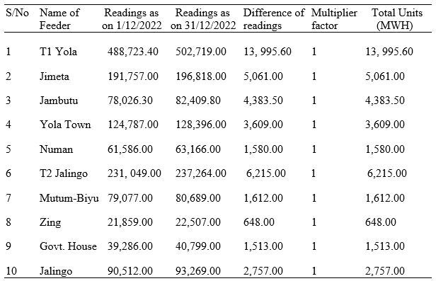
Incoming and Outgoing Feeders of Substation
NACETEM Researchers’ Lecture Series 2024

Slide 14
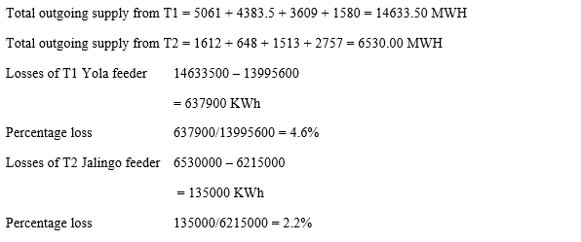
Losses of T1 Feeder and T2 Feeder

Slide 15
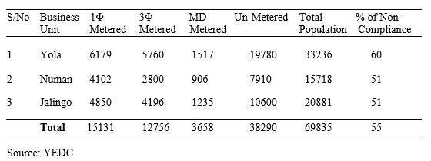
Customer Population Profile
NACETEM Researchers’ Lecture Series 2024

Slide 16
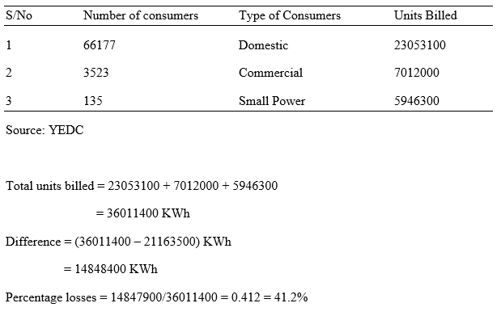
Details of Billed Units
Outgoing Feeders: There are only three main types of consumers on this feeder. Their total units consumed/billed have been recorded from their monthly billing sheet and the results in the table below were obtained.

Slide 17
Detailed Analysis of T1 Feeder
Yola (T1) feeder which includes Jimeta, Jambutu and Yola Town is used here as case study for non-technical loss calculation whereas:-
Total metered customers from table above = 13,456
Total un-metered customers from the same table = 19,780
Difference between metered and un-metered customers = 6324
Therefore % of metered Customers = 6324/19780 = 32%
Also % of un-metered Customers = 6324/13456 =47%
Total Mega Watts consumed in Yola for the month of December, 2016 = 13053.5MWh
Unit Consumed by metered Customers in T1 =32% of 13053.5MWh = 4177.12MWh
Estimated bill of un-metered Customers in T1 = 47% of 13053.5MWh = 6135.15MWh
Total unit consumed = 79% of 13053.5 = 10312.27MWh
Non-Technical loss = 21% of 13053.5MWh = 2741.24MWh

Slide 18
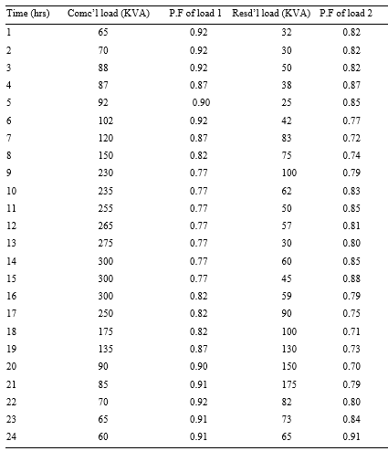
Profile for Commercial and Residential Loads

Slide 19
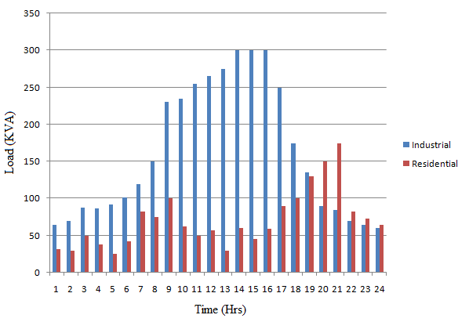
Load variation over 24 hrs period

Slide 20
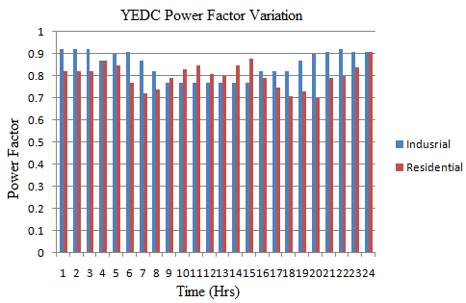
Variation of power factor over 24 hrs

Slide 21
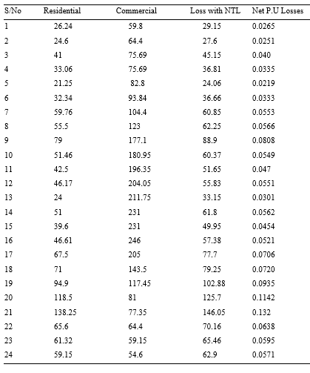
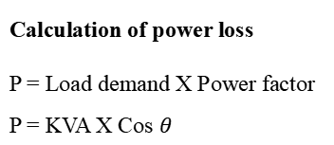
Power Loss Profile
Calculation of power loss
P = Load demand X Power factor
P = KVA X Cos $θ$

Slide 22
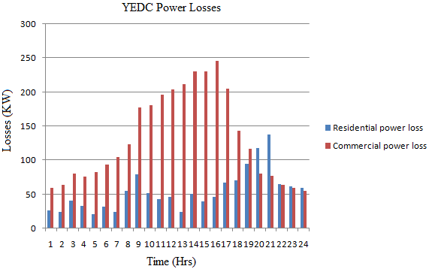
Power Losses

Slide 23
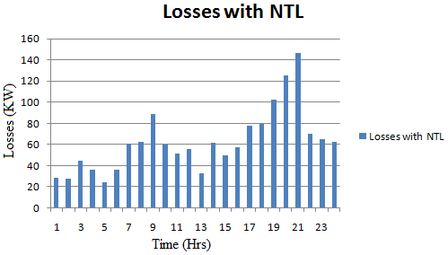
Non-Technical Losses

Slide 24
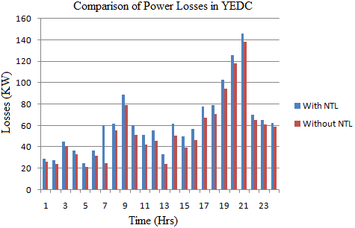
Losses Comparison

Slide 25
Conclusion
The comparison between the sampled metered and un-metered consumers have revealed that indeed metering is the only valuable tool required to minimize Non-Technical losses in the dispensation of electrical energy supply.
The results also indicate that Non-Technical losses have both financial implications on the consumers as well as political stability implications on the general operations of Yola Electricity Distribution Company.

Slide 26

NACETEM Researchers’ Lecture Series 2024

