Slide 1

ICT Integration in Improving Agility of Petroleum Distribution in Nigeria
National Centre for Technology Management (NACETEM), Nigeria
Dr. Obiageli Nneka Nze

Slide 2

Introduction
The petroleum products supply and distribution in Nigeria requires a well-articulated and strategically structured logistics and supply chain system.
This study explores the effect of ICT on agile logistics and its petroleum products distribution performance in Nigeria.
To improve the distribution in a timely and efficient manner to achieve best results.

Slide 3
Study Background
Oil companies, according to Dike, Anthony & Abdulkareem (2013), acknowledged that adoption of ICT to improve the efficiency and effectiveness of their operations, as well as to aid management decision making and strengthen their competitive positions in rapidly changing environments.
ICT allows for the storage and manipulation of the different levels of data on purchasing and delivery of crude oil, refining, and distribution of end products.
Agility in this context is driven by logistics processes that are lean, responsive, adaptable, and cost-efficient.
Eteyen (2024) examined digital transformation strategies, including AI and big data, for enhancing supply chain efficiency in Nigeria's oil sector.
Terab, Umar & Oyedeji (2023) explore information technology usage in supply chain management within Nigeria's petroleum sector.
Attaining such a system requires a multidimensional approach involving institutional reforms, infrastructure upgrades, and the integration of digital technologies (Ucheobi et al, 2025).
Umuteme (2021) highlights, is key to achieving operational excellence in distribution through process digitalization of logistics and supply chain management into more efficient, optimised, more profitable, and value-adding operations.

Slide 4

Methodology
The research data is sourced through interviews and questionnaire administered to the Major Oil Marketers Association of Nigeria (MOMAN).
The study targets 30 executive staff of each of the selected companies drawn from sales, marketing, admin, HR, imports, logistics, business analyst, and finance.
Data analysis follows the One-Sample Kolmogorov-Smirnov Test and Analysis of Covariance (ANOVA).

Slide 5

Results and Discussions
Temporal analysis of distribution software in other sectors and possible application in petroleum distribution
Five top Software companies acknowledged in the oil and gas exploration are:
Petrel software solution by Schlumberger
Landmark software solution by Halliburton
Eclipse reservoir simulation software by Schlumberger
HYSYS process simulation software by AspenTech
OFM is a production analysis software by Schlumberger

Slide 6
Results and Discussions cont.
Best Strategies in Petroleum Product Distribution
The variables BDO₂-BDO_{5,} representing samples of pipeline efficiency, ICT systems, boost in local supply, and supplier segmentations, have minimum values of 3 and 5, respectively.
The mean ratio of all sample variables ranged between 4.2 and 4.5, with the sample data of ICT system having the highest mean value of 4.5.
Table 1: Descriptive Statistics of Best Distribution Options
Options | N | Min. | Max. | Mean | Std. Deviation
BDO₁: Large-scale storage for efficient distribution | 187 | 2.00 | 5.00 | 4.2995 | .85267
BDO₂: Improved and efficient pipeline network | 187 | 3.00 | 5.00 | 4.3743 | .75419
BDO₃: Supplier segmentation for resource optimization | 187 | 3.00 | 5.00 | 4.4973 | .65068
BDO₄: Integrated ICT system for efficient management | 187 | 3.00 | 6.00 | 4.5134 | .71360
BDO₅: Investment in local refinery to boost supply | 187 | 3.00 | 5.00 | 4.3422 | .74088
BDO₆: Investment in local expertise for efficient operation | 187 | 2.00 | 5.00 | 4.3529 | .73582
BDO₇: Integrated management system and process | 187 | 2.00 | 5.00 | 4.3155 | .81776
Valid N (listwise) | 187

Slide 7
Results and Discussions cont.2
Effect of ICT Integration on Agile Performance of Petroleum Distribution
K-test data result of Table 2 shows mean responses higher than the Likert mean test value of 3, indicating the variables are true of ICT effects on product distribution efficiency.
ICT_{V1}: Availability of right information at the right time for various stakeholders
ICT_{V2}: Improved efficiency and accountability through integrated ICT system to manage sales, purchase, stock, customer queries, and inventory (Q₂)
ICT_{V3}: Cost management through transport resource, logistics, and inventory tracking (Q₃)
ICT_{V4}: Positioning right products to right market (Q₄)
ICT_{V5}: Effectively match demand with supply (Q₅)
ICT_{V6}: Mitigate supply chain risk through facilitation of informed decisions in transport and distribution (Q₆)
ICT_{V7}: Facility and retail outlet monitoring through GIS location-based Information (Q₇)
Table 2: One-Sample Kolmogorov-Smirnov Test of ICT variables effect Agile Distribution
 |  | ICT_{V1} | ICT_{V2} | ICT_{V3} | ICT_{V4} | ICT_{V5} | ICT_{V6} | ICT_{V7}
N |  | 187 | 187 | 187 | 187 | 187 | 187 | 187
Normal Parameters^{a,b} | Mean | 4.6684 | 4.4278 | 4.4920 | 4.5615 | 4.4920 | 4.5829 | 4.4225
 | Std. Dev. | .59317 | .79574 | .65884 | .68800 | .66695 | .61112 | .74641
Most Extreme Differences | Absolute | .439 | .363 | .363 | .401 | .365 | .400 | .358
 | Positive | .288 | .236 | .220 | .257 | .223 | .247 | .220
 | Negative | -.439 | -.363 | -.363 | -.401 | -.365 | -.400 | -.358
Test Statistic |  | .439 | .363 | .363 | .401 | .365 | .400 | .358
Asymp. Sig. (2-tailed) |  | .000^{c} | .000^{c} | .000^{c} | .000^{c} | .000^{c} | .000^{c} | .000^{c}
a. Test distribution is Normal.
b. Calculated from data.
c. Lilliefors Significance Correction.

Slide 8
Results and Discussions cont.3
Test of Hypothesis
The study further tested the following null hypothesis: H₀₁ There is no significant relationship between investment in ICT innovation and agile petroleum distribution performance.
The F value of 98.599 and P value of 0.000 at a 0.05 significance level, the ANOVA indicates that the variables have a significant effect on the response variable (see Table 3).
This is also confirmed by t - calculated of 9.93, which is greater than t-tabulated of 1.976.
Following these, we reject the H₀₁ and accept that ICT variables have a significant effect on agile distribution performance of petroleum products.
Table 3: ANOVA for the ICT Adoption for Agile Distribution

Slide 9
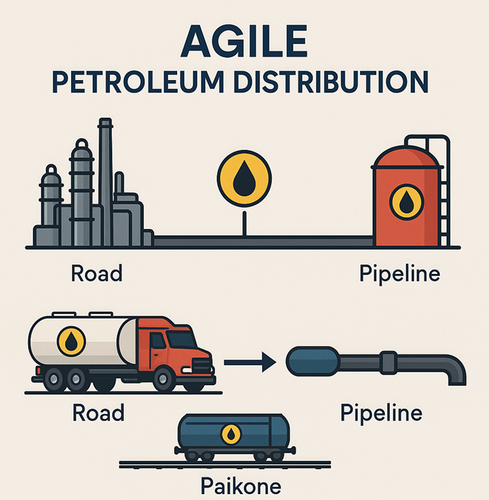
Conclusion
The study finding shows that ICT capabilities support the operational efficiency and performance of the petroleum distribution value chain.
Innovation in ICT systems and applications enables the integration of all organizational functions into a single workflow with end-to-end visibility of value chain operation beginning from product sourcing, transportation, and retail sales.
The capability of the ICT GIS system supports monitoring supply chain infrastructure, trace and track logistics vehicles, stock, sales, transportation, and organizational resources, improving accountability, mitigating losses, theft, and mismanagement of resources.
ICT system eliminates the inefficiencies of manual process and boosts operational speed, eliminates error, and supports timely and quick information flows amongst the various chain stakeholders.

Slide 10
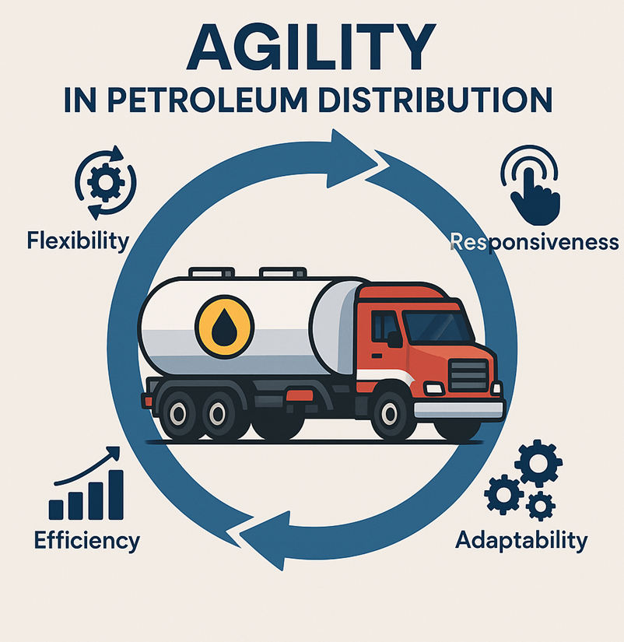
Recommendations
The need to invest in innovation in ICT for operational efficiency and improved performance cannot be over emphasized.
Innovations in ICT is a strategy to stay ahead of competition through cost efficiency, market responsiveness, operational flexibility and services that meet and exceed customer expectations.
Innovations in ICT supports quality of service by improving customer satisfaction, optimizing the inventory costs and total costs, effectively matching demand with supply and more.

Slide 11

Acknowledgement
We appreciate the staff and management of the 7 foremost oil marketers, namely, Total Energies, OVH Energy (Oando), MRS, Conoil Plc, Ardova Plc, 11 Plc, and NNPC Retail Limited, in helping us to source data for the research.
Data was collected from their office and operational base in Lagos and Abuja, respectively.

Slide 12
References
Dike, I. U., & Abdulkareem, A. (2013). Impact of ICT in oil and gas exploration: A case study. International Journal of Computers & Technology, 10(7), 1830–1835.
Eteyen, O. (2024). Digital transformation in supply chain management: Leveraging AI and big data for enhanced efficiency in the Nigerian oil sector. International Journal of Management and Fuzzy Systems, 10(2), 35–42.
Terab, B. S., Umar, U. A., & Oyedeji, A. N. (2023). Information technology in supply chain management: Perspectives from key actors in the Nigerian petroleum sector. African Journal of Science, Technology, Innovation and Development, 15(7), 955–961.
Christopher A. Ucheobi, Ejem A. Ejem, Shirgba T. Aikor, Goodluck T. Njoku, Obiageli N. Nze, Awa O. Nwosu, Chinenye L. Okafor & Chidimma F. Ekejiuba (2025). Logistics Agility of Petroleum Products Distribution in Nigeria: Economic and Environmental Implications. International Journal of Environmental Sciences, ISSN: 2229-7359, 11(4), 1561-1579.
Umuteme, B. (2021). Investment in technology: make or break for Nigeria’s oil, gas industry. https://www.blueprint.ng/investment-in-technology-make-or-break-for-nigerias-oil-gas-industry-2/

Slide 13


