Slide 1
Application of RSM in Analyzing Weld Metal Viscosity in Mild Steel Welds
Engr. Seigha Gumus, FNIMechE
NACETEM South-South
NACETEM Researchers’ Seminar Series
Thursday, 16th October, 2025

Slide 2
Outline
Introduction
Statement of the problem
Aim and Objectives of the study
Research Questions
Materials and methods
Results
Conclusions

Slide 3
Introduction
Welding is an essential manufacturing Process
  Automobile
  Ship building
  Construction
  Pipeline manufacturing
  Aerospace etc.
Welding involves the joining of materials, such as metals through the application of heat or pressure to form a cohesive bond
Welding processes inherently introduce residual stresses, which can compromise the integrity and performance of welded structures

Slide 4
Introduction Cont’d.
Weld Metal Viscosity is an integral part of welding process
Viscosity of molten welds in mild steel is a key factor during welding process.
It plays a crucial role in the weld quality thereby affecting various parameters such as penetration, bead shape and the potential for possible defects since the viscosity influences how molten metal flows and spreads to fill the welded joints
The process can be described of how the molten metal flows, wets the welded surfaces filling the deep pool and solidifies during weld pool formation.

Slide 5
Problem Statement
Controlling thermo-mechanical residual stress in mild steel weldments remains a critical challenge in welding engineering
In mild steel weldments, excessive residual stress can lead to problems such as distortion, fatigue cracking, and reduced load-bearing capacity
Inherent limitations in traditional and analytical methods
Introducing hybrid optimization and predictive modeling techniques should be able to address these short comings.

Slide 6
Aim
To optimize and predict weld metal viscosity variables in mild steel weldments using Response Surface Methodology (RSM)

Slide 7
Objectives
investigate the influence of welding parameters (current, voltage, gas flow rate, ambient temperature) on residual stress and weld metal viscosity
optimize welding parameters for weld metal viscosity using RSM

Slide 8
Research Questions
How do welding parameters affect residual stress and weld metal viscosity
What is the optimal parameter combination for minimizing residual stress using RSM

Slide 9
Materials and Methods
The Method Outlines ;
  the experimental design
  data collection strategies,
  model development procedures,
Experimental Set-up
  Base material – Mild Steel Plates
  Welding operation – Tungsten Inert Gas Welding Machine
  Shielding gas – Argon

Slide 10
Design of Experiment (DOE)
Data collection focused on four key input parameters: Current (A), Voltage (V), Gas Flow Rate (L/min), and Material Temperature (°C), which were varied systematically to investigate their effects on weld metal viscosity responses
A Central Composite Design (CCD) with 20 experimental runs was used to investigate four parameters: Current (190-220A), Voltage (21-24V), Gas Flow Rate (13-16 L/min), and Temperature (28-38°C).
TABLE 1: WELDING PARAMETERS
Parameters | Value
 | Low | High
Current (A) | 190 | 220
Voltage (V) | 21 | 24
Gas flow rate (L/min) | 13 | 16
Material Temperature (⁰C) | 28 | 38

Slide 11
Model Building and Data Collection
Using the data obtained from the central composite design (CCD), a second –order polynomial regression model for the weld metal viscosity was developed. The regression equations were fitted by including linear, interaction and quadratic terms.
TABLE 2 EXPERIMENTAL RESULTS WITH 20 RUNS
 |  | Factor 1 | Factor 2 | Factor 3 | Factor 4 | Response
Std | Run | A:Current | B:Voltage | C:Gas Flow Rate | D:Material Temp | Weld Metal Viscosity
 |  | A | V | L/min | 0C | μ, Kg/(m.s)
5 | 1 | 200 | 22 | 14 | 30 | 0.0072
11 | 2 | 200 | 22 | 14 | 30 | 0.0071
8 | 3 | 200 | 22 | 14 | 32 | 0.0071
18 | 4 | 200 | 22 | 14 | 31 | 0.0072
2 | 5 | 200 | 22 | 14 | 32 | 0.0071
6 | 6 | 210 | 23 | 15 | 33 | 0.00798386
9 | 7 | 210 | 21 | 15 | 34 | 0.00740317
12 | 8 | 210 | 24 | 15 | 36 | 0.00779224
3 | 9 | 190 | 23 | 15 | 28 | 0.00668199
4 | 10 | 220 | 23 | 15 | 34 | 0.00811341
20 | 11 | 210 | 23 | 13 | 35 | 0.00824065
10 | 12 | 210 | 23 | 16 | 37 | 0.00885476
16 | 13 | 190 | 21 | 13 | 29 | 0.00634994
15 | 14 | 190 | 24 | 13 | 35 | 0.00848058
14 | 15 | 220 | 21 | 13 | 28 | 0.00650686
13 | 16 | 220 | 24 | 13 | 38 | 0.00889388
1 | 17 | 190 | 21 | 16 | 34 | 0.00675974
19 | 18 | 190 | 24 | 16 | 30 | 0.00739965
7 | 19 | 220 | 21 | 16 | 37 | 0.00845221
17 | 20 | 220 | 24 | 16 | 38 | 0.00898277

Slide 12
The experimental trials were conducted based on the CCD matrix, and the results for each run are presented.
Each row in the table corresponds to a unique combination of the input process parameters (Current, Voltage, Gas Flow Rate, and Ambient Temperature), and the measured output responses (Weld Metal Viscosity).
A careful observation of the data reveals how variations in welding parameters significantly affect the viscosity of the mild steel weldments

Slide 13
RSM ANALYSIS
The RSM analysis in this study comprehensively assessed the relationship between the welding input parameters and the weld metal viscosity response variables using various statistical and graphical tools.
The fit summary will help identify the most suitable model—linear, interaction, or quadratic—based on statistical metrics such as R², adjusted R², and predicted R².
The lack-of-fit test will determine the adequacy of the model by comparing the variation due to the model with that due to experimental error.
Analysis of variance (ANOVA) will evaluate the significance of each input factor and their interactions, while the fit statistics will provide insights into model precision and reliability

Slide 14
TABLE 3: Fit Summary for Weld Metal Viscosity
Source | Model p-value | Lack of Fit p-value | Adjusted R² | Predicted R²
Design Model | < 0.0001 | 0.0568 | 0.9495 | 0.7967
Linear | < 0.0001 | 0.0225 | 0.8604 | 0.7782
2FI | 0.4866 | 0.0202 | 0.8596 | 0.3472
Quadratic | < 0.0001 | 0.8732 | 0.9980 | 0.9528 | Suggested
Cubic | 0.8732 |  | 0.9963 |  | Aliased
The Fit Summary for Weld Metal Viscosity evaluates various models used to predict the viscosity based on their statistical significance and predictive accuracy. The Design Model has a highly significant p-value (< 0.0001) and a strong Adjusted R² value of 0.9495, indicating it fits the data well, although its Lack of Fit p-value (0.0568) suggests a minor issue with model fit in certain regions. The Linear model is also statistically significant, with a p-value of < 0.0001, but its Adjusted R² of 0.8604 is lower, indicating a weaker fit compared to the Design Model

Slide 15
TABLE 4: Lack of Fit Tests for Weld Metal Viscosity
Source | Sum of Squares | df | Mean Square | F-value | p-value
Linear | 1.424E-06 | 13 | 1.095E-07 | 43.80 | 0.0225
2FI | 8.566E-07 | 7 | 1.224E-07 | 48.95 | 0.0202
Quadratic | 1.688E-09 | 3 | 5.628E-10 | 0.2251 | 0.8732 | Suggested
Cubic | 0.0000 | 0 |  |  |  | Aliased
Pure Error | 5.000E-09 | 2 | 2.500E-09
The Lack of Fit Tests for Weld Metal Viscosity, which assess how well the fitted models represent the data by comparing the variation explained by the model with the unexplained variation (pure error).
The Linear model has a Sum of Squares of 1.424E-06, with a high F-value of 43.80 and a p-value of 0.0225, indicating a significant lack of fit. In contrast, the Quadratic model, with a Sum of Squares of 1.688E-09, has a much lower F-value of 0.2251 and a p-value of 0.8732, suggesting it does not exhibit a significant lack of fit, making it the best model for the data

Slide 16
TABLE 5: ANOVA for Weld Metal Viscosity
Source | Sum of Squares | df | Mean Square | F-value | p-value
Model | 0.0000 | 14 | 9.251E-07 | 691.58 | < 0.0001 | significant
A-Current | 3.191E-07 | 1 | 3.191E-07 | 238.54 | < 0.0001
B-Voltage | 8.393E-09 | 1 | 8.393E-09 | 6.27 | 0.0542
C-Gas Flow Rate | 3.620E-07 | 1 | 3.620E-07 | 270.64 | < 0.0001
D-M. Temp | 1.516E-08 | 1 | 1.516E-08 | 11.33 | 0.0200
AB | 8.056E-08 | 1 | 8.056E-08 | 60.22 | 0.0006
AC | 3.381E-08 | 1 | 3.381E-08 | 25.27 | 0.0040
AD | 3.948E-08 | 1 | 3.948E-08 | 29.51 | 0.0029
BC | 1.077E-07 | 1 | 1.077E-07 | 80.49 | 0.0003
BD | 1.488E-07 | 1 | 1.488E-07 | 111.24 | 0.0001
CD | 3.095E-08 | 1 | 3.095E-08 | 23.14 | 0.0048
A² | 7.338E-08 | 1 | 7.338E-08 | 54.85 | 0.0007
B² | 2.170E-07 | 1 | 2.170E-07 | 162.21 | < 0.0001
C² | 5.566E-07 | 1 | 5.566E-07 | 416.06 | < 0.0001
D² | 4.506E-08 | 1 | 4.506E-08 | 33.69 | 0.0021
Residual | 6.688E-09 | 5 | 1.338E-09
Lack of Fit | 1.688E-09 | 3 | 5.628E-10 | 0.2251 | 0.8732 | not significant
Pure Error | 5.000E-09 | 2 | 2.500E-09
Cor Total | 0.0000 | 19

Slide 17
The ANOVA for Weld Metal Viscosity shows how various factors and how their interactions contribute to the variability in the response variable.
The Model term has a p-value of < 0.0001, indicating that the model is highly significant in explaining the variation in weld metal viscosity.
Among the factors, Current (A), Gas Flow Rate (C), and their quadratic terms (A², C²) show significant effects, with p-values less than 0.0001. Voltage (B) has a p-value of 0.0542, suggesting it is near significance but not quite impactful.
Interaction terms such as AB, AC, AD, BC, BD, and CD all have p-values below 0.05, indicating that these interactions significantly affect viscosity.
The significant interactions and quadratic terms suggest a complex relationship between factors that influences the weld metal viscosity.

Slide 18
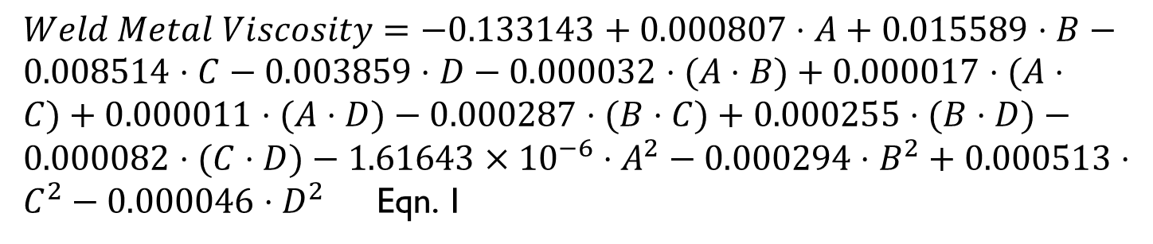
The Model
$Weld Metal Viscosity=−0.133143+0.000807⋅A+0.015589⋅B−0.008514⋅C−0.003859⋅D−0.000032⋅(A⋅B)+0.000017⋅(A⋅C)+0.000011⋅(A⋅D)−0.000287⋅(B⋅C)+0.000255⋅(B⋅D)−0.000082⋅(C⋅D)−1.61643×{10}^{−6}⋅A^{2}−0.000294⋅B^{2}+0.000513⋅C^{2}−0.000046⋅D^{2}$ Eqn. 1
The equation for Weld Metal Viscosity (Equation 1) represents a model that predicts the viscosity of the weld metal based on the factors Current (A), Voltage (B), Gas Flow Rate (C), and Ambient Temperature (D), along with their interactions and squared terms.
The coefficients in the equation quantify how each factor and its interactions influence the weld metal viscosity.

Slide 19
TABLE 6: Optimal Solution
SN | Input Parameters |  |  |  | Weld Metal Viscosity
 | Current Ampere | Voltage Volts | Gas Flow Rate L/min | Ambient Temp ºC | EXP | RSM
1 | 190 | 21 | 13 | 32 | 0.0072 | 0.0071
2 | 200 | 21 | 14 | 33 | 0.0071 | 0.0071
3 | 210 | 21 | 15 | 29 | 0.0071 | 0.0071
4 | 220 | 21 | 16 | 30 | 0.0072 | 0.0072
5 | 190 | 22 | 14 | 34 | 0.0071 | 0.0071
6 | 200 | 22 | 13 | 28 | 0.0080 | 0.0080
7 | 210 | 22 | 16 | 37 | 0.0074 | 0.0074
8 | 220 | 22 | 15 | 35 | 0.0078 | 0.0078
9 | 190 | 23 | 15 | 31 | 0.0067 | 0.0067
10 | 200 | 23 | 16 | 36 | 0.0081 | 0.0081
11 | 210 | 23 | 13 | 36 | 0.0082 | 0.0082
12 | 220 | 23 | 14 | 38 | 0.0089 | 0.0089
13 | 190 | 24 | 16 | 29 | 0.0063 | 0.0064
14 | 200 | 24 | 15 | 34 | 0.0085 | 0.0085
15 | 210 | 24 | 14 | 37 | 0.0065 | 0.0065
16 | 220 | 24 | 13 | 35 | 0.0089 | 0.0089
17 | 190 | 22 | 13 | 32 | 0.0068 | 0.0068
18 | 200 | 21 | 15 | 28 | 0.0074 | 0.0074
19 | 210 | 23 | 16 | 30 | 0.0085 | 0.0085
20 | 220 | 24 | 14 | 36 | 0.0090 | 0.0090

Slide 20
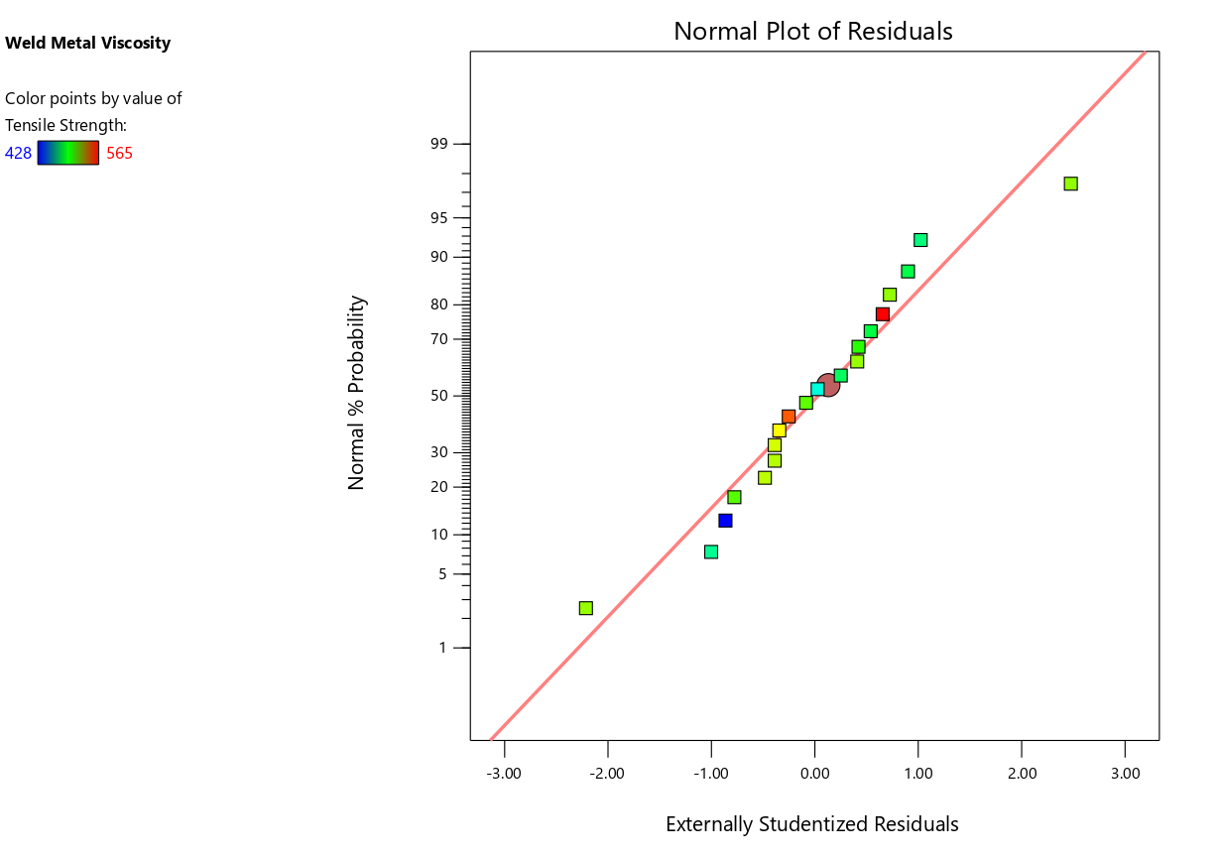
Accuracy of Prediction
With the quadratic model, a reliability plot of the observed and predicted values of the weld viscosity is shown in the figures below
Figure 1: Normal Plot of Residuals for Weld Metal Viscosity

Slide 21
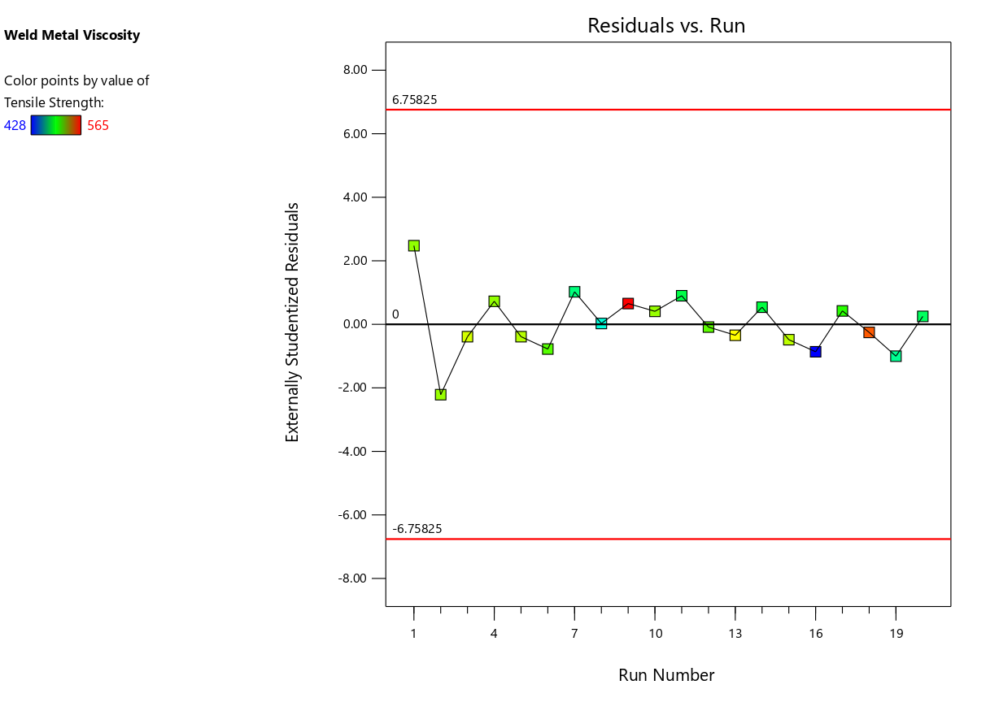
Figure 2: Plot of Residual Vs Run for Weld Metal Viscosity
The Residuals vs. Run Plot for Weld Metal Viscosity (Figure 2) reveals that the residuals are generally randomly distributed over the course of the experimental runs, with no discernible pattern or trend, which is a positive indication that the model is well-specified

Slide 22
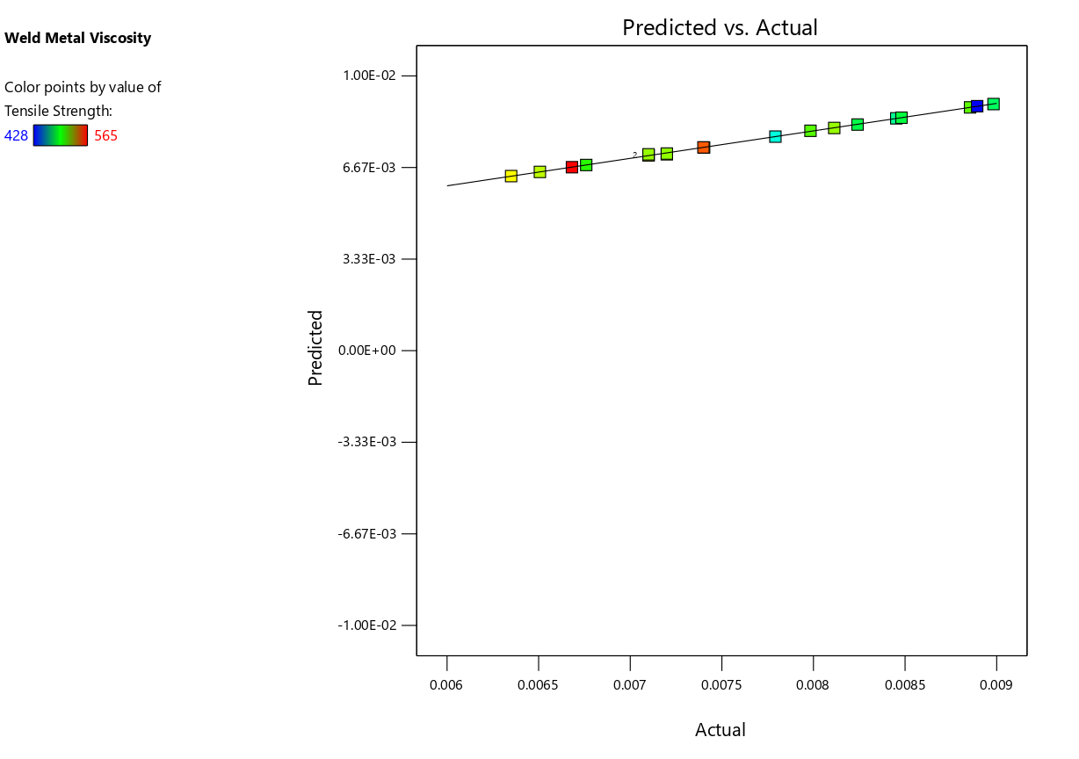
Figure 3: Predicted Vs Actual for Weld Metal Viscosity
The Predicted vs. Actual Plot for Weld Metal Viscosity, presented in fig 3, demonstrates that the regression model provides an accurate fit to the data.
Most of the points are closely aligned with the diagonal reference line, indicating that the predicted values of weld metal viscosity are very close to the actual observed values

Slide 23
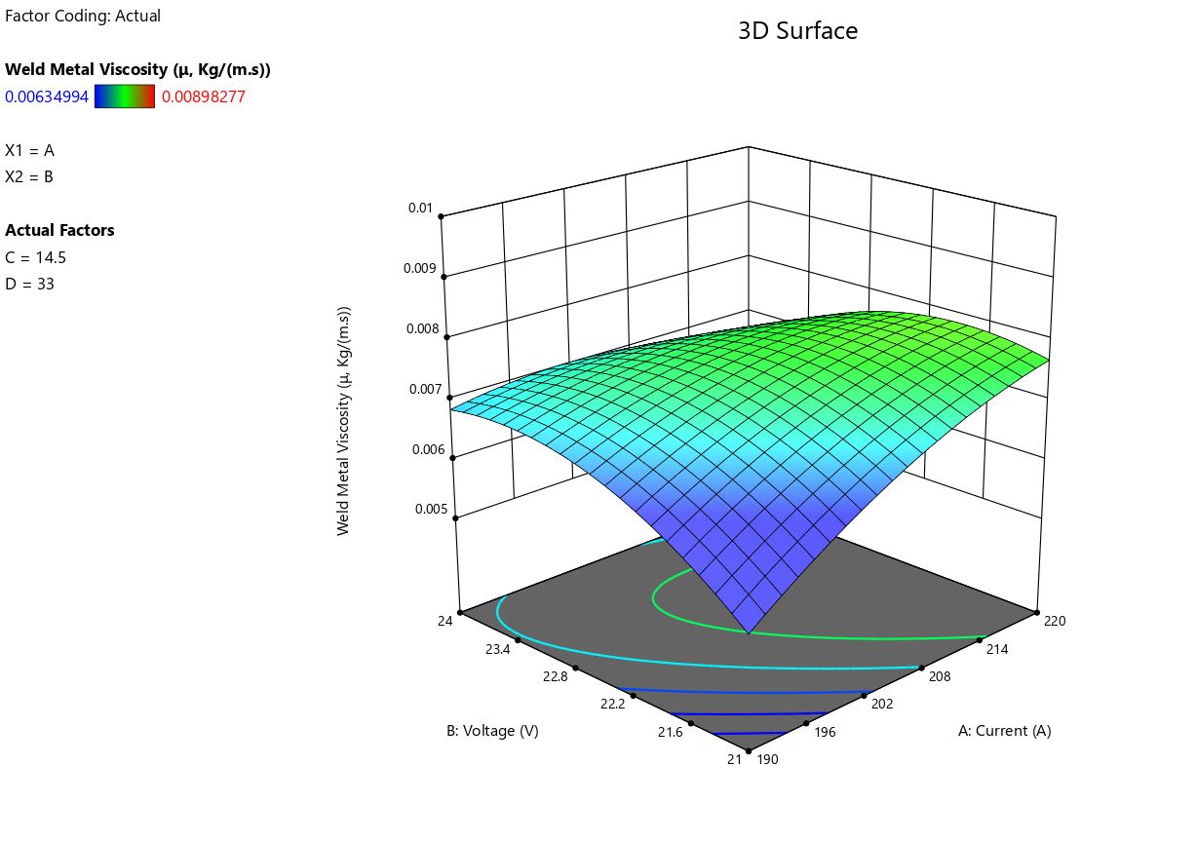
Figure 4: Surface Plot for Weld Metal Viscosity
The 3D Surface Plot for Weld Metal Viscosity, offers a detailed three-dimensional visualization of how Current (A) and Voltage (B) interact to affect the weld metal viscosity, while keeping other factors constant (C=14.5 and D=33). The plot reveals an upward-sloping surface from the bottom-left (low A and B) to the top-right (high A and B), indicating that increasing both current and voltage leads to higher weld metal viscosity. The highest viscosity values (around 0.00898 kg/(m·s)) are observed at the peak in the green region, suggesting that optimal process conditions lie in this top-right zone

Slide 24
CONCLUSIONS
The study successfully shows that Response Surface Method can be effectively applied to mild steel metal for the prediction and optimizing of a weld metal viscosity.
Through a systematic experimentation and data modeling technique, the research established significant relationships between input welding parameters (Voltage, Current, Gas Flow and Temperature) and the key response variable (Weld Metal Viscosity)
.

Slide 25

Thank you.

