Slide 1
ASSESSMENT OF THE SURFACE WATER AND GROUNDWATER INTERACTION WITHIN THE OPA DRAINAGE BASIN, SOUTH-WESTERN NIGERIA
By
OKPURU Ogbonna Aguta
July, 2025

Slide 2
Outline
Introduction
Literature Review
Location and Geology of the Study Area
Research Statement
Aim and Objectives
Methodology
Results and Discussion
Conclusion
References

Slide 3
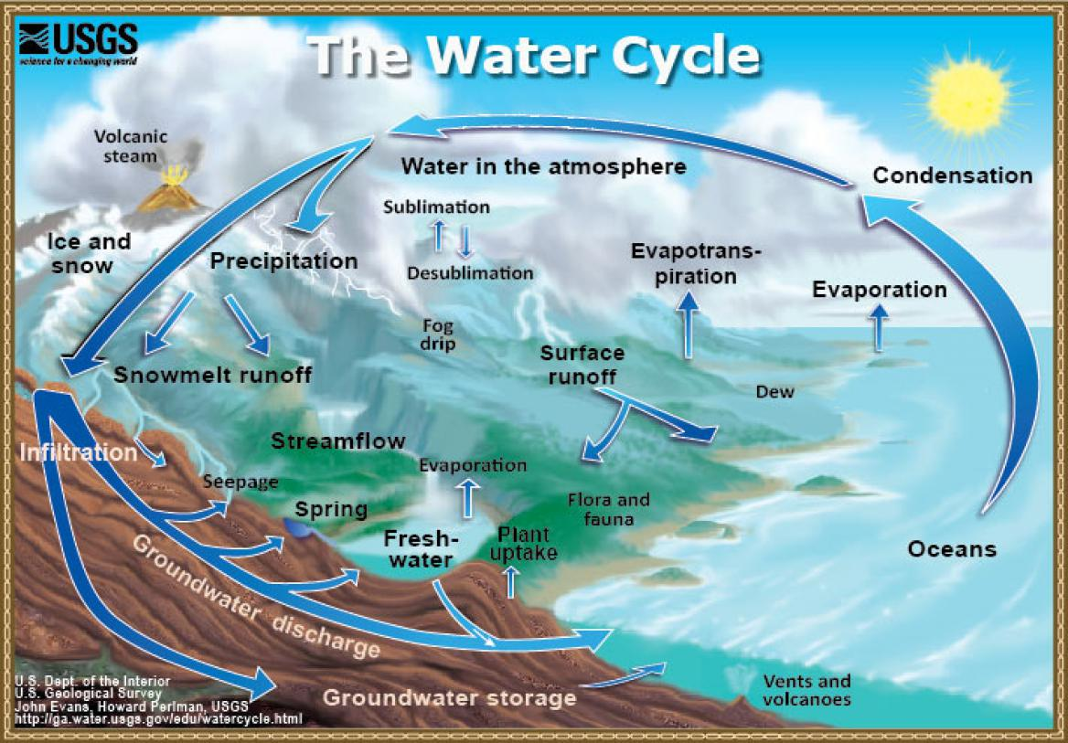
Introduction
Where is water found?
Figure 1: Hydrologic Cycle (Source: USGS, 2019)

Slide 4
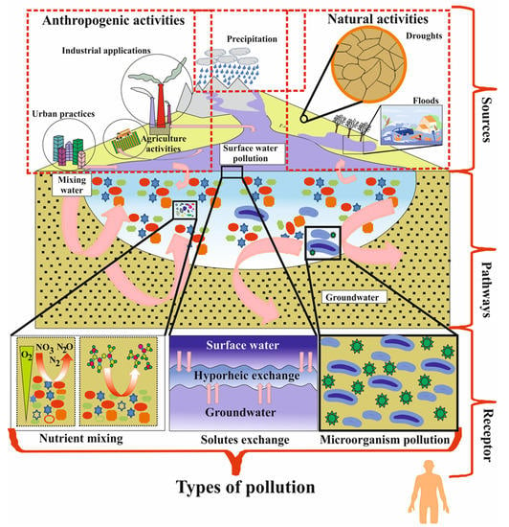
Introduction cont’d
Sources of water contamination
Figure 2: Water Contamination due to Natural and Anthropogenic sources (Akhta et al 2021)

Slide 5
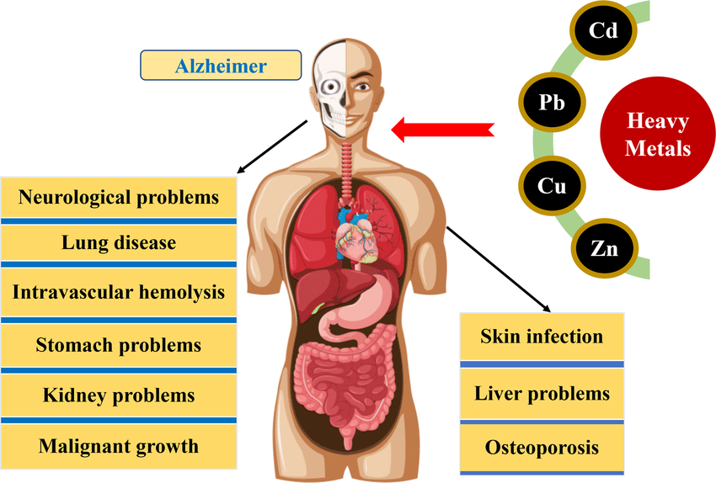
Introduction cont’d
Effect of heavy metals in water on human health
Figure 3: Impacts of Heavy Metals Toxicity on Human Health (Hama et al 2023)

Slide 6
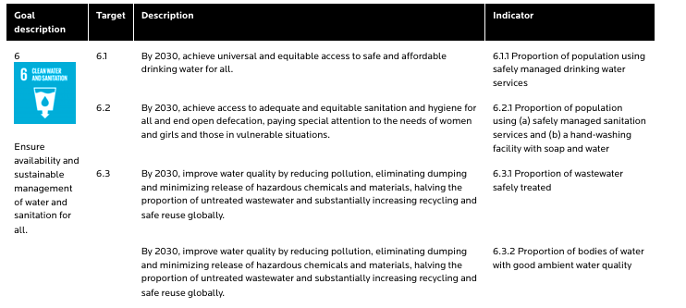

Introduction cont’d
SDG 6 and targets
q

Slide 7
Literature Review
q
Investigated the effect of Oja-Tun market effluent on the chemical quality of Opa Reservoir.
Assessed the effect of discharges from re-channelled rivers and municipal runoff on the water quality of Opa reservoir.
Investigated the Chemical Quality of Groundwater in Obafemi Awolowo University Campus
Examined the suitability of Opa reservoir water for drinking and irrigation purposes.
(Adedeji et al, 2017)
(Konwea et al, 2022)
(Oyewusi et al, 2021)
(Eludoyin et al, 2004)

Slide 8
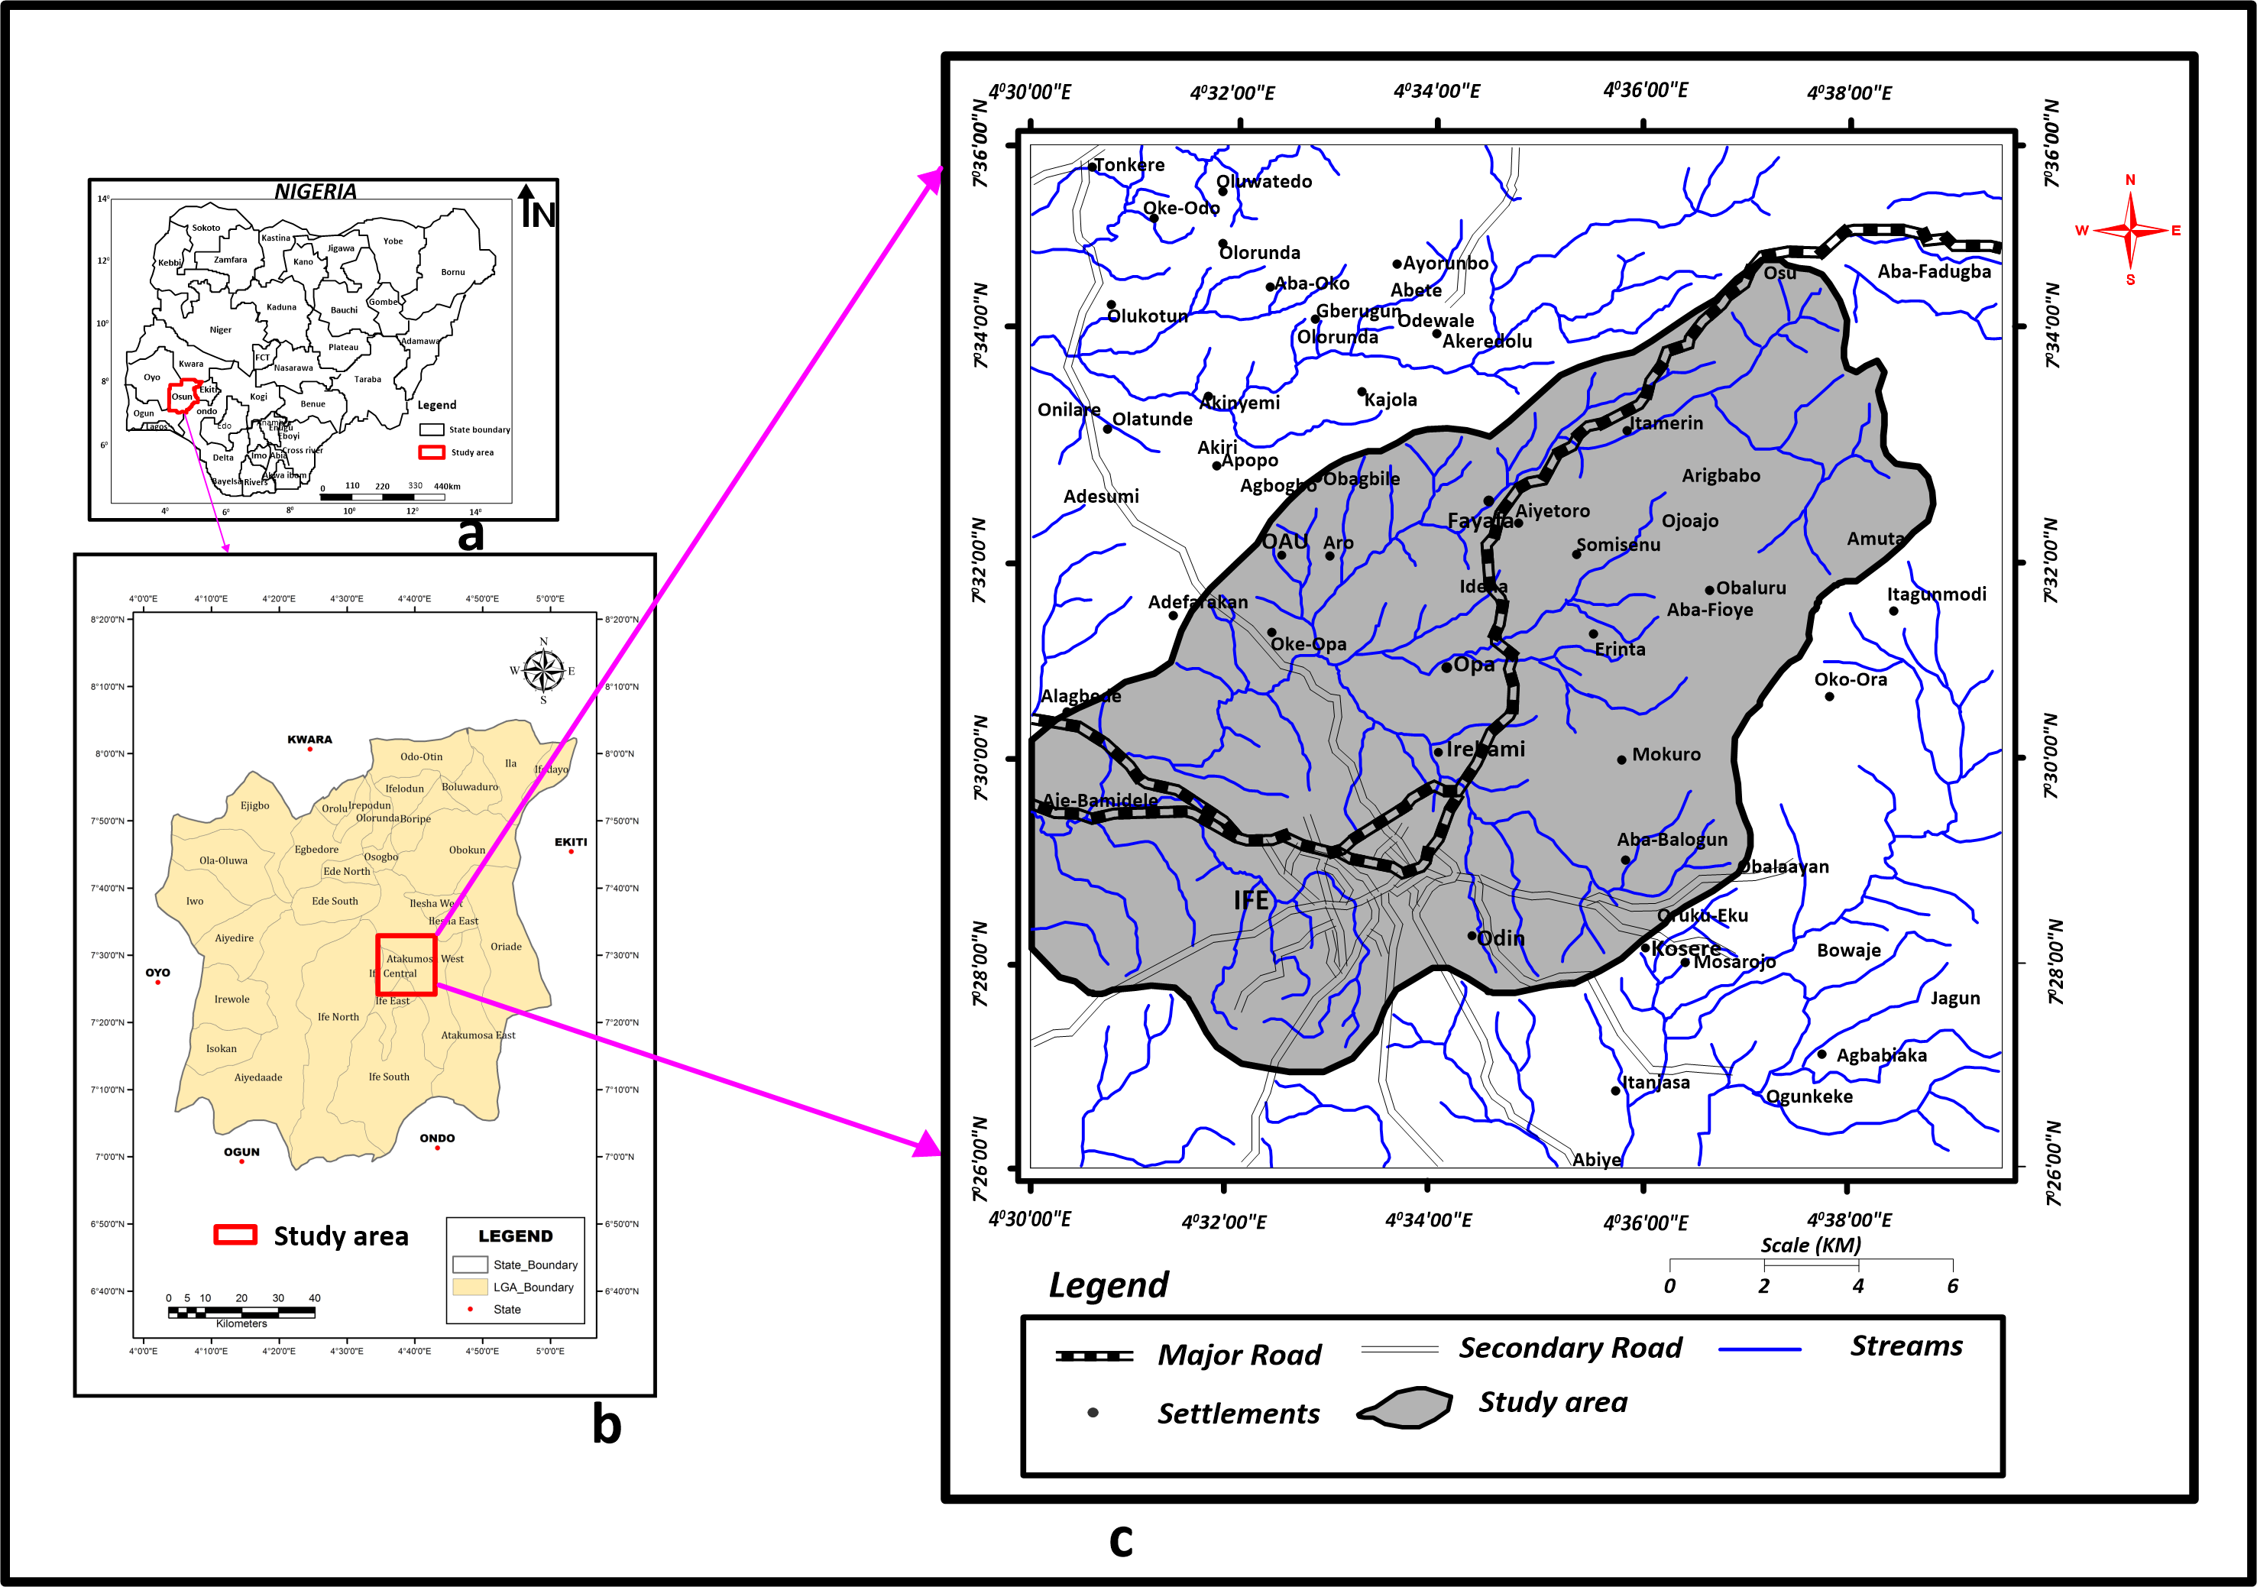
Location of the Study Area
Figure 4A Map of Nigeria (Google.com/Nigeria map, 2015)
4B Map of Osun State (Osunstate.gov.ng/geography/htm, 2011)
4C Study Area (Modified from Google map)

Slide 9
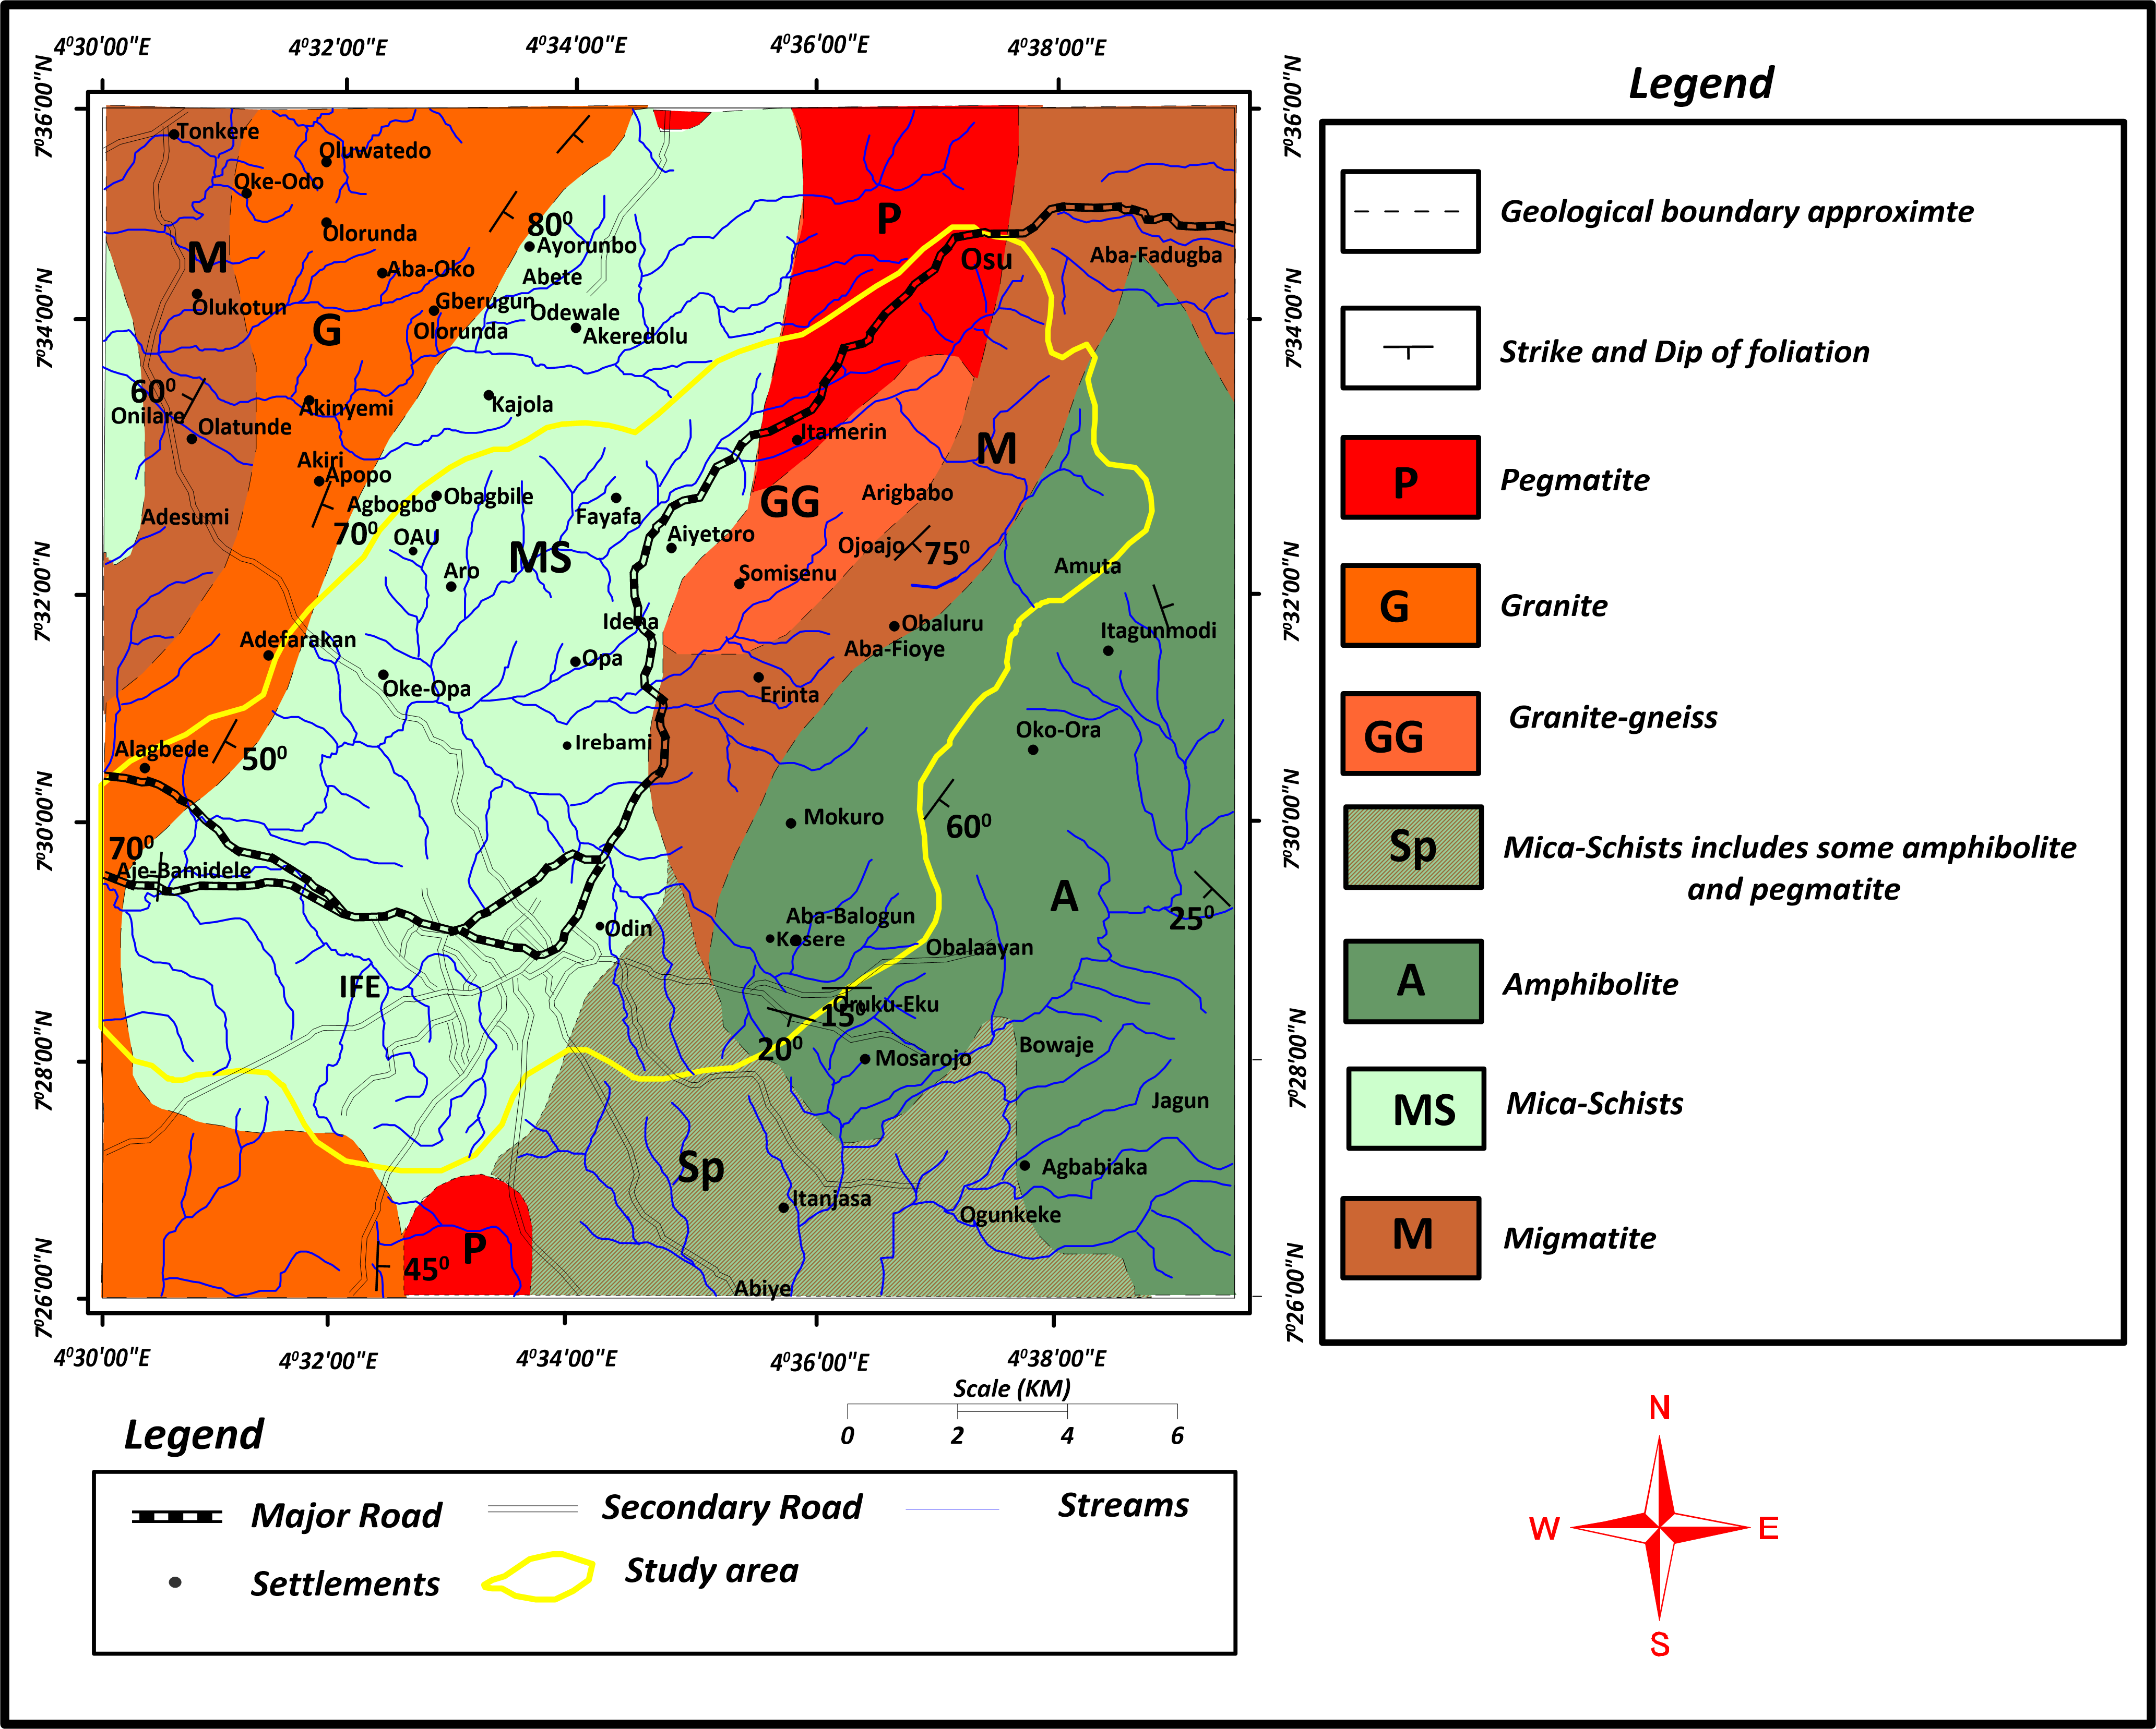
Geology of the Study Area
Figure 5: Geological Map of the Study Area. (Modified from GSN, 1965 using ARCGIS))

Slide 10
Research Statement
Surface water within Opa drainage basin has been the major source of water in Ile-Ife and its environs. Mining activities has led to the contamination of the surface water. Consumption of contaminated water is detrimental to human health. In recent times, the reliance on groundwater has increased due to the surface water contamination. Prevailing hydrogeological settings can cause the migration of contaminants from surface water to groundwater, hence this study.

Slide 11
Aim and Objectives
The aim of this study is to assess the degree of interaction of the surface and groundwater within the Opa drainage basin, South-Western Nigeria.
The objectives of this study are to determine the:
Seasonal variation in the surface water and groundwater chemistry and the sources of the different chemical groups influencing the surface water and groundwater chemistry;
Degree of interaction between the surface water and groundwater; and
Contamination level as well as the surface water and groundwater quality within the Opa drainage basin.

Slide 12
Research Methodology
Desk Work
Reconnaissance Survey
Hydrogeological Investigation
Water Quality Assessment
Soil Investigation
Soil Sampling
Physical Parameters
Chemical Parameters
Grain Size Analysis
Statistical Analysis
Hydraulic Conductivity
Source Identification
Contamination Level
Contaminants Grouping
Seasonal Variation
Water Quality
SW-GW Interaction
Figure 6: Work Flow Diagram

Slide 13
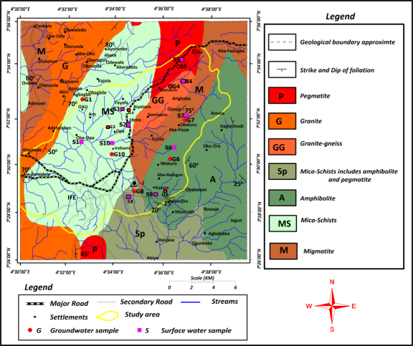
Distribution of Water Samples
Figure 7: Water Sampling Locations (Modified from GSN, 1965 using ARCGIS)

Slide 14
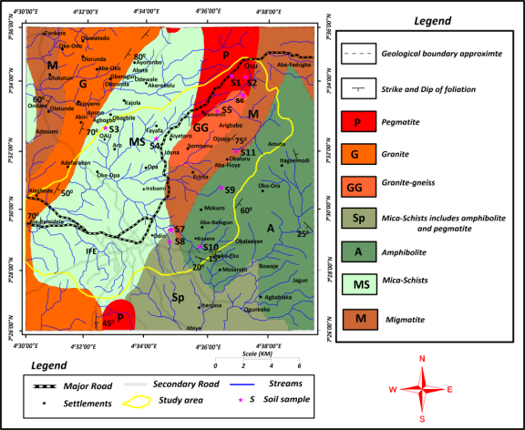
Distribution of Soil Samples
Figure 8: Soil Sampling Locations (Modified from GSN, 1965 using ARCGIS)

Slide 15
Results and Discussions
Table 1: Physicochemical Parameters of Surface Water (Wet and Dry Seasons)
Parameters | Surface Water for Wet Season |  |  | Surface Water for Dry Season |  |  | Control Sample | NSDWQ, 2015 | WHO, 2017
 | Range | Mean | Std. Deviation | Range | Mean | Std. Deviation
Turb | 12.50-236.50 | 124.50 | 158.39 | 4.00-305.00 | 154.50 | 212.84 | 4.00 |  | 5
pH | 7.00-10.50 | 8.75 | 2.47 | 7.00-11.00 | 9.00 | 2.83 | 8.70 | 6.5-8.5 | 6.5-8.5
EC | 0.09-0.24 | 0.17 | 0.11 | 0.10-0.23 | 0.17 | 0.09 | 0 | 1000 | 1000
TDS | 80.00-185.00 | 132.50 | 74.25 | 91.00-168.00 | 129.50 | 54.45 | 009 | 500 | 500
T | 23.10-27.10 | 25.10 | 2.83 | 25.40-30.40 | 27.90 | 3.54 | 23.10 | Ambient | Ambient
DO | 9.30-14.10 | 11.70 | 3.39 | 5.20-6.80 | 6.00 | 1.13 | 11.29
BOD | 2.60-10.20 | 6.40 | 5.37 | 0.30-3.95 | 2.13 | 2.58 | 3.02
Coliform | 0-10972 | 5486 | 7758 | 94->1110 |  | . | 0 | 0 | 0
Na⁺ | 0.00-0.35 | 0.18 | 0.25 | 5.95-16.90 | 11.43 | 7.74 | 0.01 | 200 | 200
K⁺ | 4.74-10.04 | 7.39 | 3.75 | 2.38-25.22 | 13.80 | 16.15 | 0.50
Mg²⁺ | 11.21-21.94 | 16.58 | 7.59 | 9.74-14.73 | 12.24 | 3.53 | 1.09 | 20 | 150
Ca²⁺ | 0.17-0.22 | 0.20 | 0.04 | 0.05-0.09 | 0.07 | 0.03 | 8.40
Fe | 1.43-32.95 | 17.19 | 22.29 | 0.14-45.65 | 22.90 | 32.18 | 0.52 | 0.3 | 0.3
Cd | 0.01-0.04 | 0.03 | 0.02 | 0.00-0.01 | 0.01 | 0.01 |  | 0.003 | 0.003
Co | 0.00-0.04 | 0.02 | 0.03 | 0.09-0.21 | 0.15 | 0.08 | 0
Cr | 0.00-0.00 | 0.00 | 0.00 | 0.05-0.25 | 0.15 | 0.14 | 0 | 0.05 | 0.05
Cu | 0.02-0.05 | 0.04 | 0.02 | 0.00-0.04 | 0.02 | 0.03 | 0 | 1 | 2
Mn | 0.23-0.44 | 0.34 | 0.15 | 0.00-0.17 | 0.09 | 0.12 | 0.02 | 0.2 | 0.4
Ni | 0.00-0.00 | 0.00 | 0.00 | 0.00-0.05 | 0.03 | 0.04 | 0 | 0.02 | 0.07
Pb | 0.20-0.35 | 0.28 | 0.11 | 0.03-0.09 | 0.06 | 0.04 | 0.01 | 0.01 | 0.01
Zn | 0.26-0.42 | 0.34 | 0.11 | 0.04-0.15 | 0.10 | 0.08 | 0.34 | 3 | 3
As | 0.01-0.01 | 0.01 | 0.00 | 0.01-0.01 | 0.01 | 0.00 |  | 0.01 | 0.01
Cl⁻ | 27.91-39.36 | 33.64 | 8.10 | 41.52-74.81 | 58.17 | 23.54 | 5.11 | 250 | 250
SO₄²⁻ | 2.41-3.97 | 3.19 | 1.10 | 4.71-12.60 | 8.66 | 5.58 | 1.31 | 100 | 400
NO₃⁻ | 29.50-59.90 | 44.70 | 21.50 | 0.07-0.79 | 0.43 | 0.51 | 0.01 | 50 | 50
HCO₃⁻ | 3.00-13.50 | 8.25 | 7.42 | 1.50-6.00 | 3.75 | 3.18 | 10.00
CO₃²⁻ | 0.00-0.00 | 0.00 | 0.00 | 0.00-0.00 | 0.00 | 0.00 | ND
PO₄³⁻ | 1.55-3.49 | 2.52 | 1.37 | 1.42-3.29 | 2.36 | 1.32 | 0.21

Slide 16
Results and Discussions
Table 2: Physicochemical Parameters of Groundwater (Wet and Dry Seasons)
Parameters | Groundwater for Wet Season |  |  | Groundwater for Dry Season |  |  | NSDWQ, 2015 | WHO, 2017
 | Range | Mean | Std. Deviation | Range | Mean | Std. Deviation
Turb | 3.00-25.00 | 14.00 | 15.56 | 0.00-8.00 | 4.00 | 5.66 |  | 5
pH | 6.70-12.50 | 9.60 | 4.10 | 7.20-10.50 | 8.85 | 2.33 | 6.5-8.5 | 6.5-8.5
EC | 0.10-0.81 | 0.46 | 0.50 | 0.10-0.74 | 0.42 | 0.45 | 1000 | 1000
TDS | 82.00-595.00 | 338.50 | 362.75 | 84.00-537.00 | 310.50 | 320.32 | 500 | 500
T | 23.00-27.30 | 25.15 | 3.04 | 26.10-30.10 | 28.10 | 2.83 | Ambient | Ambient
DO | 9.70-21.10 | 15.40 | 8.06 | 5.70-8.70 | 7.20 | 2.12
BOD | 1.20-16.50 | 8.85 | 10.82 | 0.40-2.80 | 1.60 | 1.70
Coliform | 0-21 | 10.95 | 14.92 | 0->1110 |  |  | 0 | 0
Na⁺ | 0.00-3.57 | 1.79 | 45717.00 | 7.02-50.00 | 28.51 | 30.39 | 200 | 200
K⁺ | 5.20-29.54 | 17.37 | 17.21 | 1.91-11.50 | 6.71 | 6.78
Mg²⁺ | 8.72-19.29 | 14.01 | 7.47 | 6.67-23.02 | 14.85 | 11.56 | 20 | 150
Ca²⁺ | 0.20-0.25 | 0.23 | 0.04 | 0.09-0.13 | 0.11 | 0.03
Fe | 0.36-4.49 | 2.43 | 2.92 | 0.23-0.85 | 0.54 | 0.44 | 0.3 | 0.3
Cd | 0.01-0.02 | 0.02 | 0.01 | 0.00-0.01 | 0.01 | 0.01 | 0.003 | 0.003
Co | 0.00-0.04 | 0.02 | 0.03 | 0.06-0.22 | 0.14 | 0.11
Cr | 0.00-0.00 | 0.00 | 0.00 | 0.00-0.10 | 0.05 | 0.07 | 0.05 | 0.05
Cu | 0.01-0.03 | 0.02 | 0.01 | 0.00-0.04 | 0.02 | 0.03 | 1 | 2
Mn | 0.06-0.60 | 0.33 | 0.38 | 0.00-0.27 | 0.14 | 0.19 | 0.2 | 0.4
Ni | 0.00-0.00 | 0.00 | 0.00 | 0.00-0.02 | 0.01 | 0.01 | 0.02 | 0.07
Pb | 0.11-0.34 | 0.23 | 0.16 | 0.00-0.10 | 0.05 | 0.07 | 0.01 | 0.01
Zn | 0.14-0.32 | 0.23 | 0.13 | 0.06-0.22 | 0.14 | 0.11 | 3 | 3
As | 0.01-0.01 | 0.01 | 0.00 | 0.01-0.02 | 0.02 | 0.01 | 0.01 | 0.01
Cl⁻ | 30.76-55.41 | 43.09 | 17.43 | 21.98-53.57 | 37.78 | 22.34 | 250 | 250
SO₄²⁼⁻ | 4.14-7.41 | 5.78 | 2.31 | 4.10-6.75 | 5.43 | 1.87 | 100 | 400
NO₃⁻ | 0.52-28.10 | 14.31 | 19.50 | 0.26-1.13 | 0.70 | 0.62 | 50 | 50
HCO₃⁻ | 0.90-30.00 | 15.45 | 20.58 | 3.00-6.00 | 4.50 | 2.12
CO₃²⁻ | 0.00-8.00 | 4.00 | 5.66 | 0.00-0.00 | 0.00 | 0.00
PO₄³⁻ | 1.00-1.89 | 1.45 | 0.63 | 2.18-4.93 | 3.56 | 1.94

Slide 17
Results and Discussions
Seasonal Variation
Table 3: Seasonal Variation in Surface Water (Wet and Dry Seasons)
Parameters | Wet Season | Dry Season | ANOVA
 | Range | Range | F-Value | P-Value
Turbidity | 12.50-236.50 | 4.00-305.00 | 0.30 | 0.60
pH | 7.00-10.50 | 7.00-10.60 | 8.55 | 0.01
EC | 0.09-0.16 | 0.10-0.19 | 1.98 | 0.18
TDS | 80.00-136.00 | 91.00-144.00 | 0.85 | 0.37
T | 23.20-27.10 | 25.40-30.40 | 12.27 | 0.00
DO | 9.30-14.10 | 5.20-6.80 | 79.14 | 0.00
BOD | 2.60-10.20 | 0.30-3.95 | 16.97 | 0.00
Coliform | 0.80-10972.20 | 94.90-1111.00 | 0.41 | 0.53
Na | 0.00-0.35 | 5.95-16.89 | 48.69 | 0.00
K | 4.74-10.04 | 2.38-25.22 | 0.01 | 0.93
Mg | 11.21-21.94 | 9.74-14.38 | 21.50 | 0.00
Ca | 0.18-0.22 | 0.05-0.09 | 298.91 | 0.00
Fe | 1.43-32.95 | 0.14-45.65 | 0.00 | 0.97
Cd | 0.01-0.03 | 0.00-0.01 | 32.22 | 0.00
Co | 0.00-0.04 | 0.11-0.21 | 120.81 | 0.00
Cr | 0.00-0.00 | 0.05-0.25 | 22.03 | 0.00
Cu | 0.02-0.05 | 0.00-0.04 | 3.33 | 0.09
Mn | 0.23-0.44 | 0.00-0.17 | 61.29 | 0.00
Ni | 0.00-0.00 | 0.00-0.05 | 21.38 | 0.00
Pb | 0.20-0.29 | 0.03-0.09 | 169.26 | 0.00
Zn | 0.26-0.42 | 0.04-0.15 | 121.40 | 0.00
As | 0.01-0.01 | 0.00-0.01 | 0.78 | 0.39
Cl⁻ | 27.91-39.36 | 41.52-74.81 | 15.55 | 0.00
SO₄⁻ | 2.41-3.97 | 4.71-12.60 | 29.64 | 0.00
NO₃⁻ | 29.50-56.20 | 0.07-0.79 | 262.70 | 0.00
HCO₃⁻ | 3.00-13.00 | 1.50-6.00 | 9.25 | 0.01
CO₃ | 0.00-0.00 | 0.00-0.00
PO₄ | 1.55-3.49 | 1.42-3.29 | 0.07 | 0.80

Slide 18
Results and Discussions
Seasonal Variation
Table 4: Seasonal Variation in Groundwater (Wet and Dry Seasons)
Parameters | Wet Season | Dry Season | ANOVA
 | Range | Range
 |  |  | F-Value | P-Value
Turbidity | 3.00-25.00 | 0.00-8.00 | 13.47 | 0.00
pH | 6.70-12.50 | 7.20-10.50 | 1.07 | 0.32
EC | 0.10-0.81 | 0.10-0.74 | 0.83 | 0.38
TDS | 82.00-595.00 | 84.00-537.00 | 0.96 | 0.34
T | 24.40-27.30 | 26.10-30.10 | 17.31 | 0.00
DO | 9.70-21.10 | 5.70-8.70 | 16.03 | 0.00
BOD | 1.20-16.50 | 0.40-2.80 | 6.32 | 0.02
Coliform | 0.40-21.50 | 0.00-1111.00 | 4.61 | 0.05
Na | 0.00-3.57 | 7.02-50.00 | 15.64 | 0.00
K | 5.20-25.98 | 1.91-11.50 | 13.16 | 0.00
Mg | 8.72-19.29 | 6.67-23.02 | 0.96 | 0.34
Ca | 0.20-0.24 | 0.09-0.13 | 303.95 | 0.00
Fe | 0.37-4.49 | 0.23-0.65 | 2.76 | 0.12
Cd | 0.01-0.02 | 0.00-0.01 | 24.63 | 0.00
Co | 0.00-0.04 | 0.06-0.22 | 48.99 | 0.00
Cr | 0.00-0.00 | 0.00-0.10 | 17.82 | 0.00
Cu | 0.01-0.02 | 0.00-0.04 | 0.26 | 0.62
Mn | 0.06-0.60 | 0.00-0.12 | 9.66 | 0.01
Ni | 0.00-0.00 | 0.00-0.02 | 10.93 | 0.00
Pb | 0.11-0.24 | 0.00-0.10 | 46.07 | 0.00
Zn | 0.17-0.32 | 0.06-0.22 | 15.79 | 0.00
As | 0.01-0.01 | 0.01-0.02 | 1.00 | 0.33
Cl- | 30.76-45.71 | 37.68-53.57 | 12.46 | 0.00
SO₄⁻ | 4.14-7.41 | 4.10-6.75 | 0.12 | 0.73
NO₃⁻ | 0.52-27.30 | 0.33-1.13 | 9.20 | 0.01
HCO₃⁻ | 0.90-30.00 | 3.00-6.00 | 4.78 | 0.05
CO₃ | 0.00-8.00 | 0.00-0.00 | 1.13 | 0.30
PO₄ | 1.00-1.87 | 2.18-4.93 | 19.87 | 0.00

Slide 19
Results and Discussions
Source Identification
Table 5: Principal Components (A) Surface water and (B) Groundwater
A B
PCs | WSPC1 | WSPC2 | WSPC3 | WSPC4 | DSPC1 | DSPC2 | DSPC3
Parameters | TDS | BOD | Turb | Mg | EC | Cd | Cr
 | Pb | pH | Cu | Zn | TDS | NO₃⁻ | Fe
 | EC | DO | Fe |  | Na |  | Ni
 | NO₃⁻ | K |  |  |  |  | Turb
 | Mn | HCO₃⁻ |  |  |  |  | Zn
 | Cd | PO₄ |  |  |  |  | Cu
EigenVal | 7.4 | 5.52 | 2.89 | 2.51 | 7 | 5.67 | 3.39
%Vari | 30.83 | 23.02 | 12.02 | 10.47 | 26.91 | 21.8 | 13.05
Cum % | 30.83 | 53.84 | 65.86 | 76.33 | 26.91 | 48.7 | 61.75
Source (Ariyibi et al., 2011, Okoye et al., 2011, Konwea et al., 2023) | N/W | A/A/S | A/M | A/M | N/RWI | A/M | A/M
PCs | WGPC1 | WGPC2 | WGPC3 | WGPC4 | WGPC5 | DGPC1 | DGPC2 | DGPC3 | DGPC4
Parameters | EC | Pb | Mg | Coliform | Mn | EC | Cr | PO₄ | Mn
 | TDS | Cu | Ca | Cd | Turb | TDS | SO₄⁻ | Pb
 | HCO₃⁻ | Cl⁻ | As | Zn | PO₄ | Na | Cd | Zn
 | NO₃⁻ | K |  | Co |  | Ca
 |  |  |  |  |  | Mg
EigenVal | 5.45 | 5.2 | 3.48 | 2.94 | 2.65 | 6.05 | 4.98 | 4.33 | 3.09
%Vari | 21.78 | 20.78 | 13.92 | 11.78 | 10.6 | 23.25 | 19.16 | 16.67 | 11.88
Cum % | 21.78 | 42.56 | 56.49 | 68.26 | 78.86 | 23.25 | 42.41 | 59.08 | 70.96
Source (Ariyibi et al., 2011, Okoye et al., 2011, Konwea et al., 2023) | A/A | A/A | A/M | A/M&H&A waste | A/A | N&A(W&M) | N&A (M&DRM) | A/M | A/M

Slide 20
Results and Discussions
Contamination Level
Table 6: Water Contamination Level (A) Classification Chart (Muller, 1969), (B) Classification for this Study
A B
Index Class | I_{geo} Value | Level of Contamination Classification
0 | I_{geo}<0 | Uncontaminated
1 | 0< I_{geo} <1 | Uncontaminated to moderately contaminated
2 | 1< I_{geo}<2 | Moderately contaminated
3 | 2< I_{geo}<3 | Moderately to heavily (strongly) contaminated
4 | 3< I_{geo}<4 | Heavily (strongly) contaminated
5 | 4< I_{geo}<5 | Heavily (strongly) to extremely contaminated
6 | 5< I_{geo} | Extremely contaminated
Season | Surface Water | Season | Groundwater
Wet Season | Cd = Class 2 to Class 4 (All) | Wet Season | Cd = Class 1 to Class 3 (All)
 | Pb = Class 4 to Class 5 (All) |  | Pb = Class 3 to Class 5 (All)
Dry Season | Pb = Class 1 to Class 3 (All) | Dry Season | Pb = Class 1 to Class 3 (All, Except G2)
 | Cd = Class 1 to Class 2 (S1, S2, S3, S4) |  | Cd = Class 1 to Class 2 (All, Except G7 And G8)
 | Cr = Class 1 to Class 2 (S1, S3, S4, S8, S9) |  | Cr = Class 1 (G2, G3, G4 And G10 )
 | Ni = Class 1 (S1, S3) |  | As = Class 1 (G7)

Slide 21
Results and Discussions
Water Quality
Figure 9: Water Quality Index (WQI) (A) Surface Water and (B) Groundwater.

Slide 22
Results and Discussions
Water Quality cont’d
Table 7: Water Quality Classification based on WQI Values (Calmuc, et. al., 2018)
Range | Type of Water | Surface Water |  | Groundwater
 |  | Wet season | Dry season | Wet season | Dry season
0 – 25 | Excellent | 0 | S4 | 0 | G4, G6, G7, G8, G9
26 – 50 | Good | 0 | S2, S5, S6 | G1, G2, G3, G4, G6, G7, G9 | G1, G2, G3, G5, G10
51 – 75 | Poor | S8 | S8 | G5, G10 | 0
76 – 100 | Very poor | S9 | 0 | 0 | 0
>100 | Unsuitable for drinking | S1, S2, S3, S4, S5, S6, S7, S10 | S1, S3, S7, S9, S10 | G8 | 0

Slide 23
Results and Discussions
Soil Investigation
Table 8: Result of the Grain Size Analysis of the Soil Samples
Location | Lithology |  | Sieve Diameter |  |  |  |  |  |  |  |  |  |  |  | Total Weight of Soil Retained
 |  |  | 4 | 2.36 | 1.18 | 0.71 | 0.6 | 0.5 | 0.355 | 0.25 | 0.15 | 0.075 | 0.063 | Pan
OSU 1 | Pegmatite | Wt of Soil Retained | 71.50 | 71.50 | 71.40 | 41.20 | 9.70 | 12.70 | 34.00 | 56.10 | 66.50 | 38.20 | 8.20 | 17.20 | 498.2
 |  | Finer Passing | 85.70 | 71.40 | 57.12 | 48.88 | 46.94 | 44.40 | 37.60 | 26.38 | 13.08 | 5.44 | 3.80 | 0.36
OSU 2 |  | Wt of Soil Retained | 97.70 | 101.50 | 106.10 | 52.30 | 10.80 | 12.30 | 27.90 | 32.20 | 30.40 | 16.30 | 4.30 | 6.60 | 498.4
 |  | Finer Passing | 80.46 | 60.16 | 38.94 | 28.48 | 26.32 | 23.86 | 18.28 | 11.84 | 5.76 | 2.50 | 1.64 | 0.32
OAU | Mica Schist | Wt of Soil Retained | 57.30 | 59.40 | 91.00 | 64.80 | 15.60 | 18.00 | 36.80 | 43.50 | 50.50 | 35.20 | 9.00 | 17.10 | 498.2
 |  | Finer Passing | 88.54 | 76.66 | 58.46 | 45.50 | 42.38 | 38.78 | 31.42 | 22.72 | 12.62 | 5.58 | 3.78 | 0.36
Fayafa |  | Wt of Soil Retained | 18.30 | 23.90 | 52.90 | 81.40 | 20.00 | 24.80 | 62.90 | 88.60 | 86.90 | 29.10 | 4.30 | 6.20 | 499.3
 |  | Finer Passing | 96.34 | 91.56 | 80.98 | 64.70 | 60.70 | 55.74 | 43.16 | 25.44 | 8.06 | 2.24 | 1.38 | 0.14
Itamerin | Granite-Gneiss | Wt of Soil Retained | 65.40 | 40.70 | 71.50 | 69.10 | 15.90 | 16.50 | 46.90 | 56.90 | 67.80 | 33.50 | 5.50 | 8.40 | 498.1
 |  | Finer Passing | 86.92 | 78.78 | 64.48 | 50.66 | 47.48 | 44.18 | 34.80 | 23.42 | 9.86 | 3.16 | 2.06 | 0.38
Itamerin 2 |  | Wt of Soil Retained | 55.90 | 89.40 | 93.60 | 57.70 | 14.50 | 15.70 | 37.60 | 37.20 | 40.90 | 29.50 | 7.50 | 20.10 | 499.6
 |  | Finer Passing | 88.82 | 70.94 | 52.22 | 40.68 | 37.78 | 34.64 | 27.12 | 19.68 | 11.50 | 5.60 | 4.10 | 0.08

Slide 24
Results and Discussions
Soil Investigation
Table 8: Result of the Grain Size Analysis of the Soil Samples Cont’d
Location | Lithology |  | Sieve Diameter |  |  |  |  |  |  |  |  |  |  |  | Total Weight of Soil Retained
 |  |  | 4 | 2.36 | 1.18 | 0.71 | 0.6 | 0.5 | 0.355 | 0.25 | 0.15 | 0.075 | 0.063 | Pan
Odin 1 | Amphibolite | Wt of Soil Retained | 26.20 | 40.60 | 67.70 | 53.10 | 15.00 | 21.70 | 50.90 | 66.40 | 78.90 | 48.40 | 8.00 | 21.90 | 498.8
 |  | Finer Passing | 94.76 | 86.64 | 73.10 | 62.48 | 59.48 | 55.14 | 44.96 | 31.68 | 15.90 | 6.22 | 4.62 | 0.24
Odin 2 |  | Wt of Soil Retained | 57.20 | 53.20 | 67.60 | 62.10 | 20.70 | 24.70 | 54.70 | 47.20 | 47.10 | 35.60 | 7.90 | 19.90 | 497.9
 |  | Finer Passing | 88.56 | 77.92 | 64.40 | 51.98 | 47.84 | 42.90 | 31.96 | 22.52 | 13.10 | 5.98 | 4.40 | 0.42
Erinta | Amphibolite | Wt of Soil Retained | 62.80 | 65.30 | 64.60 | 44.10 | 12.30 | 18.60 | 44.10 | 50.40 | 55.70 | 46.90 | 8.10 | 25.20 | 498.1
 |  | Finer Passing | 87.44 | 74.38 | 61.46 | 52.64 | 50.18 | 46.46 | 37.64 | 27.56 | 16.42 | 7.04 | 5.42 | 0.38
Lajaroko/Kosere |  | Wt of Soil Retained | 42.70 | 59.80 | 71.30 | 57.70 | 14.70 | 21.40 | 44.80 | 45.20 | 52.90 | 41.20 | 9.10 | 36.10 | 496.9
 |  | Finer Passing | 91.46 | 79.50 | 65.24 | 53.70 | 50.76 | 46.48 | 37.52 | 28.48 | 17.90 | 9.66 | 7.84 | 0.62
Obaluru | Migmatite and Gneiss | Wt of Soil Retained | 24.50 | 40.10 | 44.20 | 37.50 | 15.60 | 25.30 | 68.90 | 81.70 | 78.90 | 51.90 | 10.80 | 19.00 | 498.4
 |  | Finer Passing | 95.10 | 87.08 | 78.24 | 70.74 | 67.62 | 62.56 | 48.78 | 32.44 | 16.66 | 6.28 | 4.12 | 0.32

Slide 25
Results and Discussions
Soil Investigation
Figure 10: Grain Size Distribution Curve of Osu 1

Slide 26
Results and Discussions
Soil Investigation
Table 9: Hydraulic Conductivity of the Soil Samples
Location | Lithology | Effective Grain Size (D₁₀) | D₁₀² | Hydraulic Conductivity (cm/s) | Mean Hydraulic Conductivity (cm/s)
OSU 1 | Pegmatite | 0.12 | 0.01 | 1.43 | 3.78
OSU 2 |  | 0.25 | 0.06 | 6.13
OAU | Mica Schist | 0.12 | 0.01 | 1.49 | 2.28
Fayafa |  | 0.18 | 0.03 | 3.06
Itamerin 1 | Granite-Gneiss | 0.15 | 0.02 | 2.3 | 2.01
Itamerin 2 |  | 0.13 | 0.02 | 1.71
Odin 1 | Amphibolite embedded with Mica Schist and Pegmatite | 0.1 | 0.01 | 1.09 | 1.24
Odin 2 |  | 0.12 | 0.01 | 1.38
Obaluru | Migmatite | 0.1 | 0.01 | 1.04 | 1.04
Erinta | Amphibolite | 0.1 | 0.01 | 0.97 | 0.79
Lajaroko/Kosere |  | 0.08 | 0.01 | 0.61
Amphibolite < Migmatite and Gneiss < Amphibolite embedded with Mica Schist and Pegmatite < Granite-Gneiss < Mica Schist < Pegmatite

Slide 27
Results and Discussions
SW-GW Interaction
Table 10: Coefficient of Variation between Surface Water and Groundwater for Wet Season across different Lithologies
Sample/Conc. | SITE 1 | SITE 2 | SITE 3 | SITE 4 | SITE 5 | SITE 6 | SITE 7 | SITE 8 | SITE 9 | SITE 10 | Average
Rock unit | Mica Schist | Mica Schist | Mica Schist | Granite-Gneiss | Pegmatite | Amphibolite | Migmatite | Amphibolite | Amphibolite | Mica Schist
Parameters (>100) | 4 | 3 | 3 | 6 | 1 | 7 | 5 | 2 | 1 | 5
Parameters (>50<100) | 4 | 6 | 8 | 2 | 4 | 4 | 8 | 6 | 5 | 7
Parameters (<50) | 17 | 16 | 14 | 17 | 20 | 14 | 12 | 17 | 19 | 13
High variation (%) | 16.00 | 12.00 | 12.00 | 24.00 | 4.00 | 28.00 | 20.00 | 8.00 | 4.00 | 20.00 | 14.80
Moderate variation (%) | 16.00 | 24.00 | 32.00 | 8.00 | 16.00 | 16.00 | 32.00 | 24.00 | 20.00 | 28.00 | 21.60
Low variation (%) | 68.00 | 64.00 | 56.00 | 68.00 | 80.00 | 56.00 | 48.00 | 68.00 | 76.00 | 52.00 | 63.60

Slide 28
Results and Discussions
SW-GW Interaction
Table 11: Coefficient of Variation between Surface Water and Groundwater for Dry Season across different Lithologies
Sample/Conc. | SITE 1 | SITE 2 | SITE 3 | SITE 4 | SITE 5 | SITE 6 | SITE 7 | SITE 8 | SITE 9 | SITE 10 | Average
Rock unit | Mica Schist | Mica Schist | Mica Schist | Granite-Gneiss | Pegmatite | Amphibolite | Migmatite | Amphibolite | Amphibolite | Mica Schist
Parameters (>100) | 4 | 3 | 4 | 4 | 5 | 3 | 5 | 3 | 4 | 2
Parameters (>50<100) | 3 | 8 | 2 | 4 | 3 | 5 | 3 | 7 | 4 | 5
Parameters (<50) | 20 | 15 | 20 | 18 | 18 | 18 | 18 | 16 | 19 | 19
High variation (%) | 14.81 | 11.54 | 15.38 | 15.38 | 19.23 | 11.54 | 19.23 | 11.54 | 14.81 | 7.69 | 14.12
Moderate variation (%) | 11.11 | 30.77 | 7.69 | 15.38 | 11.54 | 19.23 | 11.54 | 26.92 | 14.81 | 19.23 | 16.82
Low variation (%) | 74.07 | 57.69 | 76.92 | 69.23 | 69.23 | 69.23 | 69.23 | 61.54 | 70.37 | 73.08 | 69.06

Slide 29
Recommendations
The following recommendations are proposed for effective management and utilisation of the water resources within Opa Drainage Basin in line with SDG) 6 ensuring availability and sustainable management of water and sanitation for all
Establish long term monitoring systems for surface water and groundwater to track seasonal variations and contamination level.
Develop and implement advanced water treatment solutions.
Strengthen the enforcement of existing water quality regulations and standards.
Prioritize sustainable mining.

Slide 30
Conclusion
The study established a high degree of interaction between the surface water and groundwater based on the low concentration variation observed in the water chemistry data for the wet and dry seasons, varying across soils from different rock types.
This therefore shows that the surface water and groundwater are hydraulically connected and undergo significant exchange, influencing each other's quality.

Slide 31
References
Adedeji, A. A., Adesakin, T. A., Aduwo, A. D. I and Taiwo, Y. F. (2017): Effect of discharges from re-channeled rivers and municipal runoff on water quality of Opa reservoir, Ile-Ife, Southwest Nigeria, African Journal of Environmental Science and Technology. Vol. 11(1), pp. 56-70
Akhtar, N., Muhammad I. S. I., Showkat, A. B., and Khalid U. 2021. "Various Natural and Anthropogenic Factors Responsible for Water Quality Degradation: A Review" Water 13, no. 19: 2660.
Ariyibi, E., Folami, S., Ako, B., Ajayi, T and Adelusi, A. (2010): Application of the principal component analysis on geochemical data: a case study in the basement complex of Southern Ilesa area, Nigeria. Arabian Journal of Geosciences. Vol. 4, pp 239-247.
Calmuc, V., Calmuc, M., Topa, M.C., Timofti, M., Iticescu, C., and Georgescu L., (2018): Various Methods for Calculating the Water Quality Index. Annals of “Dunarea de Jos”, University of Galati Mathematics, Physics, Theoretical Mechanics Fascicle II, XVol. 2 no. 9.
Eludoyin, A., Ofoezie, E., and Ogunkoya, O. (2004): The effect of Oja-titun market effluent on the chemical quality of receiving OPA reservoir in Ile-Ife, Nigeria. Journal of environmental management. 72. Pp. 249–259.
Hama, A. K. H., Mustafa, F. S., Omer, K. M., Hama, S., Hamarawf, R. F., and Rahman, K. O. (2023): Heavy metal pollution in the aquatic environment: efficient and low-cost removal approaches to eliminate their toxicity: a review. RSC Adv. Vol. 13(26), pp. 17595-17610.

Slide 32
References
Konwea, C. I., Ajayi, O., and Ayodele, A. (2022). Chemical Quality of Groundwater in Obafemi Awolowo University Campus, Southwestern Nigeria 1 1 2.
Konwea, C. I., Eziagor, F. C., Evurani, D. E., and Ajayi, O. (2023): Characterization and assessment of groundwater from Obafemi Awolowo University campus, southwestern N igeria, Physics and Chemistry of the Earth, Parts A/B/C, Volume 129, 103354.
Muller, G. (1969) Index of Geoaccumulation in Sediments of the Rhine River. GeoJournal, 2, pp. 108-118.
Okoye, A. C., Oluyemi, E. A., Oladipo, A. A. and Ezeonu, F. C. (2011): Physicochemical Analysis and Trace Metal Levels of Rain Water for Environmental Pollution Monitoring in Ile – Ife, Southwestern Nigeria. J. Int. Environmental Application & Science, Vol. 6 (3): pp. 326- 331
Oyewusi, T., Jimmy, O., Akinleye, M., Salami, L. O., Joseph, O., and Opadoja, O. (2021): Suitability of Opa reservoir water for drinking and irrigation purposes. 4. Pp. 40-46.
United States Geological Survey. USGS (2019): "Water Q&A: Why is water the "universal solvent"?. Water Science School. United States Geological Survey. U.S. Department of the Interior. 20 June 2019. Retrieved 16th Novermber 2022.

Slide 33
Thank you for listening

