Slide 1
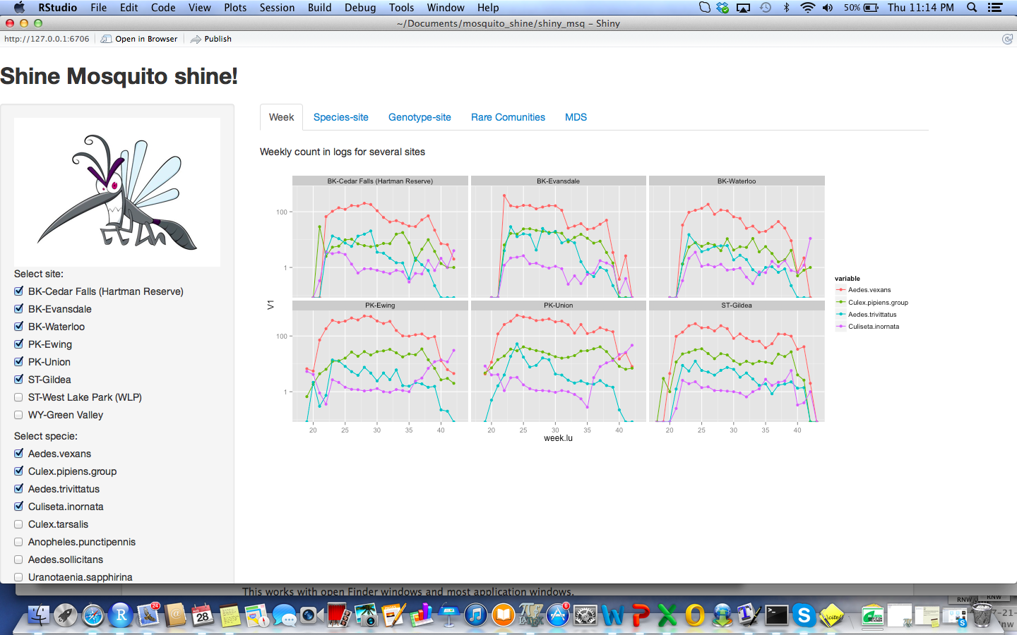
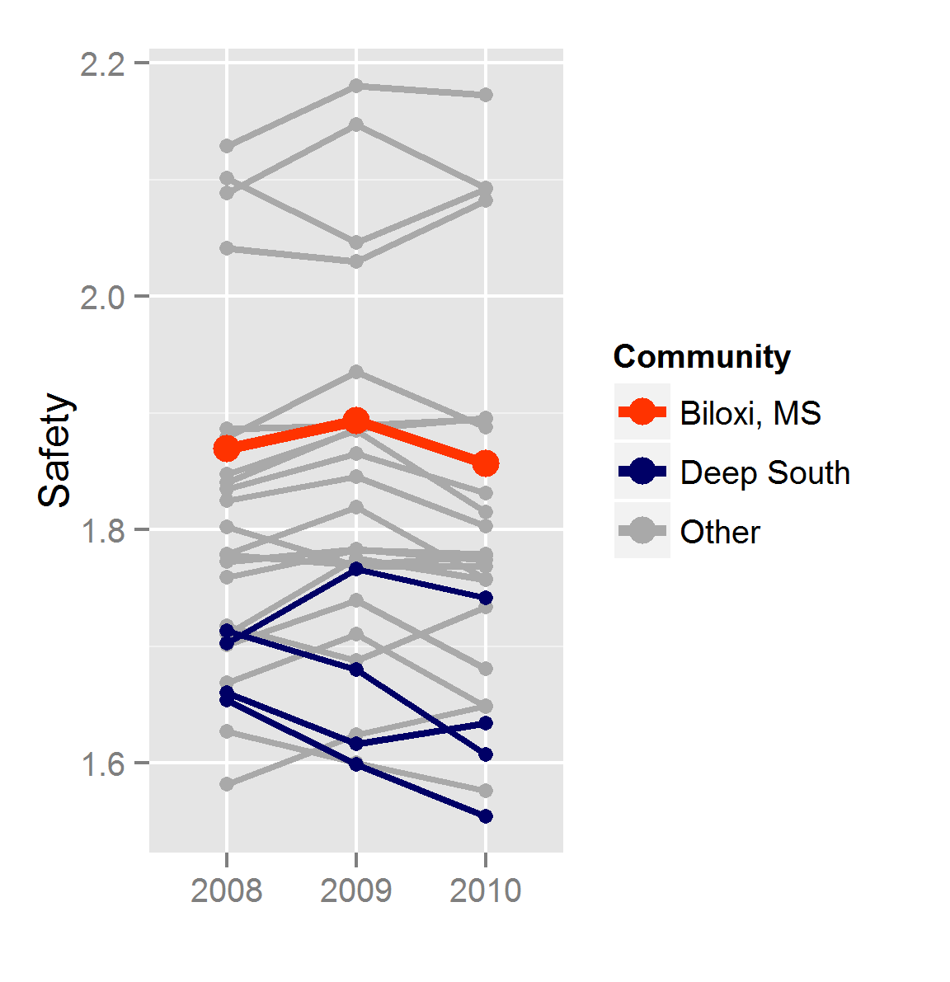
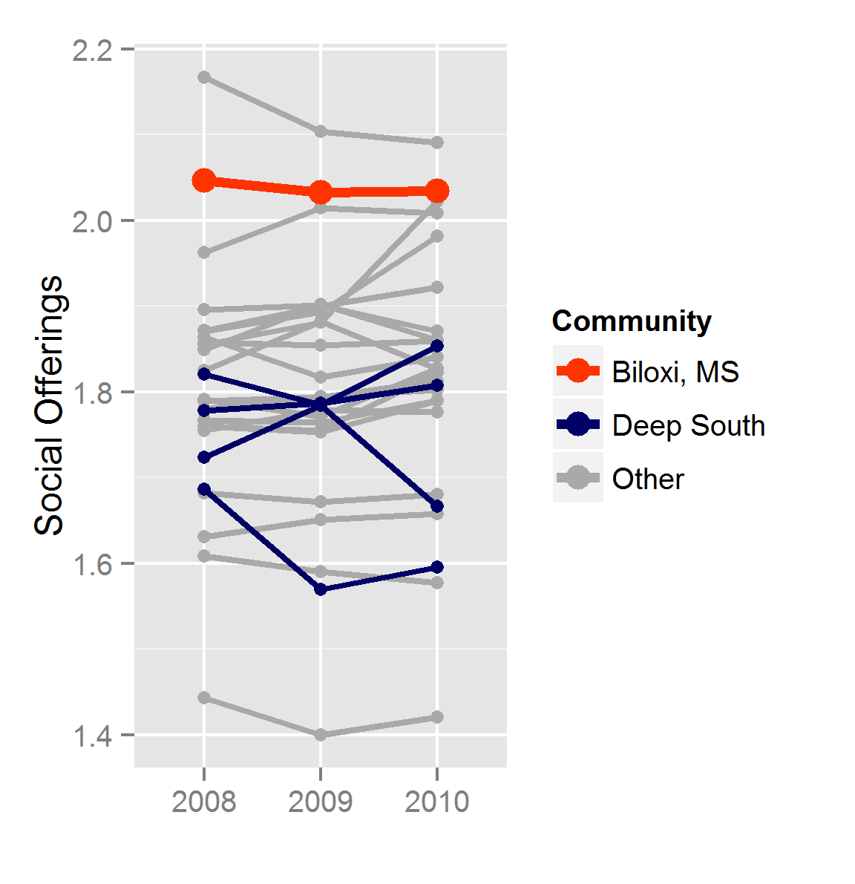
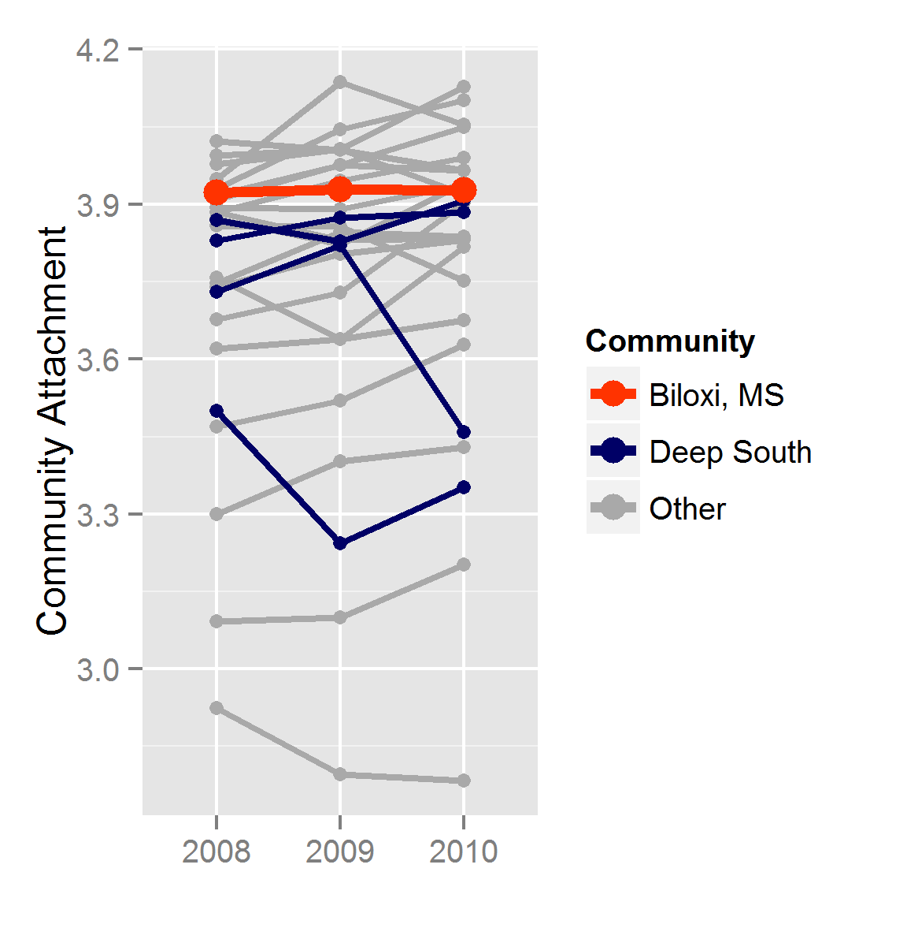
Twenty Year Ecological Analyses of Adult Mosquito Communities in Iowa
Ignacio Alvarez, Natalia da Silva, Mike Dunbar
Department of Statistics, Iowa State University
Week
fkaldsfjalkdsjf
Spece-site
fkaldsfjalkdsjf
Genotype-Site
fkaldsfjalkdsjf
Rare Communities
fkaldsfjalkdsjf
MDS
faldsfjalkdsjf
Universities in the Great Plains Communities:
Aberdeen, SD | Northern State University
Duluth, MN | University of Minnesota Duluth
Grand Forks, ND | The University of North Dakota
St. Paul, MN | Saint Catherine University Concordia University Hamline University The University of St. Thomas

Slide 2
