Slide 1

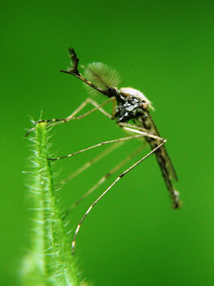
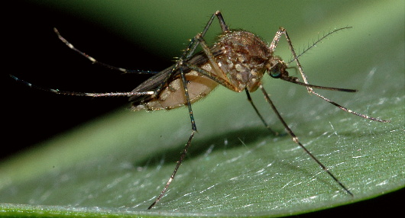
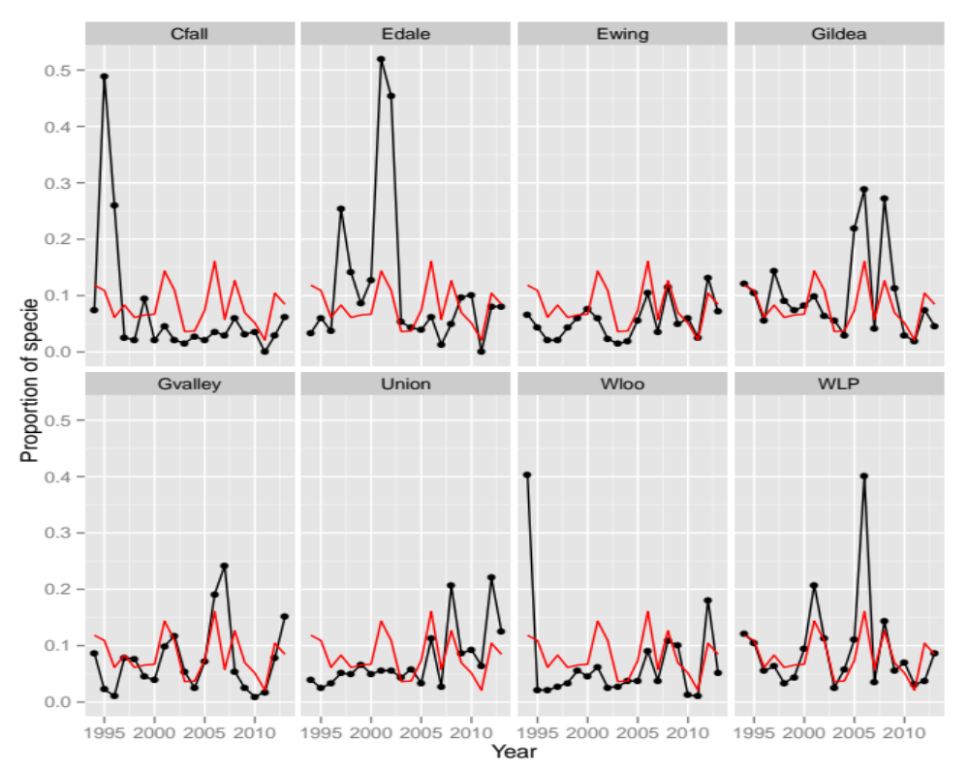
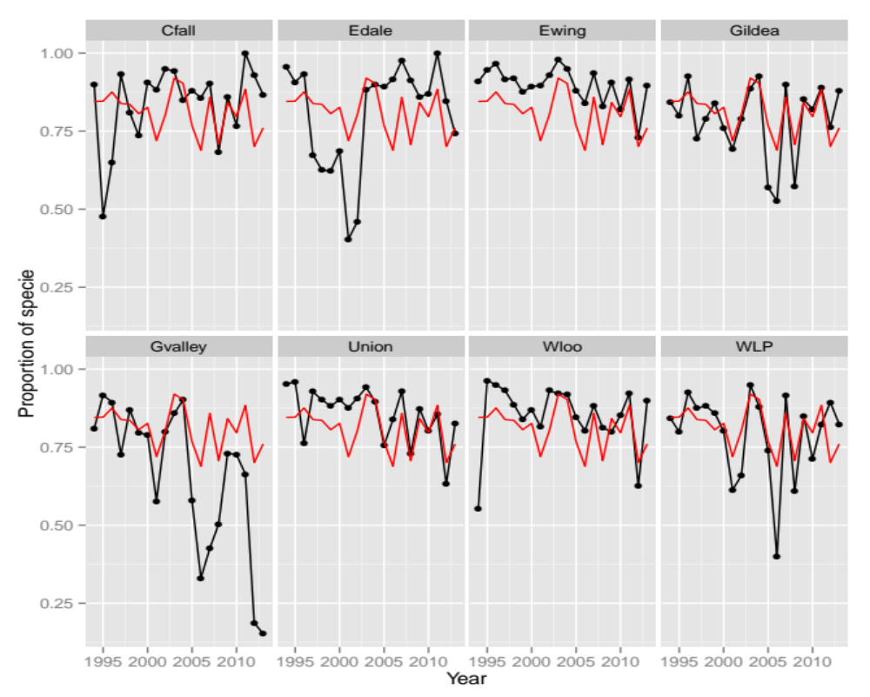
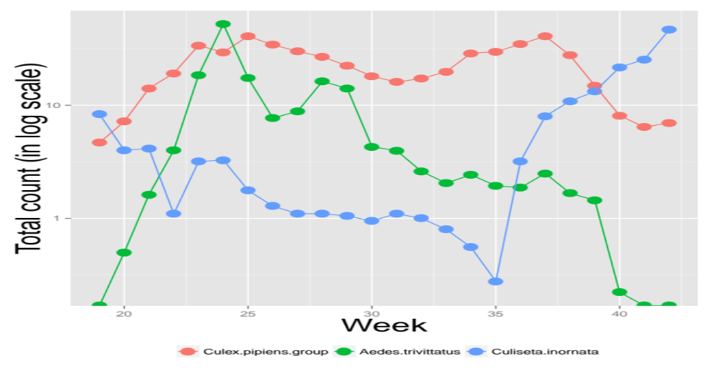
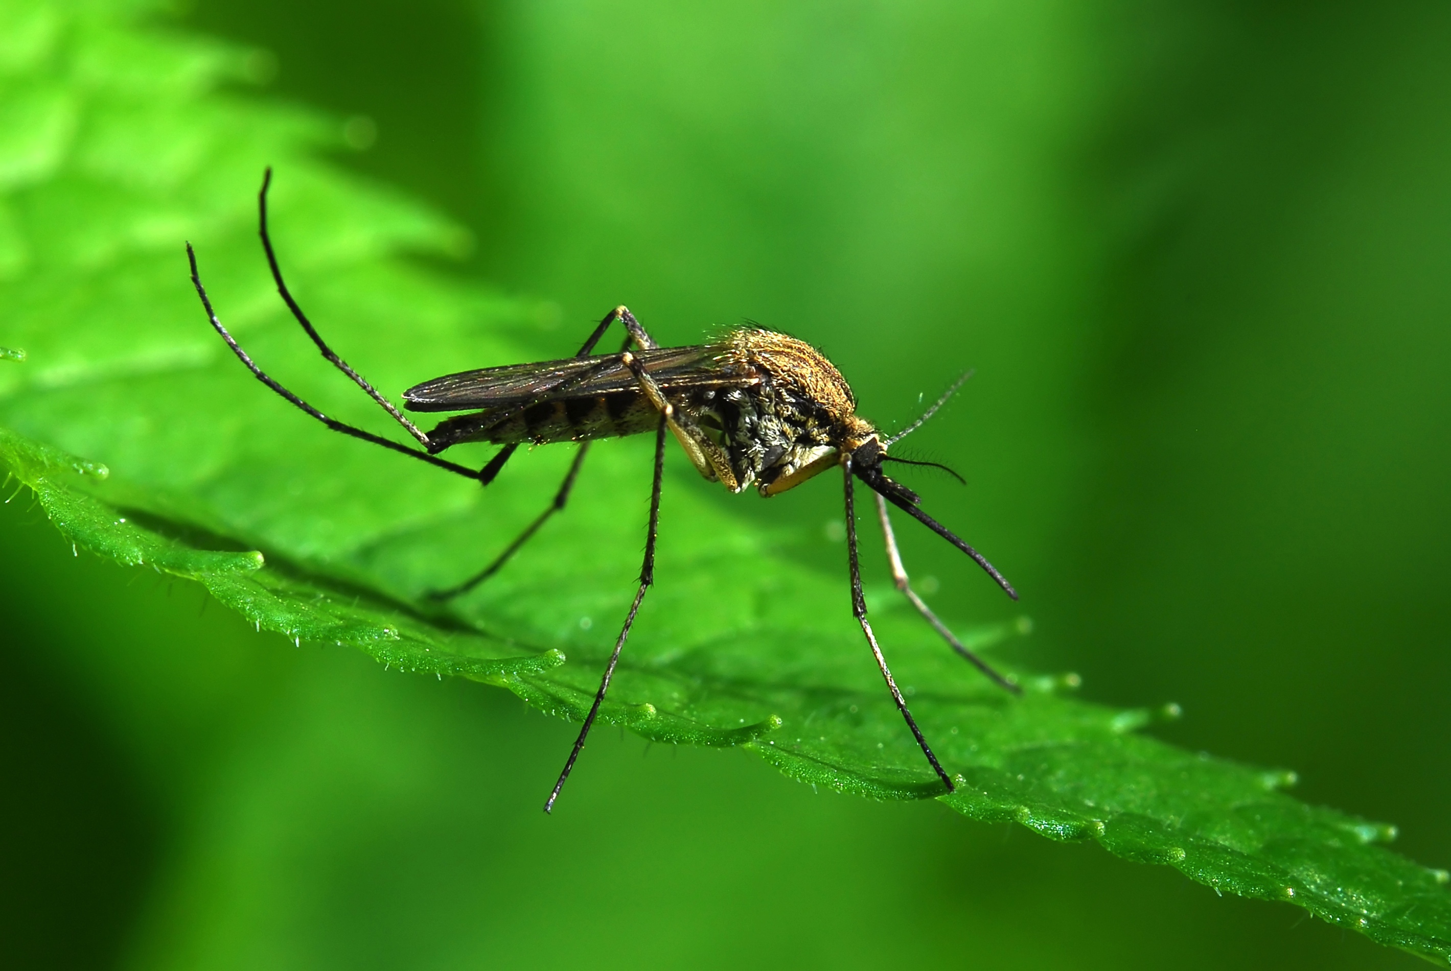
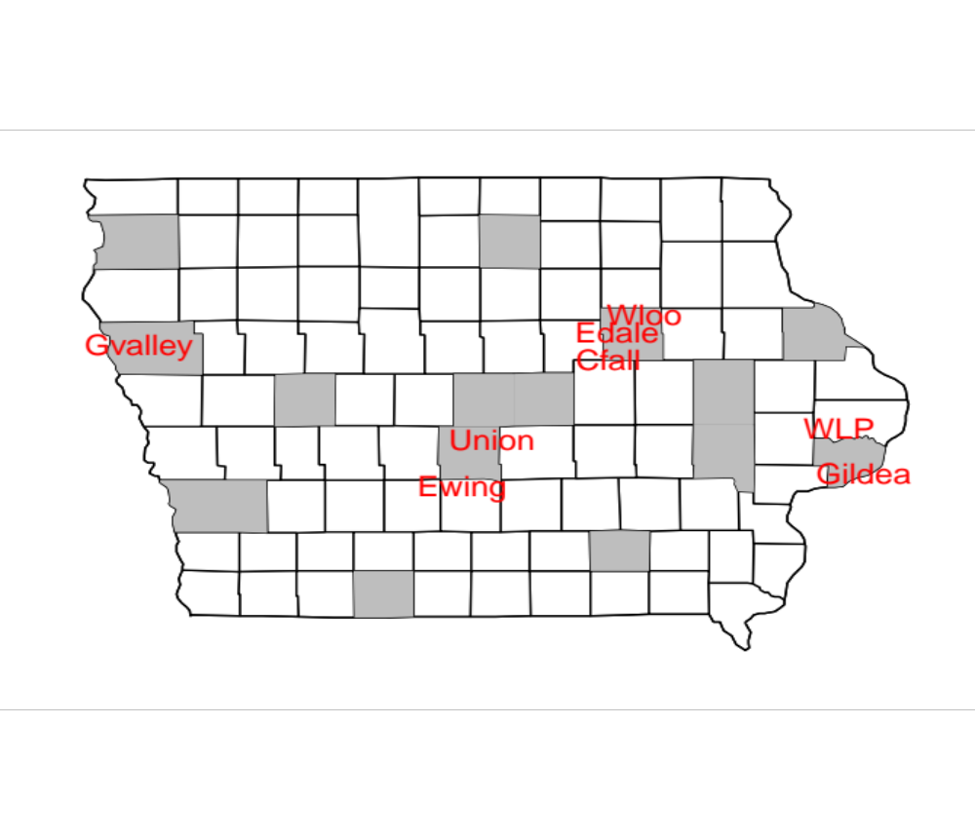
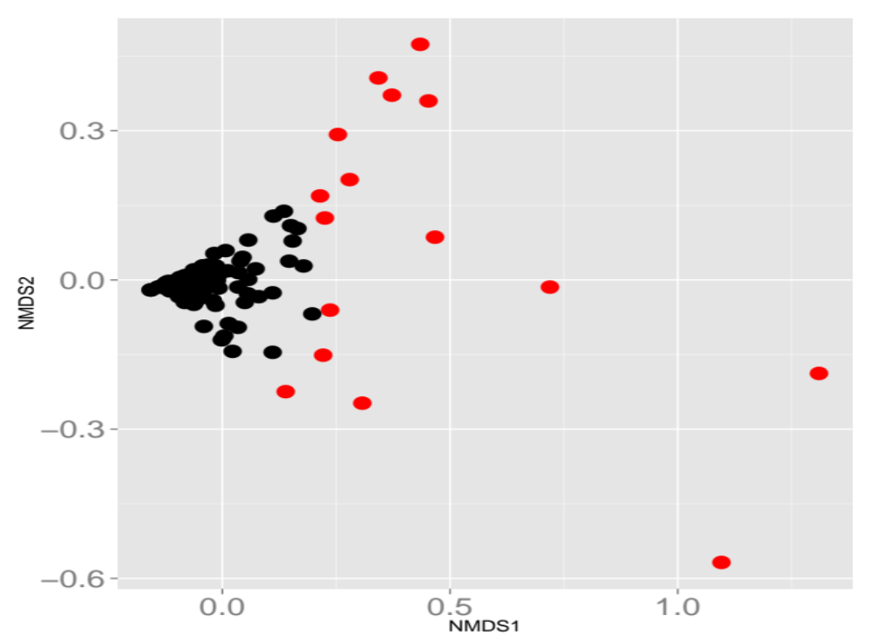
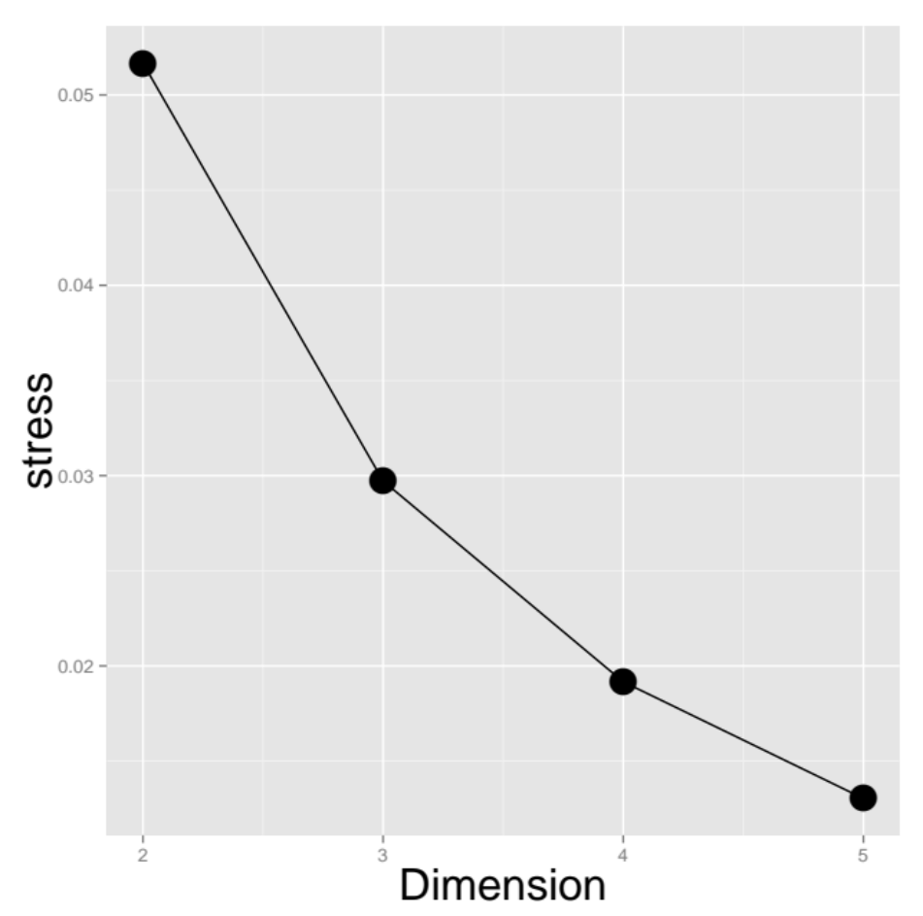
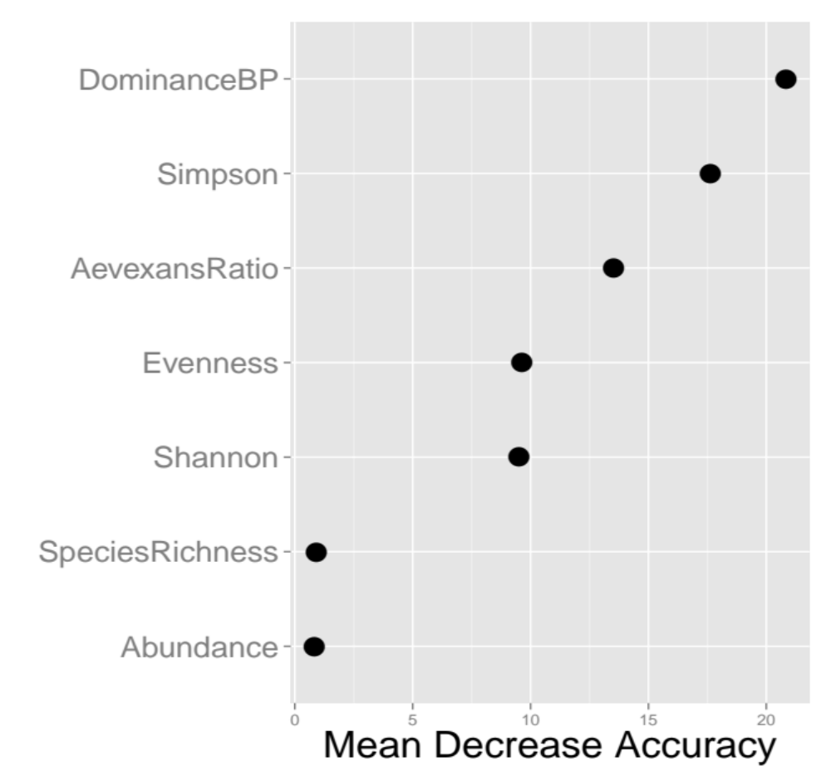
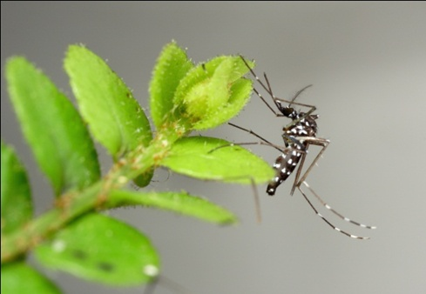
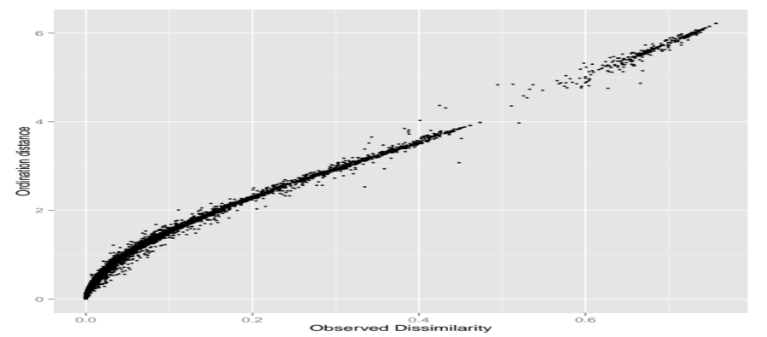
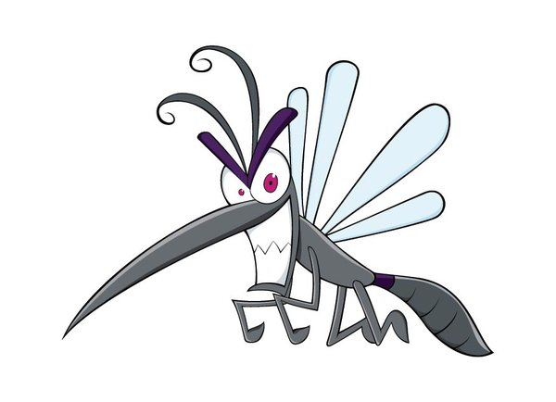
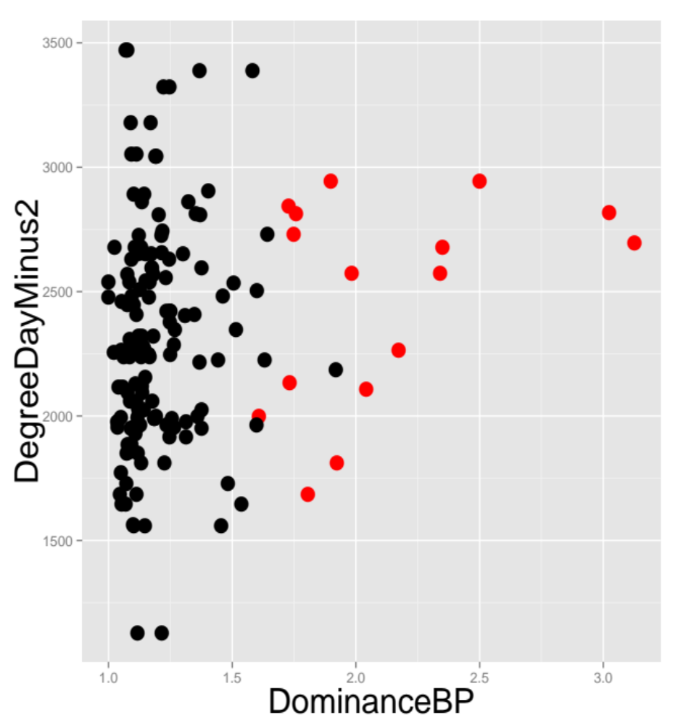
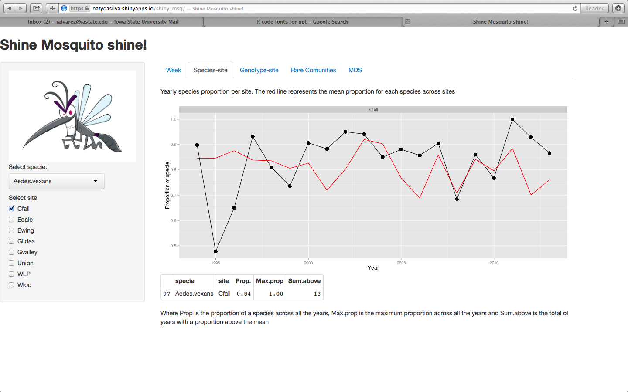
Twenty-Year Ecological Analysis of Adult Mosquito Communities in Iowa
Ignacio Alvarez, Natalia da Silva, Mike Dunbar
Department of Statistics, Iowa State University
Introduction
Within species
Between species
Species do not exist alone in a black box and therefore must interact with other species and the environment. The objectives of this study were to characterize mosquitoes at the community level over a multi-year period and identify communities with rare composition, a regionally relevant vector species. Ecological indices, including abundance, species richness, and various measures of diversity, were calculated to reveal differences among common and rare communities. Differences in abiotic factors such as precipitation and degree day accumulation were also used for comparison among mosquito communities. Observing communities of sympatric species may reveal population dynamics terms that could not be explained by observations of a single species, describing sympatric species interactions could better inform vector management decision making.
Proportion of Culex Pipens in selected Iowa sites
Proportion of Aedes Vexans in selected Iowa sites
Check out our shiny app!!!
Two tap sets with this level of comparison “Week” and “Genotype”
Week:
Shows the average count on each week for a particular specie in each site.
You can add more species and more site in order to compare.
Usually each species shows their maximum in the middle of the summer (Try it “Inornata”).
Culex seems to be more tolerant than Aedes to the lack of the water at the end of the summer.
Genotype:
Shows the annual proportion of genotypes
You can select more than one genotype and site.
Levels of Analysis
Within specie: the objective is to analyze the individual behavior of one specie across years and for different sites. Does the specie behavior have changed across the years? For a particular specie, is there any difference between sites? How many years the proportion of each specie is above the mean proportion of the specie across sites?
Between genotypes and species: the objective is to analyze more than one genotype at the same time or more than one specie. We want to answer: which genotype are more relevant in each site along all the years? Are there some years where some genotype is more relevant in one site? What are the spatial abundance by specie?
Community level: we want to see the community dynamic, we want to answer: which communities are rare? Which environmental factors are important to distinguish rare communities?
Goals
Characterize mosquito population dynamics and interactions over the course of 2 decades.
Identify rare communities base on ecological measures.
Design a friendly interactive tool to analyze the data.
The red line represents the average proportion of this species on each year. So on average across all years and sites, Culex Pipens represents around 10% while Aedes vexans represents 80% of the mosquito counts.
On Cedar Falls the Culex Pipens proportion is most of the time below the mean, with a huge pick on 1995.
Edale presents maximum proportion of Culex Pipens in one year.
Edwing and Union presents a similar proportion of Culex Pipesns until 2007 below the mean.
On Green Valley the Aedes vexan proportion is most of the time below the mean, What happen in Green Valley ? The Vexans don’t like it anymore !!!!
Ewing the proportion of Aedes vexan is always above the mean
Edale the proportion of Aedes vexan changes pattern 1997-2002 below the mean and above the mean until now
Mosquito population dynamics have been monitored annually since 1969, at numerous sites across the state of Iowa. The traps used have run on a daily basis from late spring through early fall. Eight of these trapping sites were chosen for ecological and statistical analyses based on the availability of 20 years of unbroken data (1994 to 2013). During this 20 year period, over 385,000 specimens of 36 species were trapped and identified.
Community Level
Within specie Level
We want to identify similarities patterns among the mosquito communities.
Horn distance to measure dissimilarities.
Non-metric MDS solution to visualize the horn dissimilarities among communities.
With the MDS solution we compute the Euclidean distance from the center to each of the 160 communities.
Determine a cut point in the 90% quantile of the distance to center variable.
Any community further to center than the cut-off point is considered rare.
MDS representation using Horne distance
Stress plot
Why a community is rare?
Trapping mosquito sites in Iowa used
To find the reasons why a community is rare we use a classification Random Forest using as response variable “Rare communities”.
Two Random forest: using ecological indices and other with abiotic factors.
The error rate for the ecological index was 1.8% while with abiotic factors was 10
%.
Variable importance
With the ecological index Random Forest the most important variables was:
DominanceBP , Simpson index and Aedes ratio..
Non-metric MDS
With two dimensions the stress is around 5% and with more dimensions the stress decrease but we use two dimensions because 5% is good enough.
Multi-dimensional scaling is a tool to visualize the ecological dissimilarities among communities. On the the MDS plane, if two points are close it means that the two communities have a similar species composition.
With 2 dimensions the stress level is close to 5%
The MDS solution shows that most of the communities share a similar specie composition but there are some of them that are far away from all the rest. This suggest the existence of rare communities rather than a grouping structure.
Variable | Rare | Common | p-val
Aedes.vexans | 663 | 2180 | < 0.001
Culex.pipiens | 265 | 134 | 0.0382
DominanceBP | 2.11 | 1.2 | 0.0004
Simpson | 2.9 | 1.4 | < 0.001
DegreeDayM2 | 2476.15 | 2315.4 | 0.1606
PrecipationM2 | 397.45 | 424.56 | 0.5326
Shiny App: Shine mosquito Shine!!!
What are behind the app?
Web application using shiny package in R to help entomologist to visualize summarize and analyze the data produced by the survellance program
Data analysis round trip
Sofware
Data analysis is not one way.
An interactive tool is very powerful in interdisciplinary teams.
Once you know what variables are relevant to explain the occurrence of a rare community, is important to understand what direction is that variable impact.
The figure in the right shows a scatter plot of the most important variable among indices and the most important abiotic factor.
The shiny tab allows to change parameters in the stat model (distance function, cut-off point, MDS dimensions) and immediately see how affect the results.
Shiny is an R package developed by Rstudio.
Two main files behind any shiny application : ui.r and server.r
Here is the code for one tab:
What we know now!!
Sixteen communities were designated as rare communities.
Six of the 8 NJLT locations had rare communities.
Aedes vexans dominant species in most of the communities.
The mean proportion of Aedes vexans was significantly greater in common communities than rare communities.
In rare communities, the proportion of Culex pipiens was more than three times higher than in common communities.
Culex pipiens raw abundance was also significantly larger in rare over common communities.
Rare communities tended to be more diverse than common communities as the rare communities had significantly greater values for Berger-Parker, Simpson, Shannon, and Shannon Evenness than the common communities .
server.r : produces the outputs we see in the app
What you can find in our app?
d1 <- reactive( {
subset(msq.spyr,specie%in%input$specie&site%in%input$site)})
d1.1 <- reactive({
subset(d.aux, specie%in%input$specie&site%in%input$site) })
output$plot1 <- reactivePlot(function() {print(
qplot(data=d1(),x=year,y=prop.spst,size=I(4),color=site)+ geom_line()+geom_line(aes(x=year,y=prop.spyr),color=I('red')) + facet_wrap(facets=~site, scales='free’)
) })
output$tab1 <- renderTable({ head(d1.1()) })
ui.r : controls the options and buttons you can choose
Five tabs, Week, Specie-site, Genotype-site s, Rare Communities and MDS.
Week and Genotype-site, Between species level.
Specie-site, Within specie level.
Rare Communities and MDS, community level.
In each tab there are different options that make this tool very flexible.
conditionalPanel(condition="input.conditionedPanels==1",
img(src="Mosquito.png", height = 100, width = 300),
selectInput(inputId = "specie”, label = "Select specie:",
choices = levels(msq.long$specie),selected='Aedes.vexans'),
checkboxGroupInput(inputId = "site”,label = "Select site:",
choices = levels(msq.long$site),selected='Cfall')
)

