Slide 1
Set Up an Office Proxy Server to Limit Staff Web Surfing
ASAPS 2014 Practice Changers
James M. Nachbar, MD, FACS
April 2014
https://github.com/nachbar/network-security
Or http://www.nachbar-github.com

Slide 2
Practice Changers April 28, 2014 Relevant Industry Relationships
I have the following relationships with Practice Enhancement Specialists (formerly Inform Solutions/Mentor Solutions):
Author of the InSched Scheduling Program & IntelliPract Billing System and Paperless Charting
Author of PatientConnection appointment reminder and lead management system
I receive royalties for sales, maintenance, and operation of those systems
Notes:
The underlined areas should be replaced with explanations as appropriate.
If the answer is “none” please write “none”

Slide 3
Presentation Level of Evidence = V
Levels of Evidence and Qualifying Studies (Therapeutic Studies):
I High-quality*, multi-centered or single-centered, randomized
controlled trial with adequate power (N ≥ 100); or a systematic review of these studies
II Lesser-quality, randomized controlled trial; prospective cohort study; or systematic review of these studies
III Retrospective comparative study; case-control study; or a systematic review of these studies
IV Case series
V Expert opinion; case report or clinical example; or evidence based on physiology, bench research or "first principles“
*“High quality” is open to interpretation. Until more specific guidelines are promulgated, 100 is the absolute minimum power, sample size or “N” which is acceptable for any study to be considered Level 1.

Slide 4

Importance of Internet Security

Slide 5
So, How do they get in?

Slide 6
So, How do they get in?
Because Windows, Mac, Internet Explorer, Firefox, Chrome, etc. etc. etc. have flaws

Slide 7
Zero-Hour Attacks
When a flaw is discovered, hackers figure out how to “exploit” it almost immediately

Slide 8
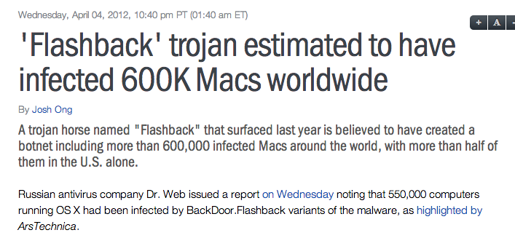

Slide 9
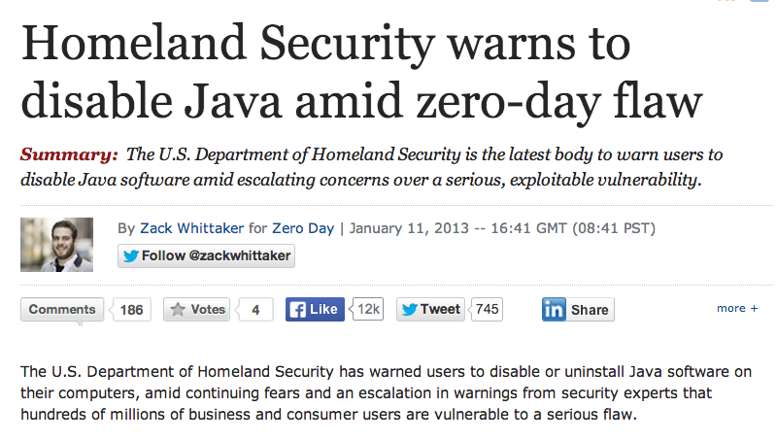

Slide 10
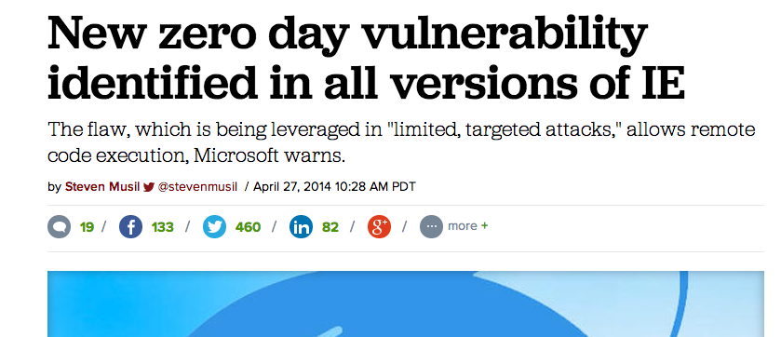

Slide 12
A new zero day vulnerability that resides in all versions of Internet Explorer has been spotted in the wild, Microsoft confirmed late Saturday.
The vulnerability, which could allow remote code execution, is being used in "limited, targeted attacks," according to an advisory issued by Microsoft. While all versions of the web browser, IE 6 through 11, are affected by the vulnerability, attacks are currently targeting IE versions 9, 10 and 11, according to security firm FireEye, which first reported the flaw Friday.
The attack leverages a previously unknown "use after free" vulnerability –
data corruption that occurs after memory has been released -- and bypasses
both Windows DEP (Data Execution Prevention) and ASLR (Address Space
Layout Randomization) protections, according to FireEye.
The vulnerability is currently being exploited by a group of hackers targeting
financial and defense organization in the US, FireEye told CNET.
"The APT [advanced persistent threat] group responsible for this exploit has
been the first group to have access to a select number of browser-based 0-day
exploits (e.g. IE, Firefox, and Flash) in the past," FireEye said. "They are
extremely proficient at lateral movement and are difficult to track, as they
typically do not reuse command and control infrastructure."

Slide 13
Your Biggest Problem
Your Friendly Staff will happily surf the web to any “interesting” pages, and get your computers infected.

Slide 14
If you allow your staff to surf the web on office computers, you WILL suffer an attack.
Paper charts too large to take or move in bulk
Your entire EMR file will easily fit on a USB stick – just ask Edward Snowden or Bradley Manning!

Slide 15
So, if you need your staff to use the web, what can you do?

Slide 16
So, if you need your staff to use the web, what can you do?
Answer: Limit the sites they can surf to using a Proxy Server

Slide 17
What is a Proxy Server?

Slide 18
What is a Proxy Server?
A Proxy Server acts as your Proxy on the Internet. Your browser is set up so that it cannot directly access any websites, but rather passes any requests for a web page to the Proxy Server.
The Proxy Server checks to see if the website is on the “Allowed List”. If so, it goes to that site and gets the info and passes it back to the browser
If the website is not on the “Allowed List”, it passes a page with an error message.

Slide 19
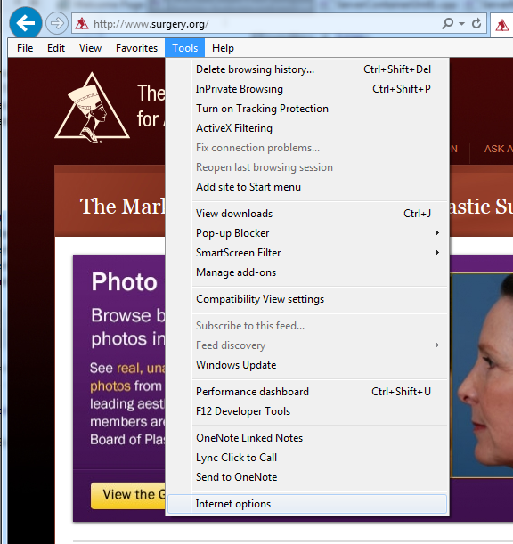

Slide 20
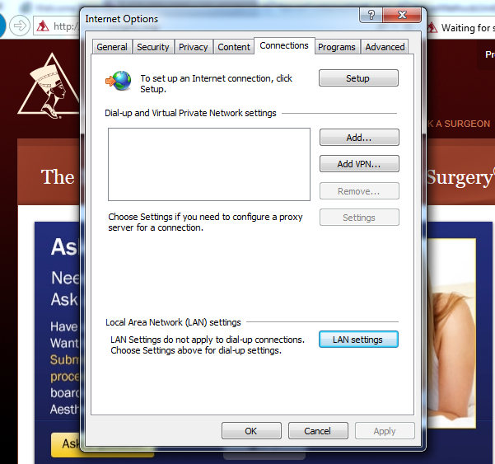

Slide 21
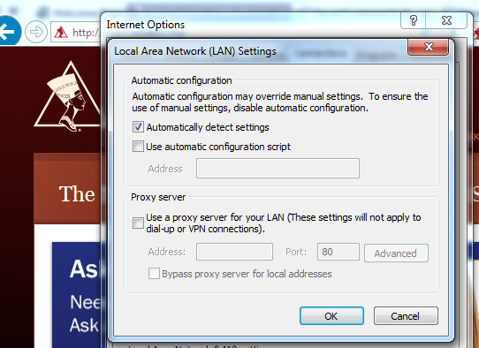

Slide 22
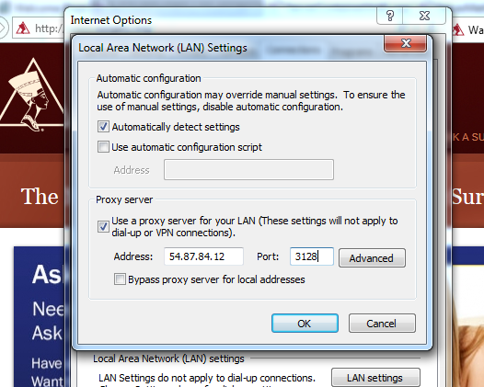

Slide 23
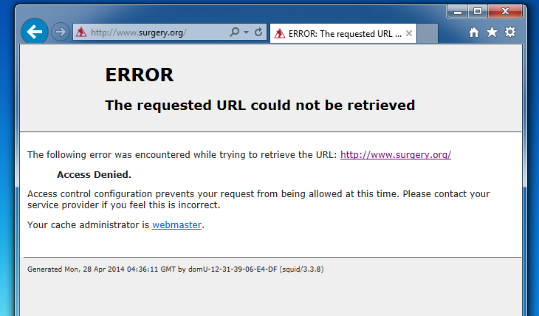

Slide 24
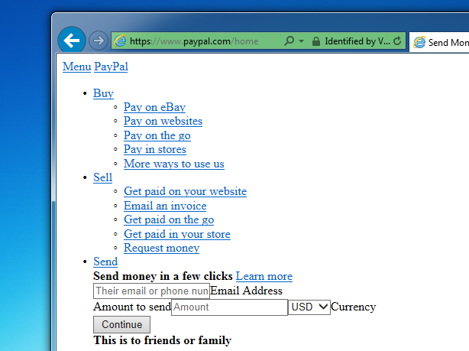

Slide 25
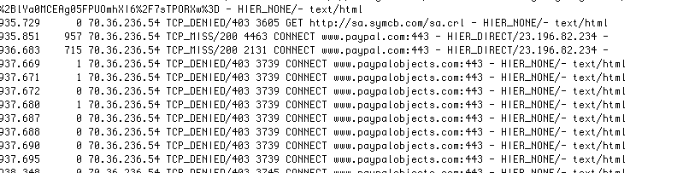

Slide 26
You obviously also need a Firewall to prevent direct access to websites outside of your Proxy Server

Slide 27
Web Browsing Danger
Zero-Hour Attacks will infect computers that go to websites with a browser with a flaw in it.
A Zero-Hour Attack on all versions of Internet Explorer was announced Sunday, April 27, 2014
If you let your staff surf the web from office computers, you WILL become infected.
You can limit the sites they can surf using a Proxy Server, either internal or external to your office

Slide 28
https://github.com/nachbar/network-security
Or http://www.nachbar-github.com

