Slide 1
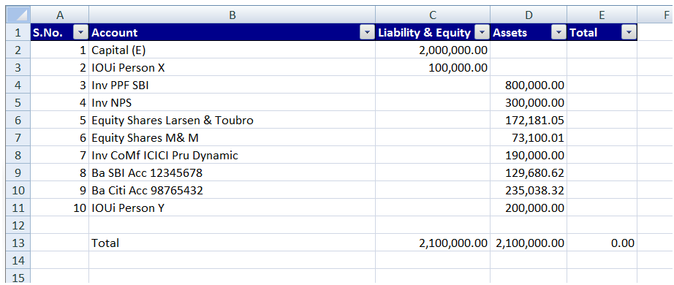
4
6
5
7
2
3
9
8
10
Unrestricted

Slide 2
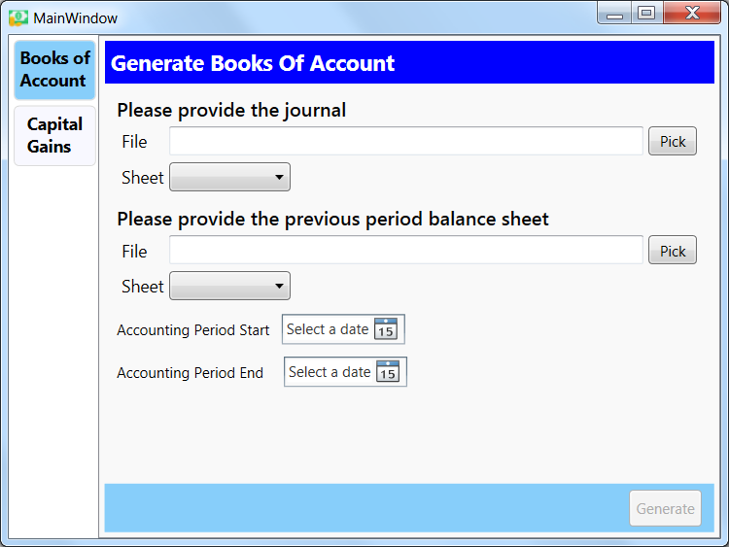
2
3
4
7
5
6
8
9

Slide 3
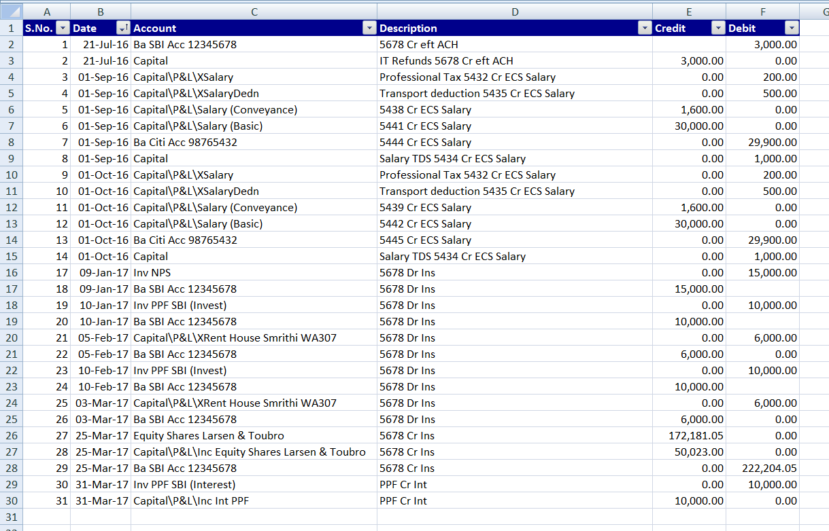
4
5
6
7
8
9
2
3
12
11
10 a
10 b

