Slide 1
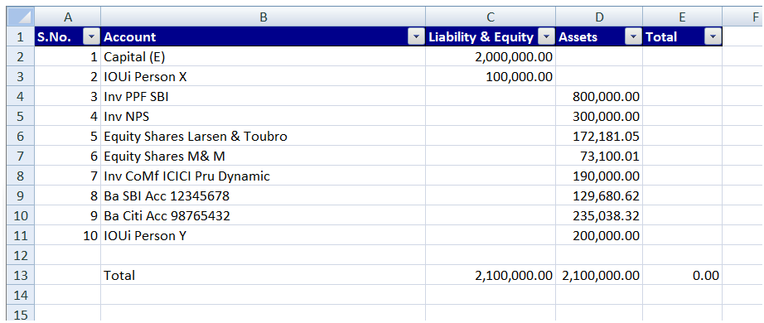
4
6
5
7
2
3
9
8
10
Unrestricted

