Slide 1

Project Title Seasonal Agriculture Performance Analysis
Student Name: Nachiket
College Name: Sharnbasva University
AICTE STU ID : STU696b8a245fbd91768655396

Slide 2

PROBLEM STATEMENT
Agricultural activities are influenced by seasonal variations in environmental conditions, farming practices, resource availability and market conditions. As a result, agricultural performance may differ from one season to another. However, raw agricultural data does not clearly explain how agricultural performance changes across seasons or what patterns can be observed in different seasonal conditions. The problem is to analyse the given agricultural dataset and investigate seasonal differences in agricultural performance by identifying meaningful patterns, trends, relationships and variations within the available data.

Slide 3
Project Description In this project, I analysed agricultural data from 4,000 farm records. I first cleaned the dataset and handled the missing values before starting the main analysis. I then compared the three seasons using yield, production, profit, water usage, environmental conditions and resource usage. I also looked at crop and state-wise performance and used correlation analysis and statistical tests to understand the important relationships in the data.

Slide 4

WHO ARE THE END USERS?
The findings from this analysis can be useful for:
Farmers – to compare crop and seasonal performance.
Agricultural planners – to understand resource and seasonal patterns.
Government agriculture departments – to study regional performance.
Agricultural analysts – to work with farming and production data.
Researchers and students – for further agricultural studies.

Slide 5

Technology Used
Tools and Technologies
Python – used for the overall data analysis.
Pandas – used for cleaning, grouping and analysing the dataset.
NumPy – used for numerical calculations.
Matplotlib – used to create the charts.
Seaborn – used for the correlation heatmap.
SciPy / Statsmodels – used for statistical testing.
Jupyter Notebook / VS Code – used to develop and run the project.

Slide 6
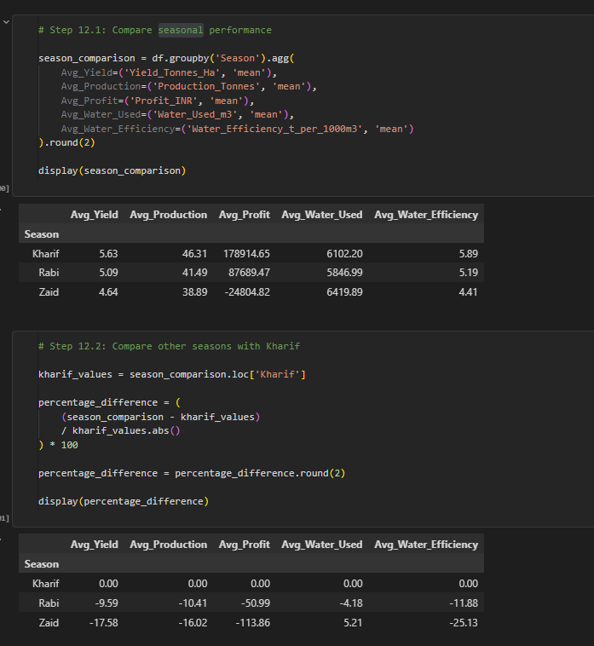
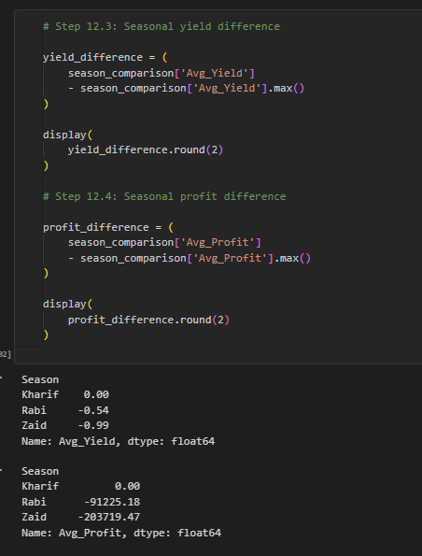
RESULTS

Slide 7
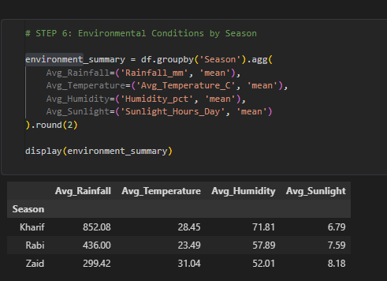
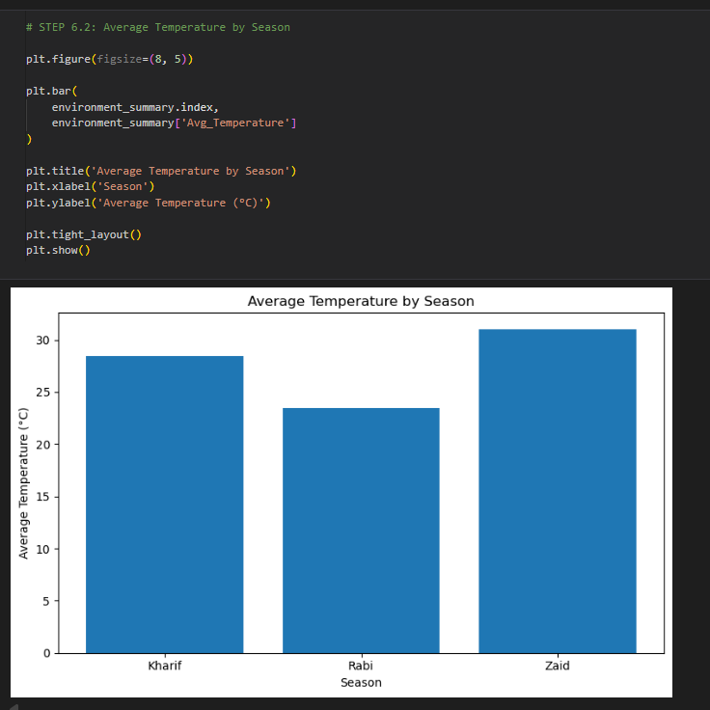
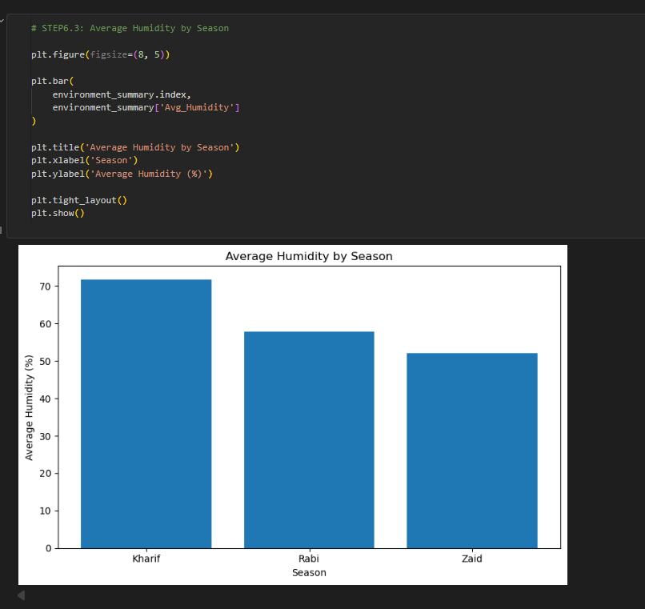
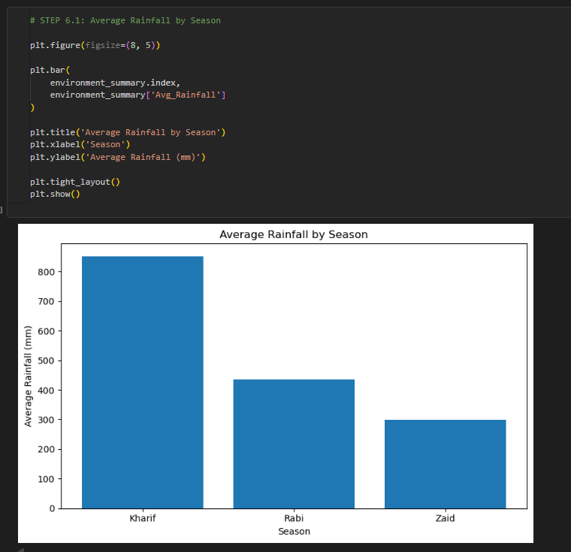
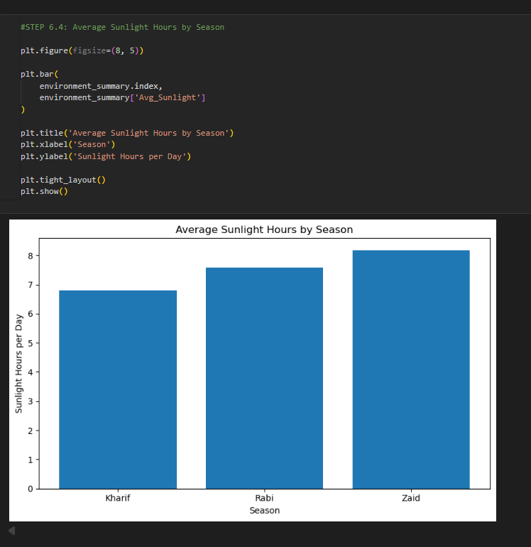
RESULTS

Slide 8
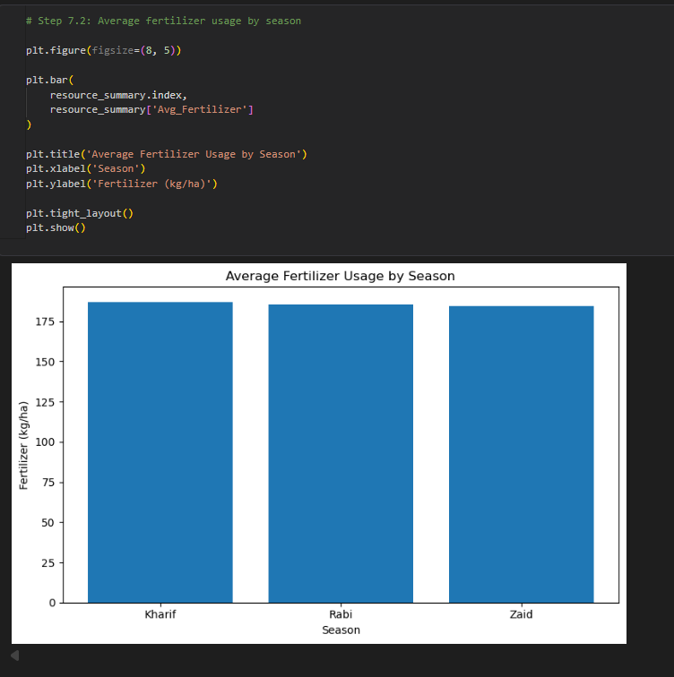
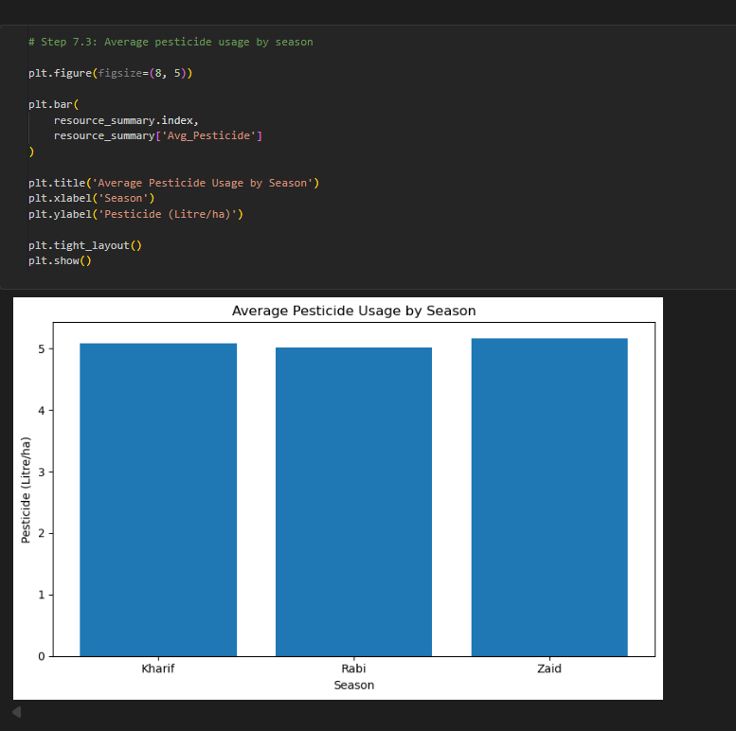
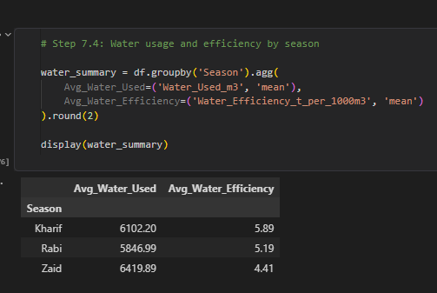
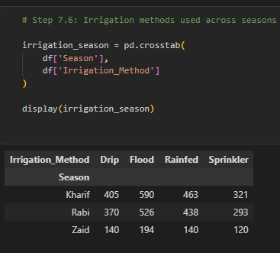
RESULTS

Slide 9
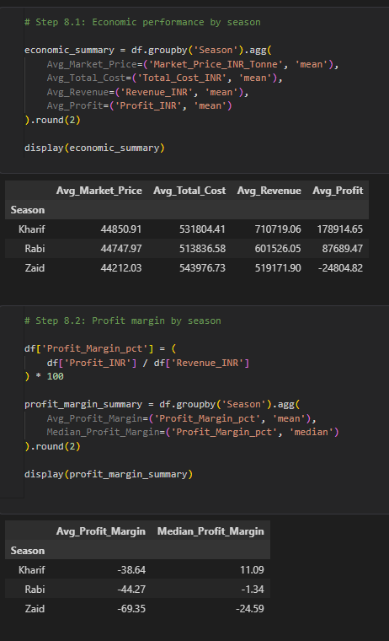
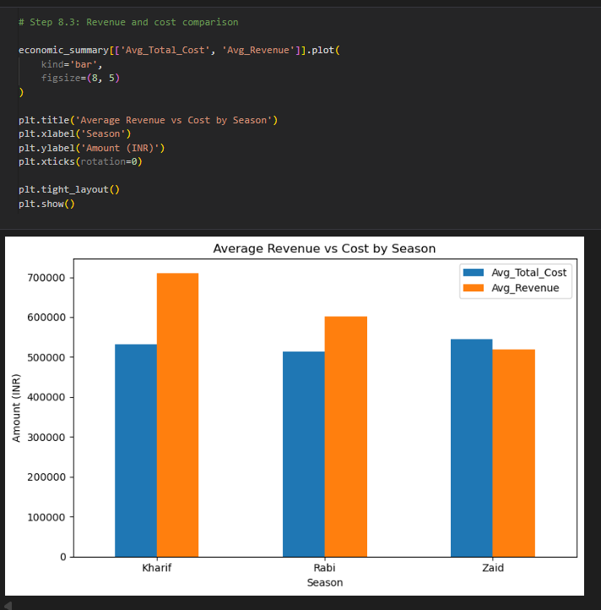
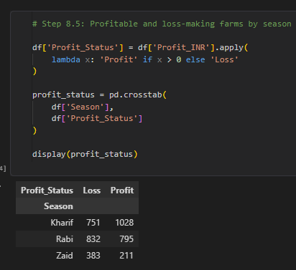
RESULTS

Slide 10
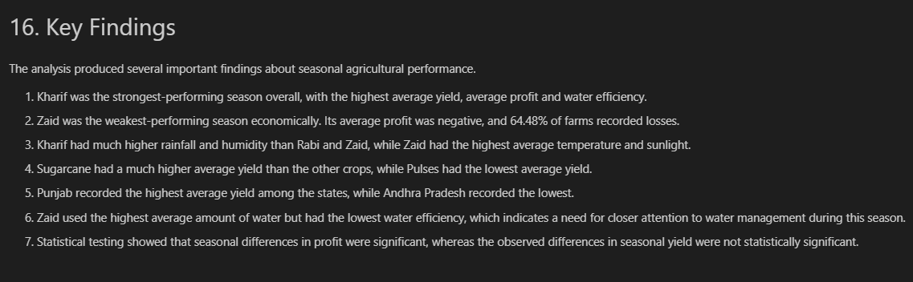
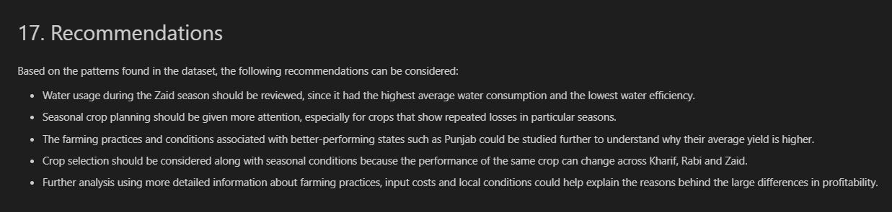
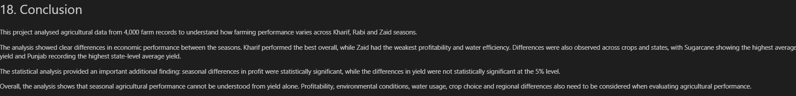
RESULTS

Slide 11
Future scope
There are several ways this project could be taken further.
Use machine learning to predict crop yield and profit.
Add historical weather data for better seasonal comparisons.
Include live market prices and weather information.
Build an interactive Power BI or web-based dashboard.
Develop a crop recommendation system using soil and environmental conditions.
Predict future water requirements and production.

Slide 12
GitHub Link
https://github.com/nachiket-mr360/Seasonal_Agriculture_performance_by_VOIS

Slide 13
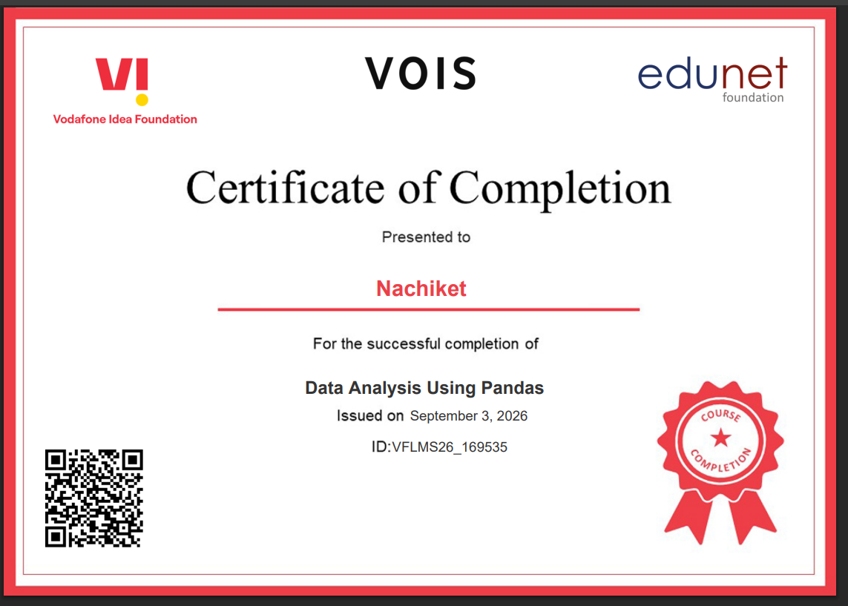
VOIS Course completion certificate - Course name- Data Analysis Using Pandas

Slide 14
Thank you

