Slide 1
Matiks - Data Analyst Task
By
Nachimuthu chinnadurai

Slide 2
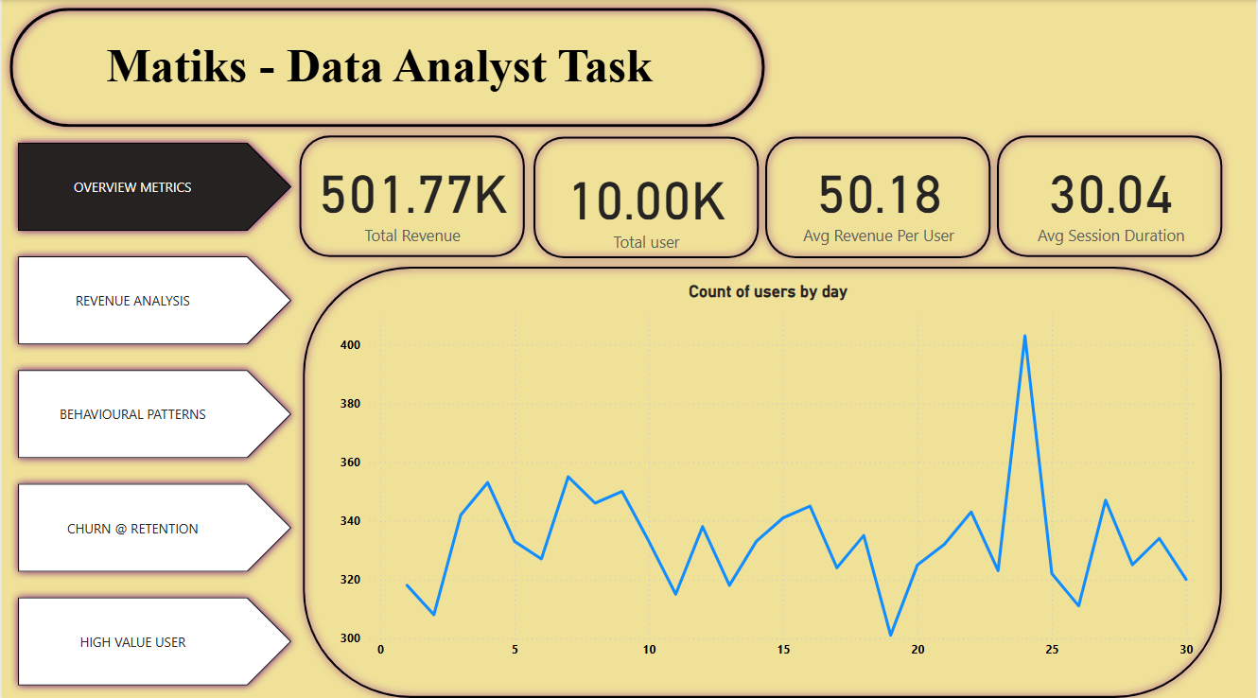
Performance Summary
Key Metrics:
DAU / WAU / MAU Trend
Total Revenue
Churn %
Insights:
Steady MAU growth, stable DAU.
Monitor churn rate (~15%) month-over-month.

Slide 3
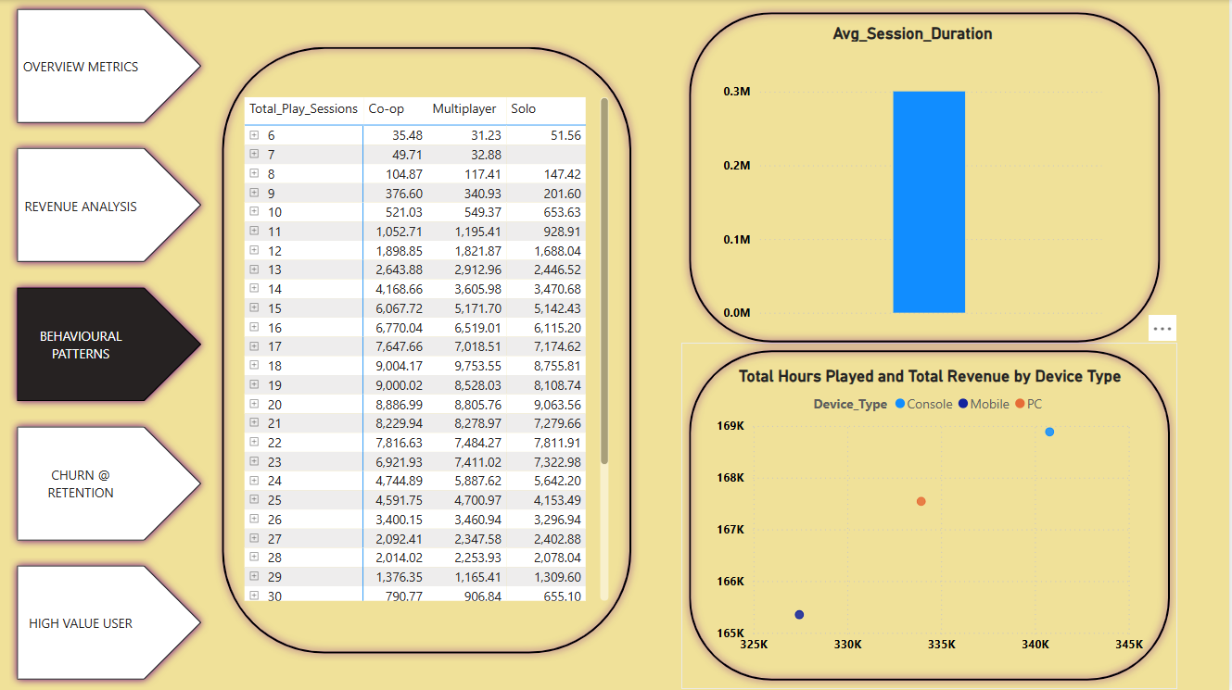
What’s Working
Segment Performance:
Gold Tier + PC Device + Multiplayer Mode
Visuals:
Insight:
High engagement and revenue from this segment.

Slide 4
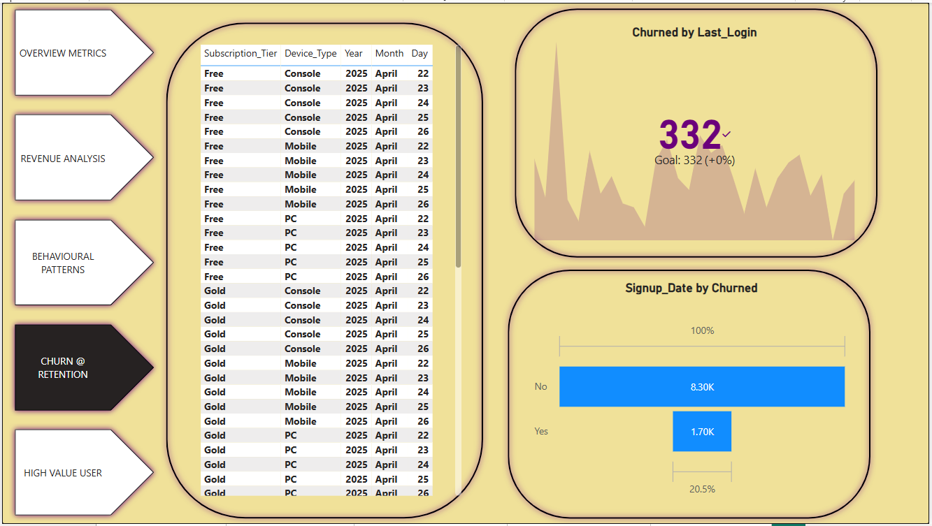
What’s Not Working
Churn & Engagement Issues:
Free Tier + Mobile Device Users
Visuals:
Insight:
Low engagement, high churn in this segment.

Slide 5
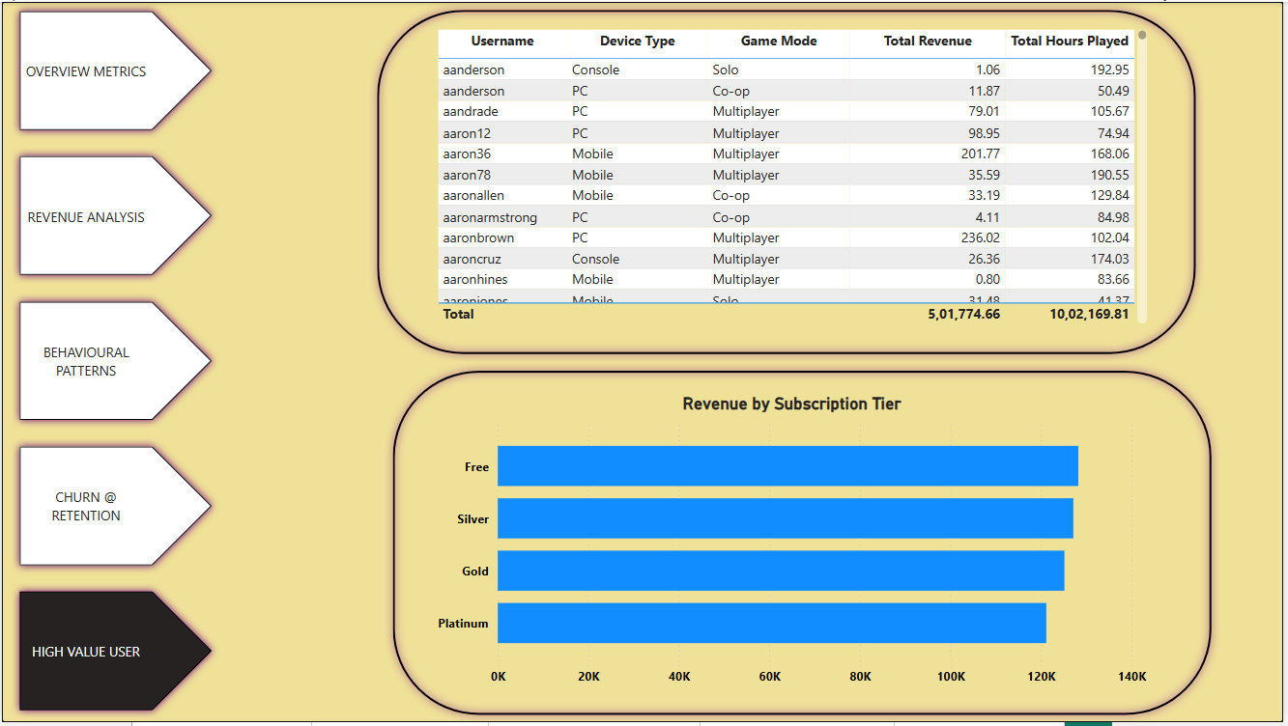
High-Value Users
Visuals
Insights
Top 10% users contribute [Insert %] of revenue.
Most are on [Device] and use [Game Mode].
High-value users favor [Subscription Tier].

Slide 6


