Slide 1
Fare Optimizer
Project Guide:
Prof Vrushali Bongirwar
Department of Computer Science and Engineering
Nachiket Satpute(46)
Kunal Khadkeshwar(43)
Krunal Pande(42)
Navin Rathi(47)
Pranshu Singh(51)

Slide 2
Agenda
Collect the past cab Booking data of New York.
Clean data for outliers and unnecessary columns.
Apply apt Clustering Algorithm to find most profitable clusters near driver.
Find factors affecting fares.
Selecting the apt algorithm for fare prediction.
Training and testing data.
Display the clusters and predicted fare in the Android based UI.

Slide 3
Introduction
New drivers are often clueless about popular or most profitable locations of the city.
Moreover, many drivers have no idea about average fares in a locality.
Using previous Cab Booking Data, the popular booking locations of a city can be analysed and clustered.
Similarly, Cab Fares can be predicted.
A Machine Learning Approach is suitable for solving this problem.

Slide 4
Motivation
Lesser Cab Availability in Major Areas.
An app helping Cab Drivers and Customers alike did not exist.
Machine Learning helps analysing huge data.
Using Firebase to make a scalable application.
Implementing modern technologies like data cleaning, K Means Clustering, Random Forest Regressor, and using Firebase.

Slide 5
Objectives
To help Cab Drivers and Customers to find popular Cab Booking Locations.
Customers and Drivers will know accurate cab fares from previous data.
Maximizes user and driver profit.
Predict Cab Fares and Clusters at low Error Rate.
Display predicted data on Android.

Slide 6
Technology Stack And Workflow

Slide 7
Data Cleansing
Data cleaning, also called data cleansing, is the process of ensuring that your data is correct, consistent and useable by identifying any errors or corruptions in the data.
Using tools to cleanup data will make everyone more efficient since they’ll be able to quickly get what they need from the data.
Better data beats fancier algorithms.
We cleaned data by removing outlier co-ordinates, removing negative coordinates and removing unnecessary columns and by removing empty rows.

Slide 8
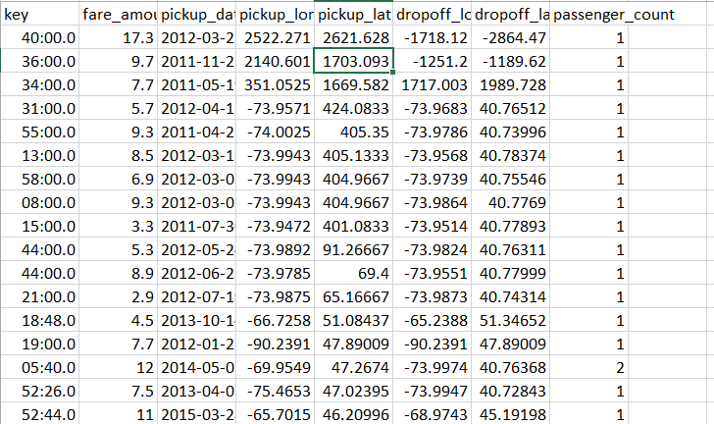
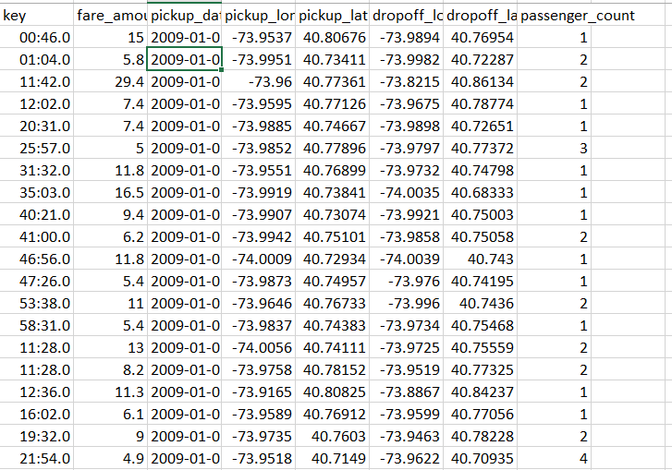
Before Cleaning:
After Cleaning:

Slide 9
Machine Learning
Machine Learning is the field of study that gives computers the capability to learn without being explicitly programmed. ML is one of the most exciting technologies that one would have ever come across. As it is evident from the name, it gives the computer that which makes it more similar to humans: The ability to learn.
Machine learning is actively being used today, perhaps in many more places than one would expect.

Slide 10
ML Models Used in the application
Random Forest Regressor
K-Means Clustering

Slide 11
1.Regression
Regression is a machine learning algorithm based on supervised learning. It performs a regression task. Regression models a target prediction value based on independent variables. It is mostly used for finding out the relationship between variables and forecasting. We’ve used Random Forest regression model in the application.

Slide 12
Random Forest Regression
Random forest is a Supervised Learning algorithm which uses ensemble learning method for classification and regression.
Random forest is a bagging technique. The trees in random forests are run in parallel. There is no interaction between these trees while building the trees.
It operates by constructing a multitude of decision trees at training time and outputting the class that is mean prediction (regression) of the individual trees.
XGBoost is an advanced gradient boosting tree library. It is integrated DSS visual machine learning, meaning that you can train XGBoost models without writing any code.

Slide 13
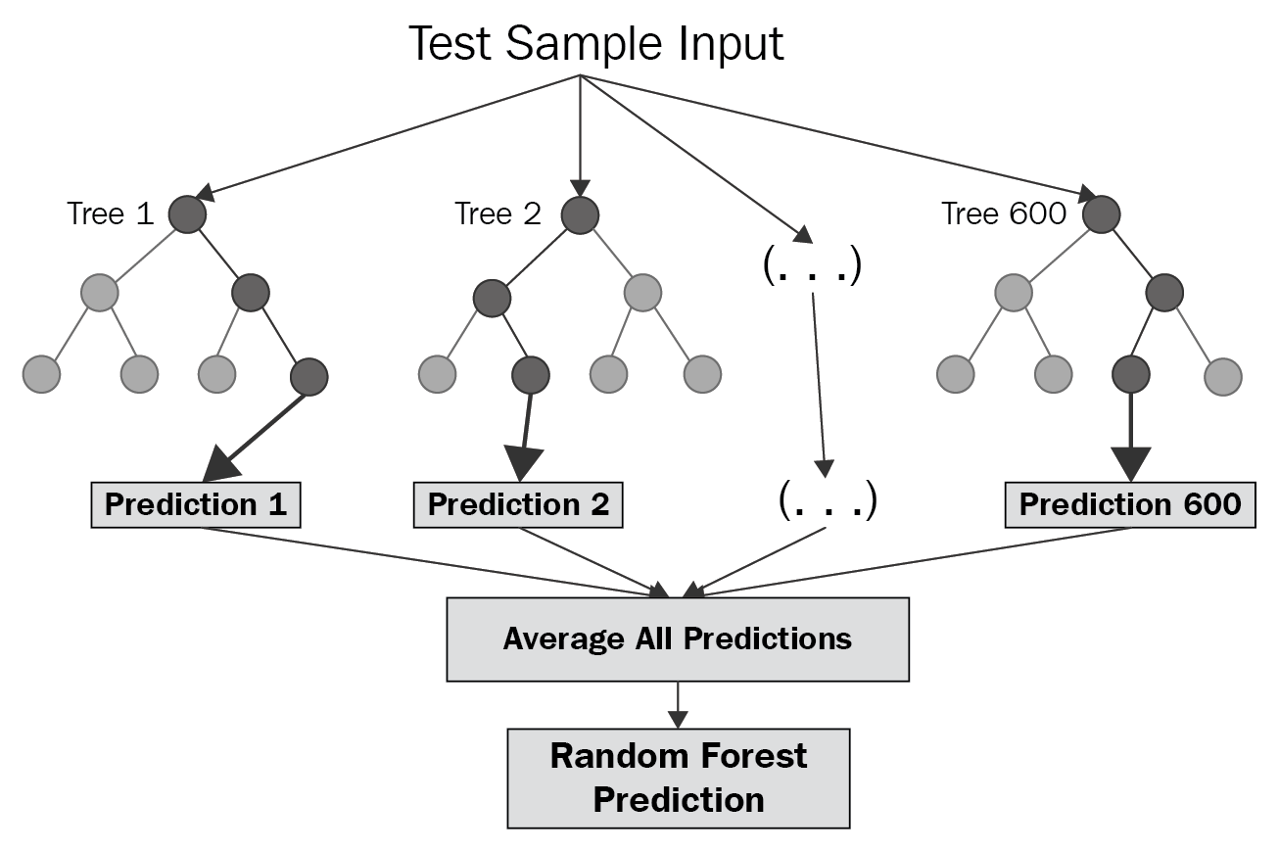
A random forest is a meta-estimator (i.e. it combines the result of multiple predictions).
The number of features that can be split on at each node is limited to some percentage of the total
Each tree draws a random sample from the original data set when generating its splits, adding a further element of randomness that prevents overfitting.

Slide 14
Code used in the Application

Slide 15
Feature and Advantages of Random Forest :
It is one of the most accurate learning algorithms available. For many data sets, it produces a highly accurate classifier.
It runs efficiently on large databases.
It can handle thousands of input variables

Slide 16
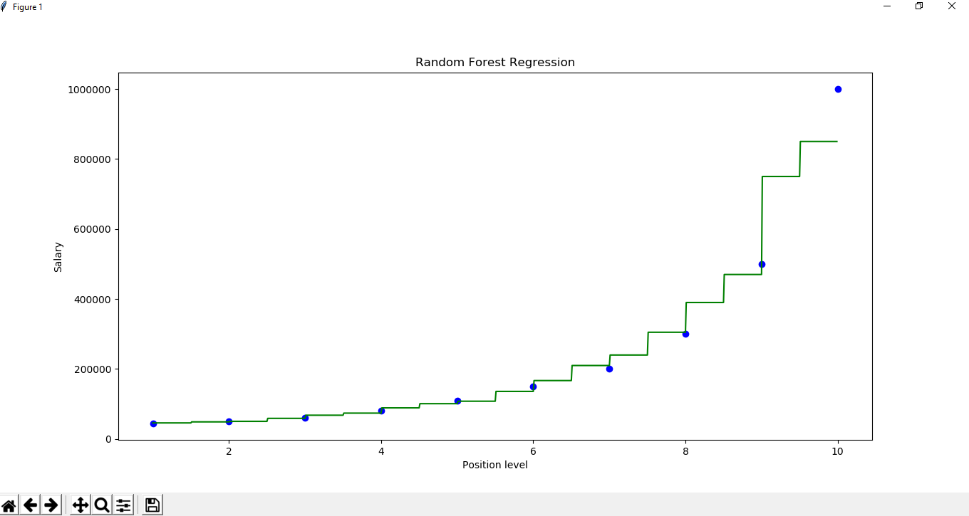
Visualization

Slide 17
K-Means Clustering
A cluster refers to a collection of data points aggregated together because of certain similarities.
K-means clustering is one of the simplest and popular unsupervised machine learning algorithms.
In other words, the K-means algorithm identifies k number of centroids, and then allocates every data point to the nearest cluster, while keeping the centroids as small as possible.
Used K-Means to divide the cab booking data into clusters. The clusters were then plotted on the Android Map. The number of Clusters was set at 150, since it covers most of the hotspots in New York City without overwhelming the map or the user.
Code Snippet:
plt.scatter(X[:,0],X[:,1], label='True Position')
kmeans = KMeans(n_clusters=150)
kmeans.fit(X)

Slide 18
Working of K-Means
To process the learning data, the K-means algorithm in data mining starts with a first group of randomly selected centroids, which are used as the beginning points for every cluster, and then performs iterative (repetitive) calculations to optimize the positions of the centroids
It halts creating and optimizing clusters when either:
The centroids have stabilized — there is no change in their values because the clustering has been successful.
The defined number of iterations has been achieved.

Slide 19
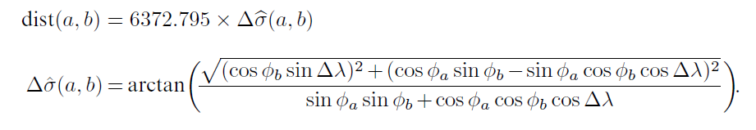
User Specified range of Clusters.
We used K Means to form upto 150 clusters in New York City using previous data and user Range.
Clusters were color mapped based on Fare Amount, blue for low and red for higher fares.
Distance between two points on the map given by their respective coordinates is calculated by the formula given below.

Slide 20
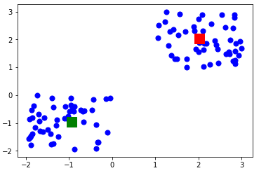
Visualization
For 2 Clusters:

Slide 21

Python Script
This Script acts as a server.
PyreBase Library is used to access firebase in Python
It is the backend Process .
It is continually running to fetch and process client request.
As soon as there is a request is starts computing hotspots within user specified location and range.

Slide 22

FireBAse
Firebase is a mobile and web app development platform that provides developers with a plethora of tools and services to help them develop high-quality apps
The Firebase Realtime Database is a cloud-hosted NoSQL database that lets you store and sync between your users in Realtime.
With just a single API, the Firebase database provides your app with both the current value of the data and any updates to that data.

Slide 23
We used Firebase's Realtime Sync API to get Realtime updates to data via the Android App. The data was then retrieved by ML Code on host PC to test data.
Clusters were then deployed to server and retrieved by the Android App
.

Slide 24
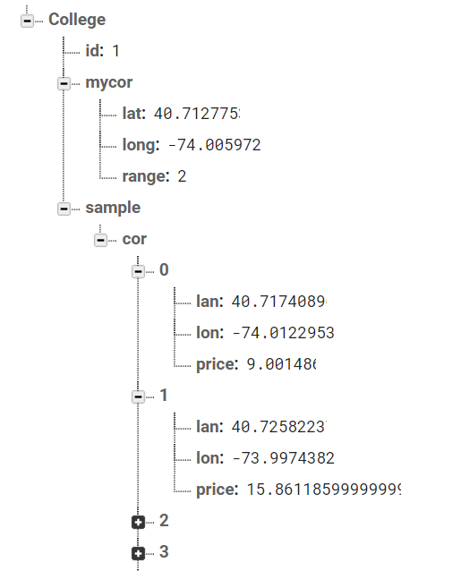

Slide 25

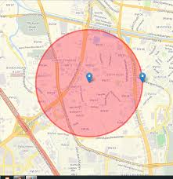
Android
We implemented Maps using Google Maps API.
Data was obtained from Firebase to display on map.
Maps API was used to display clusters obtained from Firebase as Circles on Map with varied colours.
Maps displayed route from given source to destination.

Slide 26
private DatabaseReference mref;
mref = FirebaseDatabase.getInstance().getReference().child("College");
mref.addValueEventListener(new ValueEventListener() {
@Override
public void onDataChange(@NonNull DataSnapshot dataSnapshot) {
long l = dataSnapshot.getChildrenCount();
m2 = dataSnapshot.child("sample").child("cor");
x = m2.getChildrenCount();
lan = (double) m2.child(s).child("lan").getValue();
lon = (double) m2.child(s).child("lon").getValue();
price=(double) m2.child(s).child("price").getValue();
}}
});

Slide 27
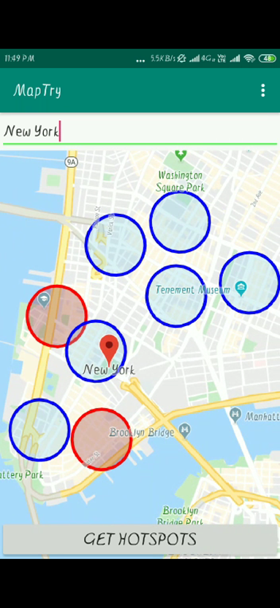
mMap = googleMap;
mMap.addCircle(new CircleOptions()
.center(position)
.radius(300)
.strokeColor(Color.RED)
.fillColor(Color.argb(80, 150, 50, 50))
.clickable(true));

Slide 28
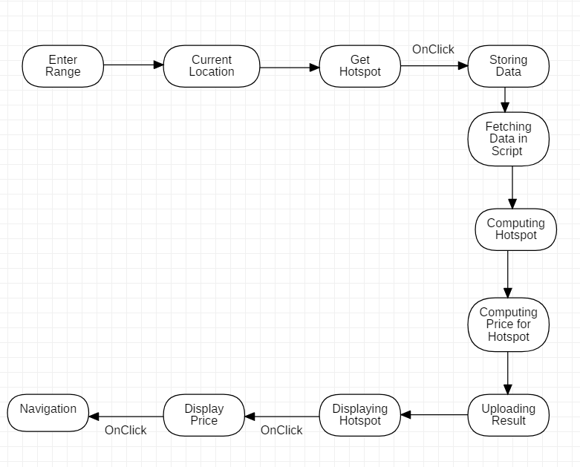
Work-Flow

Slide 29
Result and Future Improvements
We made an Android App to Display Clusters based on User specified Range.
The App also displays predicted fare in a Dialog and helps with navigation.
Fare Prediction by Algorithm has a mean error of 1.84%. Database has 150 cached Clusters across New York City.
App can be Scaled for Large scale applications and dataset can be improved.

Slide 30
Conclusion
Through this project we came to understand following topics:-
1. Data Cleaning
2. K Means Clustering
3. Random Forest Regressor
4 Firebase Database

Slide 31
References
Dataset : https://www.kaggle.com/c/new-york-city-taxi-fare-prediction/data
https://firebase.google.com/
https://towardsdatascience.com/random-forest-and-its-implementation-71824ced454f
K Means Clustering https://towardsdatascience.com/understanding-k-means-clustering-in-machine-learning-6a6e67336aa1

Slide 32
Thank You !

