Slide 1
A Natural Semantics for Lazy Evaluation

Slide 2
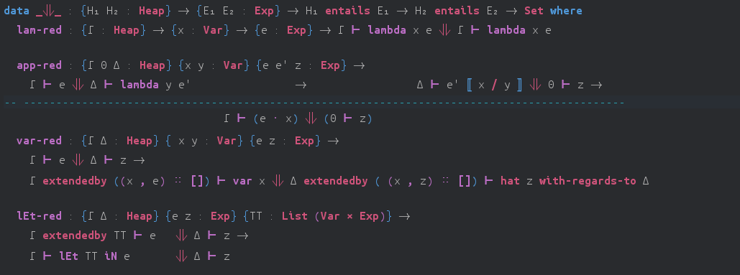
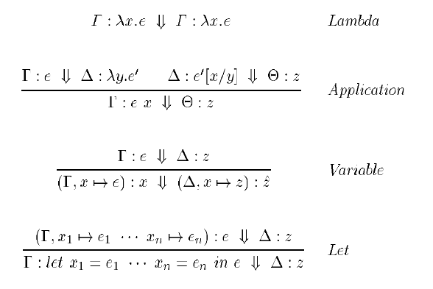
Reduction Rules

Slide 3
Reduction Rules

Slide 4
Reduction Rules

Slide 5
Reduction Rules

Slide 6
Reduction Rules

Slide 7
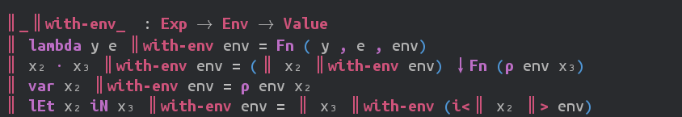
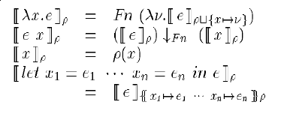
Semantics of Terms

Slide 8
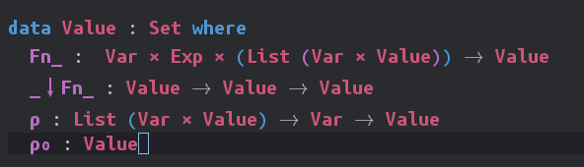
Semantics of Terms

Slide 9
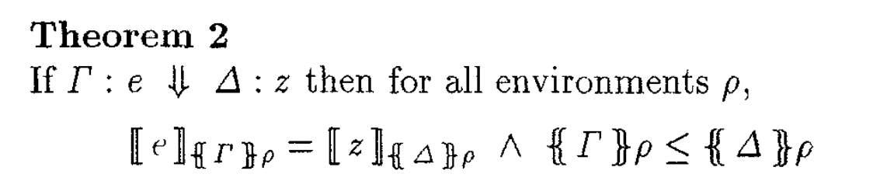

Theorem Proving !!!

Slide 10


Theorem Proving !!!

Slide 11
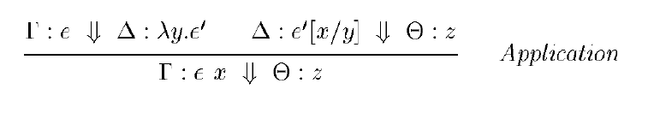
Theorem Proving !!!

Slide 12

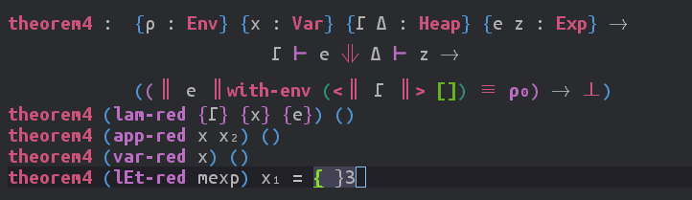
Theorem Proving !!!

