Slide 1
tlv_logistics flows commercial facing (cf) street segments
nachman.shelef@gmail.com
+972544566016

Slide 2
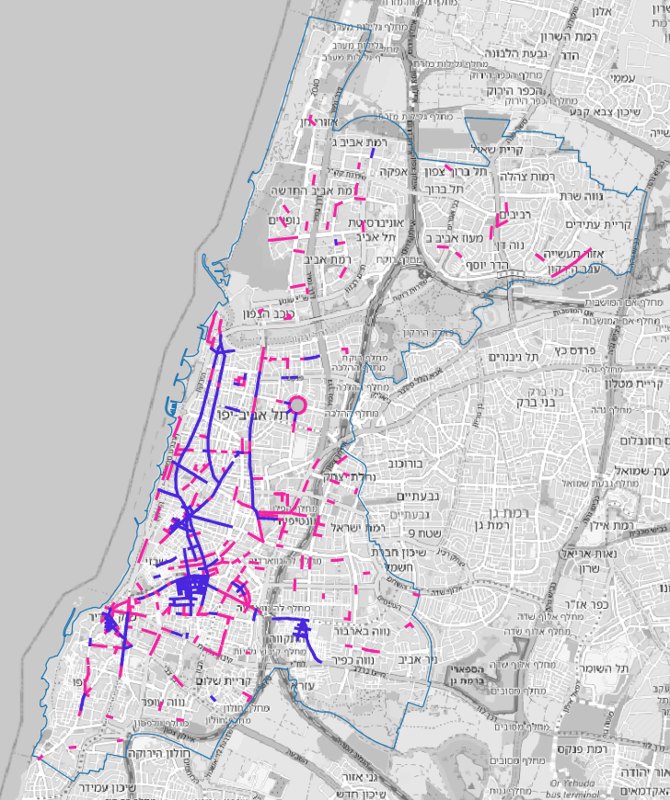
881 commercial facing street segments

Slide 3
Sources and Preprocessing
tlv
>> TA_CommFront.shp
>> TA_CommFront_1_2_w_streetnames_snapped.geojson
iview
>> Trafic Signs Points prika ve teina.shp
>> Trafic Signs Points prika ve teina oid.geojson
>> sign_text_v6s_ap.xlsx >> sign_text_v6s_ap.csv
>> Trafic Signs Points prika ve teina v6s_ap.geojson
tlv ap
>> שכבת_עסקים_-_כולל_עמודת_היקף_הפצה_שבועית.xlsx
>> tlv_businesses_w_logistics_filtered_v0.csv + מרכזים מסחרים - עם-בלי הסדר פריקה וטעינה ייעודי.xlsx
>> tlv_businesses_w_logistics_filtered.csv

Slide 4
preprocessing
supply for on-street delivery :
download prika point and line layers from iview
do not use line layer
split point shp layer files to: csv for sign text file and to location of signs geojson file
process sign text in xlsx to extract prika length in meters and hours in week
AP manual process of signs text that failed auto process
AP manual fill in missing meters when meters are till next intersection or next sign
fill in default values for meters and hours where missing
factor 24h signs for relevant hours in week
remerge (join) based on id : location of signs and supply (hours in week x meters)
demand for on-street delivery:
start with business layer with weekly delivery demand
filter out items that have weekly delivery value of zero
filter out hotels with more than 3 stars (assume dedicated on-site delivery spaces)
filter out businesses in big merkazim_mischariim (assume dedicated on-site delivery spaces)

Slide 5
tlv_logistics_web_app

Slide 6
TA_CommFront_1_2_w_streetnames_snapped.geojson
snap_cf_supply_demand.py
Trafic Signs Points prika ve teina v6s_ap.geojson
tlv_businesses_w_logistics_filtered.csv
buff_cf.py
Trafic Signs Points prika ve teina v6s_ap snap100 cf.geojson
tlv_businesses_w_logistics_filtered_snap100_cf.geojson
cf_1_2_buff5.geojson
cf_1_2_buff25.geojson
cf_1_2_buff100.geojson
segments_cf_points_in_poly.py
segments_cf_poly_metrics.geojson
segments_cf_format_abs_output.py
segments_cf_poly_metrics_abs_4326.geojson
tlv_logistics_s2d.js
Leaflet
tlv_logistics\index.html
tlv_logistics_s2d.js
voc_output_to_web_app_v1.js
Interactive
Map
Display

Slide 7
index.html
voc_output_to_web_app_v1.js
tlv_logistics_s2d.js
gzip_big_files_tlv_logistics.py
index.html
voc_output_to_web_app_v1.js
tlv_logistics_s2d.js.gz
upload_tlv_logistics2aws_s3.py
AWS S3
transport-justice/tlv_logistics_web_app\tlv_logistics index.html
tlv_logistics_s2d.js
voc_output_to_web_app_v1.js
Leaflet
Interactive
Map
Display

Slide 8
tlv_logistics_norm_web_app

Slide 9
TA_CommFront_1_2_w_streetnames_snapped.geojson
snap_cf_supply_demand.py
Trafic Signs Points prika ve teina v6s_ap.geojson
tlv_businesses_w_logistics_filtered.csv
buff_cf.py
Trafic Signs Points prika ve teina v6s_ap snap100 cf.geojson
tlv_businesses_w_logistics_filtered_snap100_cf.geojson
cf_1_2_buff5.geojson
cf_1_2_buff25.geojson
cf_1_2_buff100.geojson
segments_cf_points_in_poly.py
segments_cf_poly_metrics.geojson
segments_cf_format_output.py
segments_cf_poly_metrics_norm_4326.geojson
street_segments25.js
average_stdev.js
street_segments25.js
Leaflet
tlv_logistics\index.html
average_stdev.js
Interactive
Map
Display

Slide 10
average_stdev.js
street_segments25.js
gzip_big_files_tlv_logistics_norm.py
average_stdev.js.gz
street_segments25.js.gz
upload_tlv_logistics_norm2aws_s3.py
AWS S3
transport-justice/tlv_logistics_norm_web_app\tlv_logistics index.html
average_stdev.js
street_segments25.js
Leaflet

Slide 11
tlv_logistics flows commercial facing (cf) street segments
nachman.shelef@gmail.com
+972544566016

Slide 12
20june2023
Avi, just want to confirm that you took the following action items:
- supply: get data to better estimate the meters for delivery of "netivim mitchalfim"
- demand: filter out businesses in big merkazim_mischariim (assume dedicated on-site delivery spaces)
I made much progress in automatic processing and web-app visualization using the existing supply and demand data.
but I am now waiting for the data updates above.
do you want me to help with the data updates above?

Slide 13
~14June2023
the segments are from the commercial front layer
the supply is based on the manually updated file you sent me
the default for missing prika length is 12meters (can be changed)
the default for missing hours is 36 hours a week (can be changed)
no limit hours (24 hours a day) is counted as 6 * 24 hours per week (can be changed)
the buffer used to sum the supply and the demand is 200meters
the total average supply to demand ratio is 3.0 [meters * weekly hours / weekly deliveries] (which is equivalent to 6meters for 30min per delivery
so in the map a supply to demand ratio less than 3 is below average and higher than 3 is above average...
in order to improve the supply data we need a layer with street directions (till the next intersection... and the rest of the signs to take into account canceling signs...
another potential improvement in the map analysis is to snap the supply and demand points to the nearest street segment before summing... this deals with double counting...
in addition we could take excess parking areas into consideration as supply...
also, I think we need to add underground delivery supply for the big commercial centers...
let me know how best to proceed... or call to discuss.

