Slide 1
tlv_logistics flows commercial facing (cf) street segments
nachman.shelef@gmail.com
+972544566016

Slide 2
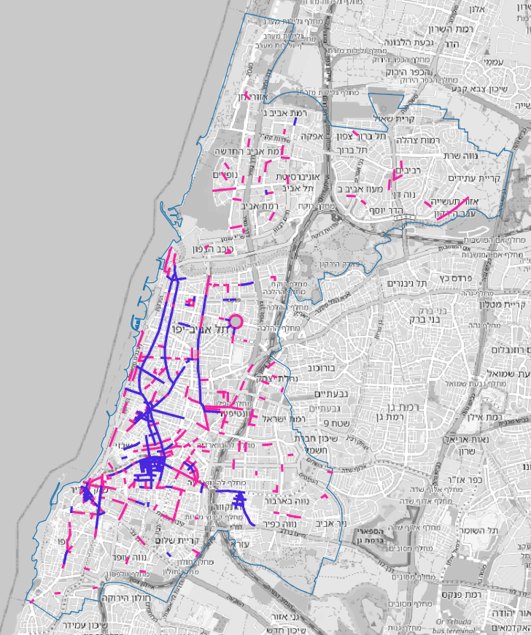
881 commercial facing street segments

Slide 3
settings / assumptions
the street segments analysed are from the commercial front layer
the buffer used to sum the supply and the demand per segment is 100meters
the default for missing prika length in sign text is 12meters
the default for missing hours in sign text is 36 hours a week
no limit hours in sign text (24 hours a day) is counted as 6 * 24 hours per week
assumption: hotels with more than 3 stars use dedicated on-site delivery spaces
assumption: big malls use dedicated on-site delivery spaces
assumption: a single onstreet delivery takes up (on average) 6meters for 20min

Slide 4
preprocessing street segments with commercial front
get TA_CommFront.shp layer
remove segments with CommFront = 0
get Streets.shp layer from iView
snap CommFront segments to street segments
intersect with buff10 street segments
add street names from max length intersect
export to geojson
TA_CommFront.shp
Streets.shp
QGIS
TA_CommFront_1_2_w_streetnames_snapped.geojson

Slide 5
preprocessing supply for onstreet delivery :
Trafic Signs Points prika ve teina.shp
download prika point layer from iview (do not use line layer)
split point shp layer files to: csv for sign text file and to location of signs geojson file
process sign text in xlsx to extract prika length in meters and hours in week
AP manual process of signs text that failed auto process
AP manual fill in missing meters when meters are till next intersection or next sign (netivim mitchalfim)
fill in default values for meters and hours where missing
factor 24h signs for relevant hours in week
remerge (join) based on id : location of signs and supply (hours in week x meters)
QGIS
sign_text_v2.csv
sign_text_v2.xlsx
sign_text_v3.xlsx
sign_text_v6s_ap.xlsx
Trafic Signs Points prika ve teina oid.geojson
sign_text_v6s_ap.csv
QGIS
Trafic Signs Points prika ve teina v6s_ap.geojson

Slide 6
preprocessing demand for onstreet delivery:
start with business layer with weekly delivery demand
filter out items that have weekly delivery value of zero
filter out hotels with more than 3 stars (assume dedicated on-site delivery spaces)
AP manual filter out businesses in big merkazim_mischariim (assume dedicated on-site delivery spaces)
שכבת_עסקים_-_כולל_עמודת_היקף_הפצה_שבועית.xlsx
tlv_businesses_w_logistics_filtered_v0.csv
מרכזים מסחרים - עם-בלי הסדר פריקה וטעינה ייעודי.xlsx
tlv_businesses_w_logistics_filtered_v0.xlsx
tlv_businesses_w_logistics_filtered.csv

Slide 7
tlv_logistics_web_app

Slide 8
TA_CommFront_1_2_w_streetnames_snapped.geojson
snap_cf_supply_demand.py
Trafic Signs Points prika ve teina v6s_ap.geojson
tlv_businesses_w_logistics_filtered.csv
buff_cf.py
Trafic Signs Points prika ve teina v6s_ap snap100 cf.geojson
tlv_businesses_w_logistics_filtered_snap100_cf.geojson
cf_1_2_buff5.geojson
cf_1_2_buff25.geojson
cf_1_2_buff100.geojson
segments_cf_points_in_poly.py
segments_cf_poly_metrics.geojson
segments_cf_format_abs_output.py
segments_cf_poly_metrics_abs_4326.geojson
tlv_logistics_s2d.js
Leaflet
tlv_logistics\index.html
tlv_logistics_s2d.js
voc_output_to_web_app_v1.js
Interactive
Map
Display

Slide 9
index.html
voc_output_to_web_app_v1.js
tlv_logistics_s2d.js
gzip_big_files_tlv_logistics.py
index.html
voc_output_to_web_app_v1.js
tlv_logistics_s2d.js.gz
upload_tlv_logistics2aws_s3.py
AWS S3
transport-justice/tlv_logistics_web_app\tlv_logistics index.html
tlv_logistics_s2d.js
voc_output_to_web_app_v1.js
Leaflet
Interactive
Map
Display
https://transport-justice.s3.eu-central-1.amazonaws.com/tlv_logistics_web_app/tlv_logistics/index.html

Slide 10
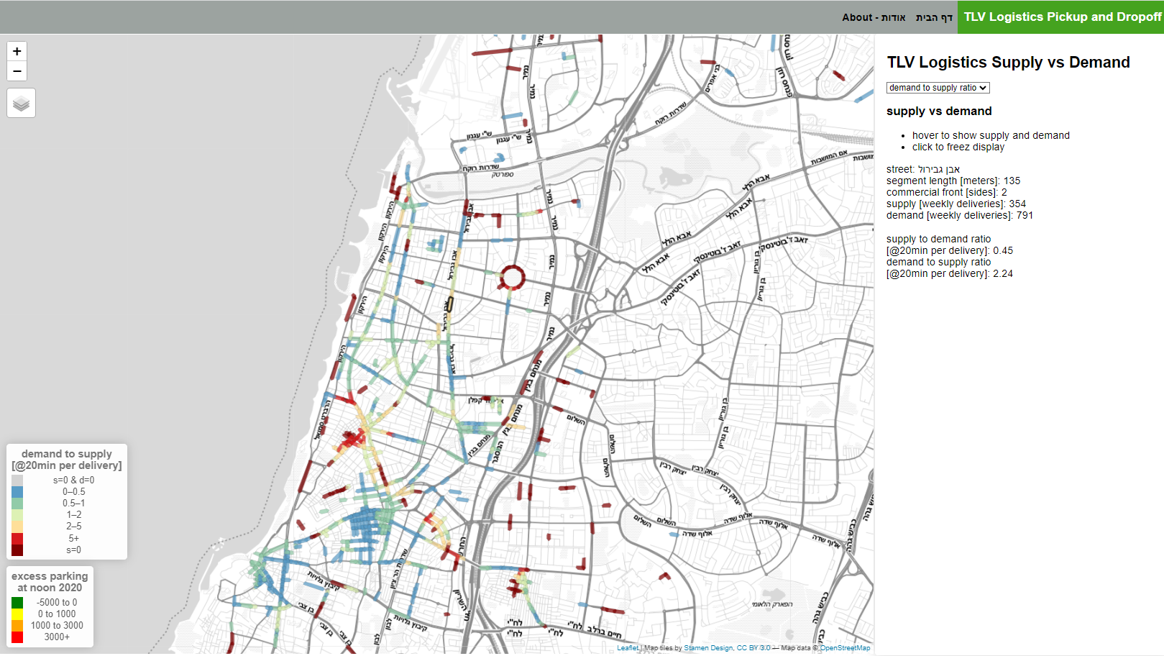
1
5
3
4
2

Slide 11

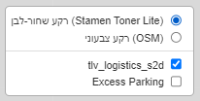
select what to display
choose from the following:
demand to supply ratio is the default
1
hover over segment to show supply and demand data
click on segment to freeze display
click again on a segment to un-freeze display
2
3
segment name, length, and commercial front data and
segment delivery supply and demand data
segment supply to demand ratio
segment demand to supply ratio
4
change to color base map
add excess parking layer to display
5

Slide 12
tlv_logistics flows commercial facing (cf) street segments
nachman.shelef@gmail.com
+972544566016

