Slide 1


Detecting human movements based on geophone sensor and SNN Project number: p-2025-058 Students: Nachman Mimoun - 321730558 and Eliav Neeman – 207549650 Supervisors: Prof. Shlomo Greenberg
Notes:
שלום לכולם, אני אליאב נאמן ויחד עם נחמן מימון אנחנו עובדים על פרויקט מספר -2025-058p, זיהוי תנועת אדם באמצעות חיישן גיאופוני ורשת עצבית מסוג S

Slide 2
introduction
Problem Description
Detecting human and vehicle movement is essential for security, monitoring, and smart-home systems.
Traditional methods (e.g., cameras, RF sensors) are often intrusive, expensive, or sensitive to environmental changes.
Project Objective
Develop a system using geophone sensors to capture ground vibrations caused by footsteps (Works on various floors & conditions).
Advanced SCTN Ensemble Architecture for non-intrusive, energy-efficient movement classification.
Aim for high classification(95%) accuracy with ultra-low power consumption(1µW).
Notes:
תיאור הבעיה:
זיהוי מדויק של תנועה אנושית במרחב נתון מהווה אתגר עבור יישומי אבטחה, ניטור ויישומי בית חכם. שיטות מסורתיות (למשל, מצלמות או חישה מבוססת RF) יכולות להיות חודרניות, יקרות או רגישות לתנאי הסביבה.
מטרת הפרויקט:
לפתח מערכת המבוססת על חיישן גיאופון (ללכידת רעידות קרקע) ורשת עצבית Spiking (SNN) להשגת זיהוי תנועה אנושי יעיל ולא פולשני. הגישה ממנפת עיבוד אותות בתדר זמן (באמצעות SCTN) ואחריו סיווג באמצעות רשת ספייק, במטרה לדיוק גבוה וצריכת חשמל נמוכה.

Slide 3
Technical Approach
System Architecture
Geophone sensor module: Captures structural vibrations (1-200 Hz range)
Feature extraction: SCTN-based resonator bank .
Classification: Advanced SCTN Ensemble Architecture binary classifier (movement/no movement)
Key Innovations
Direct continuous-time processing (no frame-based windowing)
Ultra-low power SCTN neurons (<40 nW per resonator)
Neuromorphic frequency detection using spiking resonators
Notes:
1 מודול החיישן הגיאופוני: קולט רעידות בטווח 1-200 הרץ. יתרון משמעותי של הגישה שלנו הוא שאין צורך בהמרה אנלוגית-לדיגיטלית יקרה, כיוון שהרשת העצבית שלנו יכולה לעבוד ישירות עם אותות .)PDM (Pulse Density Modulation
.2 מודול חילוץ מאפיינים: זהו הלב של המערכת - בנק של 29 רזונטורים המבוססים על מודל SCTN. כל רזונטור הוא למעשה "מסנן" המכוון לתדר ספציפי. בניגוד ל-FFT המסורתי, הגישה שלנו עובדת באופן רציף ללא צורך בחלוקה לחלונות זמן.
.3 מסווג מבוסס SNN: מקבל את דפוסי הספייקים מבנק הרזונטורים ומחליט האם יש תנועת אדם או לא.
להדגיש זמן רציף קידוד pdm

Slide 4
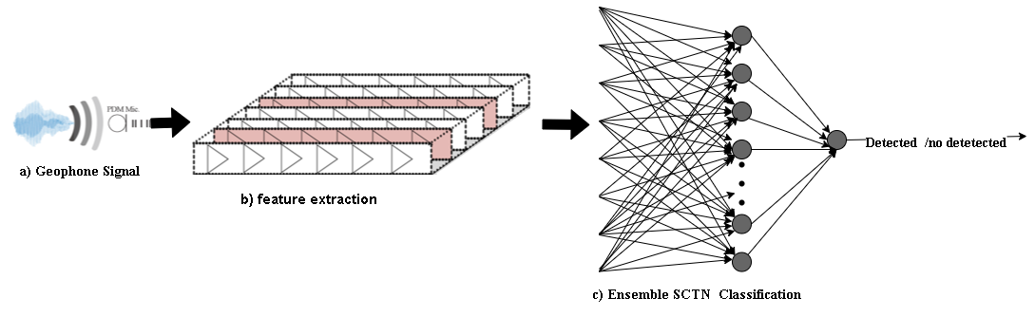
System Block Diagram

Slide 5
Geophone Signal Analysis
Four separate CSV files were provided for comparison:
Human Data:
• human.csv: 1,400,040 samples (1,400 seconds), Signal with human movement
• human_nothing.csv: 998,440 samples (998 seconds), Baseline signal with no human.
Vehicle Data:
• car.csv: 840,024 samples (840 seconds), Signal with vehicle movement.
• car_nothing.csv: 480,036 samples (480 seconds), Baseline signal with no vehicle.
Sampling Rate: 1000 Hz
These files enable a direct comparison between activity and baseline, and support accurate frequency-domain analysis for both human and vehicle movement.

Slide 6
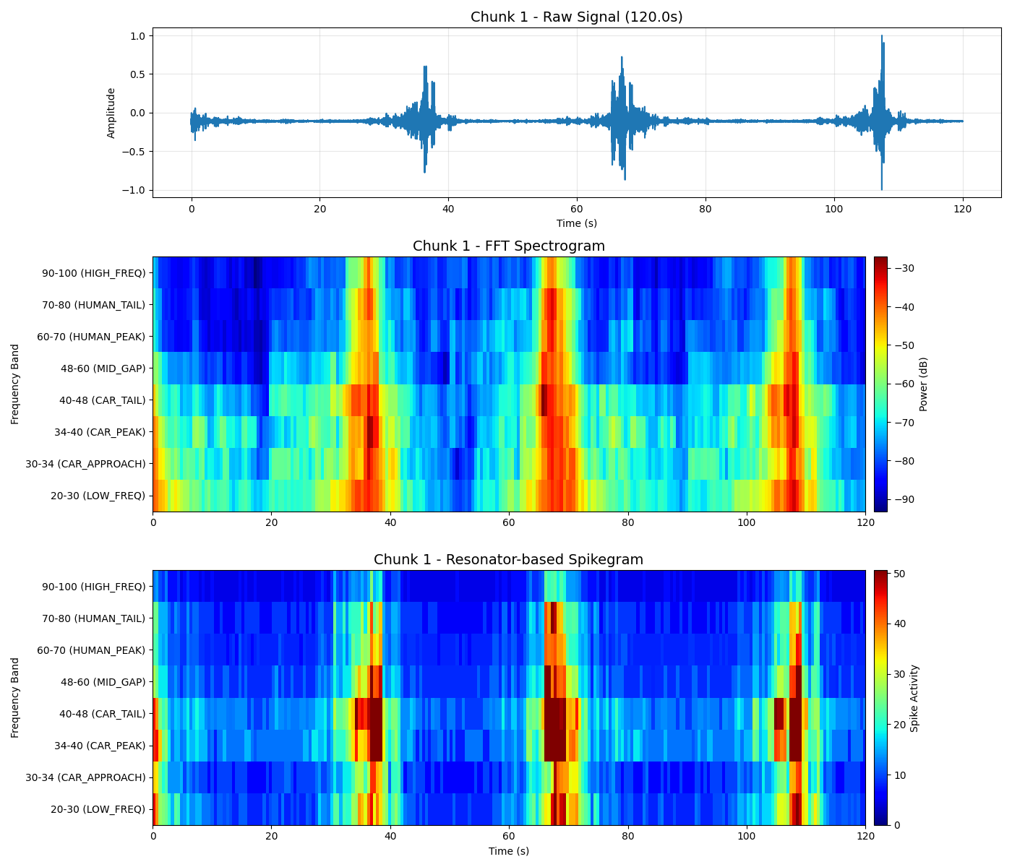
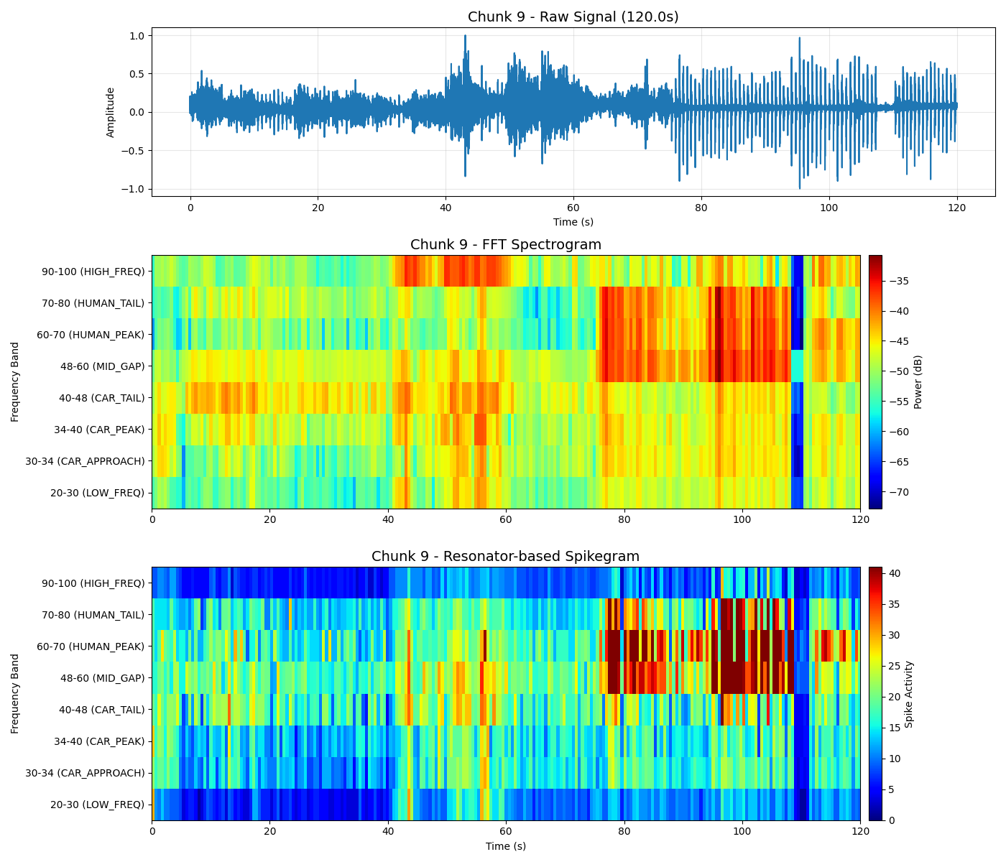
exemple
Car:
Human:

Slide 7
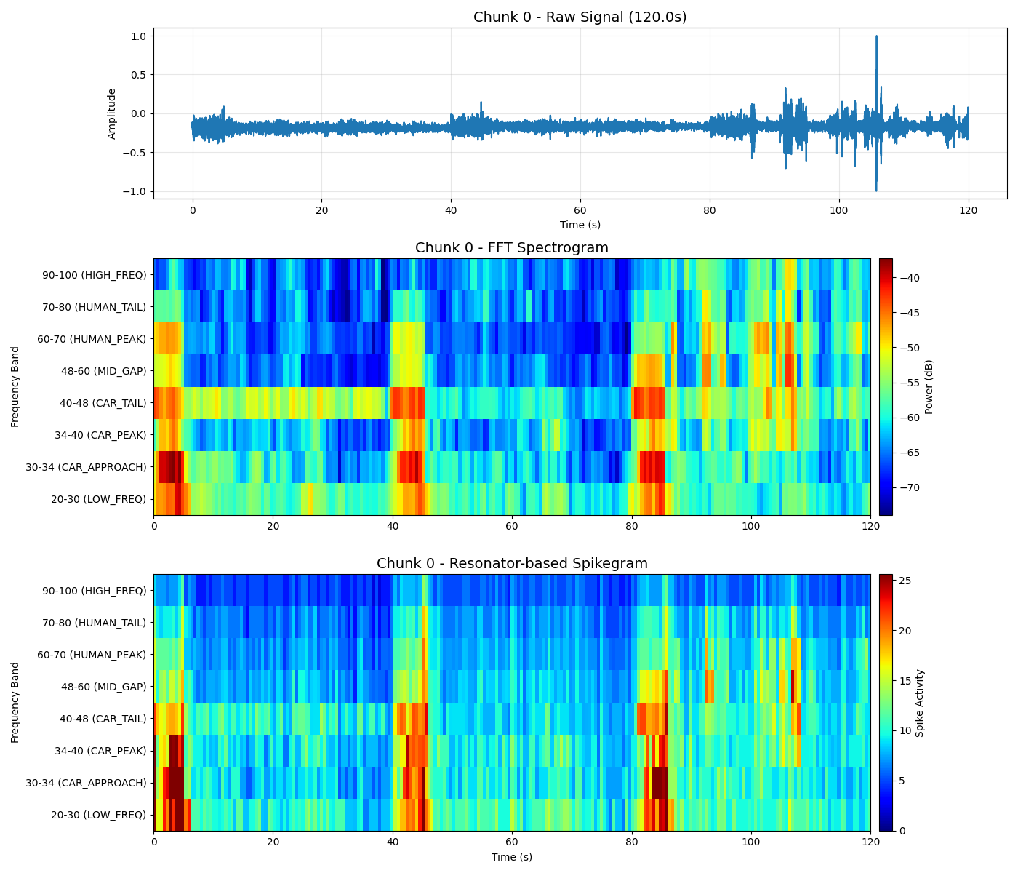
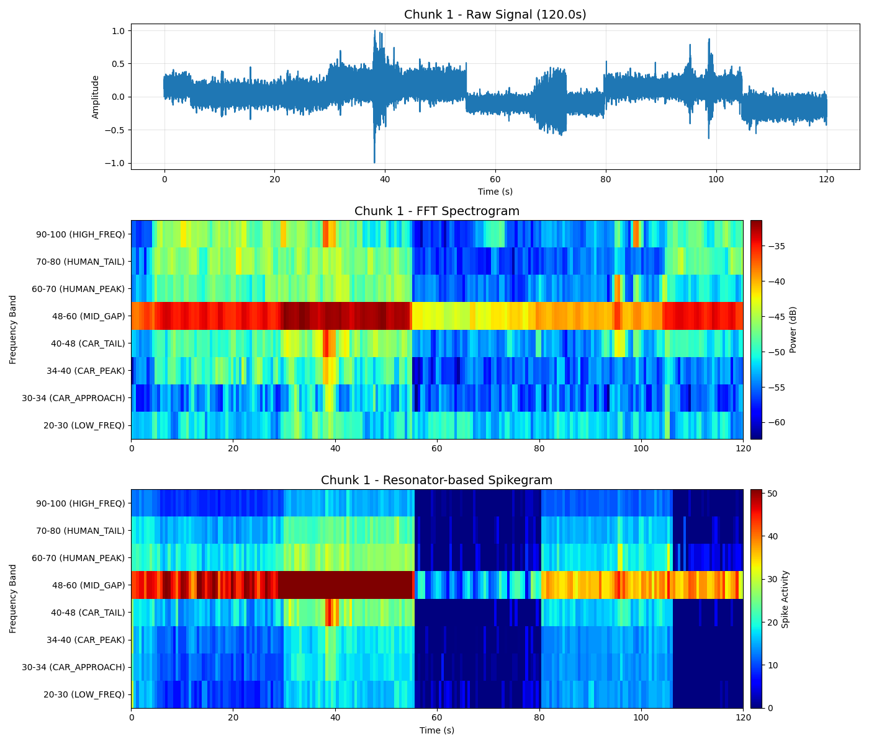
Car _nothing
Human _nothing

Slide 8
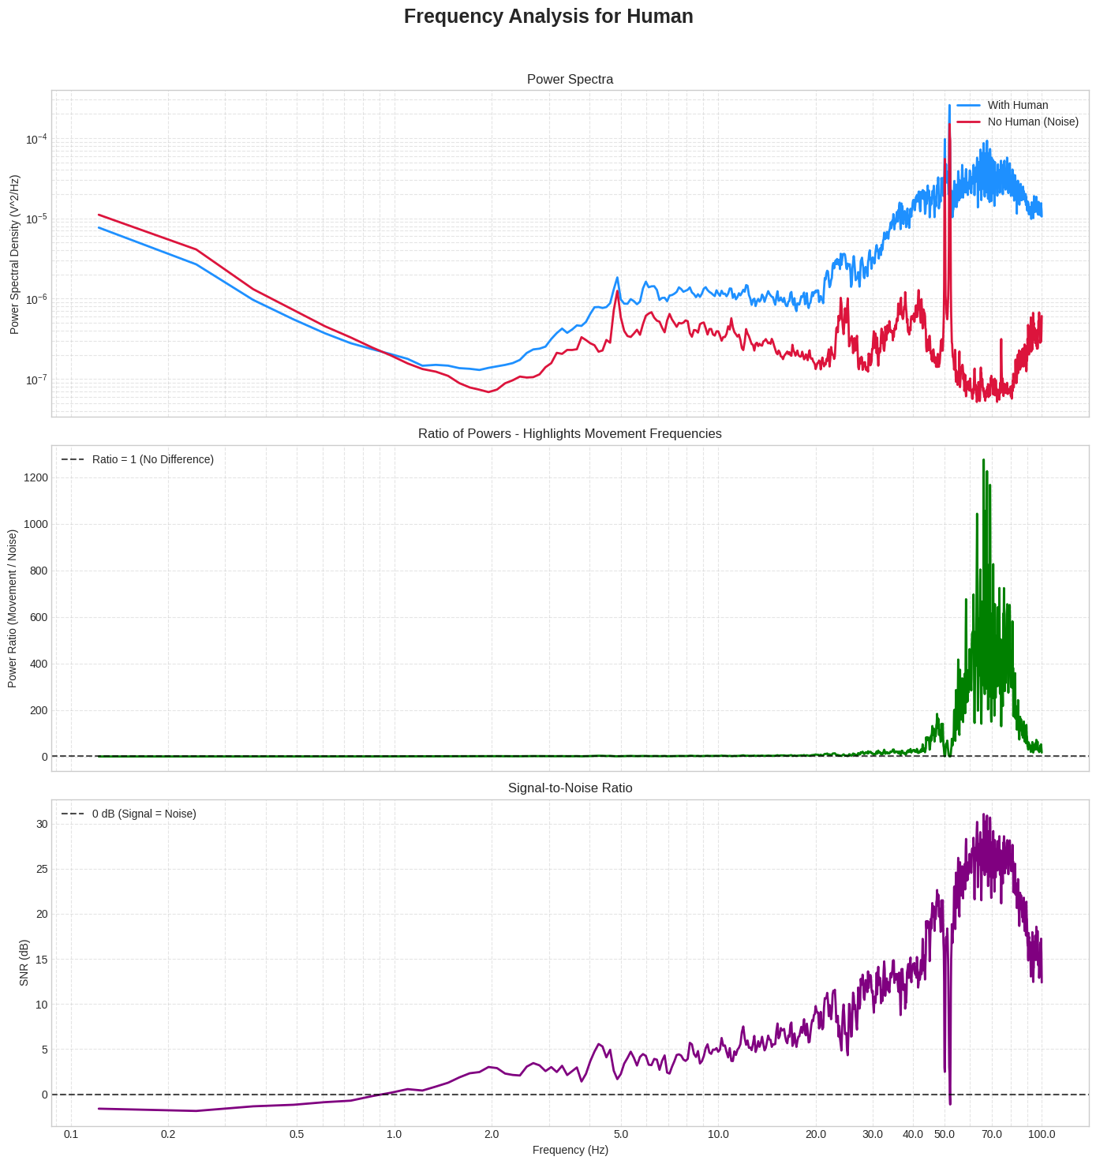
Data Analysis Results
To identify the characteristic patterns of human and vehicle movement, we performed FFT-based frequency analysis.
Human Movement: Main frequency band: 60–70 Hz
Notes:
בגרף השלישי, שמציג את היחס בין תנועה לשקט בכל תדר, גילינו תובנה מעניינת:
.1 פס 70-80 הרץ )מודגש בכחול(: מראה יחס גבוה מאוד, עם שיאים מעל ,300 ומהווה אינדיקטור חזק לתנועת אדם
. .2 בניתוח התדרים, זיהינו 229 תדרי שיא עם יחס תנועה/שקט משמעותי. עשרת התדרים המובילים נמצאים בעיקר בטווח 61-83 הרץ, כאשר התדרים הדומיננטיים ביותר הם 68.66 הרץ, 83.07 הרץ, 73.67 הרץ, ו74.40- הרץ. ניתן לראות ריכוז ברור של תדרים חשובים באזור 70-80 הרץ. גילוי זה מאפשר לנו לפתח מערכת חכמה המתמקדת בעיקר באינדיקטורים לתנועה בפס 70-80 הרץ, יחד עם מספר תדרים בעלי יחס גבוה נוספים שזיהינו.

Slide 9
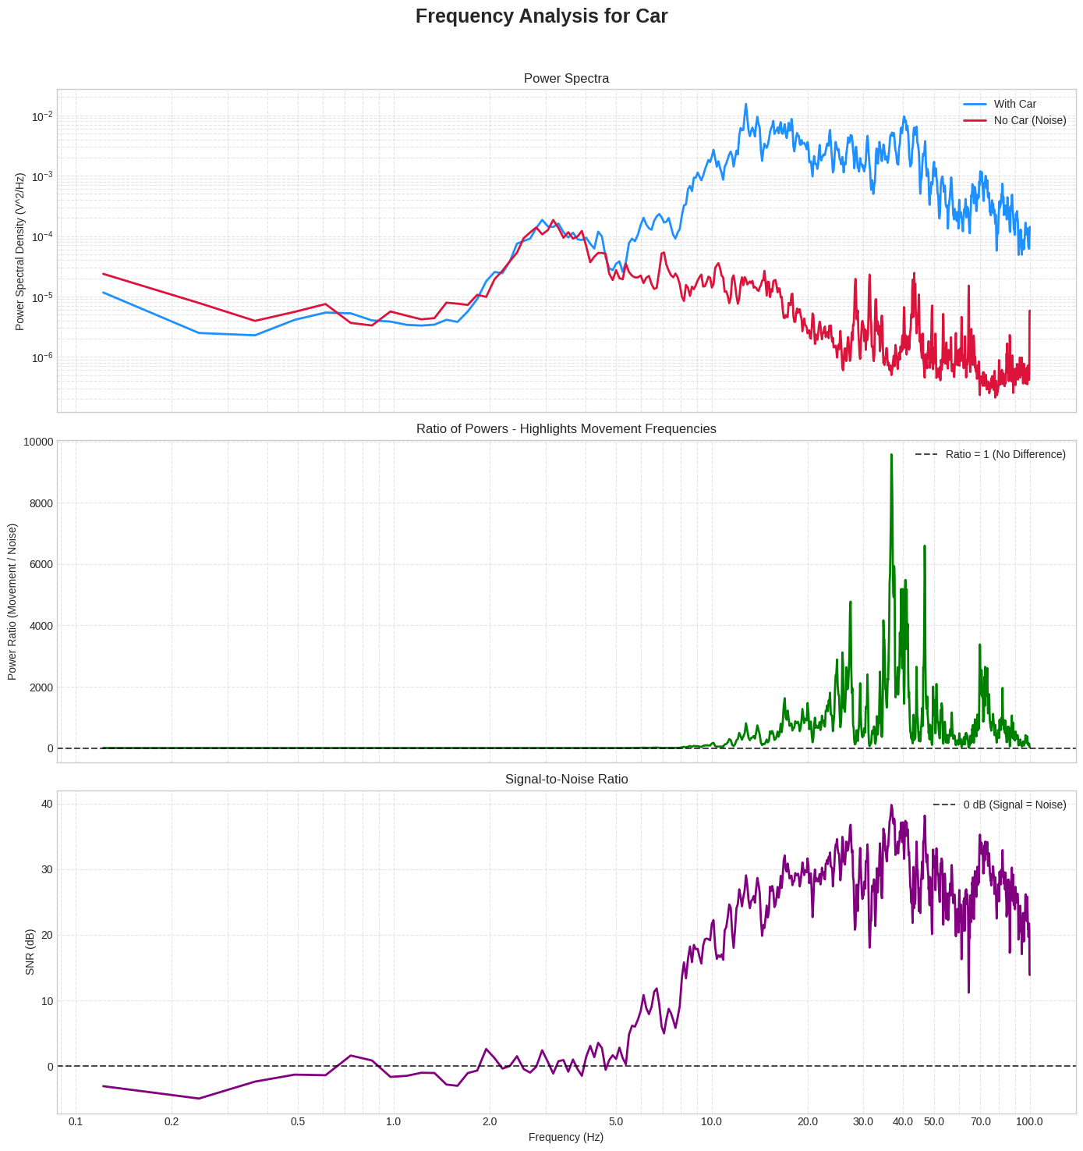
Car Movement: Main frequency band: 34–40 Hz

Slide 10

After understanding the characteristics of the signals, the appropriate frequency range is:
Frequency Band Definitions:
• LOW_FREQ : 20–30 Hz
• CAR_APPROACH : 30–34 Hz
• CAR_PEAK : 34–40 Hz
• CAR_TAIL : 40–48 Hz
• MID_GAP : 48–60 Hz
• HUMAN_PEAK : 60–70 Hz
• HUMAN_TAIL : 70–80 Hz
• HIGH_FREQ : 90–100 Hz
Car Movement – 15 Resonators
• 22.1 Hz and 28.8 Hz cover the LOW_FREQ range
• 30.5 Hz cover the CAR_APPROACH range
• 34.7 Hz, and 37.2 Hz cover the CAR_PEAK range
• 40.2 Hz, 43.6 Hz, and 47.7 Hz cover the CAR_TAIL range
• 52.6 Hz and 58.7 Hz cover the MID_GAP range
• 63.6 Hz and 69.4 Hz cover the HUMAN_PEAK range
• 76.3 Hz covers the HUMAN_TAIL range
• 89.8 Hz and 95.4 Hz cover the HIGH_FREQ range
Human Movement – 10 Resonators
• 22.1 Hz covers the LOW_FREQ range
• 30.5 Hz and 33.9 Hz cover the CAR_APPROACH range
• 34.7 Hz covers the CAR_PEAK range
• 41.2 Hz covers the CAR_TAIL range
• 50.9 Hz and 52.6 Hz cover the MID_GAP range
• 63.6 Hz covers the HUMAN_PEAK range
• 76.3 Hz covers the HUMAN_TAIL range
• 95.4 Hz covers the HIGH_FREQ range

Slide 11
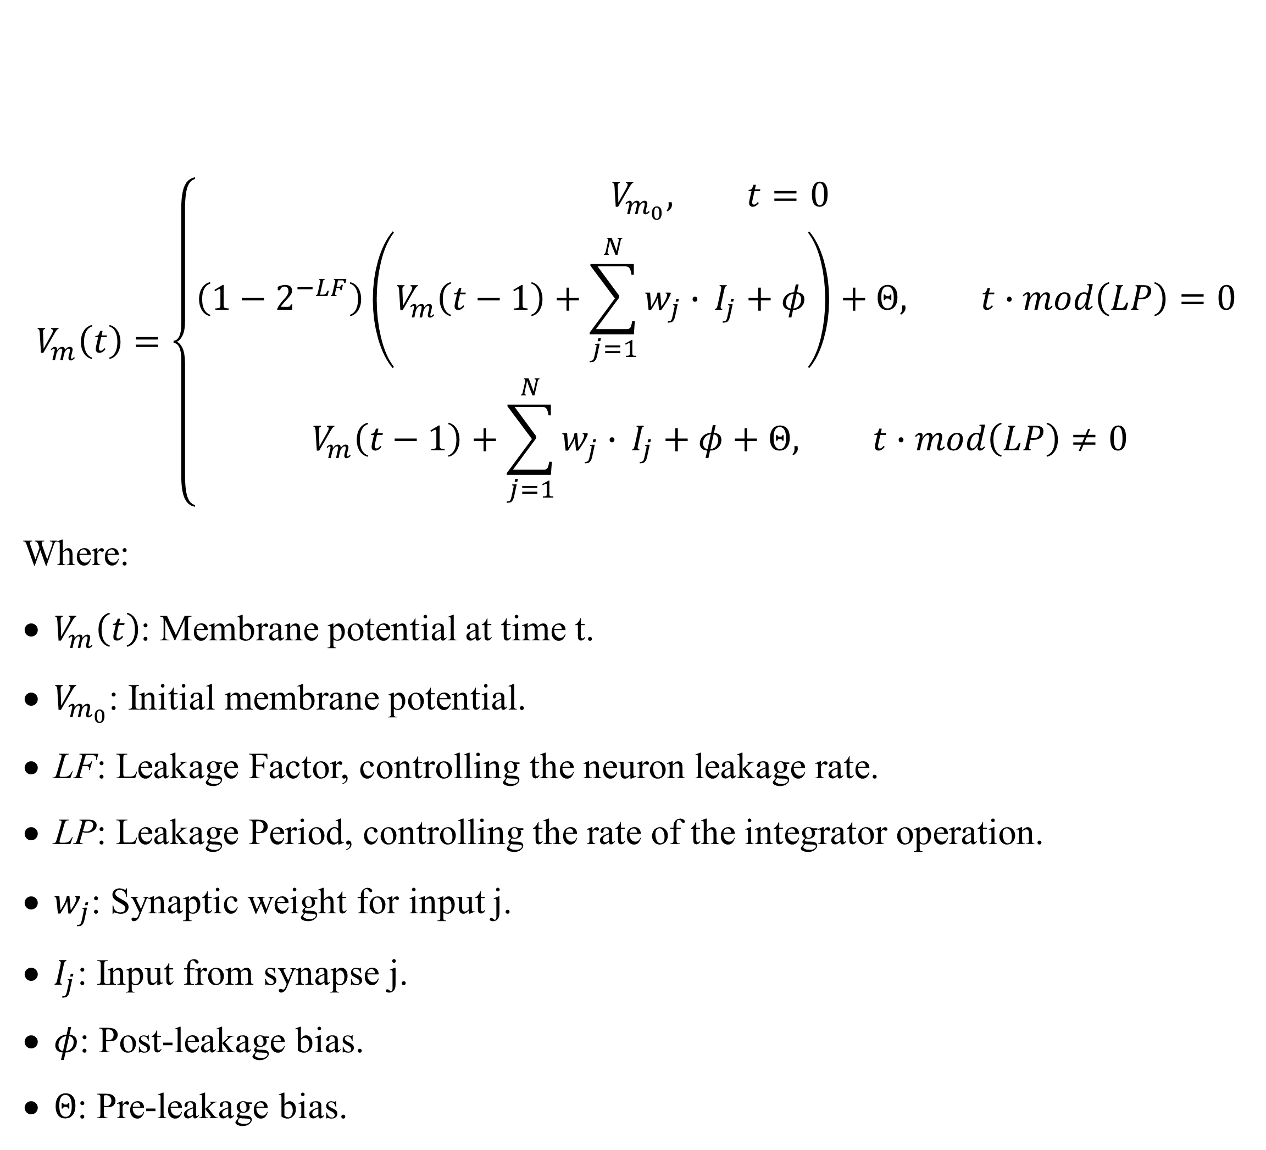
SCTN Resonator
A biologically inspired neuron model capable of replicating real neural behavior. By interconnecting basic neuron blocks, SCTNs can form efficient networks suitable for cognitive algorithms and voice processing applications.
The Spiking Continuous Time Neuron (SCTN) mathematical model is defined by:
Notes:
הרזונטור הוא אבן היסוד של המערכת שלנו. מדובר ברשת של 5 נוירוני SCTN המחוברים בצורה ייחודית, כאשר הנוירון הראשון מקודד את האות והארבעה הנוספים יוצרים תהודה בתדר ספציפי. הסוד טמון בחיבור המשוב בין הנוירון האחרון לנוירון השני, שיוצר תהודה חזקה בתדר המטרה.

Slide 12
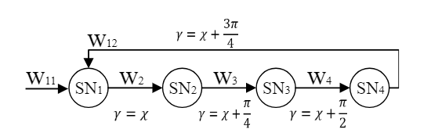
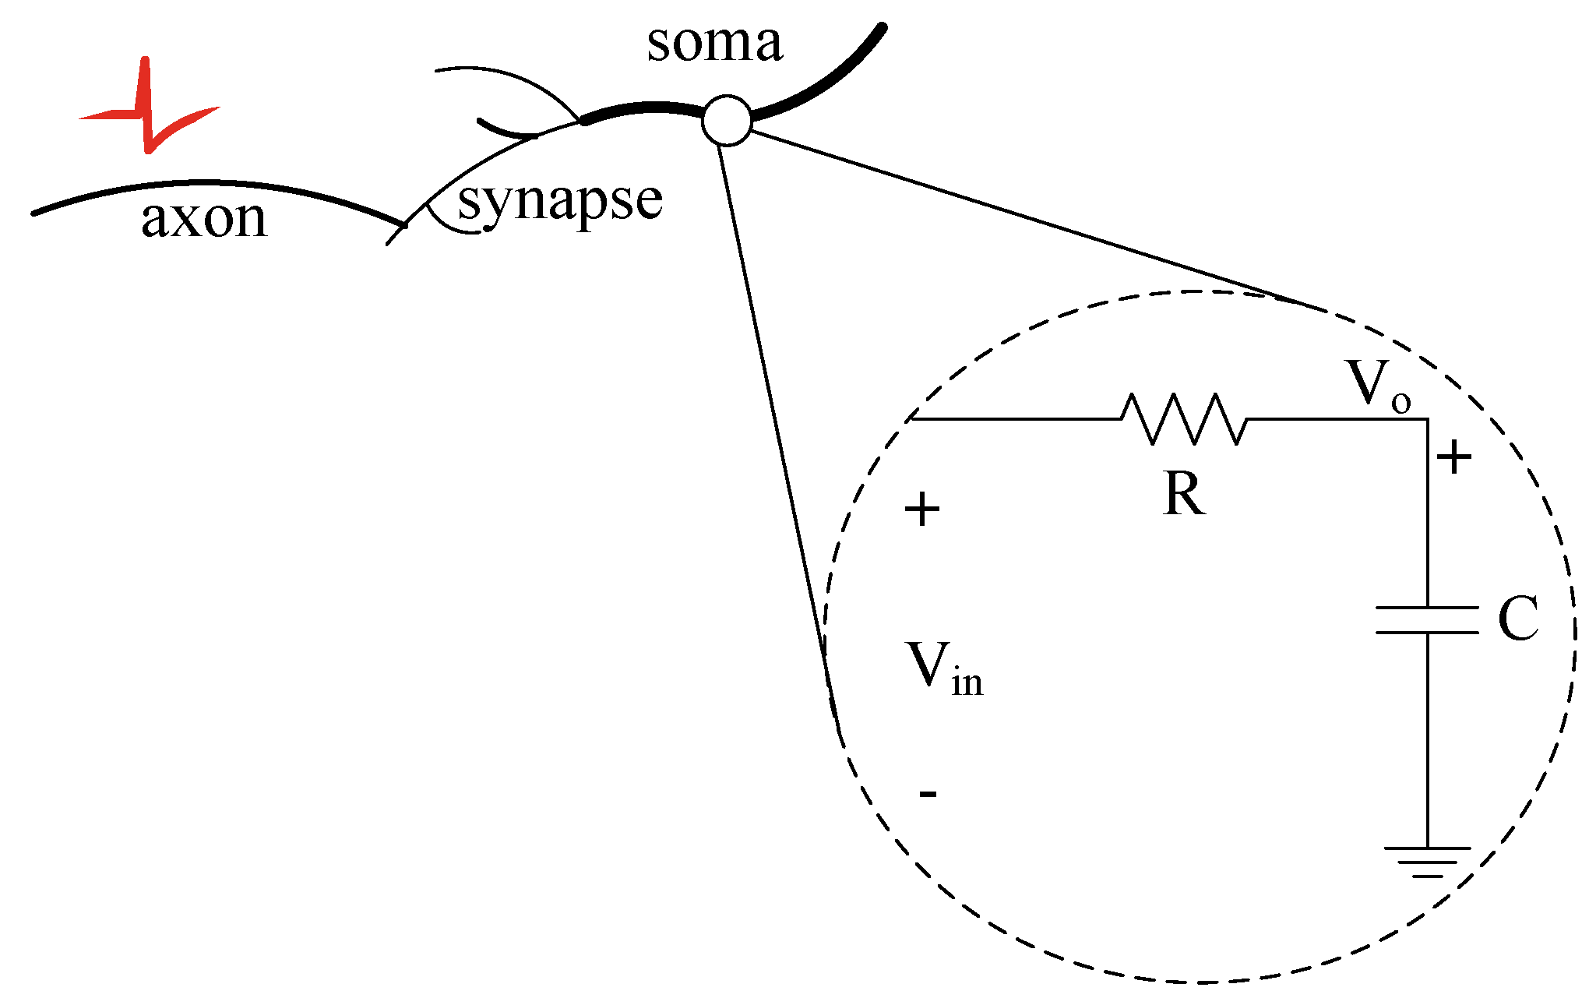
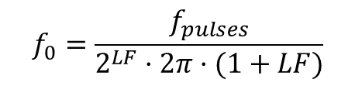
A resonator is a component that responds strongly to a specific frequency and reacts only to it or to a narrow band around it. (1) Each resonator is built from 4 SCTN (Spike Continuous Time Neurons), which are connected in a way that creates a focused resonant response.
(2) The connections and parameters (such as leakage and time constants) are tuned so that the system generates a peak response only at the desired frequency. The frequency is defined by the following formula:
$$f_{0}=\frac{f_{pulses}}{2^{LF}·2π·(1+LF)}$$

Slide 13
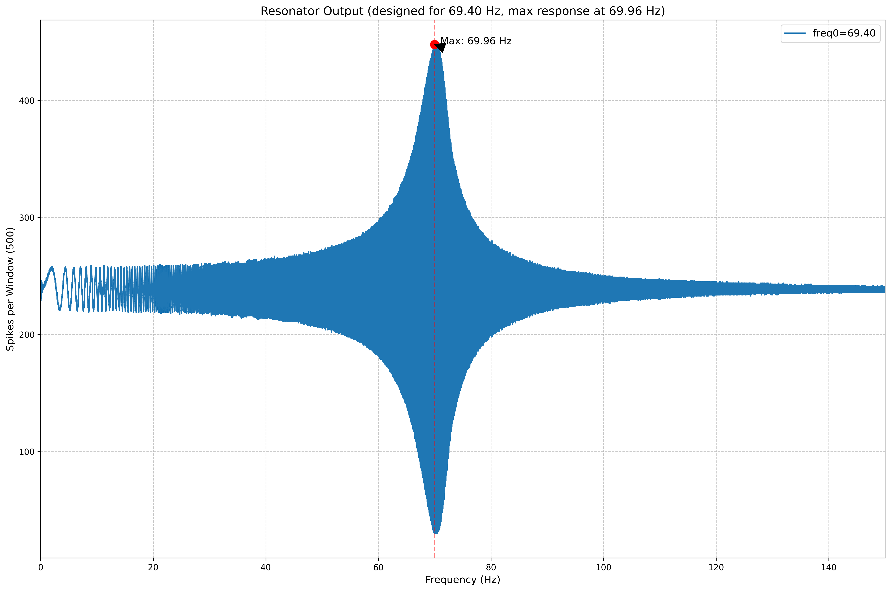
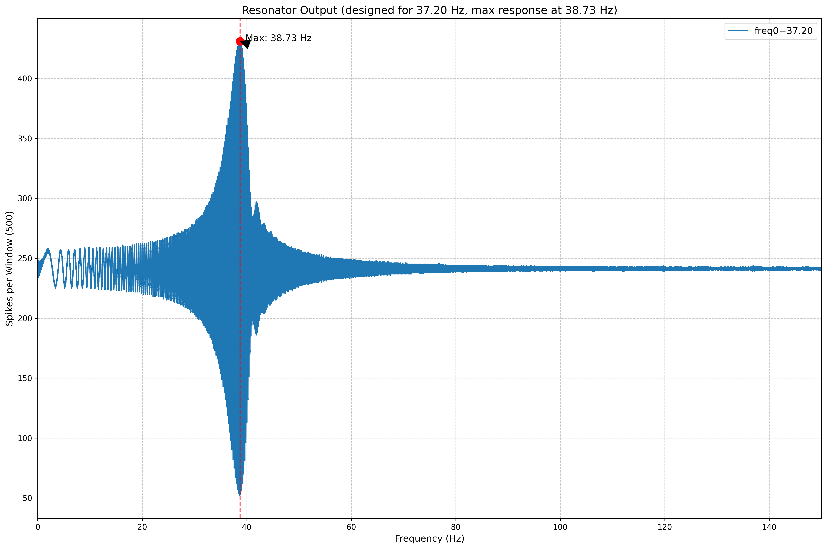
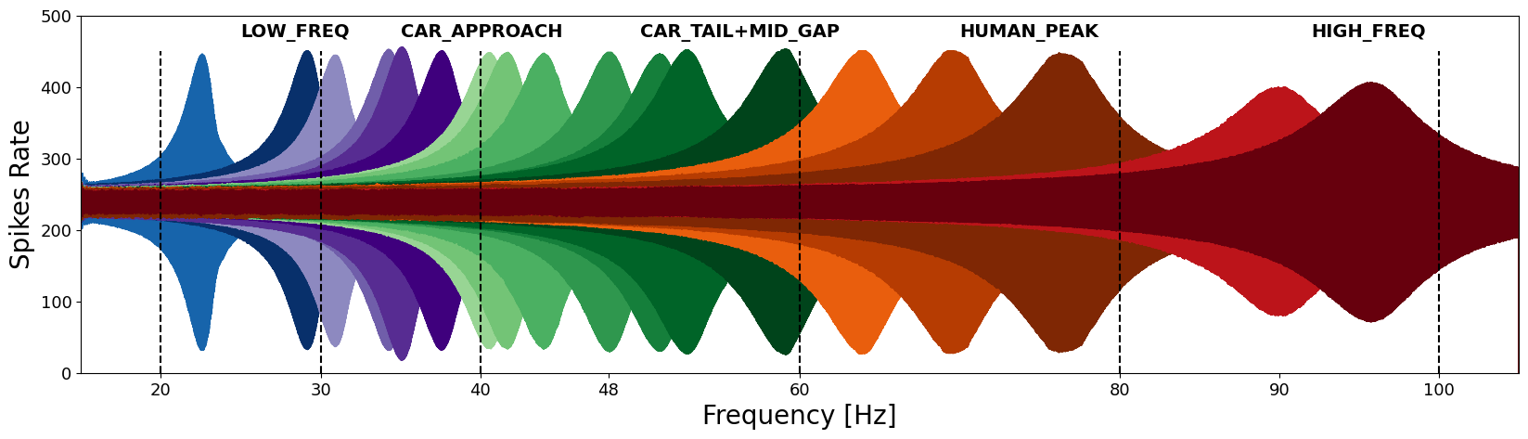
We built all the resonators using the parameters defined above. We input a sine wave signal into each resonator to observe its response and to obtain a spike at the desired frequency. For example, for the frequency 69.96,37.2 Hz, the output of the resonator is:
And for the entire set of resonators:

Slide 14
Feature extraction- SCTN-based resonators
FFT vs. Spikegram Comparison
Car:
Car_nothing:

Slide 15
Human:
Human_nothing:

Slide 16
To handle the large amount of data, the system processes the recordings in chunks:
• Chunk Size: 30 seconds (30,000 samples)
• Total After Processing:
- Human: 80 samples (47 signal + 33 noise)
- Vehicle: 44 samples (28 signal + 16 noise)
Results:
We observe that for both vehicle and human movement, there is a concentration of energy within the desired frequency range.There is a clear distinction between periods of movement and no movement.
High correlation between FFT spectrogram and SCTN spikegram.
There is a clear distinction between the frequency bands of human and vehicle movement.
The defined resonators are able to separate similar signals in real time.

Slide 17
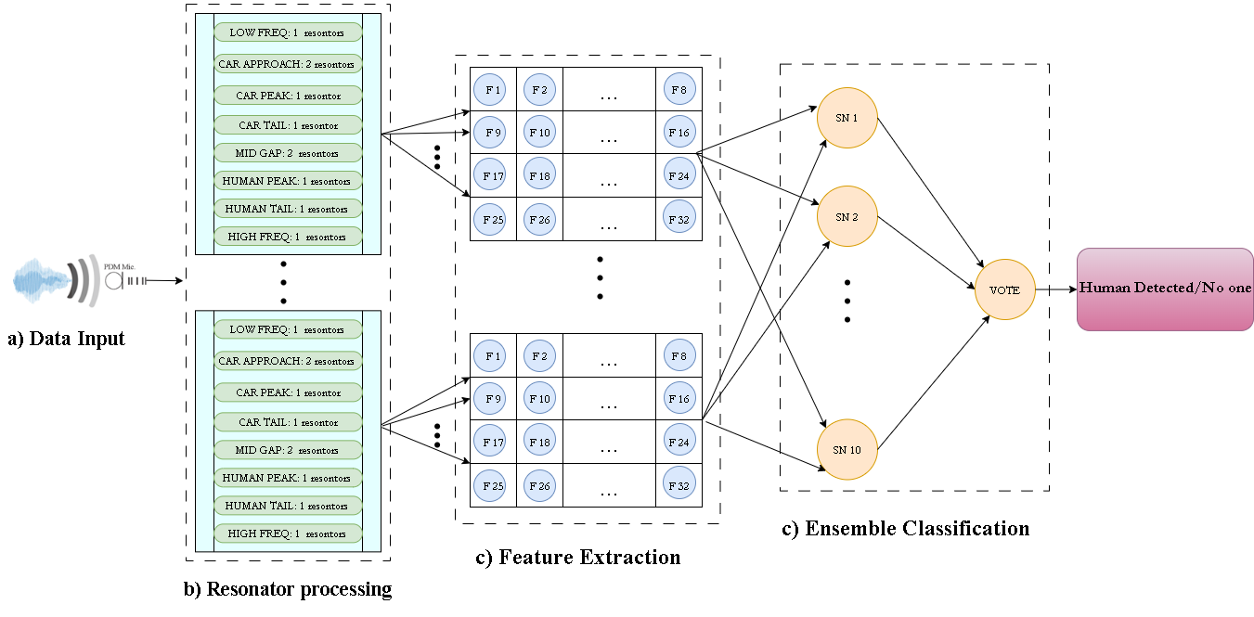
System Block Diagram - Human

Slide 18
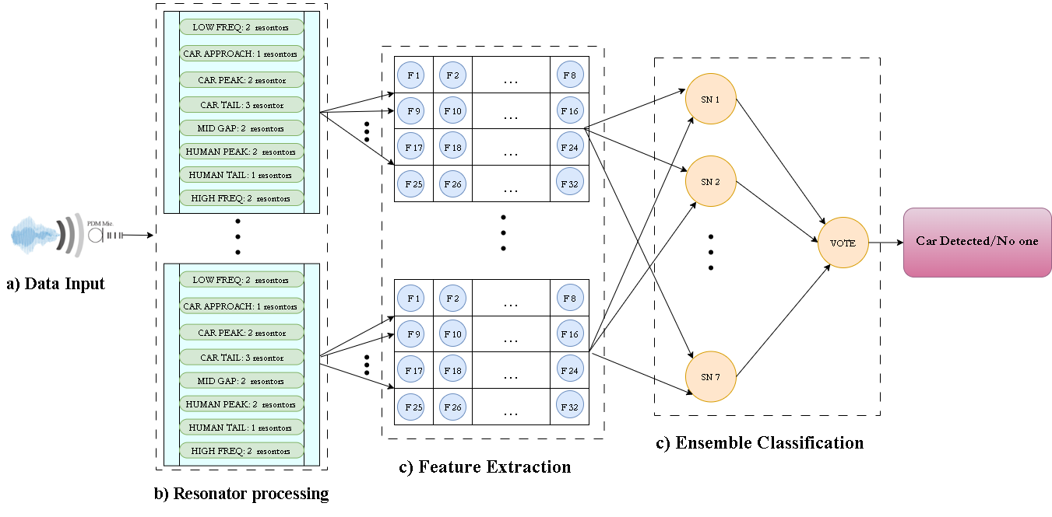
System Block Diagram - Car

Slide 19
Dataset Split & Extracted Features
Train/Test Split:
• Human Classifier: Train 68% (54 samples), Test 32% (26 samples)
• Vehicle Classifier: Train 75% (33 samples), Test 25% (11 samples)
Extracted Features – Total: 32
• Group 1 – Spectro-Temporal Signatures (8): car/human signature, peak ratios, max/mean intensity
• Group 2 – Temporal Dynamics (4): peak, range, asymmetry, active periods
• Group 3 – Resonator Persistence (4): burst length, activity concentration, entropy, efficiency
• Group 4 – Advanced Distinguishability (16): spectral centroid, event strength, clustering, autocorrelation

Slide 20
Advanced SCTN Ensemble Architecture
Instead of a single network, the system uses an advanced SCTN ensemble architecture:
Human Detection:
• 10 SCTN models with varied parameters
• Bootstrap sampling – each model trained on a different subset
• Weighted voting based on validation performance
• Optimized for transient event detection
Car Detection:
• 7 efficient SCTN models
• Parameters tuned for periodic patterns
• Weighted consensus voting strategy
1) Bootstrap Diversification:
• Each SCTN model is trained on a random subset of the original dataset
• Ensures model diversity and improves generalization
• Augmentation factor increases the training set size (×6 for human, ×4 for car)
• Ensemble leverages model variability for more robust predictions
2) Feature Selection (24 of 32 features):
• Automatically selects the most discriminative features
• Reduces overfitting and improves training speed
• Separate optimized features for human and car detection

Slide 21
5 Fold Cross-Validation Performance
The system uses 5-Fold Stratified Cross-Validation to ensure robust and unbiased evaluation:
5-Fold Cross-Validation?
• The dataset is split into 5 equal parts (folds)
• In each round, 4 folds are used for training and 1 for testing
• The process repeats 5 times so each sample is tested once
• Final results are averaged for a more reliable estimate
Human Detection Example Results,
(10-model ensemble):
• Fold 1: Accuracy = 87.5%, F1 = 0.89
• Fold 2: Accuracy = 75.0%, F1 = 0.80
• Fold 3: Accuracy = 87.5%, F1 = 0.90
• Fold 4: Accuracy = 93.75%, F1 = 0.95
• Fold 5: Accuracy = 100%, F1 = 1.00
Car Detection Example Results,
(7-model ensemble):
• Fold 1: Accuracy = 88.9%, F1 = 0.91
• Fold 2: Accuracy = 100%, F1 = 1.00
• Fold 3: Accuracy = 88.9%, F1 = 0.92
• Fold 4: Accuracy = 100%, F1 = 1.00
• Fold 5: Accuracy = 87.5%, F1 = 0.91
Final Cross-Validation Performance:
• Human: 86.25% ± 10.75%
• Vehicle: 93.06% ± 5.69%

Slide 22
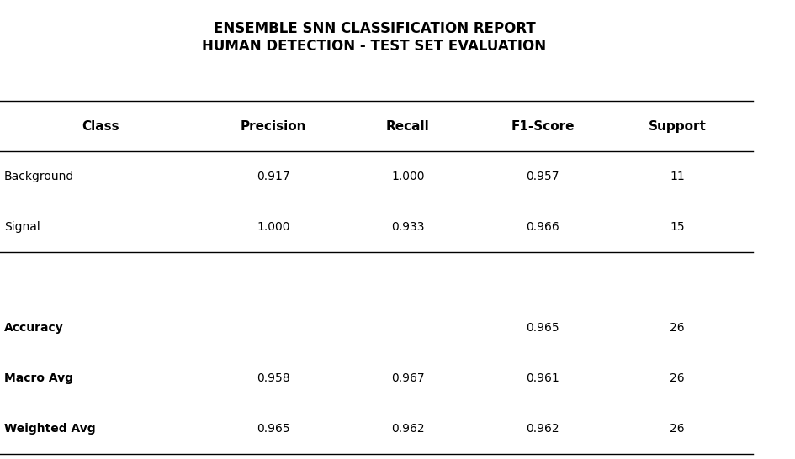
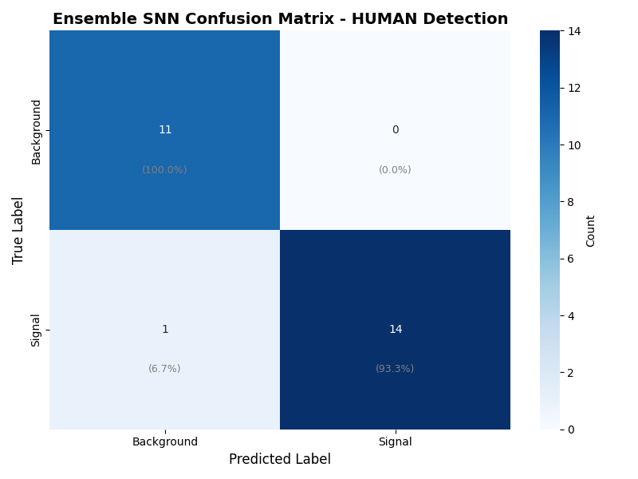
Human Detection –
Classification Results

Slide 23

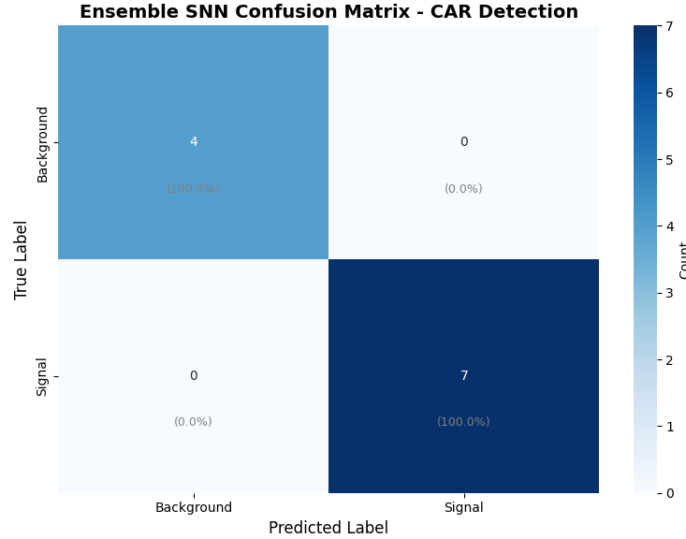
Car Detection –
Classification Results

Slide 24
Final Summary
The improved system delivers a major leap in geophone signal classification.
• 32 engineered features for full signal representation.
• Multi-SCTN ensemble with adaptive tuning per signal type.
• Weighted voting ensures confident decision-making.
• Achieved 96.15% accuracy for human and 100% for vehicle detection.
• Fully deployable in production environments

Slide 25
Technical Challenges & Solutions
Challenge: Precise frequency tuning of resonators
Solution: Adaptive tuning of resonator parameters was performed based on frequency analysis. In addition, existing resonators were reused by applying a frequency division factor of 10 (clock divided to 1 MHz).
Challenge: Limitations in computational resources for real-time processing Solution: Execution was carried out using Gennady's computational resources
Notes:
Combined Environmental Challenges: The interplay between floor type, distance, and walking style adds complexity to the signal interpretation. Adaptive algorithms will need to account for these combined factors to maintain consistent system performance.
Proposed Solution:Use a diverse dataset that includes recordings from multiple floor types, varying distances, and different walking styles. Training the Spiking Neural Network (SNN) on these varied examples fosters adaptability to different conditions and helps ensure consistent performance across complex environments.
Challenge: Mixed floor types, distances, and walking styles disrupt signal clarity
Solution: Train SNN using diverse, real-world recordings for better adaptability

Slide 26
Questions?

