Slide 1

TEAM7 CODEQUEST

Slide 2
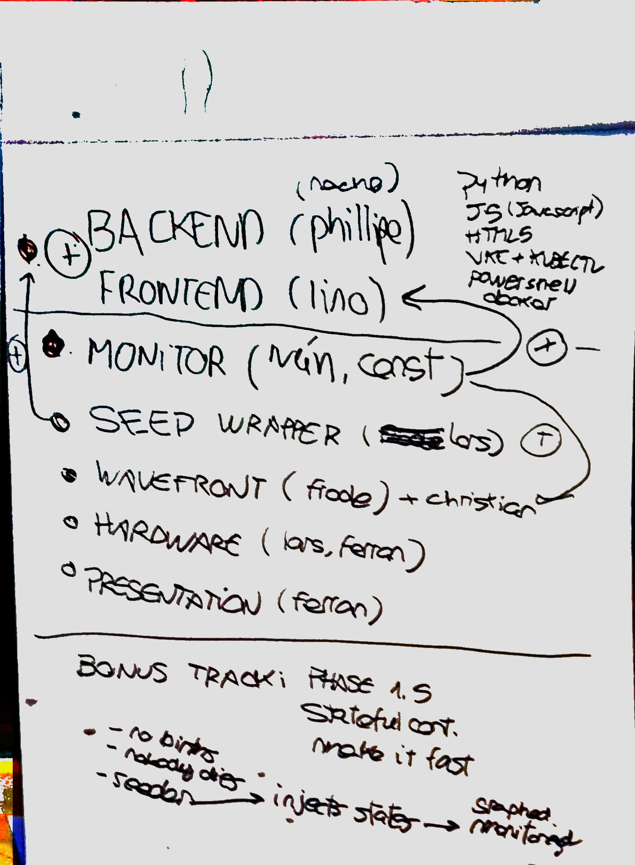
TEAM7 - CODEQUEST
Ignacio Osete – Team Leader
Lars Troen – Hardware developer
Ivan Ruíz – Wavefront Wizard
Ferran Espigares – Presentation & HW
Philipe Dellaert – Outsourced Developer
Frode Garnes – Wavefront Wizard
Lino Telera – Clarity Frontend Developer
Kristian Risdal – Wavefront
Constantin Ivanov – Monitoring

Slide 3
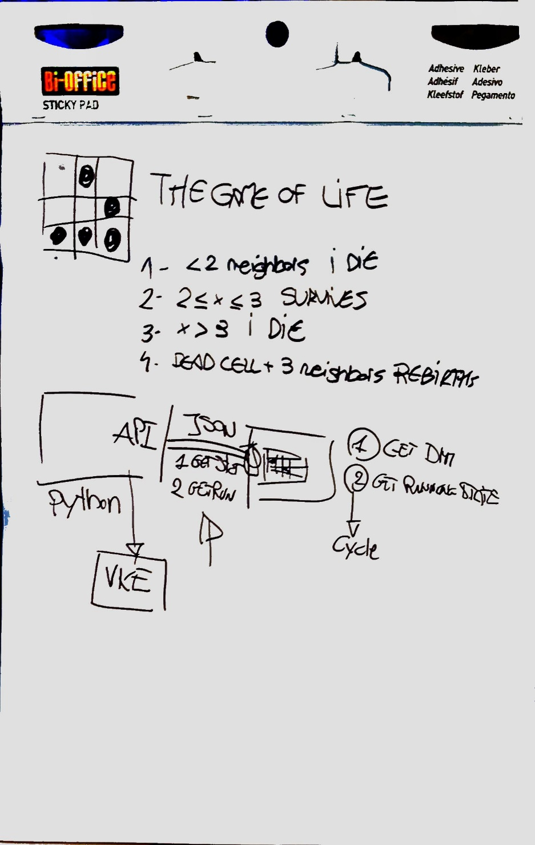
7OBJECTIVES
Implement Conway’s Game of Life as a set of Kubernetes containers
UseVMware VKE – VMware Kubernetes Engine
Use Clarity to present container status on a nice frontend
Monitor platform with Wavefront
Integrate a IoT device to display platform data
Meet & get to know NEW colleagues
Have FUN

Slide 4
CONWAY’S GAME OF LIFE
A SIMPLE SET OF RULES CREATE A COMPLEX BEHAVIOUR

Slide 5
CONWAY’S GAME OF LIFE
Any live cell with fewer than two live neighbors dies, as if by underpopulation.
Any live cell with two or three live neighbors lives on to the next generation.
Any live cell with more than three live neighbors dies, as if by overpopulation.
Any dead cell with exactly three live neighbors becomes a live cell, as if by reproduction.

Slide 6
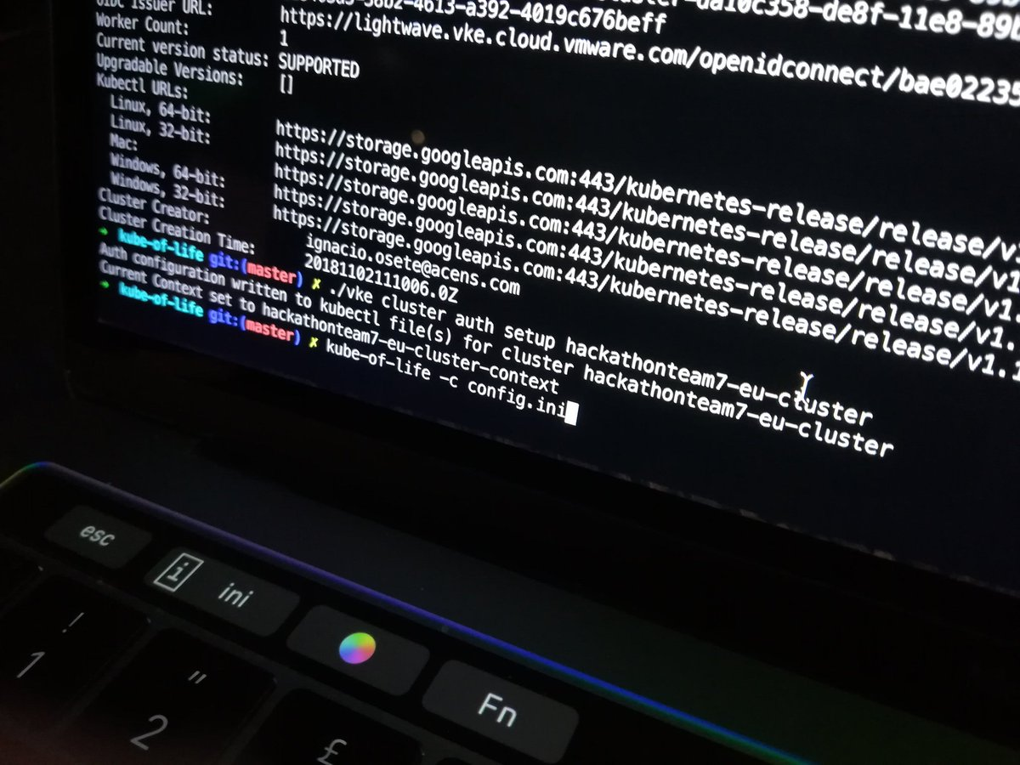
VMware VKE
Provide a Kubernetes platform as a service on top of VMware on AWS
With a fully standard kubectl endpoint

Slide 7


VMware Clarity and WaveFront
Clarity Design System
UX guidelines, HTML/CSS framework, and Angular components working together to craft exceptional experiences
Monitor Cloud-Native Environments with High-Velocity Custom Metrics and Analytics.

Slide 8
What we have Learned
VMware VKE – easily deploy k8s clusters on demand
VMware Wavefront – monitoring custom metrics
VMware Clarity – HTML interface development made easy
GitHub collaboration
Arduino IDE is a **** and embeded IoT hardware, and development cycle is faaaar from fast (without OTA updates)
ICE is a good RED WINE stain remover (twice)

Slide 9
What we did before and today
Before:
Plan
Today:
Have fun & Everything else

Slide 10
DEMO TIME (brace yourselves)

Slide 11
OK RECORDED Backup DEMO TIME

Slide 12
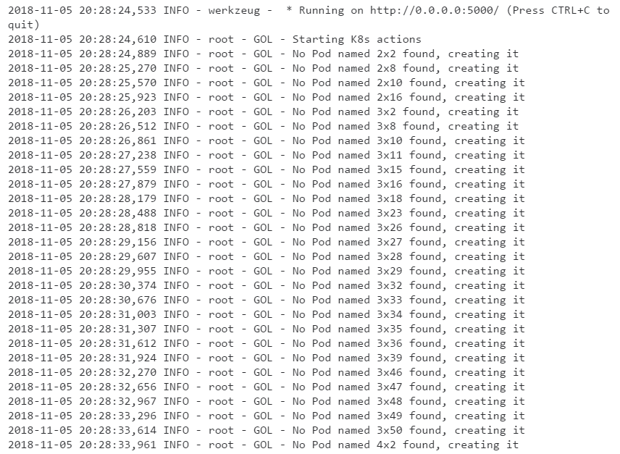

Slide 13
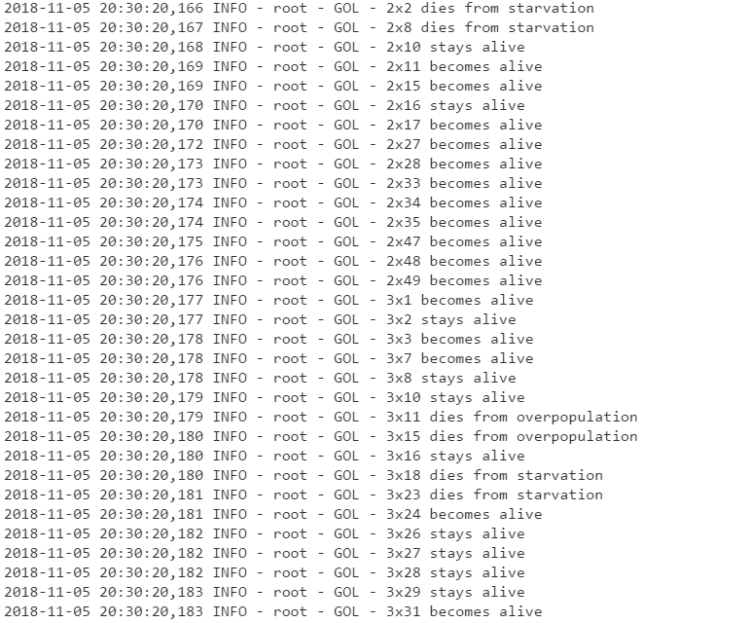
https://vmwarecode.slack.com/files/U0TKZ8MK7/FDVHZTDT2/20181105_vmworld-kube-of-life.txt

Slide 14
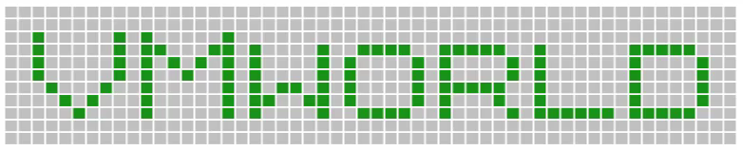
11 x 54 -> 594 containers

Slide 15
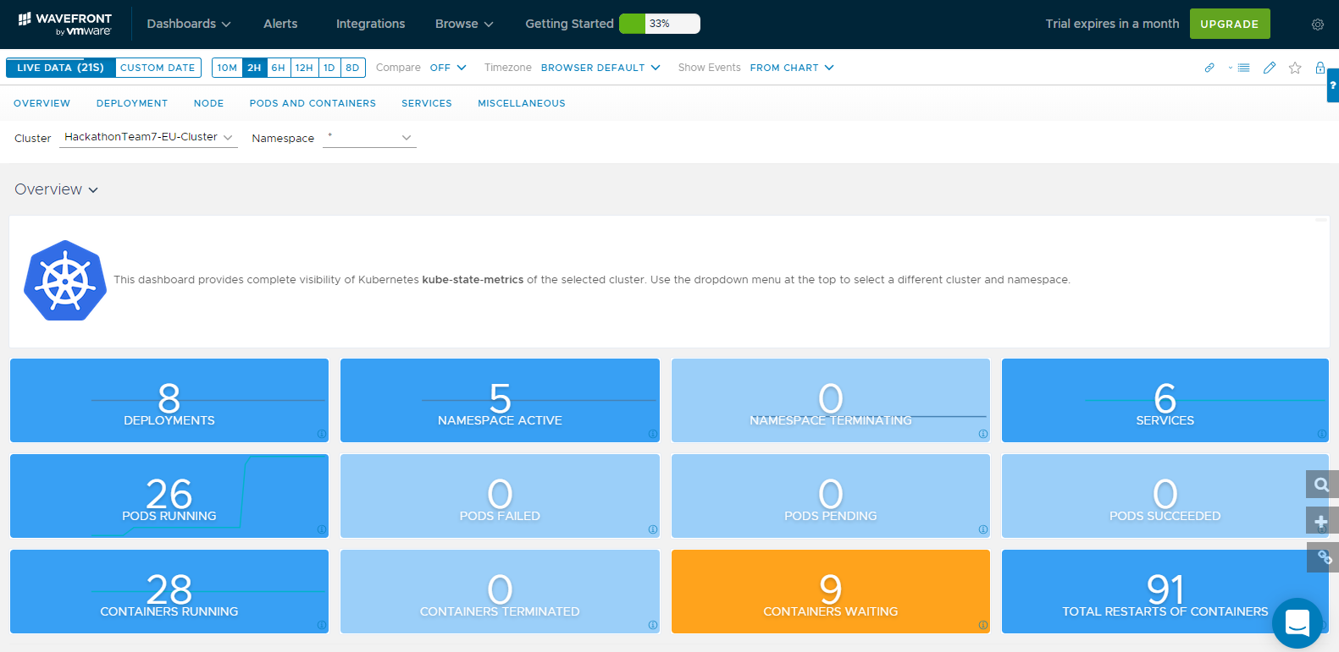

Slide 16
UNFORTUNATELY ALL CONTAINERS DIED IN THE END

