Slide 1

Cosmic-Ray Hit Rejection Using Fuzzy Logic Modeling
Lior Shamir, Robert J. Nemiroff
Michigan Tech
Abstract. The presence of cosmic ray hits in astronomical CCD frames is frequently considered as a disturbing effect. Cosmic rays add an undesirable signal to astronomical images and can weaken algorithms of astronomical image processing. Exposures taken at high altitude observatories get more cosmic ray hits than sea level observatories. This becomes even more significant in space-based telescopes located far from a planetary magnetic field.
By using fuzzy logic modeling we obtain an algorithm that aims to reject cosmic ray hits by simulating human perception. The proposed algorithm provides high accuracy in terms of rejection and false positives, but its main advantage over previously reported algorithms is its low computational complexity, which makes it suitable for autonomous robotic telescopes returning vast pipelines of data.

Slide 2
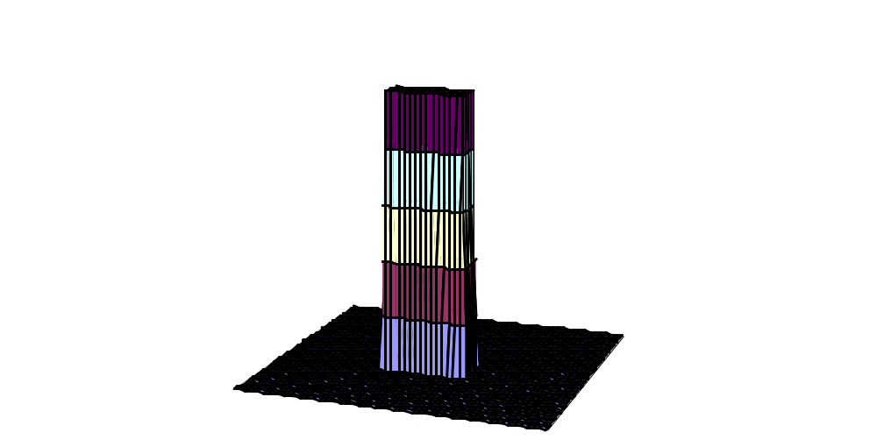
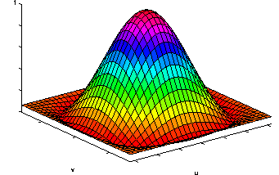
Point Spread Function
Cosmic Ray Hit
Human Intuition: Cosmic ray hits in astronomical exposures are usually noticeably different then PSFs of true astronomical sources, and a reasonably trained human can usually tell between the two.
One examining an astronomical frame can notice that cosmic ray hits are usually smaller than PSFs of astronomical sources, and their edges are usually sharper. Although many
cosmic ray hits are not larger than just one pixel, in some cases they can be larger than some of the point spread functions of astronomical sources (Van Dokkum 2001). An observer trying to manually detect cosmic ray hits in an astronomical frame would probably examine the edges and the surface size of the peaks. For instance, if the surface size of the peak is very small and it has sharp edges, it would be classified as a cosmic ray hit. If the surface size of the peak is larger and its edges are not very sharp, it would be probably classified as a PSF of an astronomical source. Since some of the cosmic ray hits have only one or two sharp edges, it is also necessary to examine the sharpest edge of the PSF.

Slide 3
Human Intuition
The intuition of detecting cosmic-ray hits can be summarized by a set of intuitive natural language rules such as:
1. If the peak is small and the edges are sharp then the peak is a cosmic ray hit.
2. If the peak is large and the edges are not very sharp then the peak is not a cosmic ray hit.
3. If the peak is medium and most of the edges are not very sharp except from one extremely sharp edge then the peak is a cosmic ray hit.
4. If the peak is small and the edges are moderately sharp then the peak is a cosmic ray hit.
5. If the peak is large and the edges are not sharp except from one edge that is moderately sharp then the peak is not a cosmic ray hit.

Slide 4
A Human Perception-Based Fuzzy Logic Model
Surface Size (pixels)
Sharpest Edge (σ)
Average Edge (σ)
Fuzzy Logic Modeling
1/0

Slide 5
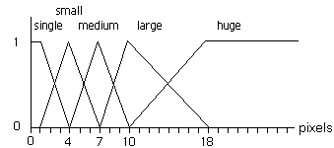
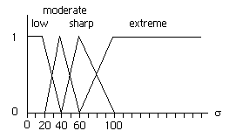
Membership Functions
Surface Size
Edge Sharpness

Slide 6
Fuzzy Rules
The fuzzy rules are defined using the membership functions of the antecedent variables ({single, medium, large, huge} and {low, mederate, sharp, extreme}) and the domain of the consequent variable {0,1}. The rules are based on natural language rules of intuition.

Slide 7
Fuzzy Rules
Large ^ Low ^ Low → 0
Single ^ Sharp ^ Sharp → 1
Large ^ Sharp ^ Sharp → 1
Large ^ Low ^ Sharp → 0
Small ^ Low ^ Sharp → 1
Medium ^ Sharp ^ Low → 1
Huge ^ Sharp ^ Sharp → 1

Slide 8
The Computation Process
The computation process is based on product inferencing and weighted average defuzzification (Takagi & Sugeno 1983,1985), and can be demonstrated by the following example:
Suppose that surface_size=5, average_edge=35 and
sharpest edge=60. The membership of the value of the
fuzzy variable surface_size in the fuzzy set small is 2/3, and the membership in the fuzzy set medium is 1/3. The membership in the fuzzy sets single, large
and huge is 0.
Similarly, the membership of the value of the fuzzy variable average edge in the fuzzy set moderate is ¾, and in the fuzzy set low it is ¼. 60 is the point
where the membership function of the fuzzy set sharp reaches its maximum of unity, so the membership of 60 in sharp is (60-40)/20=, while its membership in all other fuzzy sets is 0.
In the inference computation stage, the first rule single ^ low ^ low → 1
is depended on the fuzzy sets single, low and low, so the strength of this rule is
0 * ¼ * 0 = 0.

Slide 9
The Computation Process
When using product inferencing, if one of the fuzzy variables has a membership level of 0 (no membership) in one of the fuzzy sets referred by the rule, the rule does not have any effect on the final result of the computation. In this example,
the only fuzzy rules that have non-zero membership values
in all of 3 fuzzy sets are:
1. small ^ low ^ sharp → 1
2. small ^ moderate ^ sharp → 1
3. medium ^ low ^ sharp → 0
4. medium ^ moderate ^ sharp → 0
The membership of the values of the antecedent variables in the fuzzy sets of rule 1 (small, low and sharp) 2/3, 1/4, 1 respectively. Similarly, the membership of the antecedent variables in the fuzzy sets of rule 2 are 2/3, 3/4, 1, membership in the fuzzy sets of rule 3 are 1/3, 3/4, 1, and themembership in the fuzzy sets of rule 4 are 1/3, 1/3, 1.

Slide 10

The Computation Process
Since the defuzzification is performed using the weighted average defuzzification method (Takagi & Sugeno 1983, 1985), the computed value of the consequent variable is:
The value of the consequent variable is handled such that values greater than 0.5 are classified as cosmic ray hits. Otherwise, the values are classified as non-cosmic ray hits. Since in the above computation the output value is d, , the input values in this example are classified as a cosmic ray hit.

Slide 11
Performance
In order to compare the performance of the proposed algorithm to previously reported algorithms, we used the data and comparison approach proposed by Farage and Pimbblet (2005).
Algorithm | CR Rejected | False Positives
Van Dokkum | 86% | 1.5%
Rhoads | 78% | 1.4%
Pych | 76% | 1.4%
The Proposed Algorithm | 81% | 0.8%
* The proposed algorithm has a clear advantage in terms of computational efficiency. While some of the above algorithms are relatively slow, the presented algorithm can process a 1024 . 1024 integer FITS frame in less than 8 seconds, using a system equipped with an Intel Pentium IV 2.66 MHZ processor and 512 MB of RAM.

Slide 12
References
Axelrod, T., Connolly, A., Ivezic, Z., Kantor, J., Lupton, R., Plante, R., Stubbs, C., Wittman, D.: 2004, AAS Meeting 205, #108.11
Becker, A.C., Rest, A., Miknaitis, G., Smith, R.C., Stubbs, C.: 2004, AAS Meeting 205, #108.12
Farage, C.L., Pimbblet, K.A., 2005, PASA, 22, 249
Fixsen, D.J., Offenberg, J.D., Hanisch, R.J., Mather, J.C., Nieto-Santisteban, M.A., Sengupta, R., Stockman, H.S.: 2000, PASP
112, 1350
Offenberg, J.D., Sengupta, R., Fixsen, D.J., Stockman, H.S., Nieto-Santisteban, M.A., Stallcup, S., Hanisch, R.J., Mather, J.C.: 1999, in ASP Conf. Ser. 172, 141
Otuairisg, S., Golden, A., Butler, R.F., Shearer, A., Voisin, B.: 2004, Ground-based Telescopes 5493, 467–473
Pych,W., 2004, PASP 116, 148-153
Rhoads, J.E.: 2000, PASP 112, 703–710
Salzberg, S., Chandar, R., Ford, H., Murphy, S.K., White, R.: 1995,
PASP 107, 279
Shaw, R.A., Horne, K: 1992, in ASP Conf. Ser. 25, Astronomical Data Analysis, Software and Systems
Takagi, T., Sugeno, M.: 1983, Proc. of the IFAC Symp. on Fuzzy Information, Knowledge Representation and Decision analysis, 55–60
Takagi, T., Sugeno, M.: 1985, IEEE Trans. Syst. Man & Cybern. 20, 116–132
Van Dokkum, P.G.: 2001, PASP 113, 1420–1427
Windhorst, R.A., Franklin, B.E., Neuschaefer, L.W.: 1994, PASP 106, 798
Zadeh, L.A.: 1965, Information and Control 8, 338–353
Zadeh, L.A.: 1988, Fuzzy Logic, Computer 21, 83–93
Zadeh, L.A.: 1994, IEEE Software 11, 48–56

