Slide 1


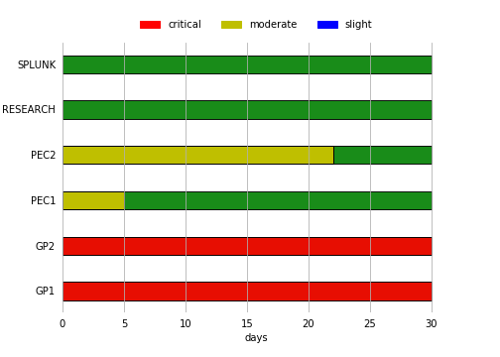
Strategic Isilon Dashboard
Cluster Compliance Status
Business Risk Status
[In Progress] Working on recommendations list (Tier homes)
[Win] Fixed HomeDir replication
[In Progress] Investigating possible DU on GP2 (SR 08035954)
[In Progress] Adding GP to Superna Eyeglass
Progress / Wins
High Impact Variables / Issues

