Slide 1
Design, development and control of a robotic arm
Proyectos III – Ignacio Martínez Capella

Slide 2
Index
Introduction
3D design
Electronic components
Results
Conclusions

Slide 3
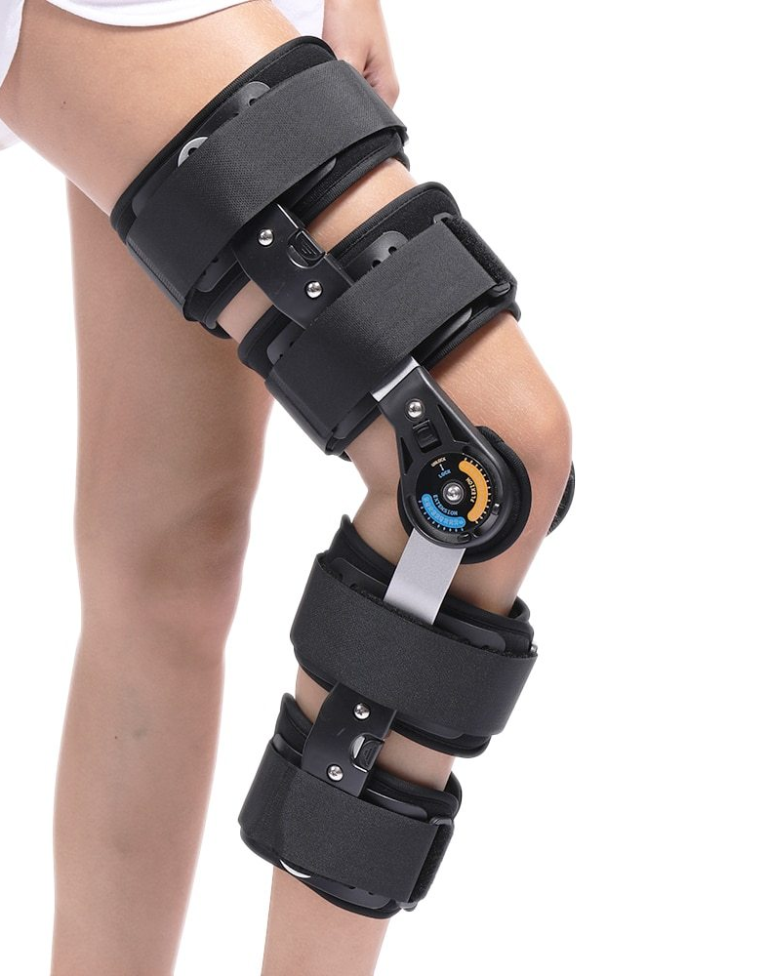
Introduction - Orthoses
What is an orthosis?
A medical device used to modify the functional and structural characteristics of the neuromuscular and skeletal system of the patient.
Four types:
Supportive
Dynamic
Corrective
Protective
Increasing demand
3D printers

Slide 4
Introduction – Our model
Based on a previous orthosis developed in the master’s degree
3D printed
Flexion/extension of the arm
New movements: pronation/supination of the forearm

Slide 5
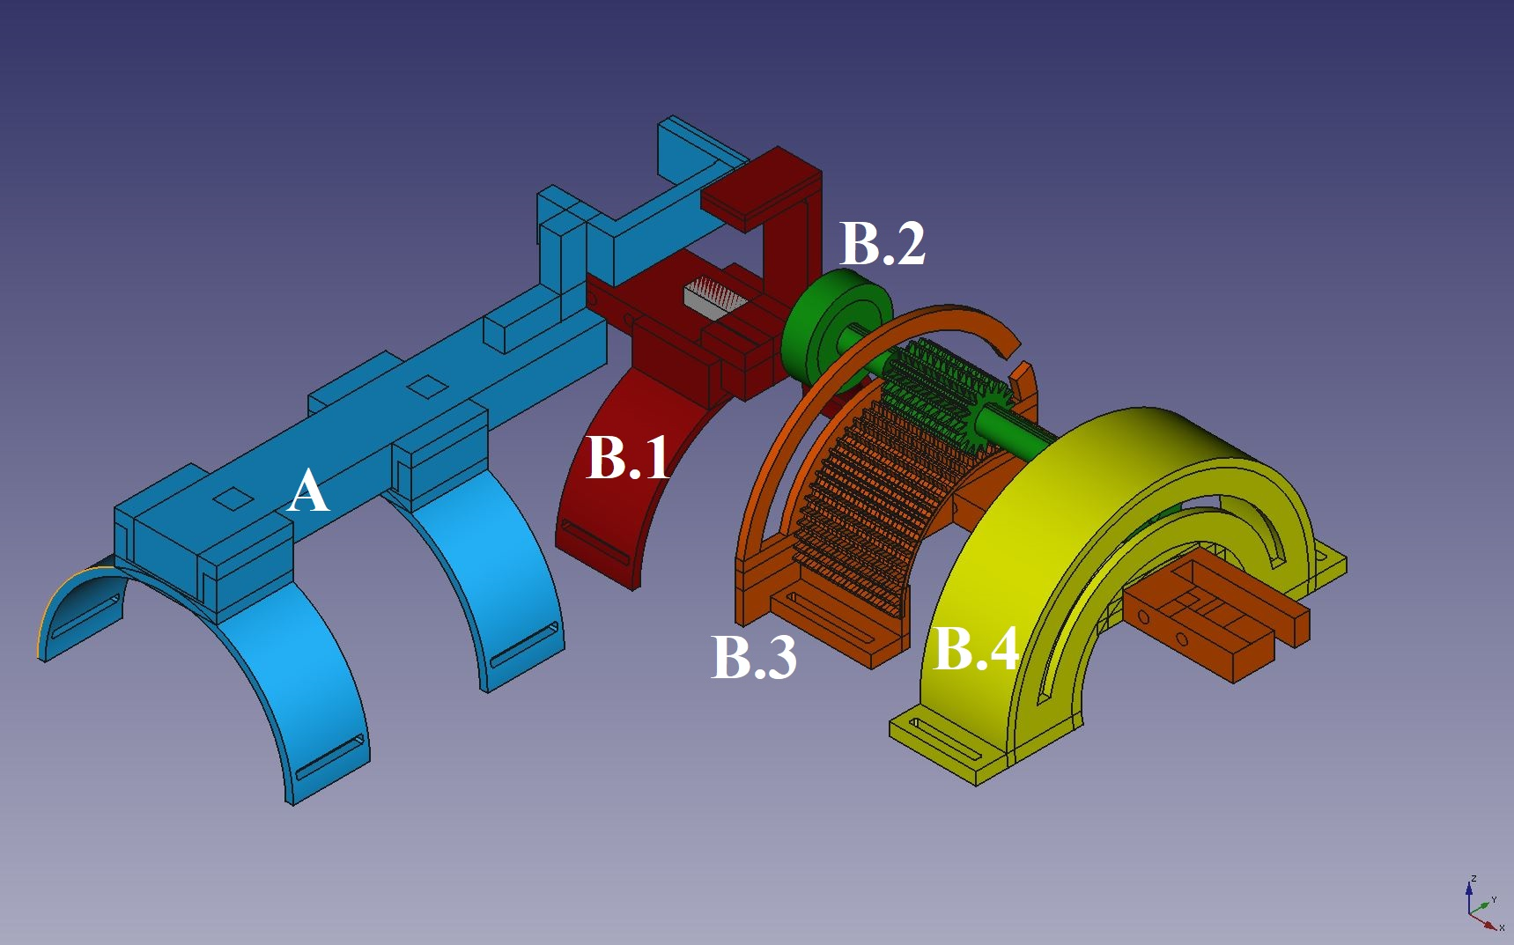
3D design
FreeCAD
Witbox 3D printer, PLA filaments
Two main pieces:
A: arm
B: forearm

Slide 6
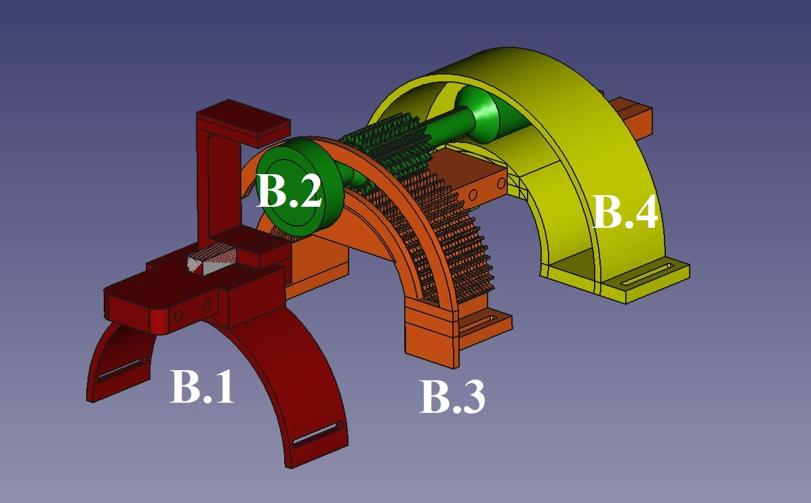
3D design
FreeCAD
Witbox 3D printer, PLA filaments
Two main pieces:
A: arm
B: forearm

Slide 7
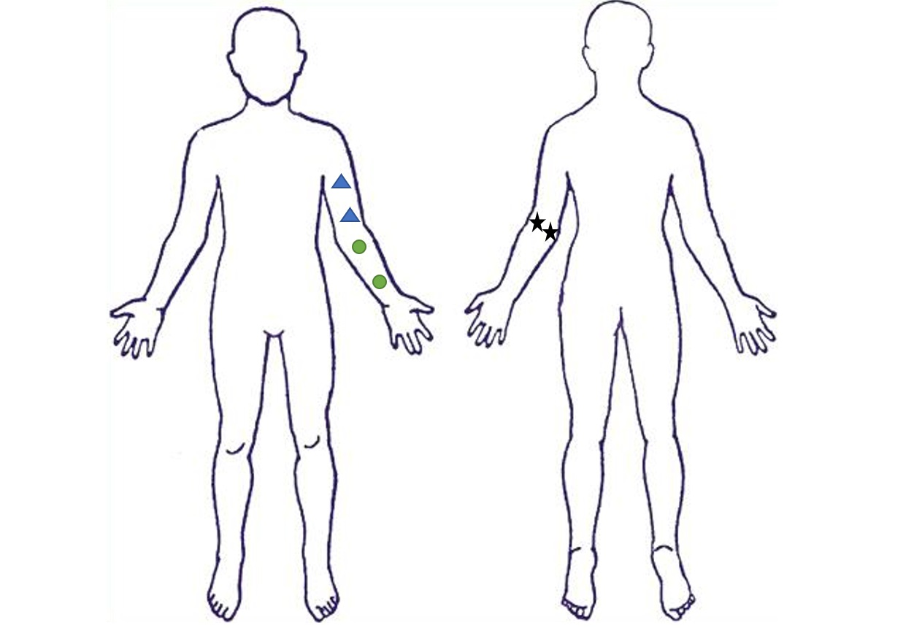
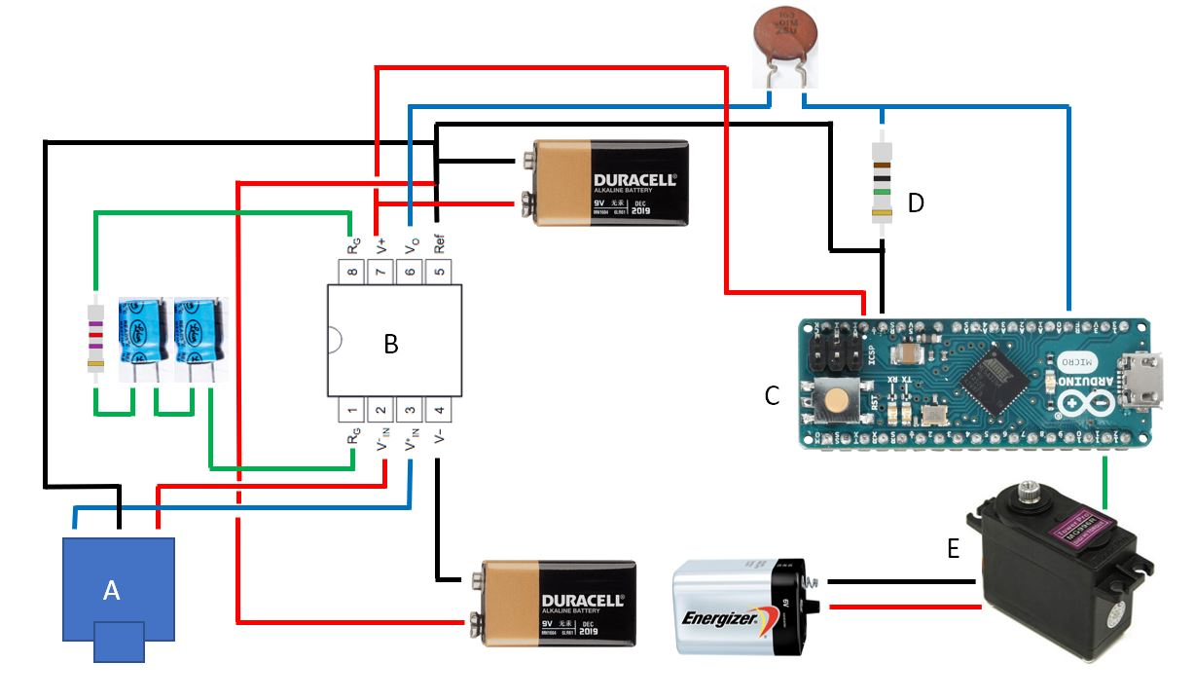

Electronic components
A: EMG audio Jack
B: Instrumentation amplifier
C: Arduino Micro
D: R_{G} gain resistor
$G=\frac{5∗{10}^{4}}{R_{G}}+1$
E: Servomotor

Slide 8
Electronic components
Voluntary contraction: Intended contraction of a muscle group
Involuntary contraction: Passive contraction of a muscle group when another one is voluntarily contracted
Forearm: 5 voluntary + 5 involuntary contractions
Biceps: 5 voluntary + 5 involuntary contractions
Signal | Top 25 values mean
Voluntary forearm | 180.6
Involuntary forearm | 63.28
Voluntary biceps | 386.16
Involuntary biceps | 265

Slide 9
Results

Slide 10
Conclusions
Objective achieved
Future work

