Slide 1
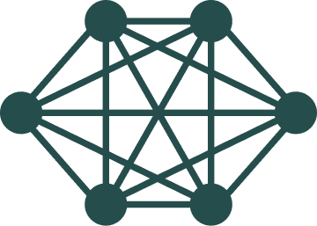
Protein classification with Graph Neural Networks
Javier Castellano Soria
&
Ignacio Fernández Sánchez-Pascuala

Slide 2
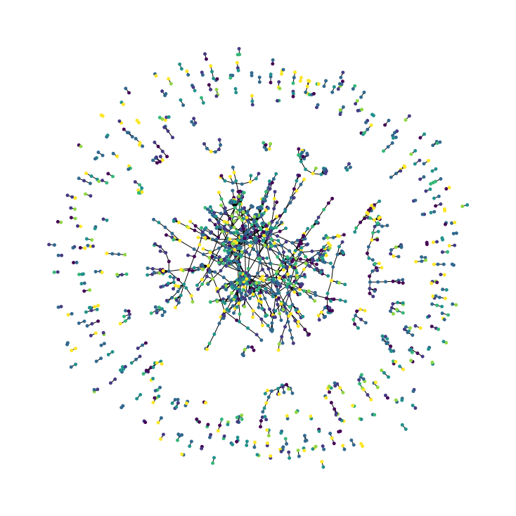
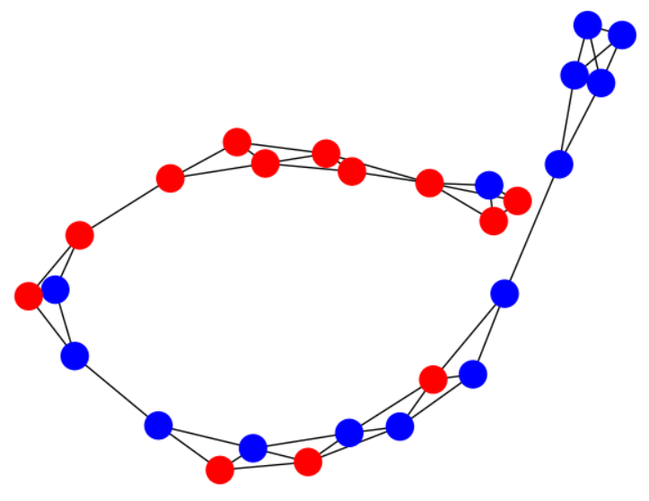
1. What advantages do they have over other models?
Classification:
At the graph level.
At the node level.
At the Edge level.
Issues:
Variable input dimension (number of nodes and edges)
A model is needed to capture and interpret the graph structure.
Solution:
Graph Neural Networks.
Datasets where patterns are graphs.
Examples:
Social network analysis.
Molecule classification.
Weather forecasting (GraphCast) [1]
Fig. 1:
Graph associated with a protein.
Fig. 2: Graph of the CORA dataset.

Slide 3
2. What are they?
They are a set of mathematical models characterized by processing information from nodes and combining it with that of their neighbors as they progress through the layers. The way information is processed and combined will determine the architecture of the model.
Basic aspects:
-How is the model input?
-What is a simple layer of a graph neural network like?
-Pooling techniques.
-Simple example of a graph neural network.

Slide 4

2.1- Input
The input will consist of a graph formed by a set of nodes 𝑉, where each node 𝑣∈𝑉 will be a real vector of dimension 𝑛, and by the adjacency matrix 𝐴.
1
${V=\{v}_{1}=\left(1,0\right), v_{2}=\left(1,0\right), v_{3}=(0,1)\}$
$A=\begin{matrix}0 & 1 & 0 \\ 1 & 0 & 1 \\ 0 & 1 & 0\end{matrix}$
2
3
Fig. 3: Graph encoding.

Slide 5
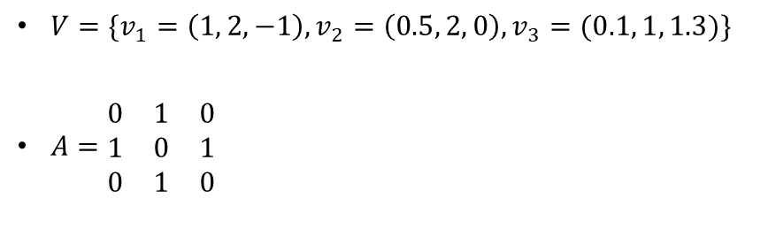

2.2- Simple layer
A layer will take as input the graph and return another graph with the same topology, but the vectors associated with the nodes will have been transformed.
${V=\{v}_{1}=\left(1,0\right), v_{2}=\left(1,0\right), v_{3}=(0,1)\}$
$A=\begin{matrix}0 & 1 & 0 \\ 1 & 0 & 1 \\ 0 & 1 & 0\end{matrix}$
${V=\{v}_{1}=\left(1, 2, −1\right), v_{2}=\left(0.5, 2, 0\right), v_{3}=(0.1, 1, 1.3)\}$
$A=\begin{matrix}0 & 1 & 0 \\ 1 & 0 & 1 \\ 0 & 1 & 0\end{matrix}$
1
1
2
2
Fig. 4: Layer processing.
3
3

Slide 6

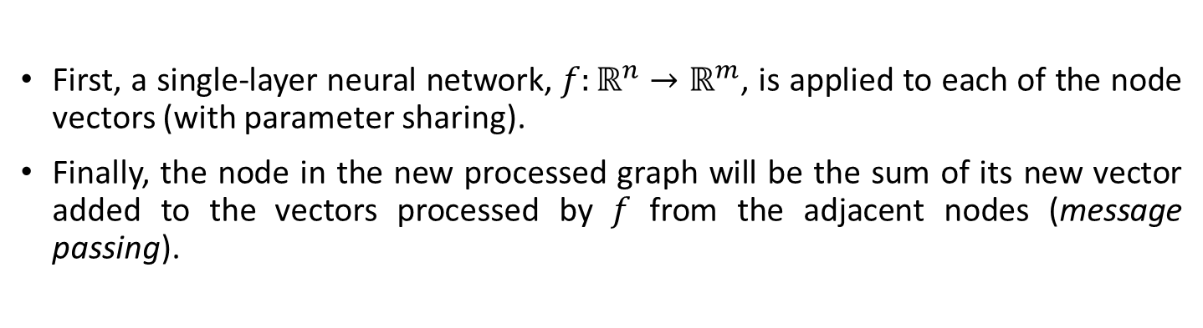
2.2- Simple layer
First, a single-layer neural network, $f:ℝ^{n}→ℝ^{m}$, is applied to each of the node vectors (with parameter sharing).
Finally, the node in the new processed graph will be the sum of its new vector added to the vectors processed by 𝑓 from the adjacent nodes (message passing).
$$v_{i}^{∗}= \sum_{v∈Ady\left(v_{i}\right)∪\{v_{i}\}}{f(v)}$$
This type of graph neural network layer was introduced by Kipf, T. N., & Welling, M (2016) in the publication “Semi-supervised classification with graph convolutional networks” [2].
There are refinements such as the inclusion of edge types, Graph Conv Layers [3], Graph Attention Networks [4], and generalization of aggregation operations [5].

Slide 7

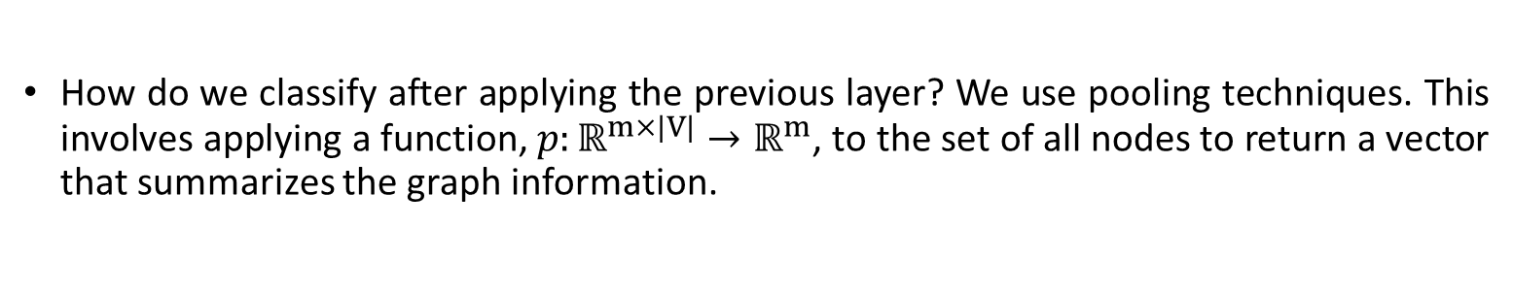
2.3- Pooling techniques
How do we classify after applying the previous layer? We use pooling techniques. This involves applying a function, $p:ℝ^{m×|V|}→ℝ^{m}$, to the set of all nodes to return a vector that summarizes the graph information.
$$w=\frac{1}{\left|V\right|}\sum_{v∈V}{v}$$
Finally, we would apply an MLP to this vector, with the output dimension being the number of classes.
Sometimes it's necessary to gradually reduce the number of nodes. One solution is TopK pooling methods [6], [7]. This involves assigning a learnable score to each node to keep only the top 𝑘 nodes.

Slide 8
2.3- Simple example
1
1
LAYER 1
POOLING
MLP
PROBABILITIES:
0.8
0.2
2
2
3
3
Fig. 5: A simple example of a graph neural network

Slide 9
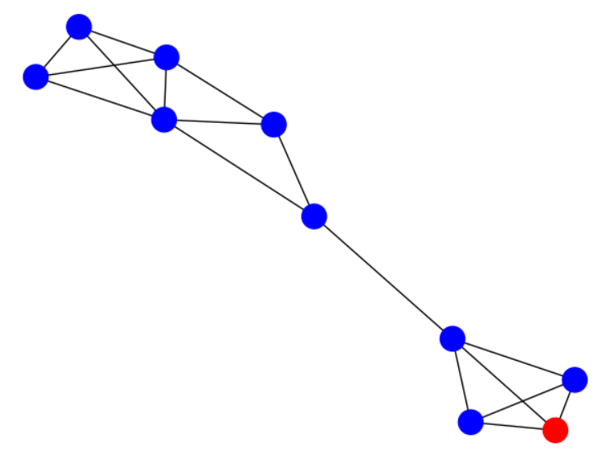
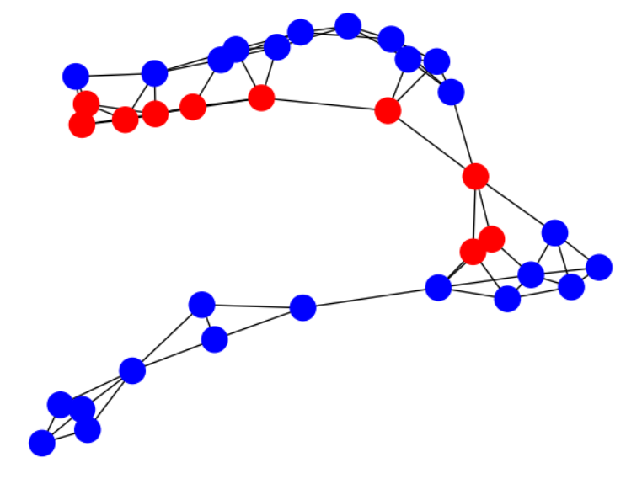
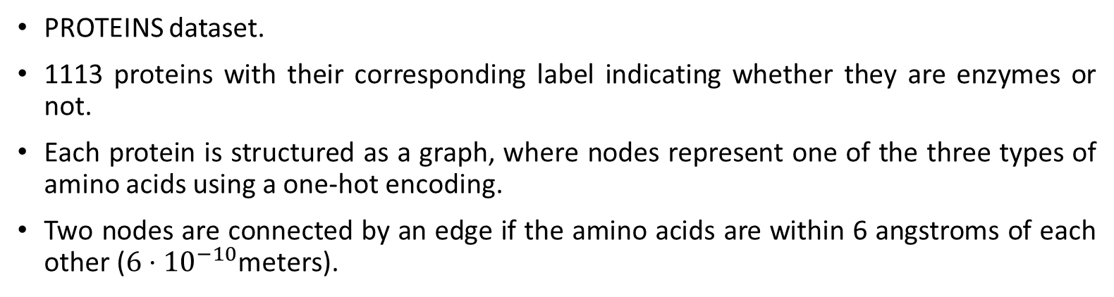
3. Dataset
PROTEINS dataset.
1113 proteins with their corresponding label indicating whether they are enzymes or not.
Each protein is structured as a graph, where nodes represent one of the three types of amino acids using a one-hot encoding.
Two nodes are connected by an edge if the amino acids are within 6 angstroms of each other ($6⋅{10}^{−10}$meters).
Fig. 6: Two examples of proteins.

Slide 10
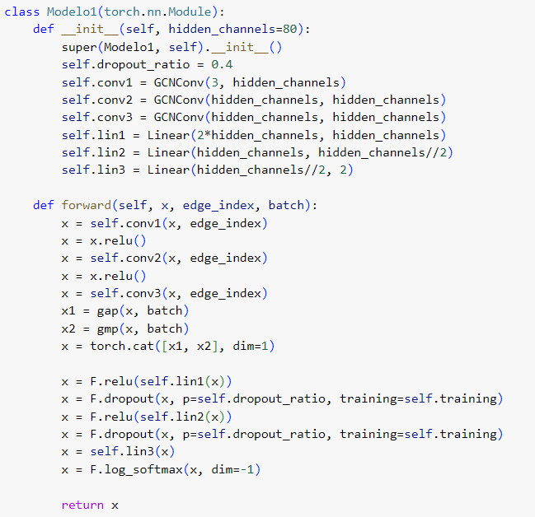
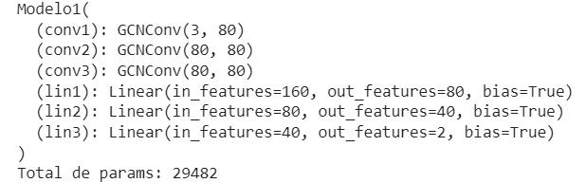
4. Model 1
Three layers [2] of graph neural network.
A pooling with mean and max.
Three dense layers (MLP).

Slide 11
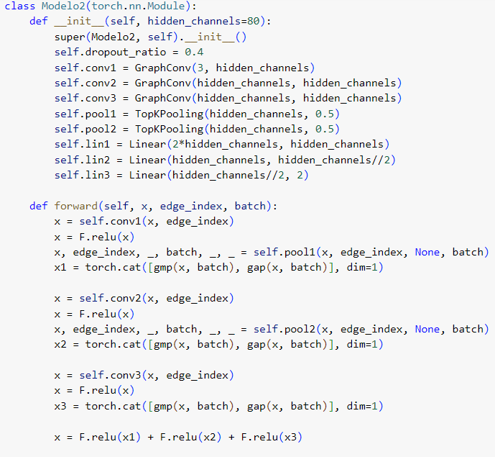
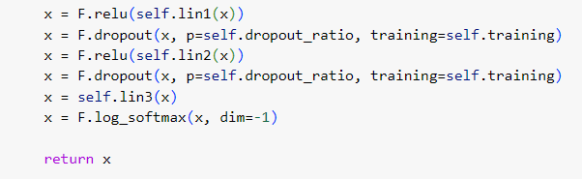
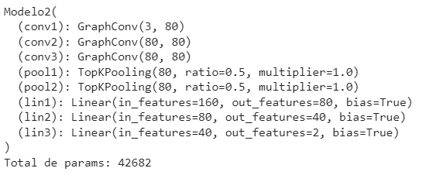
4. Model 2
Three layers [3] of graph neural network.
Two TopK pooling layers storing the mean and maximum.
Three dense layers (MLP) considering the mean and maximum of each pooling layer as input.

Slide 12
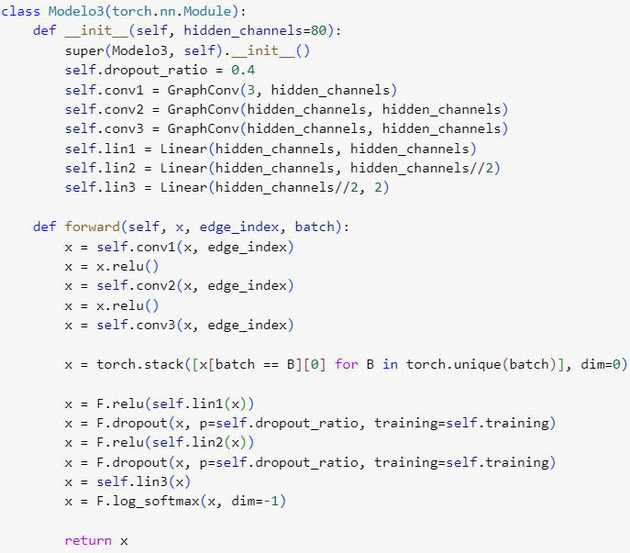
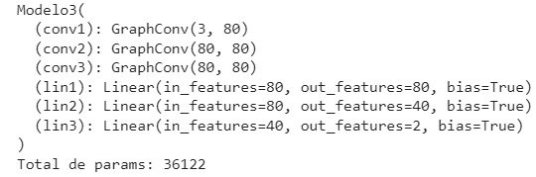
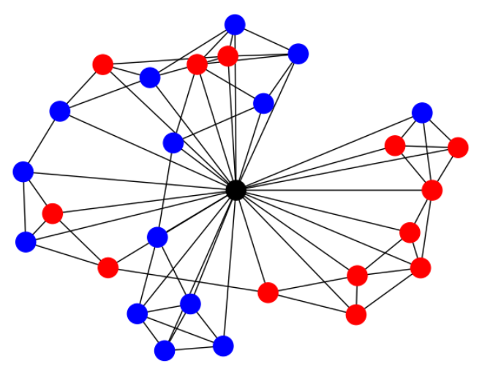
4. Model 3
Three layers [3] of graph neural network.
No pooling using artificial global node.
Three dense layers (MLP) taking the global node as input.
Fig. 7: Example of a protein with a global node

Slide 13
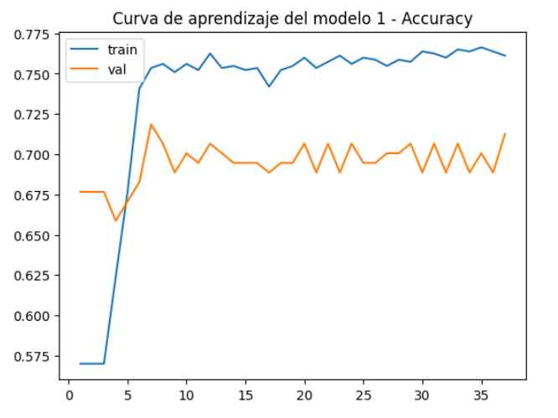
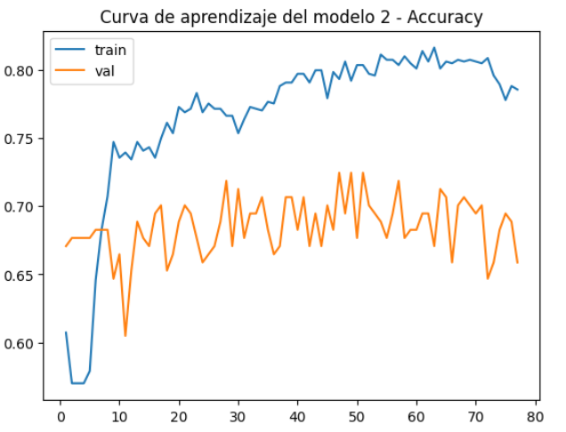
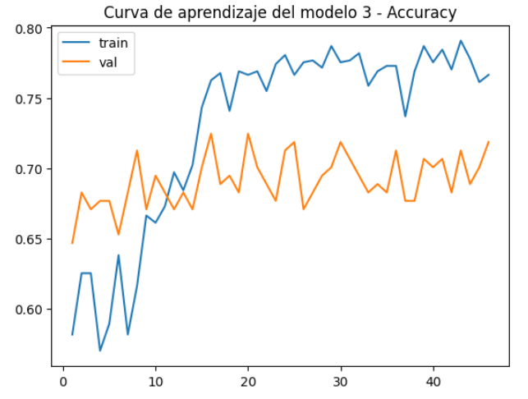
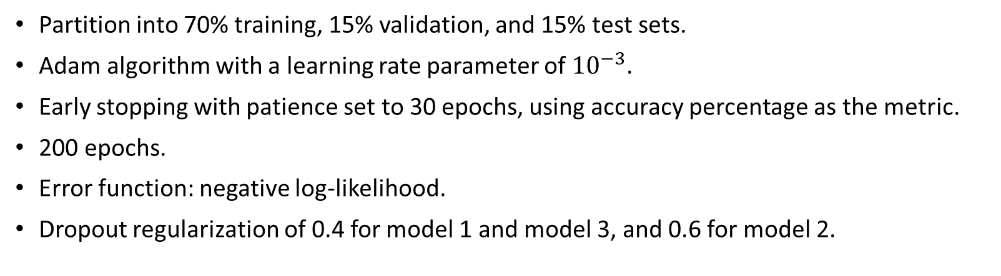
5. Training and results
Partition into 70% training, 15% validation, and 15% test sets.
Adam algorithm with a learning rate parameter of ${10}^{−3}.$
Early stopping with patience set to 30 epochs, using accuracy percentage as the metric.
200 epochs.
Error function: negative log-likelihood.
Dropout regularization of 0.4 for model 1 and model 3, and 0.6 for model 2.
Fig. 8: Learning curves of the considered models.

Slide 14
5. Training and results
In case of a tie, Model 2 was chosen because its input preserves the original data structure.
The accuracy percentage on the test set is 75.4%.
Model 1 | Model 2 | Model 3
0.719 | 0.725 | 0.725
Fig. 9: Validation accuracy percentage.

Slide 15
Bibliography
[1] Lam, R., Sanchez-Gonzalez, A., Willson, M., Wirnsberger, P., Fortunato, M., Alet, F., ... & Battaglia, P. (2022). GraphCast: Learning skillful medium-range global weather forecasting. arXiv preprint arXiv:2212.12794.
[2] Kipf, T. N., & Welling, M. (2016). Semi-supervised classification with graph convolutional networks. arXiv preprint arXiv:1609.02907.
[3] Morris, C., Ritzert, M., Fey, M., Hamilton, W. L., Lenssen, J. E., Rattan, G., & Grohe, M. (2019, July). Weisfeiler and leman go neural: Higher-order graph neural networks. In Proceedings of the AAAI conference on artificial intelligence (Vol. 33, No. 01, pp. 4602-4609).
[4] Veličković, P., Cucurull, G., Casanova, A., Romero, A., Lio, P., & Bengio, Y. (2017). Graph attention networks. arXiv preprint arXiv:1710.10903.
[5] Corso, G., Cavalleri, L., Beaini, D., Liò, P., & Veličković, P. (2020). Principal neighbourhood aggregation for graph nets. Advances in Neural Information Processing Systems, 33, 13260-13271.
[6] Gao, H., & Ji, S. (2019, May). Graph u-nets. In international conference on machine learning (pp. 2083-2092). PMLR.
[7] Zhang, Z., Bu, J., Ester, M., Zhang, J., Yao, C., Yu, Z., & Wang, C. (2019). Hierarchical graph pooling with structure learning. arXiv preprint arXiv:1911.05954.

