Slide 1
Molecular Descriptors

Slide 2
Types
One-dimensional: represent information that are calculated from the formula of the molecule
Two-Dimensional: Molecular descriptors derived from the algorithms applied to a topological representation.
-Three-Dimensional: Representation views a molecule as a rigid geometrical object in space and allows a representation not only of the nature and connectivity of the atoms, but also the overall spatial configuration of the molecule

Slide 3

One-Dimensional

Slide 4
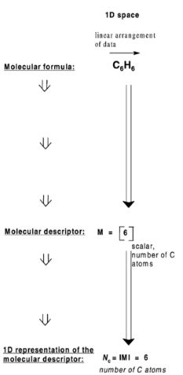
Constitutional Descriptors
Reflect the molecular composition of a compound without considering molecular geometry. They include the number of atoms, bonds, specific atom types, rings, and molecular weight. These descriptors do not account for conformational changes and do not distinguish between isomers

Slide 5
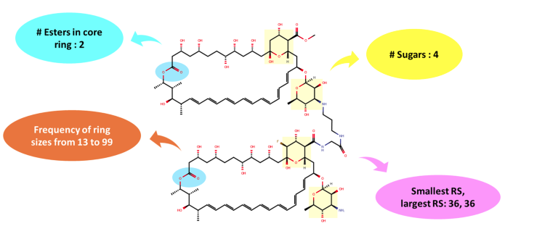
Ring descriptors
Capture various features of cyclic compounds.

Slide 6
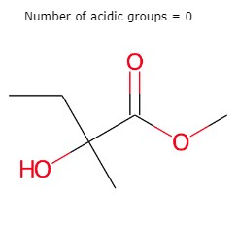
Functional Group Count
Enumerate the presence of specific functional groups within a molecule, providing insight into its potential reactivity and properties.

Slide 7
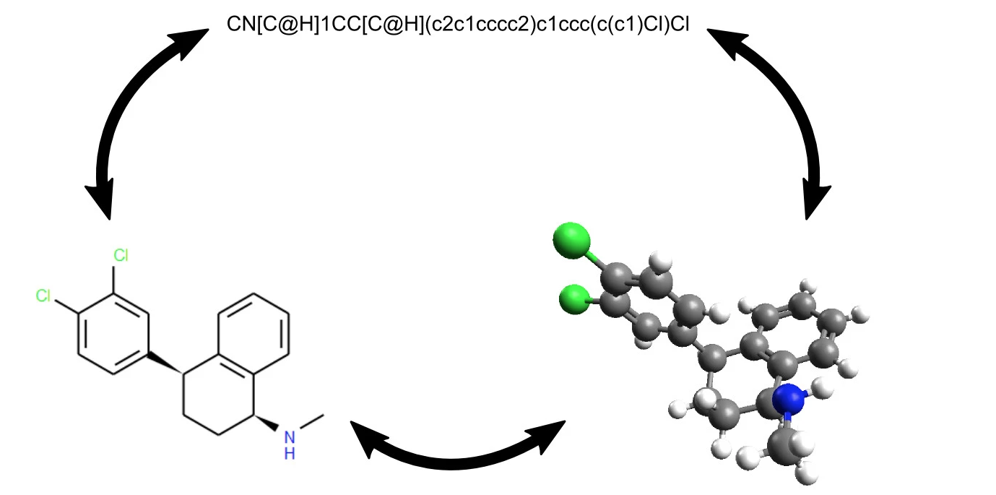
Textual Descriptors
Represent molecular features in textual formats.

Slide 8
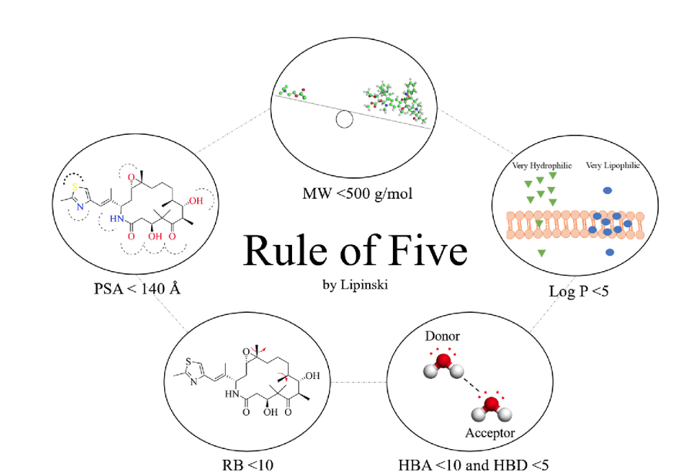
Filtering Descriptors
Involve criteria-.based descriptors used to filter molecules based on specific properties.

Slide 9
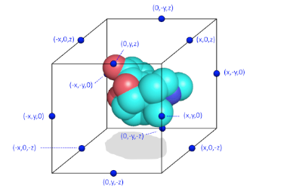
Spectrophores
Are shape-based descriptors represented by a one-dimensional spectrum of real numbers. They capture the interaction between molecular properties and artificial environments, independent of molecular topology. This makes them useful for scaffold hopping and machine learning applications. By calculating interaction energies between atomic properties and predefined artificial cages surrounding the molecule, spectrophores offer a robust tool for virtual screening and compound clustering.

Slide 10
Two-Dimensional

Slide 11
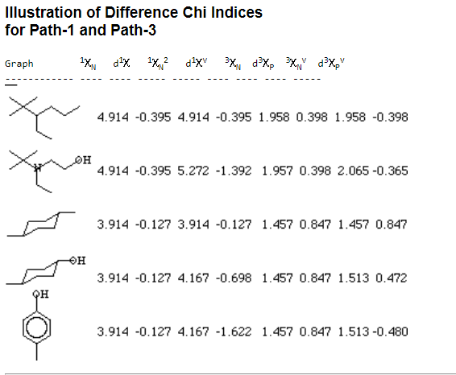
Connectivity Descriptors
Identified as key components in assessing molecular accessibility, with first- and second-order indices representing molecular accessibility areas and volumes

Slide 12
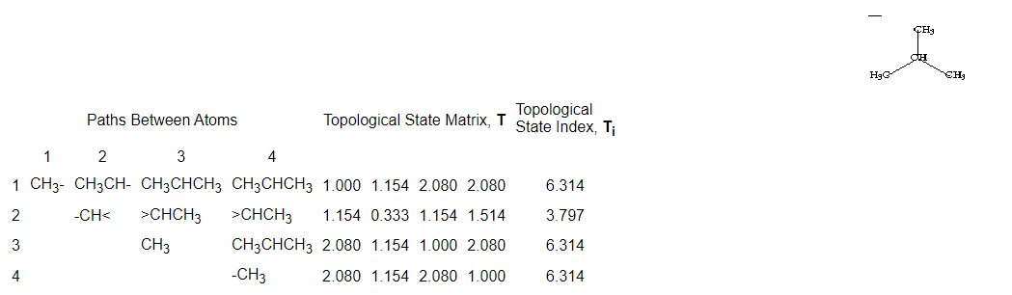
Topological Descriptors
Quantify molecular topology using algebraic operators on molecular graph matrices, capturing structural features like size, shape, symmetry, branching, cyclicity, and encoding chemical information on atom types and bond multiplicity, independent of vertex numbering.

Slide 13
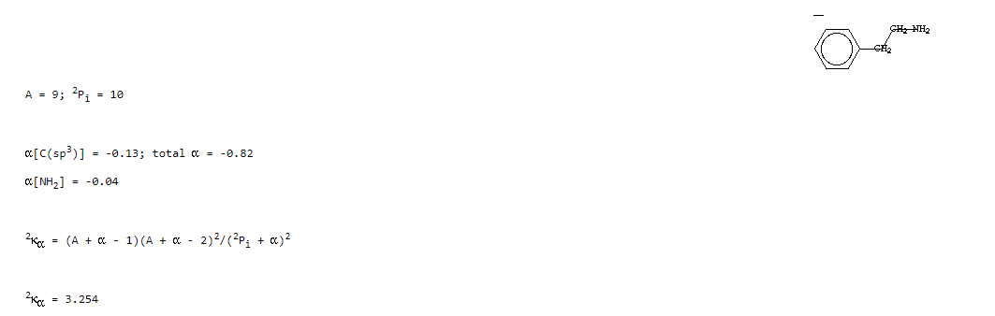
Kappa Descriptors
Quantify the shape of molecular graphs by comparing them to extreme shapes, specifically chains and stars. These indices measure the relative position of a graph between these extremes, are proportional to the inverse square of molecular path numbers, and are sensitive to shape rather than size.

Slide 14
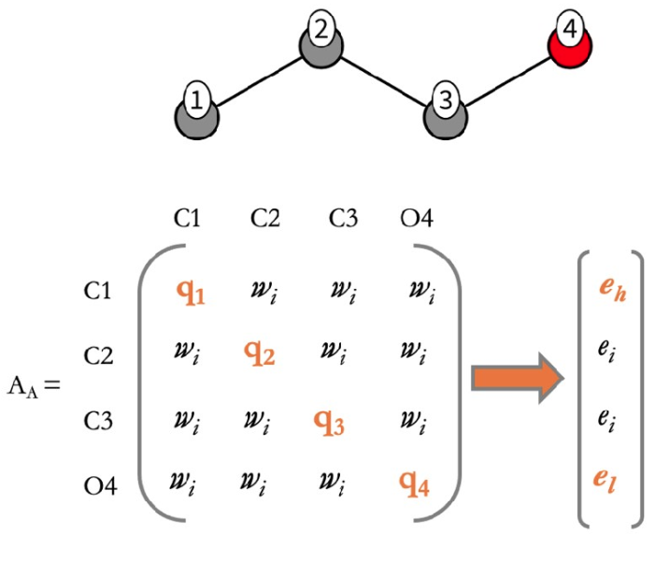
Burden Descriptors
Calculated from a molecular connection table matrix where atomic numbers are placed on the diagonal and bond types or minimal values on off-diagonals. The two lowest eigenvalues of this matrix are combined to form the descriptor, which encodes atomic properties relevant to intermolecular interactions.

Slide 15
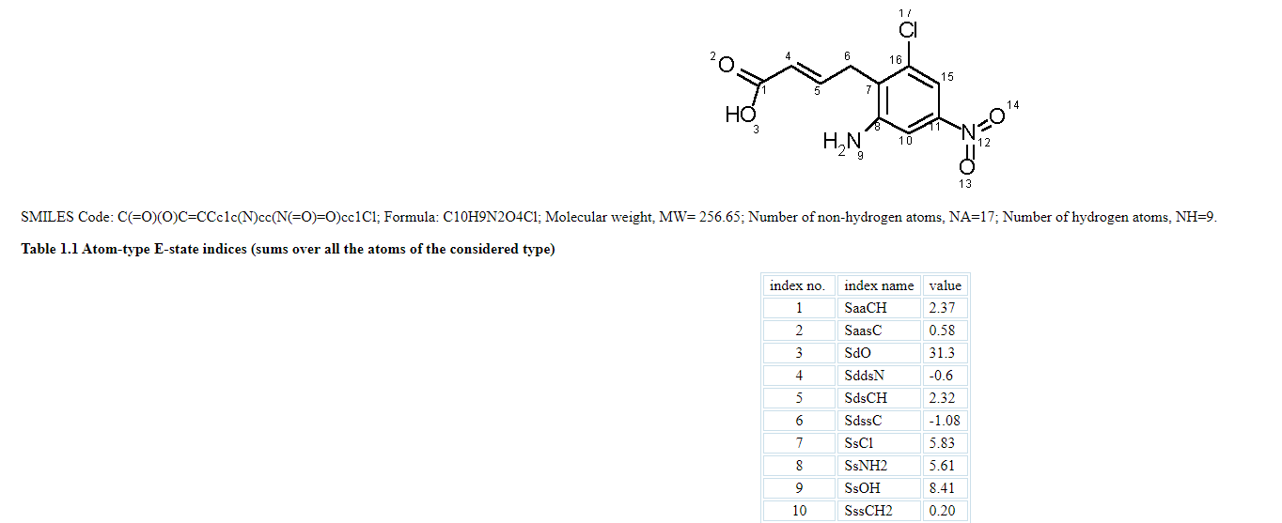
E-state Descriptors
Encode information about the topological environment of an atom and its electronic interactions.

Slide 16
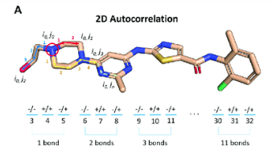
Autocorrelation Descriptors
Measure molecular properties at different lag values, with Moran, Geary, and Moreau-Broto autocorrelation descriptors using electronegativity, atomic mass, atomic polarizability, and Van der Waals volume.

Slide 17
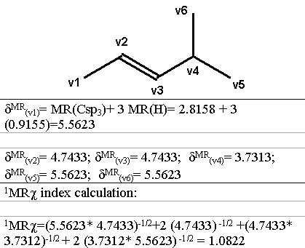
Molecular Property Descriptors
Use various properties to differentiate molecules.

Slide 18
Molecular Property Descriptors
Use various properties to differentiate molecules.

Slide 19
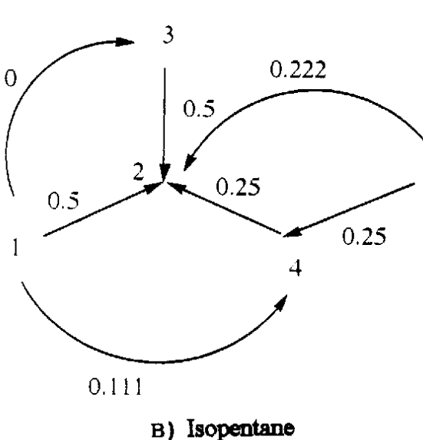
Charge Descriptors
Introduced to evaluate charge transfers between pairs of atoms in a molecule, reflecting the global charge distribution.

Slide 20
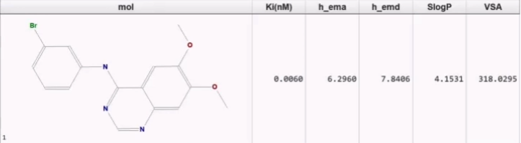
MOE-Type Descriptors
Molecular descriptors derived from the Molecular Operating Environment (MOE) software, characterizing molecular structures through geometric, topological, electronic, and hybrid properties.

Slide 21
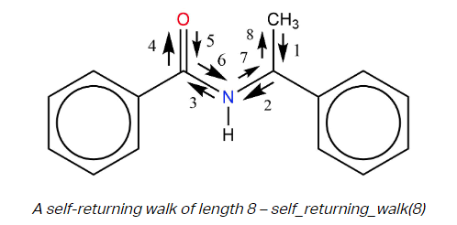
Walk and Path Descriptors
A walk in a molecular graph is a sequence of pairwise adjacent edges leading from one vertex to another one. A path is a walk without any repeated vertices or edges.

Slide 22
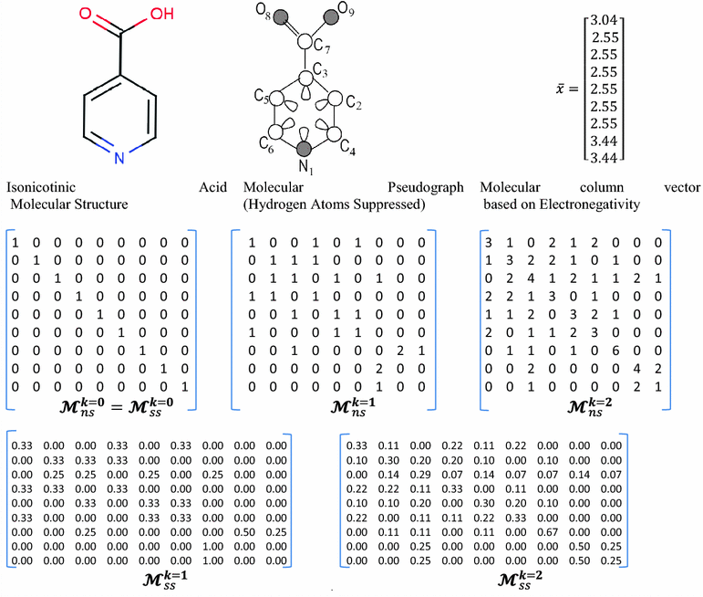
2D-based matrix descriptors
Descriptors calculated by using algebraic operations on theroetical matrices.

Slide 23
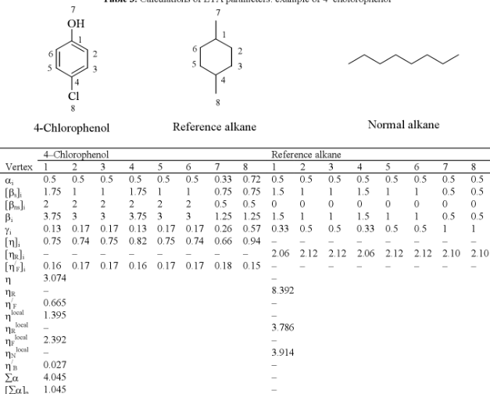
ETA Descriptors
Extended Topochemical Atom descriptors are calculated using molecular topology, electronic information and bonded interactions.

Slide 24
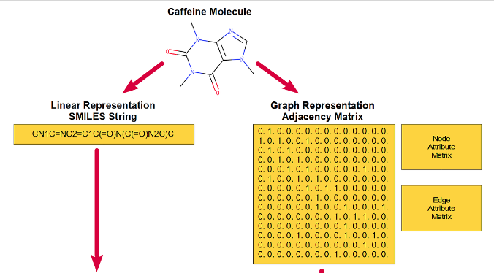
Edge adjacency descriptors
The adjacency matrix represents the whole set of connections between pairs of atoms.

Slide 25
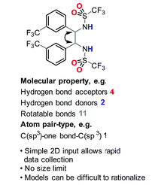
2D Atom Pairs Descriptors
Two atoms, their bond types and their interatomic separations.

Slide 26
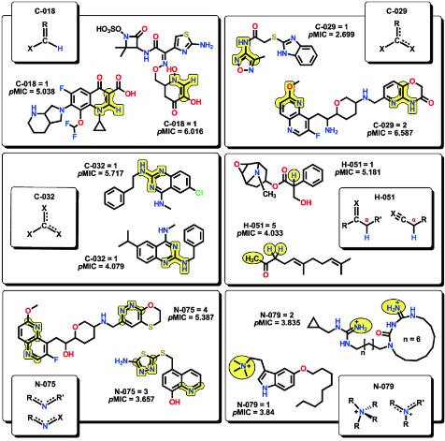
Atom-centred fragments descriptors
Describe each atom by its atom type, the bond types and the atom types of its neighbours. Hydrogen are not consider.

Slide 27
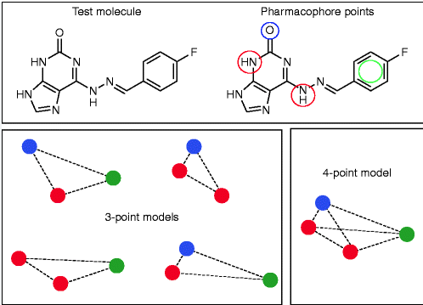
Pharmacophore Descriptors:
Based on the kinds of interactions observed in molecular recognition.

Slide 28
Three-Dimensional

Slide 29
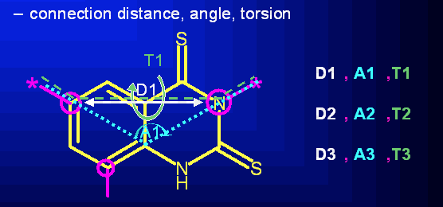
Geometrical Descriptors
Define many aspects of the molecule basing on its 3D structure.

Slide 30
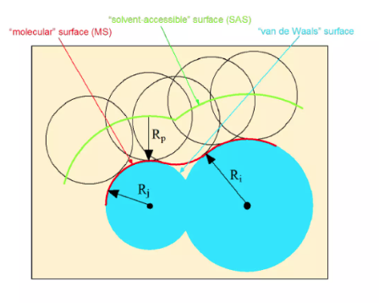
CPSA Descriptors
Charged Partial Surface Area descriptors combine shape and electronic information.

Slide 31
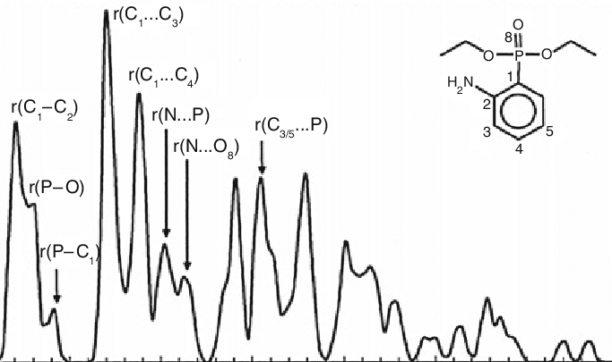
RDF Descriptors
Radial Distribution Function descriptors calculate the probability of finding an atom in a spherical volumen of radius R.

Slide 32
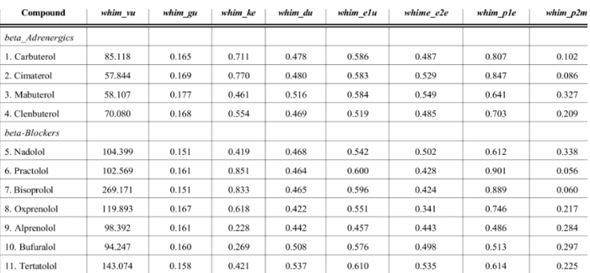
WHIM Descriptors
Weighted Holistic Invariant Molecular descriptors are calculated using a weighted covariance matrix to capture different 3D information.

Slide 33
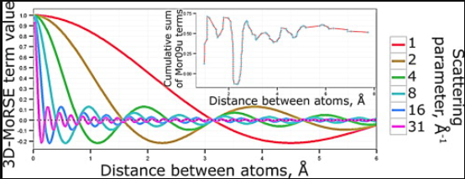
MoRSE Descriptors
Molecule Representation of Structures based on Electron diffraction descriptors obtain information from the coordinates by using electron diffraction.

Slide 34
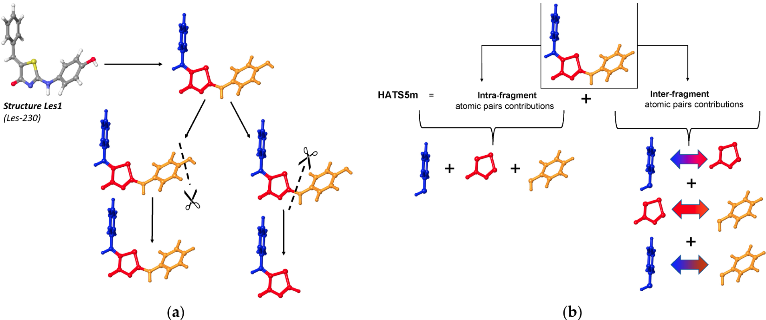
GETAWAY Descriptors
GEometry, Topology, and Atom-Weights AssemblY are calculated from the leverage matrix obtained by the centered atomic coordinates.

Slide 35
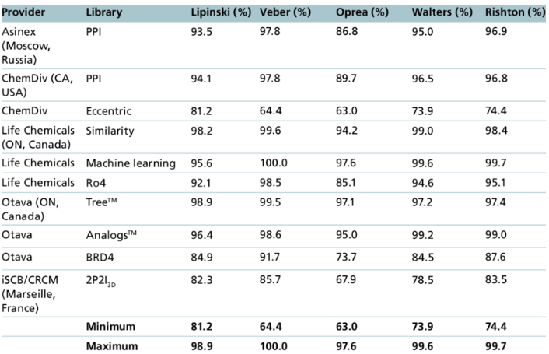
Drug-like indices Descriptors
A drug-like score is a real value ranging from 0 to 1, calculated as the fraction of criteria satisfied: a score of 1 indicates that a compound is a good candidate to be a drug.

Slide 36
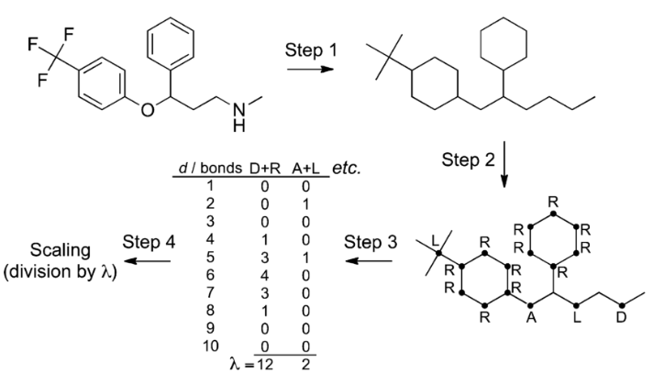
CATS 3D Descriptors
Chemically Advanced Template Search (CATS) is applied to predicting potential drug targets for a virtually assembled combinatorial compound library.

Slide 37
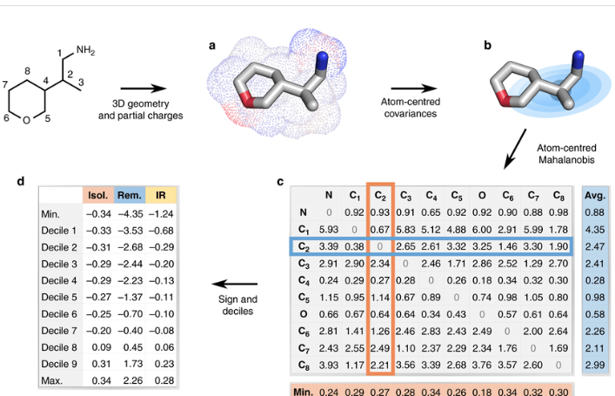
WHALES Descriptors
Weighted Holistic Atom Localization and Entity Shape (WHALES) capture molecular shape and partial charges simultaneously.

Slide 38
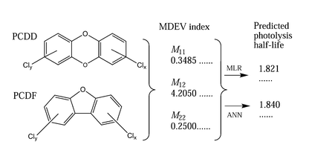
MDE Descriptors
Mean Distance-Edge, calculates geometric mean based on topological distances between atoms.

Slide 39
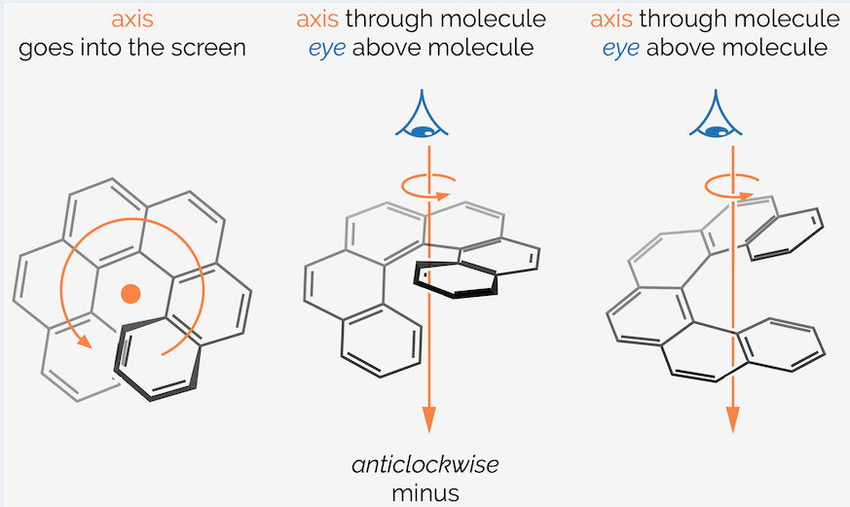
Chilarity Descriptors
A molecule is considered chiral if it can rotate plane-polarized light, and will always possess a nonsuperimposable mirror image.

