Slide 1
Fingerprints

Slide 2
Topological Fingerprints

Slide 3
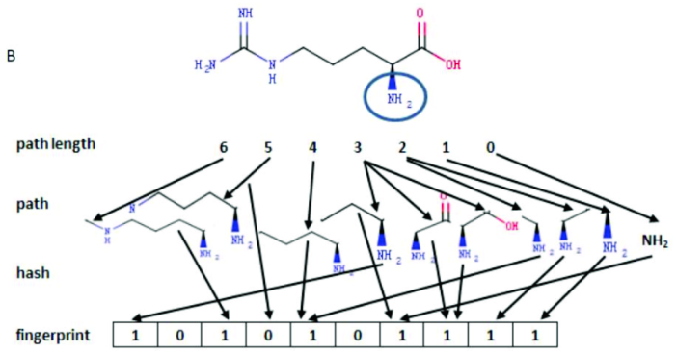
Daylight-type
Hashed fingerprints encoding each atom type, all Augmented Atoms and all paths of length 2–7 atoms, giving a total string of 1024 bits

Slide 4
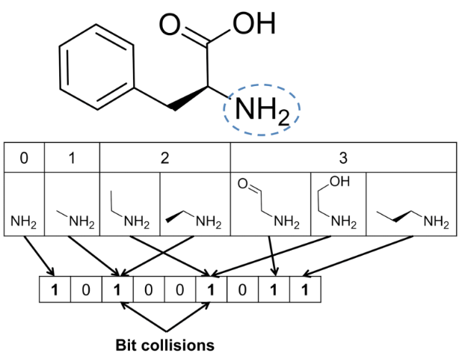
Path Fingerprints
Hash all linear fragments of a molecular graph into a fixed-length bitvector.

Slide 5
Structure-based Fingerprints

Slide 6
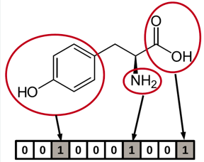
MACCS Keys
Use MDL keys to construct substructure dictionaries.

Slide 7
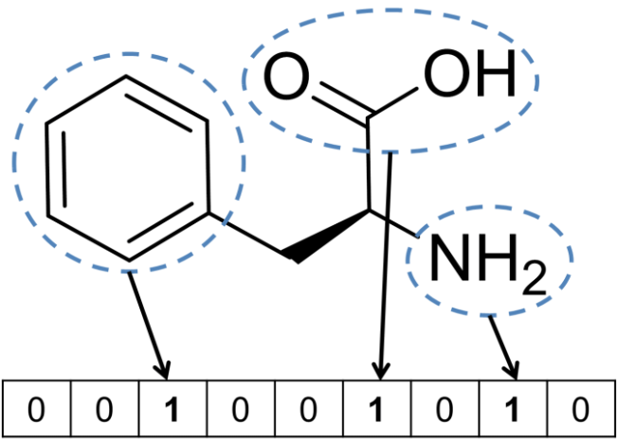
FP4 Fingerprints
Represent the classification of organic compounds from the view of an organic chemist

Slide 8
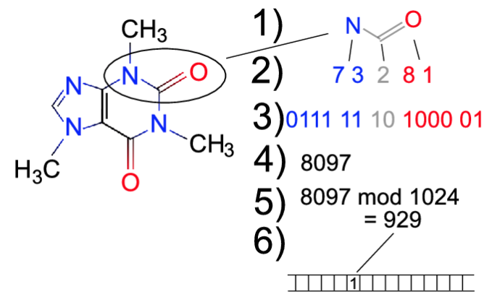
Atom Pairs Fingerprints
Arbitrary codes to describe pairs of atoms and their bond types.

Slide 9
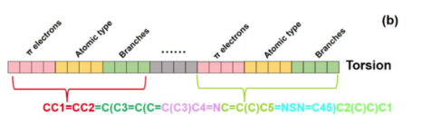
Topological Torsion Fingerprints
Linear sequences of four consecutively bonded non-hydrogen atoms, described by the number of electrons, its atom type and the non-hydrogen atoms bonded to it.

Slide 10
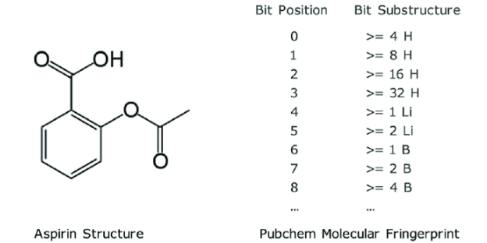
PubChem Fingerprints
Binary fingerprints that can be used by PubChem

Slide 11
Electrotopological State Fingerprints

Slide 12
E-State Fingerprints
Indicates the pressence of E-State fragments.

Slide 13
Circular Fingerprints

Slide 14
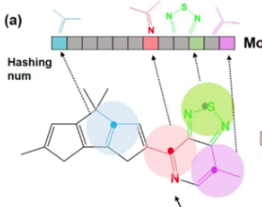
Morgan Fingerprints
Apply Morgan algorithm to atoms taking into account their neighbours.

Slide 15
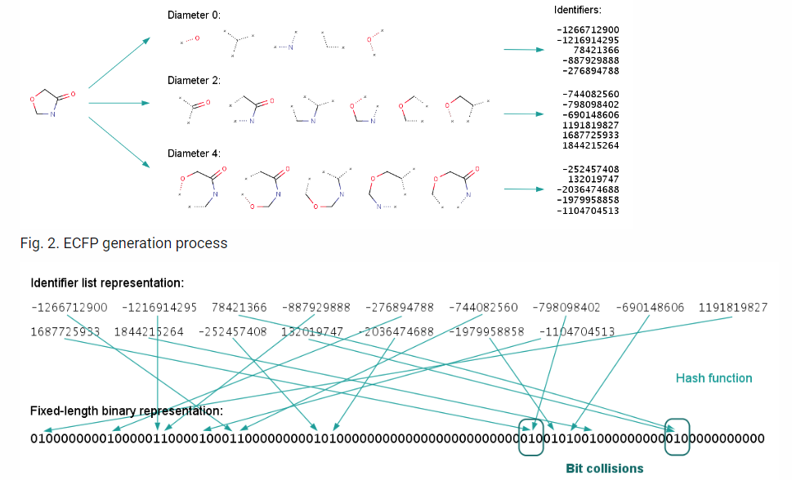
Extended Connectivity Fingerprint (ECFP)
Circular topological fingerprints developed for structure−activity modeling.

Slide 16
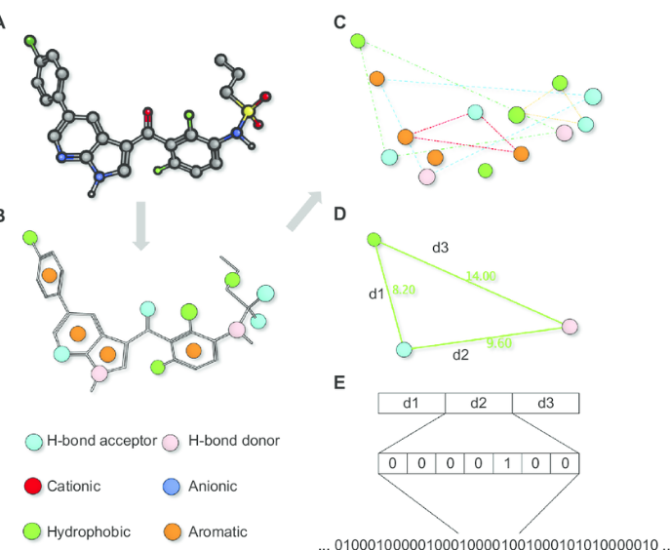
2D Phamacophore Fingerprints
Attempt to model binding related structural or chemical properties of chemical compounds with the use of simple statistics of chemical features

