Slide 1
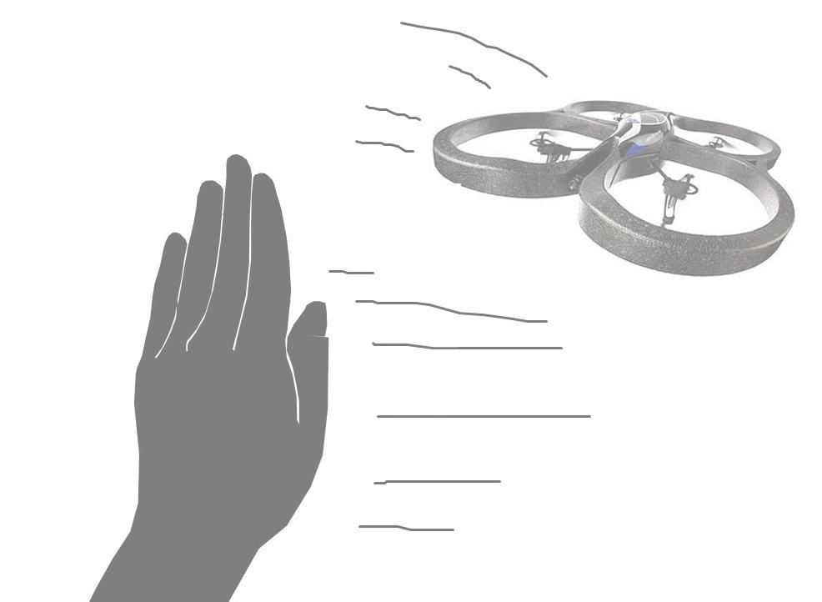
Simple Hand-Gesture Based Control of Quadcopters
Group 6
André S. Enger, Matthias Wisniowski, John Chiotellis

Slide 2
Work
Several methods for hand recognition:
HAAR classifiers
Feature detectors
Skin color detection
Contour detection
+ Colored Glove
(all methods implemented with OpenCV)

Slide 3
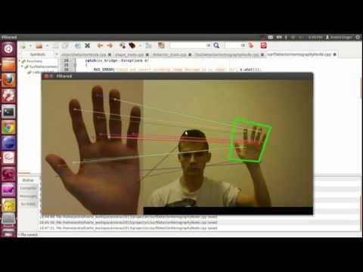
Acheivements

Slide 4
Plans for the next weeks
Refine and integrate hand detectors
Transform hand movement to quadrocopter pose and appropriate control commands (perspective projections, de-rotation, latency correction)
Tune the parameters of the PID controller
Obtain a proof-of-concept of the Simple Hand-Gesture Based Control of Quadrocopters

