Slide 1
Free navigation of the quadrocopter
via visual waypoints
Group 7
Burcu Karadeniz
Artyom Topchyan
Wolfgang Schwan

Slide 2
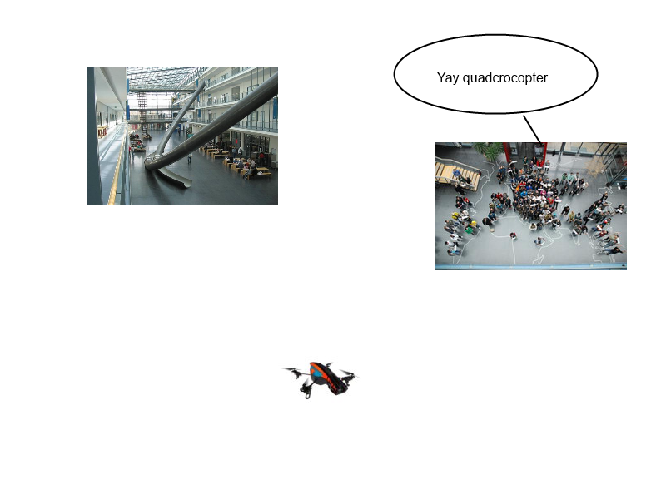
Idea of our approach
Found p1
Found p2
Getting closer p>>
Yay humans

Slide 3
Progress
Waypoint acquisition
FabMap up and running
Waypoint following using odometry and PID
Recognizing places

Slide 4
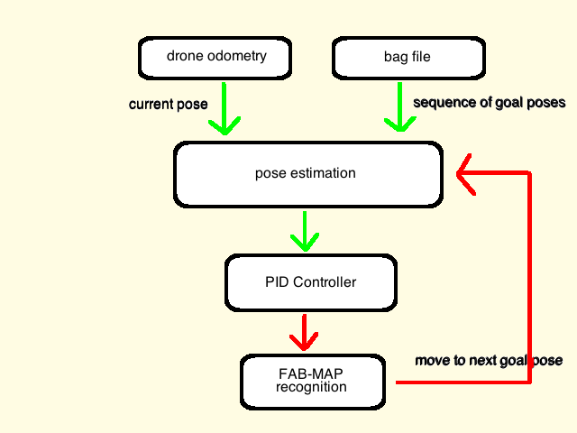
Approach
p1
p2
w
w
w
w
p4
p3
w

Slide 5
Thank You

