Slide 1
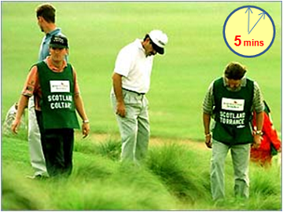

gofi the golfball finder
Anton Wilhelm
Ranjini Aravind

Slide 2
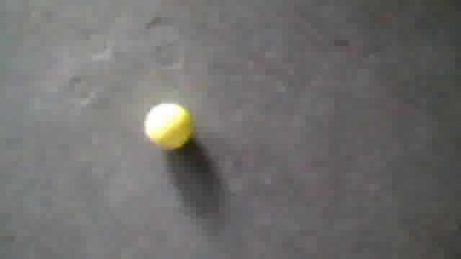
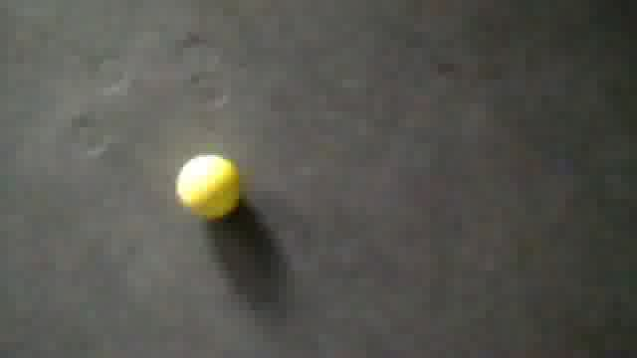
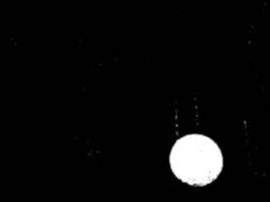
Progress so far
Images of golf balls taken
Different light intensity
Different height
Different angles
Implementing ball recognition using openCV
Implementing line recognition using openCV

Slide 3
Realization
Transmission
Read mjpeg stream
Ball recognition
Forward images to openCV
Line Recognition
Preprocess
Action
Filter
Detect line
Calculate angles
If ball found -> Land
If line found -> Change direction

Slide 4
Problems and Solutions
Delay in the transmission of images and commands
Do not use Virtual Machine
Only process a subset of images
When line detected, return and ignore the detection of the same line again
OR Use double colored line to avoid flying in the wrong direction
Line detection from different heights
Fly at a fixed height or height range

Slide 5
Thank you for your attention!

