Slide 1
Project Group Picture Midterm Presentation
Group 9
George Popescu | Julian Tatsch | Katrin Kehrbusch

Slide 2
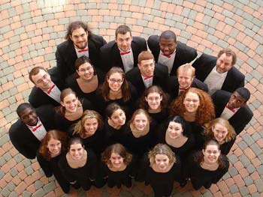
Idea Revisited
Take aerial group pictures
a fresh perspective
unobstructive

Slide 3

Status Update
Identify faces in a room
Calculate ideal camera pose
Fly to ideal camera pose
Smile detection to trigger picture taking
Rotate hovering drone
Notes:
What is challenging or interesting from the scientific perspective.

Slide 4
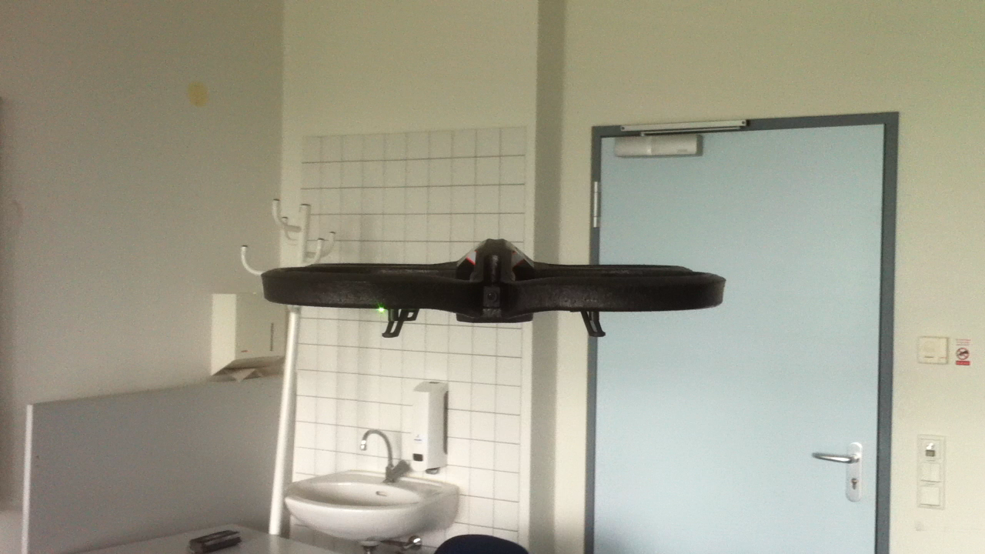
Video

Slide 5
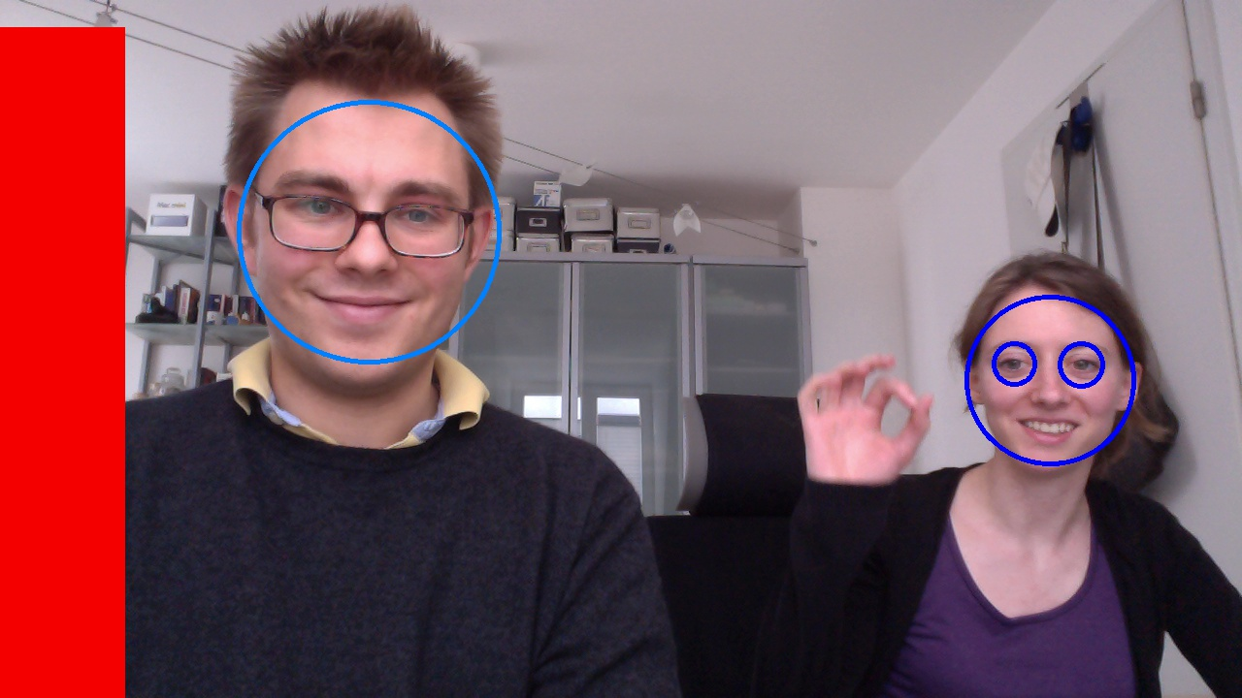
Face- / Smiledetection

Slide 6
Next Steps
Reduce false positives in facedetection
Calculate face poses
Calculate ideal drone pose
Fly to that pose and take picture
The perfect group picture drone

Slide 7

Feedback

