Slide 1

Best Location for a new restaurant in Houston neighborhood

Slide 2
Data Source for the project
Foursquare source data
For venues in Houston neighborhood
StatisticalAtlas
For finding Houston county and neighborhood
Census Data
For gathering statistics about Houston Neighborhood

Slide 3
Exploratory Data Analysis
Data Composition
62 rows representing 62 neighborhoods in Houston
64 columns for neighborhoods statistics
Handling of missing data
Delete columns where more than 90% values are missing
Replace missing values in each column by column average
Use of Foursquare for venues determination
Radius set at 5 miles for neighborhood venues evaluation
Limit set a 100 per neighborhood
4801 venues found
1234 restaurants extracted from all the venues
Neighborhoods latitudes longitudes and altitudes evaluation

Slide 4
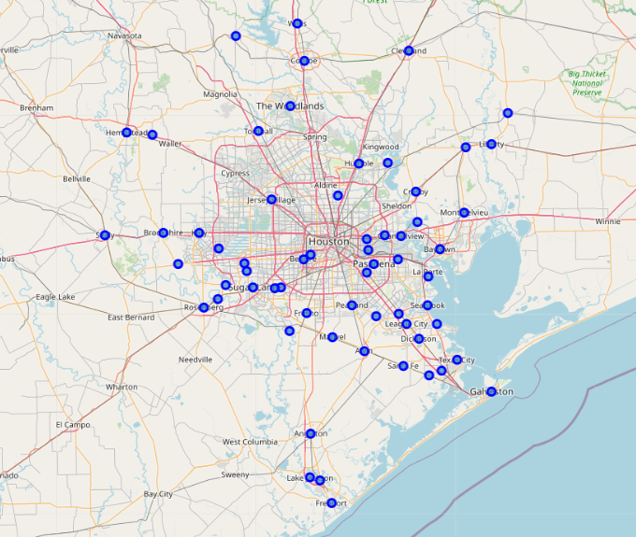
Houston map with Neighborhoods

Slide 5
Key Performance Indicators(KPI’s) for Evaluating the Neighborhood
Number of restaurant in each neighborhood
Number of restaurant per neighborhood sqft
Number of restaurant per neighborhood family income
Number of restaurant per neighborhood population

Slide 6
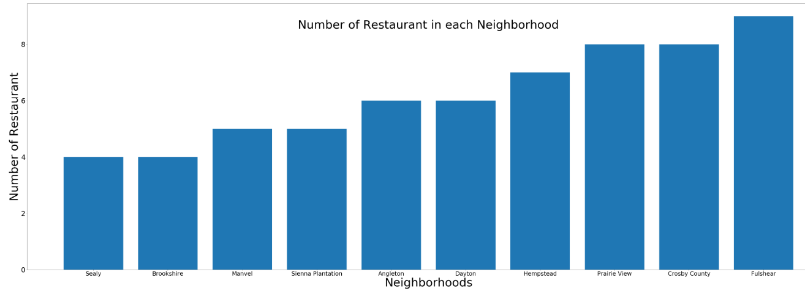
Neighborhoods with least Number of Restaurants

Slide 7
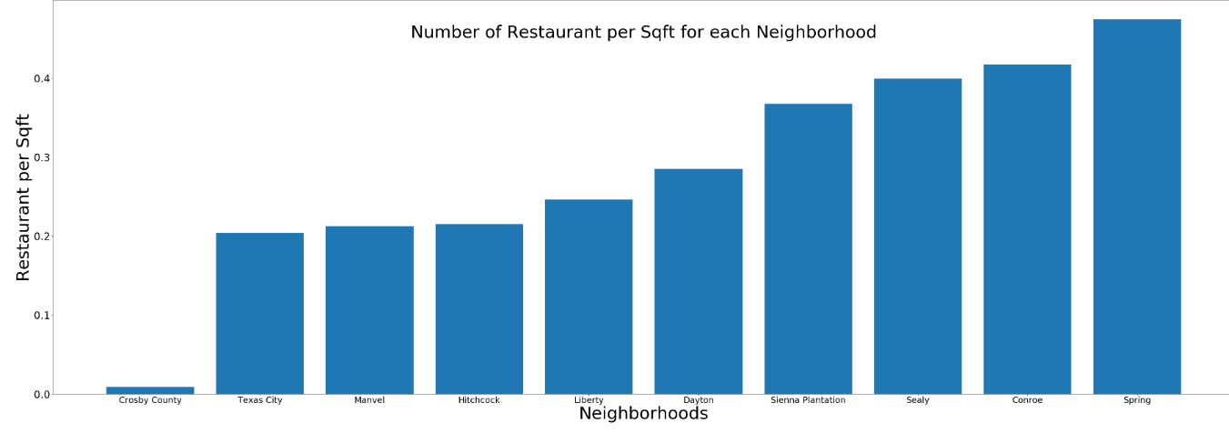
Neighborhoods with least Number of Restaurants per Sqft

Slide 8
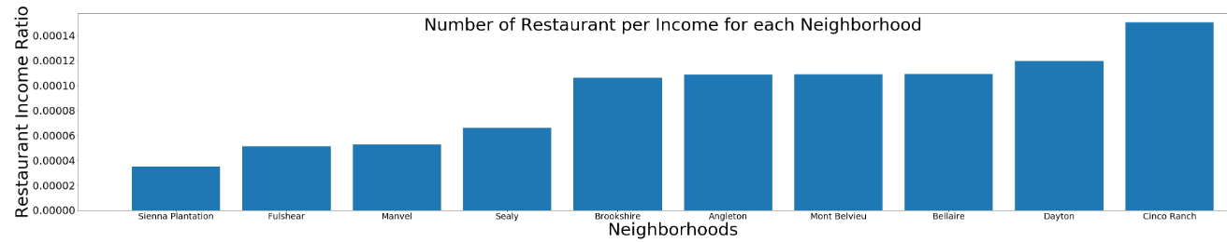
Neighborhoods with least Number of Restaurants per Family Income

Slide 9
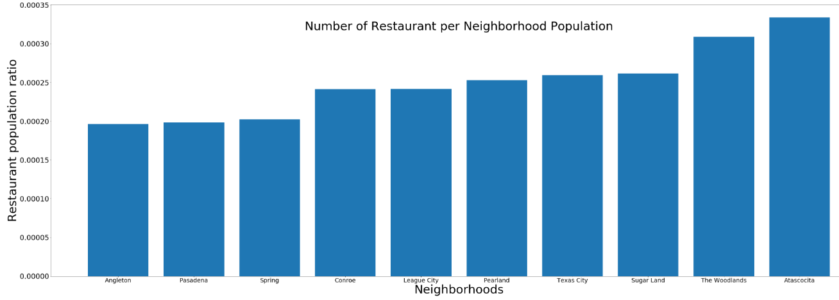
Neighborhoods with least Number of Restaurants per Neighborhood Population

Slide 10
Conclusion based on Neighborhood KPI
The best Neighborhood should be ranked low in all the 4 KPI’s
No neighborhood appears in the 5 lowest value off all 4 KPI’s
Two Neighborhoods Angleton and Manvel appears low on 3 of the 4 KPI’s
Angleton and Manvel are the 2 Neighborhood to consider for opening a restaurant

Slide 11
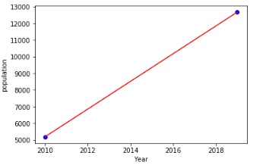
Prediction of population growth in Manvel by 2025
Manvel population Expected to growth by 39% from 2019 to 2025
Population estimate to be 17665 by 2025

Slide 12
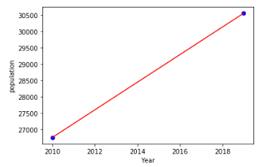
Prediction of population growth in Angleton by 2025
Angleton population expected to growth by 8% from 2019 to 2025
Population estimate to be 33084 by 2025

Slide 13
Conclusion
Manvel population is growing faster, but will take more than 10 years to get to Angleton population
Because of the higher population in Angleton, I will suggest to open the restaurant in Angleton
For future study we can look at where exactly to open the restaurant in Angleton
The map below group the Restaurant by Category. This will help to choose the most appropriate type of restaurant for Angleton to avoid to much competition

Slide 14
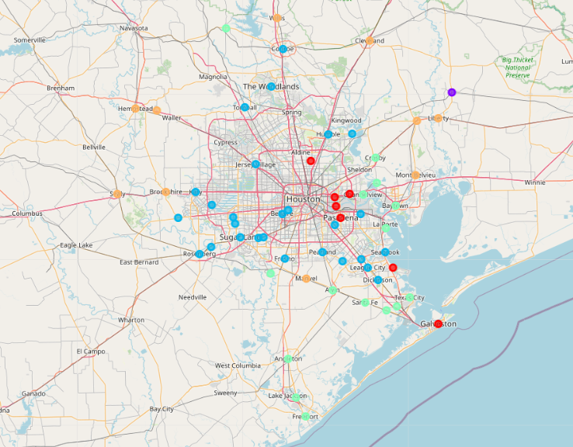
5 Clusters for Houston Neighborhood Restaurant

