Slide 1
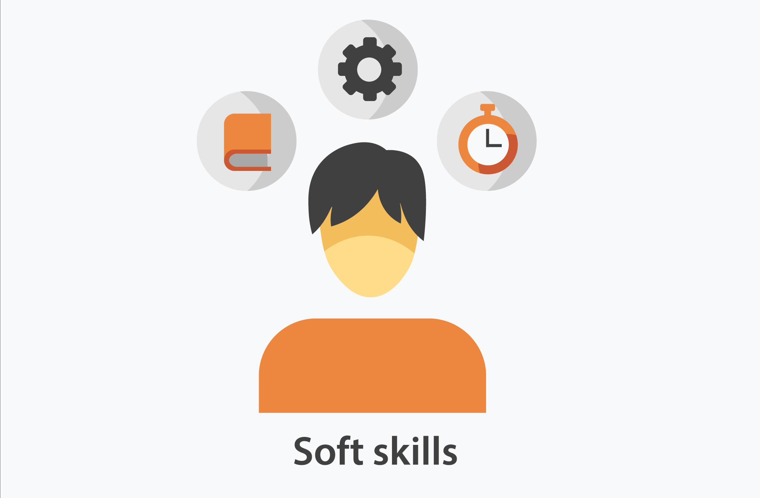
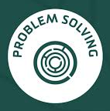
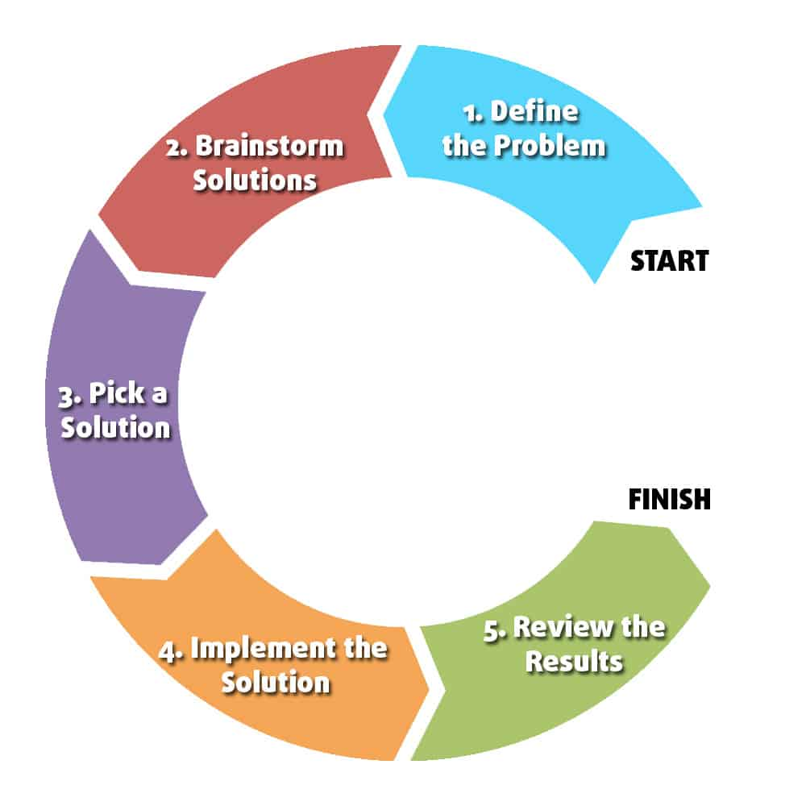
31-03-2020 | MBR | TOPIC: PROBLEM SOLVING SKILL AT WORKPLACE "You can never solve a problem on the level on which it was created." — Albert Einstein
WHAT IS PROBLEM SOLVING?
Problem solving is the process of identifying a problem, developing possible solution paths, and taking the appropriate course of action.
Problem solving is an essential soft skill. It is the ability to recognize difficulties or complications, identify possible solutions, implement them, and finally follow up to make sure they were successful. People who work in some careers are required to be particularly strong problem solvers, but employers value workers with problem-solving skills regardless of their occupation.
Problems are encountered on a daily basis in everyone’s life. Some problems may be small while some may be difficult and complex. A person’s ability to face these problems and find an effective solution to these problems shows how good his interpersonal skills are.
Similarly, at workplace, we encounter lots of problems in our day to day work. The basic requirement for any employee is that he should be able to find an effective and optimized solution to such problems. The skill is not just limited to finding a solution, one must have ability to recognize the problem, analyze its impact on the business, prioritize it and come up with an optimum solution to resolve it.
HOW TO RECOGNIZE THAT A PROBLEM EXISTS
Problem solvers immediately realize when something has gone wrong. The best of the best can anticipate a complication before it even exists. To notice that something is amiss requires a keen sense of what is going on around you
WAYS TO IMPROVE YOUR PROBLEM SOLVING SKILLS AT WORK
IMPORTANT OF PROBLEM SOLVING
Fixing things that are broken
Addressing risk
Improving performance
SUMMARY OF STRATEGIES
If you are not sure how to fix the problem, it is okay to ask for help. Problem solving is a process and a skill that is learned with practice. It is important to remember r that everyone makes mistakes and that no one knows everything. Life is about learning. It is okay to ask for help when you don’t have the answer. When you collaborate to solve problems you improve workplace communication and accelerates finding solutions as similar problems arise.

