Slide 1
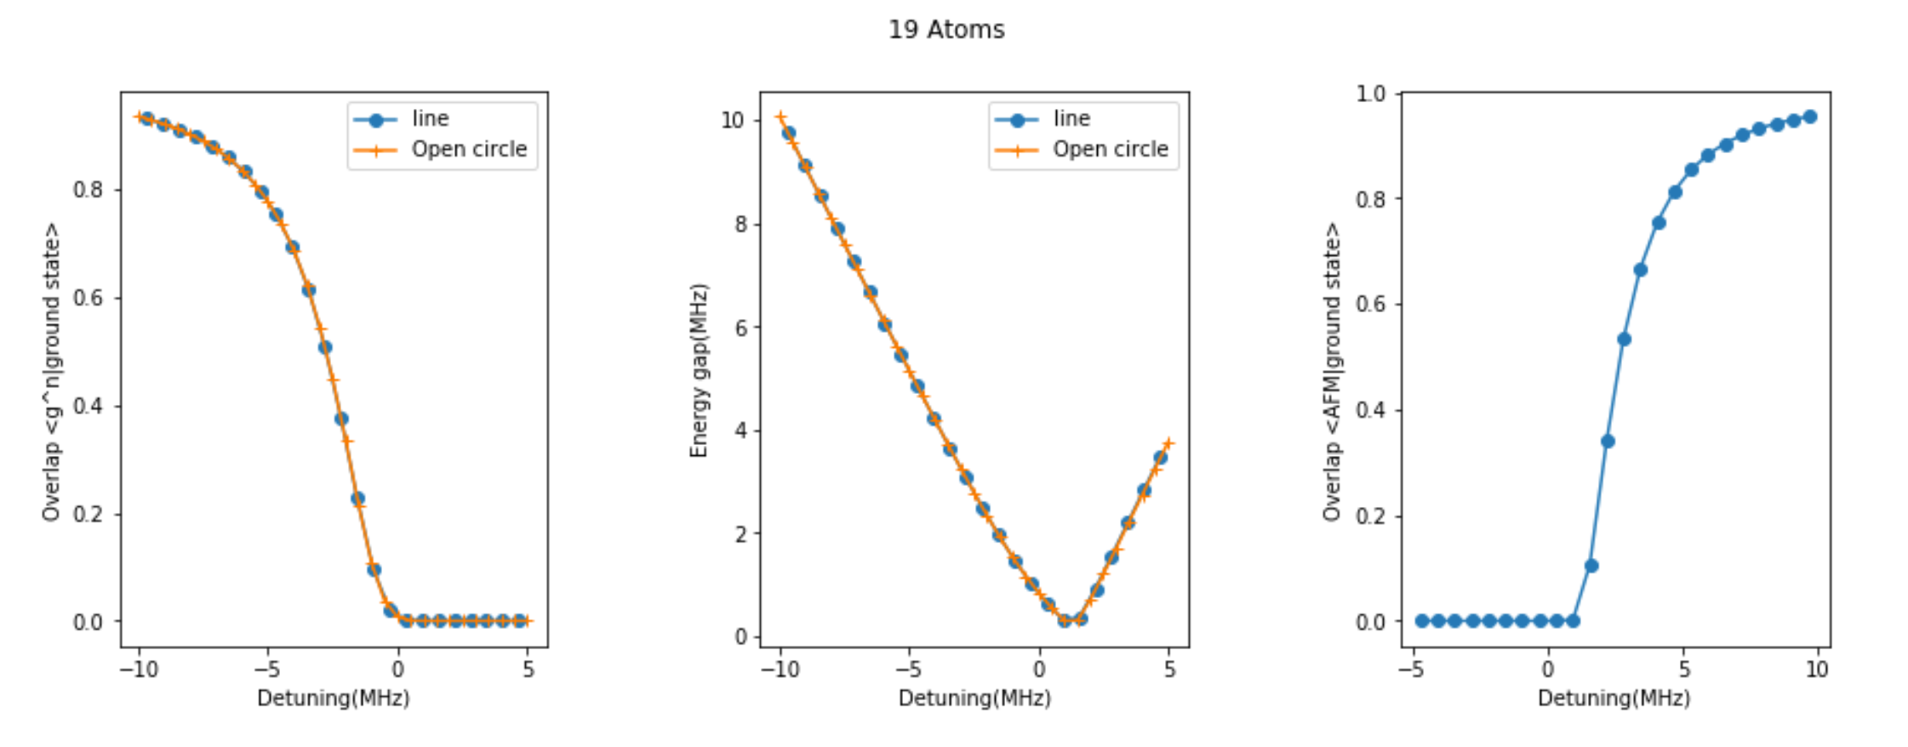
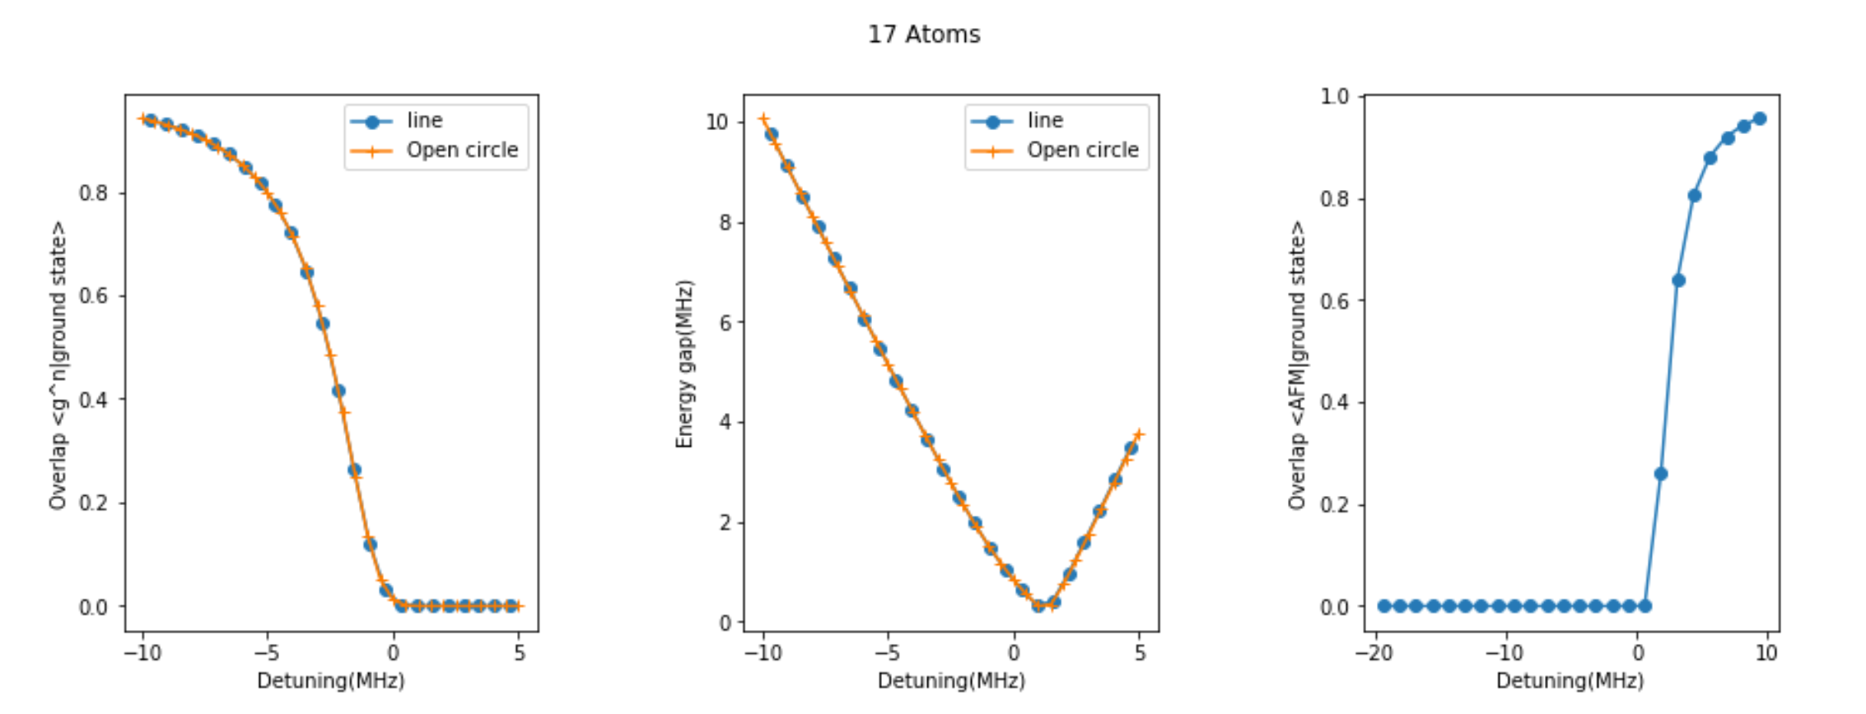
Energy& Ground state as a function of system size

Slide 2
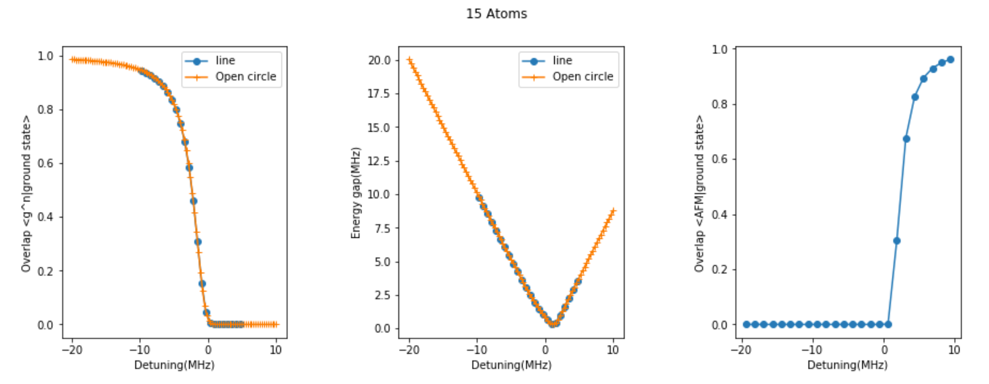
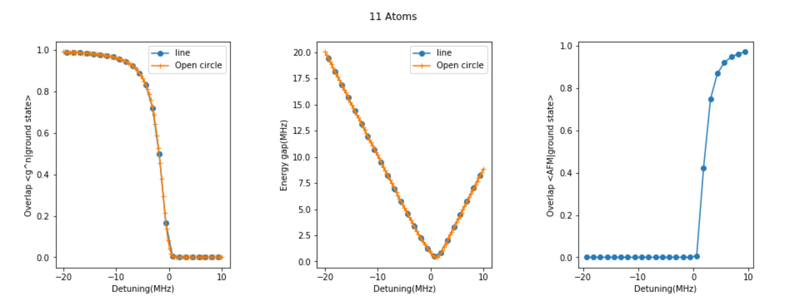
Energy& Ground state as a function of system size

Slide 3
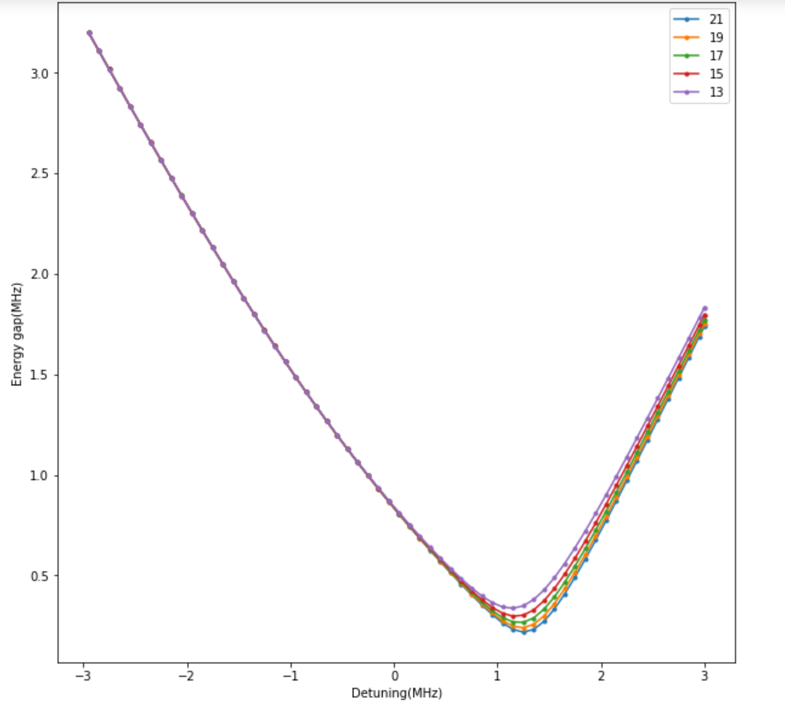
Energy& Ground state as a function of system size (scaling behavior)

Slide 4
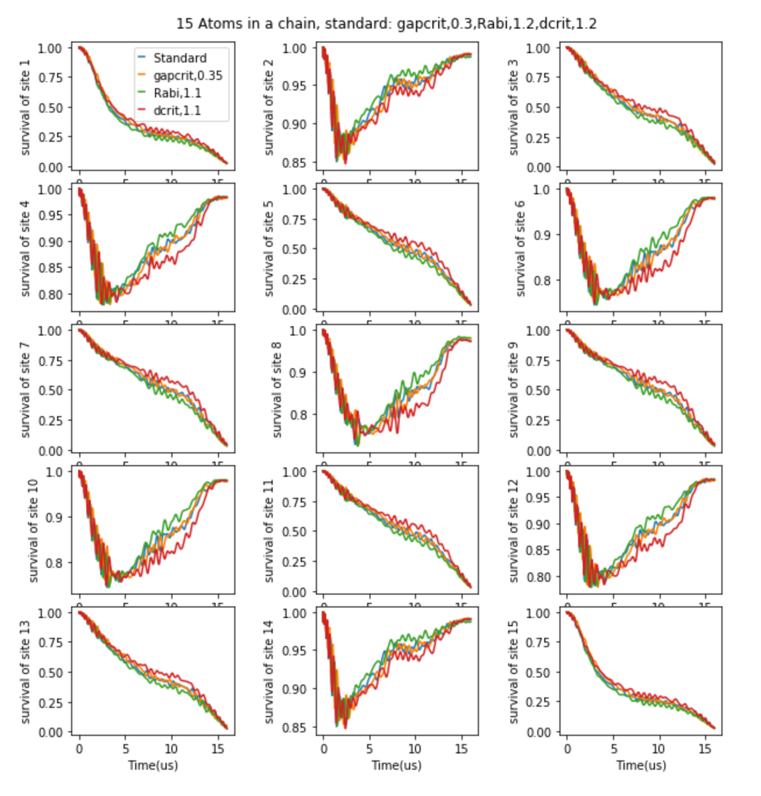
Dynamics Dilila ramp for 1*15 (T =16us)
The blue curve is the standard condition with gapcrit=0.3,rabi=1.2,dcrit=1.2
I changed one of those parameters each time to get a trace. The comparison between different traces shows the sensitivity to those parameters.
It seems the final state is not sensitive to any of those parameters but the error in dcrit(red) will result in the most visible difference in dynamics.
Unit (MHZ)

Slide 5
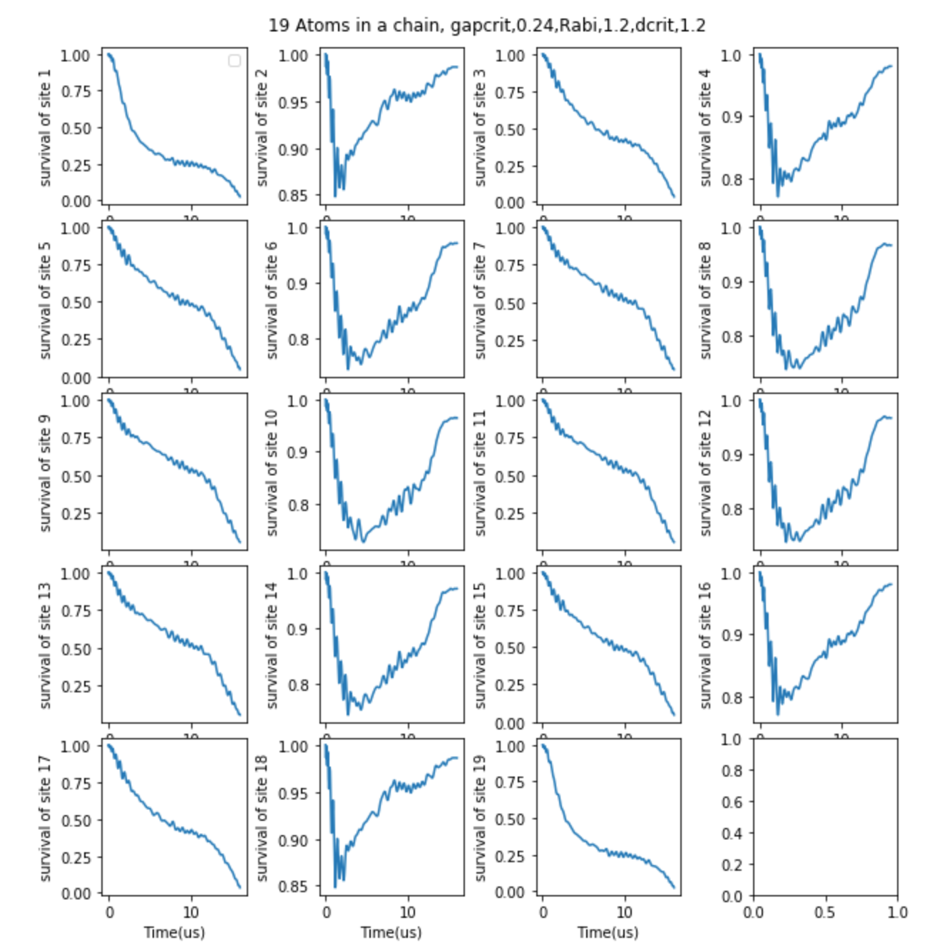
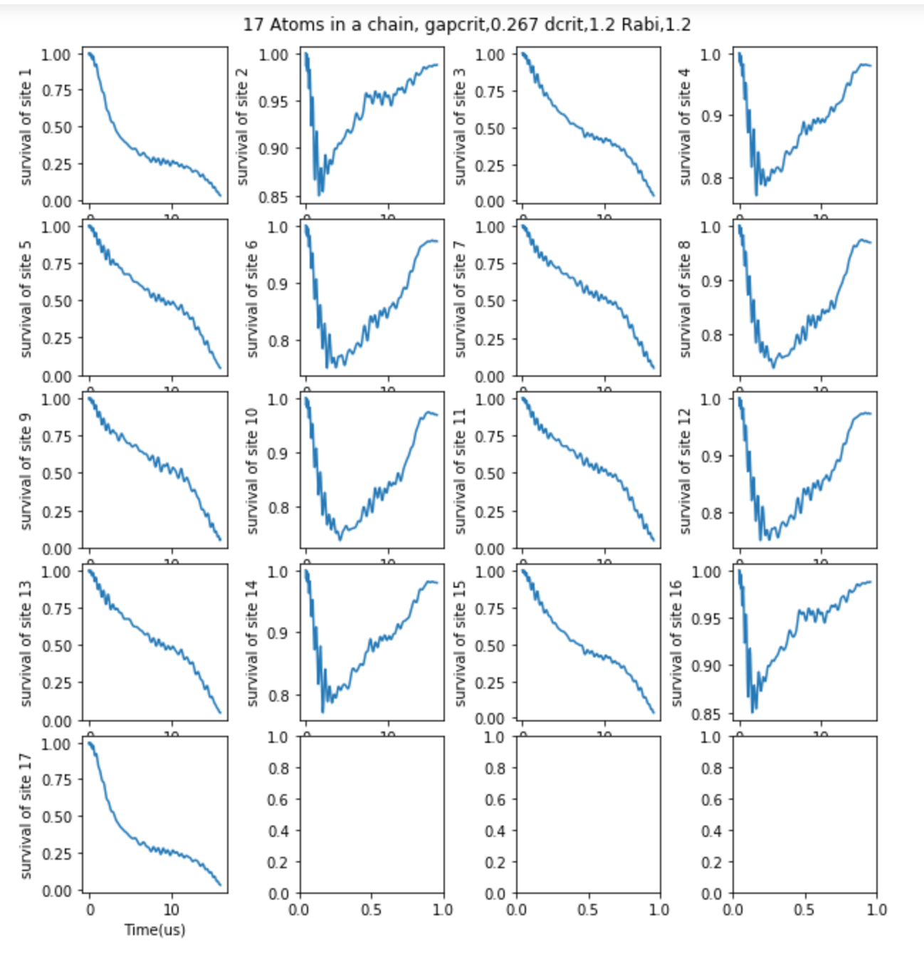
Dynamics Dilila ramp for 1*19 and 1*17 (T =16us)

